Slide 1
Partners in E 2015 Town Hall
March 13, 2015

Slide 2
Partners in E 2015
Funding Support: 2012 – 2013
Funding Support: 2014 – 2015
Collaboration: 2014 – onward
Notes:
TIM: Before we start, I wanted to acknowledge the funding support we have received for Partners in E, including initial funding received through the California Office of Health Information Integrity and recent grant support by the California HealthCare Foundation. In addition, the Partners in E program would not be possible without the support of the Healthcare Information and Management Systems Society (HIMSS).

Slide 3
About HIMSS
HIMSS is a global, cause-based, not-for-profit organization focused on better health through information technology. HIMSS leads efforts to optimize health engagements and care outcomes using information technology. www.himss.org
Vision
Better health through information technology.
Notes:
Christel could speak here about the role of HIMSS

Slide 4
HIMSS Role in Partners In E
Nationally disseminate the Partners In E curriculum
Facilitate Train the Trainer
Manage and uniformly distribute the Partners in E curriculum on HIMSS.org
Provide technical infrastructure
Provide program guidance
Notes:
Christel
HIMSS’ Role in Partners in E
Collaboration between HIMSS and the UCSF School of Pharmacy allows for nationwide dissemination of the Partners in E pharmacy informatics curriculum, ensuring consistent and unified content across all schools of pharmacy. Through the work of the HIMSS Clinical Informatics Team, we are providing the technical infrastructure and program guidance to Partners in E. Our goal is to achieve nationwide adoption of informatics curricula into the 130+ US colleges and schools of Pharmacy.

Slide 5
Key Personnel
HIMSS Staff Liaisons
Christel Anderson, MA, Director, Clinical Informatics canderson@himss.org
Lauren Kaderabek, Coordinator, Clinical Informatics lkaderabek@himss.org
Partners in E
Tim Cutler, PharmD, Principal Investigator tim.cutler@ucsf.edu
Elizabeth Breeden, DPh, MS, Co-Investigator beth.breeden@lipscomb.edu
Amanda Fingado, MPH, Project Manager amanda.fingado@ucsf.edu
Notes:
TIM: And here is the contact information for key HIMSS personnel and the three of us currently on the Partners in E grant.

Slide 6
What is Partners in E?
Online pharmacy informatics curriculum
Scalable, flexible, and adaptable
Use one module to supplement existing curriculum
Use all modules to create a new informatics course
Free to health professionals and all health professional schools
Notes:
TIM: So I know some of you on the call are brand new to the program so I wanted to give a 30-second overview about what Partners in E is…
Partners in E is an online pharmacy informatics curriculum that is scalable, flexible, and adaptable to multiple environments. You can use one module to supplement an existing curriculum or training program or use all modules to create a new informatics course. Or anything in between.
All Partners in E curriculum and supplemental materials are currently offered completely free-of-charge to health professionals and faculty from health professional schools.

Slide 7
Partners in E Program History
2012: Introduction to Pharmacy Informatics course piloted at UCSF
2013: Developed online modules for the Introduction to Pharmacy Informatics course
Partners in E expands to eight California pharmacy schools
2014: Collaboration with HIMSS to disseminate Partners in E nationwide
Train-the-trainer program at AACP with faculty from 18 schools and colleges of pharmacy
Feedback and observations from AACP:
PowerPoint slides are necessary for improved flexibility
Current file structure of modules is not user-friendly
Modules can be improved with help from content experts
More collaborative, less California-specific
Notes:
TIM: A brief history of Partners in E is listed here. Our course was piloted at UCSF in 2012 and then developed into online modules that we shared with all eight accredited California pharmacy schools in 2013. We started our collaboration with HIMSS in 2014 and conducted a train-the-trainer meeting in July of 2014 at the AACP annual meeting in Texas. This meeting was incredibly valuable to the Program for a multitude of reasons. We received feedback that for some schools with existing informatics experts, they felt comfortable giving the lectures themselves and preferred to have PowerPoint slide decks and speaker’s notes over the online module format. We also learned the file structure of the online modules was not user-friendly, when we were all unsuccessful at downloading the files during the training. And, most importantly, this meeting allowed us to meet and network with some incredible faculty from across the country. Since we were going to have to updated and redo the modules anyway, why not enlist the help of these content experts to make this program truly collaborative and less California-specific?

Slide 8
Partners in E 2015
PowerPoint slides (with full set of speaker notes) will be available for all modules
Modules now available in WebEx format
Stream live from HIMSS website or download and view later
Minimal bandwidth required for sharing on learning management systems
All modules have been updated and edited for a national audience
Seven modules have completely new content created by national experts
Notes:
TIM: And now to Partners in E in 2015.
PowerPoint slides (with full set of speaker notes) will be available for all modules
Modules are now available in WebEx format so you can either watch the by stream live from the links to the files located on the HIMSS website or you can download the files to view later or show in-class. In addition, the webinar files use minimal bandwidth to aid with sharing on learning management systems.
For those of you familiar with the previous iterations of Partners in E, you will notice that all modules have been updated and edited for a national audience. Finally, seven modules (of fourteen) have completely new content created by national experts.

Slide 9
New Collaborators
Elizabeth Breeden, DPh, MS, CPHIT, CPEHR
Lipscomb University College of Pharmacy and Health Sciences
Kevin Clauson, PharmD
Lipscomb University College of Pharmacy and Health Sciences
Randell Doty, PharmD
University of Florida College of Pharmacy
Charles Douglas, PhD, MBA
Irma Lerma Rangel College of Pharmacy, Texas A&M University
Kyle Hultgren, PharmD
Purdue University College of Pharmacy
Christopher Menzies, MD
Children’s Medical Center, Dallas, Texas
Notes:
TIM: Here are some of the experts that have helped (or who are helping) to develop new content for Partners in E. We could not be more impressed with their contributions to this programs.

Slide 10
Partners in E 2015 Updated Modules
Introduction to HIT and HIE
Strategies to Promote the Adoption of EHRs and HIE
Introduction to Pharmacy Informatics*
Introduction to EMRs, EHRs and PHRs
Interoperability*
6. E-Prescribing Basics
Computerized Provider Order Entry*
Barcode Medication Administration
Clinical Decision Support in HIT
Patient and Medication Safety in HIT*
Data Management*
Legal and Regulatory Aspects of EHRs
Introduction to Consumer Health Informatics*
Emerging Technologies*
*New content
Notes:
TIM: And here are the updated modules for Partners in E 2015. There are now 14 modules total – and seven of them are completely new for 2015. The rest were updated with current content and re-recorded.

Slide 11
Requesting Program Materials
Notes:
TIM: So now I’d like to turn the meeting over to Lauren Kaderabek from HIMSS who can go through how to get access to the materials and how to find everything you need using the HIMSS collaboration tool.
LAUREN: First, I’d like to highlight the logistics of obtaining access to the program materials. Each individual requesting access does so on www.himss.org/partnersine by selecting the Request Portal Access section. This takes the individual to a survey to submit demographic information pertinent to the program and also includes a license agreement. Once the survey is taken, we document the individuals information and add them to the appropriate committee segment in Personify.

Slide 12
Collaboration Tool (cont.)
Notes:
We then send the individual a “Welcome” email which provides details about their user name and password as well as a “How to Guide” for downloading our program materials.
All the program materials are within the Collaboration Tool.
Logistics of the Collaboration Tool: Sign on to www.himssengage.org using single sign on created for each user. Click on “HIMSS Communities Home”.

Slide 13
Collaboration Tool (cont.)
Notes:
Select the Partners in E community tab

Slide 14
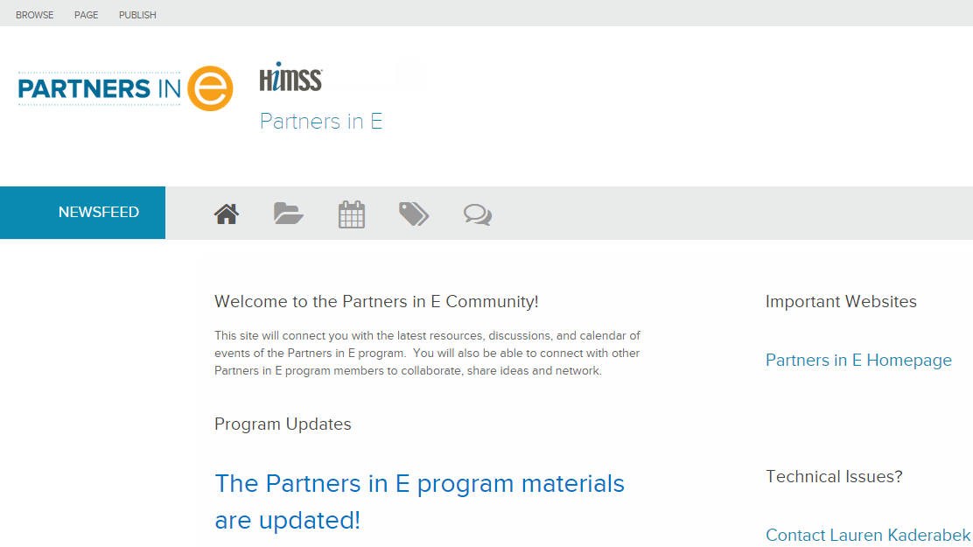
Collaboration Tool
Notes:
This takes the user to the home screen of the collaboration site:
The home screen is set up to welcome the community members and showcase the most important information and links.

Slide 15
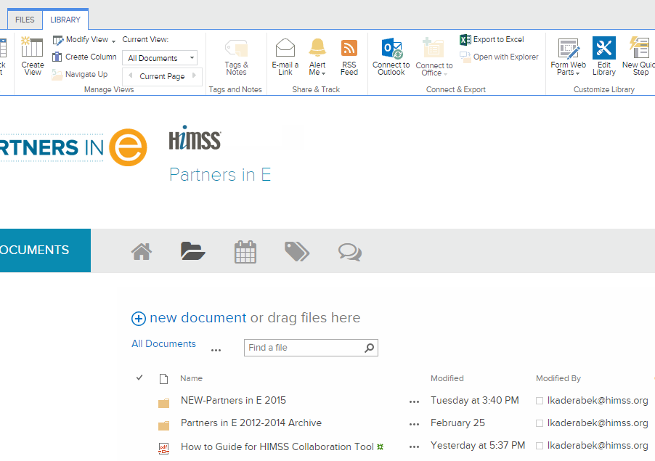
Collaboration Tool
Notes:
Most pertinent section of the site for this specific community is the documents section, using open with explorer to download the many associated files for the program materials.

Slide 16
Collaboration Tool
Notes:
Under the new content folder, the most useful document is the “WebEx Links for Partners in E 2015”. This document allows the user to either stream or download the module. The benefit of this format is anyone with the streaming link can watch the recording. Alternately, if you wish to download the module, perhaps to upload onto your institutions student portal, you may do so in a variety of formats to best suit your needs; including WMV or Windows Media Player, SWF or Flash and MP4 or MPEG-4.
Each module has an accompanying PowerPoint with speaker notes that are captured from the WebEx module.

Slide 17
Collaboration Tool
Notes:
We have begun advocating use of the discussion forum and calendar. We encourage you to create a new discussion if your question is not addressed. A great feature of the site is the alert settings. You can set the alerts to notify of any changes/edits, replies to the discussion you’re involved in, and set the alerts to be sent on a daily or weekly basis.

Slide 18
Does it Work?
"The information being learned is actually useful, unlike some other theoretical-based classes." - 1st year pharmacy student
"I really enjoyed the online Partners in E presentations that I could study at home at my own pace." - 3rd year pharmacy student
"The modules prepare students for systems they will encounter in future; I learned a new vocabulary." - 3rd year pharmacy student
"Provided information that was not taught to us in any of the other classes we took in pharmacy school." - 4th year pharmacy student
"This is a topic that we were never taught; I wish this program could be continued with future students as well." - 3rd year pharmacy student
Notes:
Christel
"There has been university-wide support for improving informatics within the academic institution.“
"The availability of the materials (online modules, quizzes and case examples) greatly helped in implementation of the course, especially for someone who is not an expert in informatics.
"We did not encounter any major barriers or challenges. The only minor discussion point was where it would fit best into our curriculum."
"I enjoyed the up and coming relevance and real time opportunity for change and influence to adapt to and improve the electronic systems." - 1st year pharmacy student, University of California, San Francisco
"I loved learning about the breadth of topics covered. This is very important information to have with us in the future as the movement to EHR gets more widespread." - 2nd year pharmacy student, University of California, San Francisco
"The information being learned is actually useful, unlike some other theoretical-based classes." - 1st year pharmacy student, University of California, San Diego
"I really enjoyed the online Partners in E presentations that I could study at home at my own pace." - 3rd year pharmacy student, University of the Pacific
"The modules prepare students for systems they will encounter in future; I learned a new vocabulary." - 3rd year pharmacy student, University of the Pacific
"Provided information that was not taught to us in any of the other classes we took in pharmacy school." - 4th year pharmacy student, University of Southern California
"This is a topic that we were never taught; I wish this program could be continued with future students as well." - 3rd year pharmacy student, Western University of Health Sciences

Slide 19
Impact to Date
130 U.S.-based colleges and schools of pharmacy
67 Universities have been granted access to the program materials and are currently exploring if, how & when to integrate into their curriculum
18 Universities participated in our first Train the Trainer, held in collaboration with the AACP (American Association of Colleges of Pharmacy) Annual Conference
140 direct web page views a month
$25,000 grant from CHCF
Notes:
Christel

Slide 20
Upcoming Partners in E Events
HIMSS15, the annual meeting for the Healthcare Information and Management Systems Society
April 12-16, 2015 in Chicago, IL
HIMSS15 Partners in E Community Meetup will be April 14, 2015 from 11:00am - 12:00pm (CT) at the HIMSS Spot: North Building, Hall B
American Society of Health-System Pharmacists Informatics Institute
June 6-10, 2015 in Denver, CO
Tim Cutler, PharmD and Beth Breeden, PharmD will be at the Partners in E booth, dates and times TBD
Notes:
BACK TO TIM: So before we open it up to questions, I wanted to share some upcoming Partners in E events…

Slide 21
Upcoming Partners in E Events
American Association of Colleges of Pharmacy (AACP) annual meeting, July 11-15, 2015 in Washington, D.C.
Collaboration with the AACP HIT Task Group
Overview of Pharmacy Informatics/Partners in E Train-the-Trainer
Date and time, TBD
Online Partners in E Train-the-Trainer
Coming Summer 2015
Date and time, TBD
Notes:
TIM…

Slide 22
Questions?
Notes:
QUESTIONS?????????
Prompts we sent to group:
What additional materials would you like developed?
What modifications would you like to see in future updates?
What are your Partners in E successes and challenges?

