Slide 1
HIMSS 101
An Informative Introduction
[Chapter name, contact]

Slide 2
HIMSS
HIMSS Vision
To realize the full health potential of every human, everywhere.
HIMSS Mission
Reform the global health ecosystem through the power of information and technology.
110,000 individual members, 480 provider organizations, 470 non-profit partners and 650 health services organizations
www.himss.org

Slide 3
Chapters
HIMSS supports 55 global chapters
Make local connections and move the conversation forward on issues that impact your community while networking with local HIMSS members.
Access targeted educational programs, products and initiatives and benefit from national market research, webinars and more.
Help shape and transform the future of health by bringing your passion and experience serving in a chapter volunteer leadership role.
https://www.himss.org/membership-participation-chapters

Slide 4
Membership
Student Membership - $30
Receive the same benefits as individual membership at a price designed for emerging healthcare leaders
May not hold a full-time equivalent (FTE) position in the fields of healthcare information and management systems
Must also be formally enrolled in, but not limited to, a: certificate, associate, undergraduate, graduate, postdoc or fellowship, or residency program
Chapter Only Membership - $39
Participate in local chapter events
Received chapter updates and education
Get member pricing on applicable chapter activities

Slide 5
Student Membership
Advance Your Career
Benefits of Regular Membership
HIMSS career resources will assist in your professional development.
Receive membership pricing on conferences, webinars, publications and resources, including member only content.
HIMSS Student Membership
Board Policy
Pricing
May not hold a full-time (FTE) position.
Standard pricing for student member is $30.
https://www.himss.org/membership-types/individual
Notes:
https://www.himss.org/student-membership-30
Valuable resources for health IT early careerists
Chart your course with our wealth of career knowledge sharing and guidance
Experience benefits of Regular Membership
Receive member pricing on conferences, webinars, publications and eLearning Academy
Access members-only content on HIMSS.org
See the "HIMSS Student Membership Policy" listed below for eligibility requirements
Student Membership does not include:
Voting Rights. Sorry! Students are non-voting members
Cannot hold a HIMSS elective office position
Use of the HIMSS+1 membership program

Slide 6
Membership
Regular Individual Membership - $199
Receive member pricing on the HIMSS Global Health Conference, regional events, webinars and the HIMSS bookstore
Participate in HIMSS communities, committees, or roundtables
Includes one HIMSS chapter of your choice
Access members-only content on HIMSS.org
https://www.himss.org/membership-types/individual

Slide 7
Emerging Healthcare Leaders Community
We support emerging leaders in all career stages—whether they are students, young professionals or seasoned authorities moving into the next level of their career.
Free Webinars
Information sharing, new ideas and practical solutions
Day In The Life series
Tools, resources and guidance you need to become a part of the next generation of health information and technology professionals
Content found in the HIMSS Resource Center
Must be a HIMSS member to join a HIMSS community
https://www.himss.org/membership-participation/emerging-leaders

Slide 8
Networking Opportunities
Local Chapter Events
HIMSS Global Health Conference and Exhibition
Volunteer Opportunities

Slide 9
Educational Offerings
Webinars
Local Chapter Educational Events
HIMSS Global Health Conference and Exhibition

Slide 10
Scholarships
HIMSS Foundation annually awards scholarships to HIMSS student members who have achieved academic excellence and have the potential to be future leaders in the healthcare information and management systems industry
https://www.himss.org/what-we-do-initiatives/foundation-overview
* Individual HIMSS Chapters may also support scholarship opportunities

Slide 11
Posters
Displayed during the HIMSS Global Health Conference and Exhibition
Storyboard presentation aligned with the main education topics of the conference
Provide attendees with a more visual means to learn about useful tools and successful case studies
Poster presenters receive complimentary registration to conference
https://www.himss.org/membership-participation/himss-emerging-healthcare-leaders-community

Slide 12
HIMSS JobMine
Looking for your next job or next hire? Discover the leading global job center for health information and technology
Create your job-seeker account: Search the largest listing of health information and technology organizations and jobs, and save your resumes and cover letters in one place
Explore expert resources: Learn how to craft a great resume, improve your digital communication style, ace the interview and get the job you want
Post your resume: Add your resume to our database, and let the employers come to you
Receive new job alerts: Get the latest job postings delivered right to your inbox and never miss an opportunity
Work with a career coach: Get expert advice on how to write your resume, cover letter and LinkedIn profile; create your job search strategy; and network and interview for jobs
http:www.jobmine.himss.org

Slide 13
Certification
CPDHTSSM
To demonstrate professional knowledge and competence in digital health transformation strategy and health strategy
Released for beta testing in winter 2021
CPHIMSSM
To demonstrate professional knowledge and competence in healthcare information and management systems
First conferred January 2002
CPHIMS-CASM
To demonstrate professional knowledge in healthcare information and management systems to potential and current employers
Candidates take both the CPHIMS exam and the Canadian Supplemental Exam
First conferred March 2005
CAHIMSSM
To demonstrate professional knowledge in healthcare information and management systems to potential and current employers
First conferred February 2013 and offered internationally in June 2017
https://www.himss.org/resources-certification/overview

Slide 14
The Value of Professional Certification
Sets one apart in an increasingly competitive marketplace
Increases credibility with employer
Expands career opportunities
Gain skills and tools to help make a difference in an organization and the community
Increases marketability
Identified as a differentiator, can increase sustainability in periods of transition
Demonstrates commitment to continued professional development and life long learning
Join a movement toward industrywide standards, contributing to the growth of the profession

Slide 15
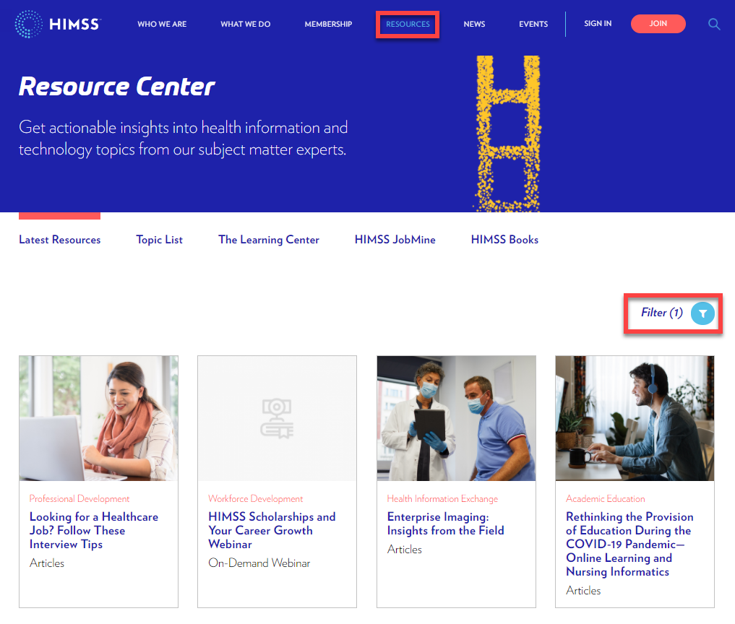
HIMSS Resource Center
Vast industry knowledge all in one place
New material continuously added
What’s in the Resource Center
On-Demand Webinars (2018-present)
Day in The Life Series
Publications and white papers
Industry research
Job descriptions
https://www.himss.org/resources-all
(use “Workforce” filter to find targeted resources)

Slide 16
HIMSS Online Learning
Access to innovative solutions, discussions and leading industry experts in healthcare
Housed in two dynamic portals:
Accelerate
HIMSS conference sessions content and continuing education opportunities
HIMSS Resource Hub
Up-to-date news, articles, blogs, on-demand webinars and other content
https://www.himss.org/resources/learning-center

Slide 17
Questions?
Final page to add local chapter links and contact info

