Slide 1
“I’m Gonna Make Him a Chatbot He Can’t Refuse”
Michael Blumental
COO
michael@hyro.ai
Notes:
Good morning everyone. It’s wonderful to be here today. My name is Michael Bluental and I’m the Chief operating officer at Hyro.
Full disclosure this is my first time in Ohio, as you cold probably guess from my name being a female michael I was not botn in the US, I relocated here a few years ago and this will be the 23rd state i visited since moving. I love to travel, I love to learn and I hope we can learn something new together today.
I’ve always worked with innovative technologies, - Started my career as an intelligence officer in the isralei defence force.I was the project manager for a cyber security project - you probably read about it in the news but thats all I can say.
Then moved to the private sector and and have been fortunate to be part of 3 incredible startups.with the first I joined as a QA engineer while was getting my computer science degree, and by the time I was 25 I was already managing 50 people, 5 teams, customer management and delivery, with the second startup I relocated to the US to San francisco to build their sales organization in the US - we were acquired by netapp and now I’m with Hyro, for the past few years, I oversee our revenue operations - which includes sales customer success and partnerships.
For our session today i want to talk about building chatbots patients can’t refuse. Or from a different perspective how to build a successful strategy for conversational ai. We are going to discuss fascinating discoveries in this space that are completely transforming the way patients interact with their healthcare system and more importantly how healthcare systems can manage those interactions ar scale. At the end of the session my hope is that you will have a clear vision on ow to expand call center operations capacity to be unlimited.

Slide 2
Chatbots and IVRs SUCK
Notes:
Raise your hand if you have had bad experiences with a chatbot. IVR is an interactive voice response system. When you make a call and hear a predefined menu saying for scheduling press one for billing press 2… all the way until maybe 105 when you dont even remember what you need to pres. Or you pressed too soon and get this annoying fomu of all the options you missed.

Slide 3
Agenda
Demand for Conversational AI Assistants
Conversational AI 101
Implementation
The Old Way
Adaptive Communications
Use Cases in Healthcare
Case Studies
Where to Start?
Notes:
No doubt weve all had our fare share of bad experiences with these types of automated communications tools tools but automated communication is definitely here to stay. It is essential for good patient experience for paitnat access and for streamlined operations. Today we are going to talk about why chatbots are here to stay, talk about some basic terms when it comes to conversational ai. understand why the experience today is so lame and learn about a new technology that's going to change all of that so that we delight patients with extraordinary digital experiences. We will cover the most common use cases in healthcare, review 2 case studies and talk about about how to start and create a strategy for implementation in your organization.

Slide 4
Patients’ digital expectations & staffing shortages have accelerated the demand for virtual assistants
PATIENTS EXPECTATIONS
STAFFING ISSUES
81%
67%
20%
28%
Of patients want the virtual tools adopted during COVID-19 pandemic to remain regular part of the healthcare experience
Of callers hang up the phone because they are frustrated by wait times to speak to a representative
Have already left the healthcare workforce as
of May 2022
Report having quit their jobs due to staffing shortages and burnout
8x8
U.S. Bureau of Labor Statistics
Forbes
Notes:
Why are these toold here to stay? The demand for virtual assistants is higher than ever. its relevant both from the patient side and the organization side.
Peitnets digital expectations are on the rise. A great website or social presence is not enough anymore. Patients are demanding self served capabilities. They are expecting to get what they need in an easy and delightful experience. As consumerism is taking over the healthcare industry, patients are expecting the uber like or amazon like experience. They are expacting immidiate responses across all channels all the time
As the number of interactions keeps on increasing, it’s becoming harder than ever to staff the call center.
From the organization side with covid and the big resignation burnout is crazy turnover rates are off the charts and so you end up with a full hour where a paitients is waiting on the line to schedule an appoitments.

Slide 5
Relieve pressure on administrative teams while meeting digital demand
Empower patients
to become self sufficient in their health
and care
Stop wasting time
with repetitive conversations
Focus more
on complexities
Alleviate stress
on your staff
Notes:
So how do we relieve the pressure on the adminitrative team while meeting the digital demans?
How do we wmpower patients to be self efficient in their health and care?

Slide 6
Leave the repetitive interactions to Conversational AI virtual assistant
Notes:
We do that with Conversational AI virtual assistant- is designed to ease the burden to the call center agent and at the same time dramatically improve the petitnet experience.
If we look at your operations before implementing automation all the interactions are handled manually by agents so hey are always over capacity and you are left with a big chunk of calls that go unawanswered, which leas to long waiting times and poorp PX and ultimately burnout for your agents as they are always over capacity.
The idea is to deploy virtual assistants that automatically handel a portion of the conversation or all of it so that most of the interactions are handled without the need for human assistant leaving the agents to focus on the most complex tasks, so now your patient are happy as they get immidiate response tme, you agents are happy as thye are under cpapcuty ad your cfo is happy because he desnt have to pay as many agents or lose patients beucase they hang up the phone.

Slide 7
Conversational AI refers to the set of technologies that enables humans to interact with machines
Voice
Assistants
Virtual
Assistants
Chatbots
/Chat Assistants
Alexa
Google
Home
Google
Assistant
Hyro
Erica
Facebook
Messenger
Drift
Notes:
But what is conversational AI? - conversational AI is the set of technologies that enables humans to interact with bots or machines, or computers. Across all digital channels via voice or text. So think about alexa, siri - all those great solutions that enables you to say what ever it is you want to say using your own works with natural language.

Slide 8
20 years, 5 waves of digital transformation
90’s
2000
2010
2015
2020
Web
Make it virtual
Search
Make it discoverable
Social
Make it shareable
Mobile
Make it responsive
Chat/Voice
Make it conversational
Notes:
Conversational AI is considered the 5th waive of digital disruption. This huge technological inventions that completely transformed the way we interact with the worl and the way we do buisness. First there was the invention of the web. Needles to say how it changes everything but if you think about it it made content virtual. Then came search how made content discoverable. Then social - now we are able to share content with one another. Then mobile who made us all adicts. No kidding, it made us all responsive, all the time. And now- conversational AI. now we are expecting the same ease of conversation when we ask alexa about the weather, or chose a tv show to play or schedule our next annual exam.

Slide 9
Health systems recognize the need for conversational AI
to meet rising patient demands.
But implementation across multiple use-cases and channels can be complex.

Slide 10
Key Terms
NLP
Natural Language Processing
NLU
NLG
Natural Language Understanding
Natural Language Generation
Notes:
Let’s cover some basic terms when it comes to conversational AI - the 3 N:
NLP NLU and NLG
NLP is the name for the entire process that takes place:
A user says something and the machine provides a response
NLU
Is the first part of this process - taking what the user said and understanding it.
Then NLG the process that decided which response to provide and how the response will be structured
Today we are going to focus on the NLU part and understand why it has failed healthcare thus far

Slide 11
The old way
Modeling the Intent (ML)
Limited “intent-based” flows
Predefined intents with limited customization
Creating virtual assistants require heavy technical investment and time to deploy
Different solutions to integrate, deploy and maintain
Data intensive solution
Lackluster user experience
Create data set
Create Tagging scheme
Tagging
Retrain models
Deploy
3-5 weeks per intent X 10 intents
ETA: 0.5-1 year

Slide 12
The old way
Find a doctor
Name detected
Specialty detected
Insurance detected
Knowledge
Intent: Name
Intent: Specialty
Intent: Insurance
Ask about specialty
Dialog management
Results by name
Results by Specialty
Results by insurance

Slide 13
The old way
“I’m looking for a cardiologist”
Name detected
Specialty detected
Insurance detected
Knowledge
Intent: Name
Intent: Specialty
Intent: Insurance
Ask about specialty
Dialog management
Results by name
Results by Specialty
Results by insurance

Slide 14
The old way
“I’m looking for a cardiologist who accepts Aetna”
Name detected
Specialty detected
Insurance detected
Knowledge
Intent: Name
Intent: Specialty
Intent: Insurance
Ask about specialty
Dialog management
Results by name
Results by Specialty
Results by insurance

Slide 15
The old way
“I’m looking for a cardiologist who accepts Aetna”
Name detected
Specialty detected
Insurance detected
Specialty detected
Intent: Name
Intent: Specialty
Intent: Insurance
Insurance detected
Intent: Specialty + Insurance
Ask about specialty
Results by name
Results by Specialty
Results by insurance
Results by Specialty + insurance

Slide 16
The old way
Each attribute adds intents exponentially
“I’m looking for cardiologist in Brooklyn”
Location detected
Location detected
Name detected
Specialty detected
Insurance detected
Specialty detected
Location detected
Specialty detected
Intent: Location
Intent: Name
Intent: Specialty
Intent: Insurance
Insurance detected
Insurance detected
Intent: Location + Specialty
Intent: Specialty + Insurance
Intent: Location + Insurance
Ask about specialty
Ask about specialty
Ask about specialty
Results by location + Specialty
Results by location
Results by name
Results by specialty
Results by insurance
Results by specialty + insurance
Results by location + insurance

Slide 17
The old way
Each attribute adds intents exponentially
“I’m looking for cardiologist in Brooklyn”
Location detected
Location detected
Name detected
Specialty detected
Insurance detected
Specialty detected
Location detected
“I’m looking for a dentist who speaks Spanish and accepts Aetna”
Specialty detected
Intent: Location
Intent: Name
Intent: Specialty
Intent: Insurance
Insurance detected
Insurance detected
Intent: Location + Specialty
Intent: Specialty + Insurance
Intent: Location + Insurance
“I’m looking for a female dentist who specializes in kids”
Ask about specialty
Ask about specialty
Ask about specialty
“I’m looking for a female dentist who accepts new patients in Brooklyn”
Results by location + Specialty
Results by location
Results by name
Results by specialty
Results by insurance
Results by specialty + insurance
Results by location + insurance

Slide 18
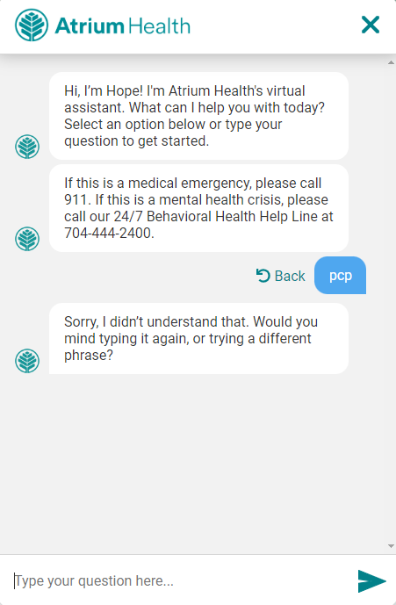
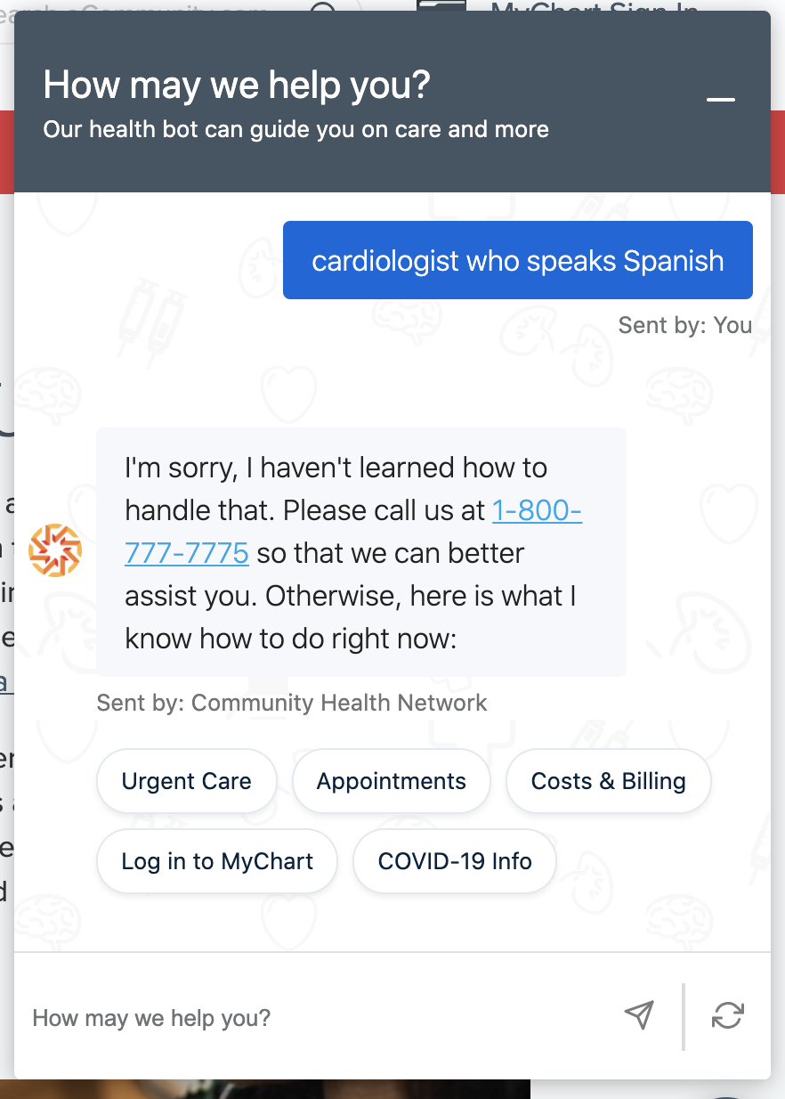
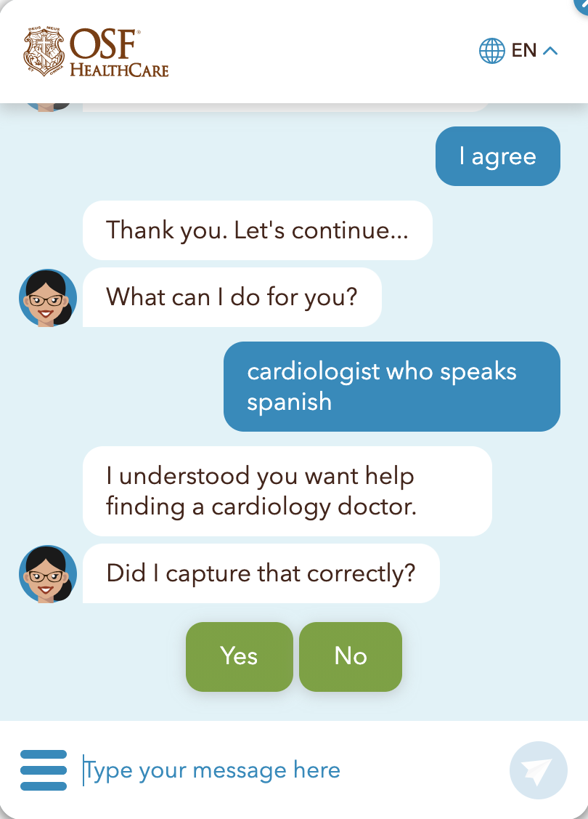
The old way
Misunderstanding
Ignoring the “Spanish” attribute.
Misunderstanding

Slide 19
Adaptive Communications
Modeling the Sentence (CL + KG)
Ubiquitous Conversational AI -
Open “intent-less” flows
Linguistics approach that doesn’t rely on historic training data
Information is automatically converted to a
knowledge graph queryable via natural language
Minimal efforts needed for deployment and maintenance
Scales easily across various use cases and platforms
Superior user experience
For the organization:
Based on existing knowledge, no maintenance or training
For the end user:
Contextualized understanding, more value
ETA: same day

Slide 20
Knowledge graph
Representation of entities and their attributes
“I’m looking for a female dentist who accepts Aetna in New York”
Crowns and Bridges
New York
Aetna
Dentistry
http://weillcornell.edu/merubin
Female
Zip code 10065
Marsha E. Currier
D.D.S
Surgery
Accepts New Patients
Medically compromised individuals
Oral medicine
Dental
implant
English

Slide 21
“I’m looking for a female dentist who accepts Aetna in New York”
“I found 4 providers (female, dentistry, Aetna and New York)
Auto generated response
Female
Dentistry
Danielle L. Rubin
Anna G. Cohen
Aetna
New York
Marsha E. Currier
Veronica M. Smith

Slide 22
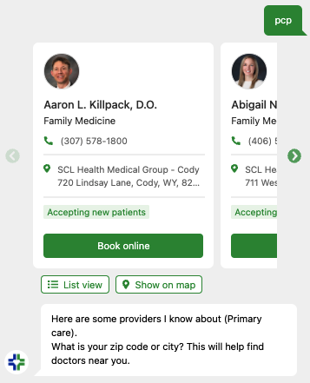
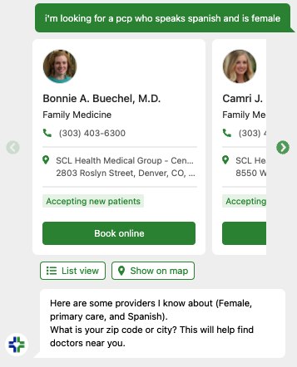
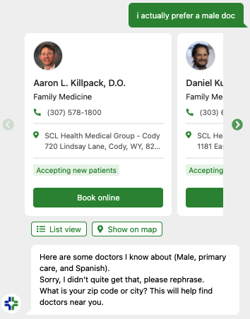
Adaptive Communications

Slide 23
Check-in
Limited “intent-based” flows
Ubiquitous Conversational AI -
Open “intent-less” flows
Create data set
Create Tagging scheme
Tagging
Retrain models
Deploy
For the organization:
Based on existing knowledge, no maintenance or training
For the end user:
Contextualized understanding, more value
Time to deploy | Quality of conversation | Ease of maintenance
Time to deploy | Quality of conversation | Ease of maintenance

Slide 24
Win the entire patient journey
Find a Doctor
Self triage
Schedule
Search for Care
Pre-Visit
Create a Patient Portal Account
eCheck-in
Appt Reminder & Confirmation
The Appointment
Post-Visit
Medication adherence
Patient Survey Prompt
Pay Medical Bills
Follow-Up Appt Reminder

Slide 25
Call center automation examples
Appointment Scheduling
Verify Appointment Details
Call to text Password Reset

Slide 26
Dramatically improved patient engagement on the WCM website
Weill Cornell Medicine is an academic medical center and physician group in New York City committed to excellence in patient care, scientific discovery and the education of future physicians in New York City and around the world.
+47%
Increased
Conversions
Increase in appointments booked on WCM’s website
+350%
Average Pages
Per Session
Increase in average number of pages visitors looked at per session on WCM's website
Challenges
Deployed web assistant by scraping information from the website
Underutilized patient services due to overwhelming amounts of data
Navigation issues - difficult to find doctors & book appointments
Patient portal access issues
-31% Site Bounce
Rate
Decrease in visitors who navigated away from WCM's site after viewing only one page
+600%
Average Session
Duration
Increase in average time visitors spent on WCM's website per session

Slide 27
Optimized call center during spike in COVID incoming calls
With over 2,500 providers, North Carolina's Novant Health Medical Group is one of the largest healthcare systems in the nation, serving millions of patients in North Carolina, South Carolina, Virginia, and Georgia.
+85%
Automation Rate
Increase in number of calls to Novant’s Care Connect Team completely handled by AI
Challenges
Duplicated KG from the web
Deployed voice assistant for incoming calls
Inundated with incoming calls:
FAQ, scheduling tests,
Eligibility for vaccines & more
8m to 3s Average Response Time
Decrease in average wait time per patient who called into Novant’s Care Connect Center

Slide 28
Where to start?
1
Choose the first channel
Call Centers
Websites
SMS
Emails
Mobile Apps
Social Media
Smart Speakers

Slide 29
Where to start?
1
Choose the first channel - Look at the pain points:
Call Centers
Websites
SMS
Emails
Long waiting times, high abandonment rate & challenges with staffing
Low adoption of web services, high bounce rate, high call volume
High cancellation rates, no shows, high registration abandonment rates

Slide 30
Where to start?
1
Choose the first channel
2
Identify the use cases

Slide 31
Where to start?
2
Identify the use cases
Call Center Layout

Slide 32
Where to start?
1
Choose the first channel
2
Identify the use cases
3
Choose the right partner

Slide 33
Where to start?
3
Choose the right partner
Highly customizable & flexible
Toolkits / SDKs
Targeted Services -
Adaptive
communications
Workflow Platforms
Ease of deployment & maintenance
Targeted Services -
Intent based

Slide 34
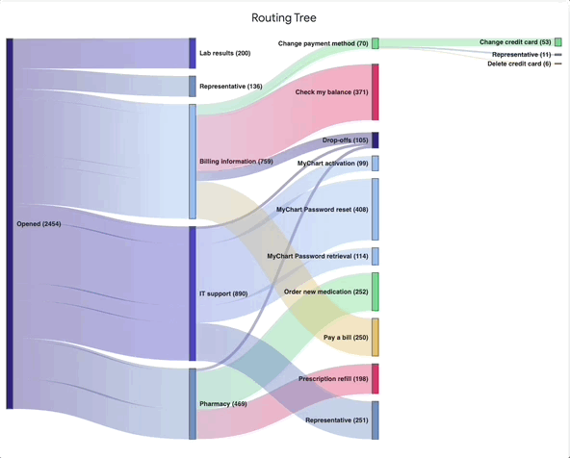
Where to start?
1
2
3
4
Iterate

Slide 35
Thank You!
Michael Blumental
COO
michael@hyro.ai

