Slide 1
Rapid Implementation of Telehealth at OSUWMC
Brooke Bellamy, MBOE, SSBC
Senior Director, Access & Capacity Management
Brian N. Mitchell, CPHIMS, CHCIO
Senior Director of Information Technology

Slide 2
Agenda
Telehealth – Pre/Post COVID
Technology Expansion
Impact & Lessons Learned
Patient Considerations
What’s Next?

Slide 3
Telehealth Journey Pre-COVID
Primary Care Focus
Limited adoption within specialty areas
~ 2% of Providers using Telehealth
100 Monthly Visits
Telehealth represented roughly 0.04% of total visits
Telehealth lacked consistent payer support/recognition as a service method
Limited provider incentives
Epic as Primary Platform

Slide 4
Telehealth Journey COVID Response
Supply
Organizational call for laptop turn-in
Creative use of personal devices
Launch
Training and distribution of 750 cameras
Software push to over 1,000 computers
Added additional telehealth platforms to meet patient needs
Sustain
Enabled 3,100+ Billable Providers
Physician Leader Engagement
Weekly Provider Level Targets and Reporting

Slide 5
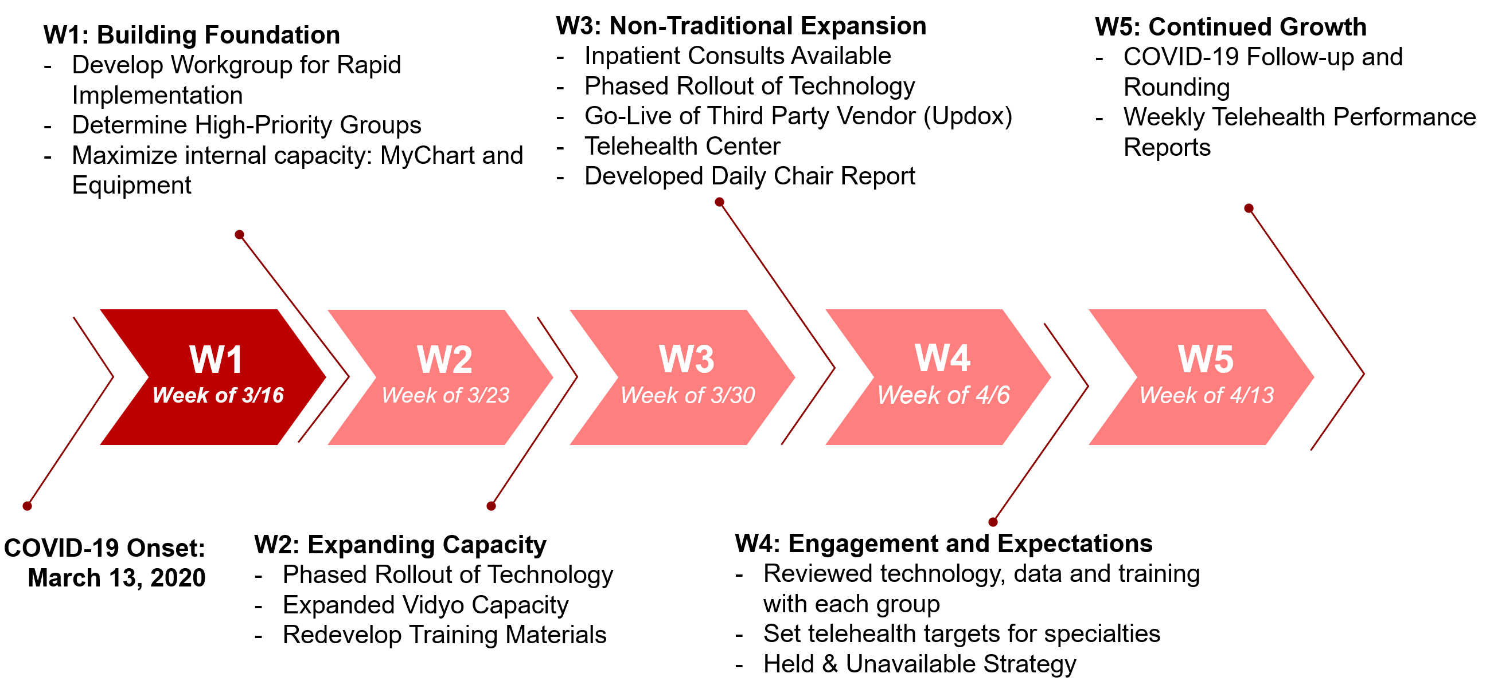
Telehealth Journey: COVID Response

Slide 6
Technology Escalation
Hardware
Software
Training
Communication
Cameras
Headsets
Connectivity
Enabling scheduling and clinical workflows
How to connect patients who had not setup patient portal access?
Or who lacked the client hardware?
Old phone?
Like setting up a Verizon retail store support desk….
Without being able to have the building to being customer and business together…
Marketing 101
Product
Price
Place
Promotion
People

Slide 7
Rapid Deployment of a New Application
Decision Made
Contract Review
Risk Assessment
Project Request
I/T Requirements
Signatures
Review, Remediate, Repeat
Marketing
Telehealth Immediate Care Office
Training
IT Firewall Changes
User Account Creation
Internet
Mass Media
Hardware

Slide 8
Telehealth Journey: Impact
90% of Providers Using Telehealth
vs 2% Pre-COVID
2,500+ Weekly Visits
vs 100 monthly
$13M Net Revenue
From Telehealth Activity

Slide 9
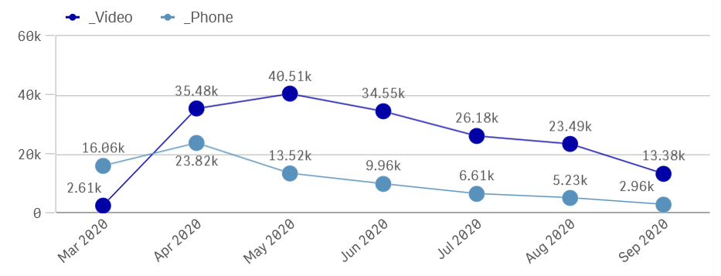
Telehealth Journey: by Mode

Slide 10
Lessons Learned: Payor Mix
+ 6.7%
+ 2.2%
- 7.2%
Managed Care
Medicaid
Medicare

Slide 11
Lessons Learned: No-Shows
By Modality
Telehealth
4.8%
Overall 8.8%
Medicaid Patients
In-Person
12.6%
Telehealth
8.6%

Slide 12
Provider Pain Points
Stable Connections
End-User Learning Curve
Multi-Person Visit Limitations
Rapid Training
Communicating Changes
(State Licensure, Billing, Scheduling)

Slide 13
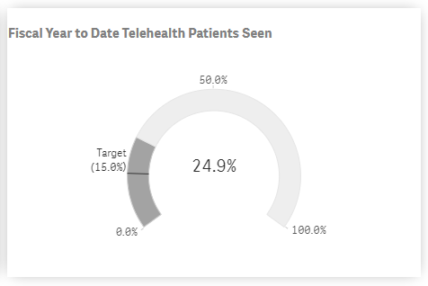
FY ‘21 Telehealth Goals 15% of all patients receiving care via Telehealth

Slide 14
Patient Impact
13.7M
237,800
49
Patient Travel Hours Saved
Or 9,500 days…
Or 27 years…
States covered
by Telehealth Visits
Miles Saved

Slide 15
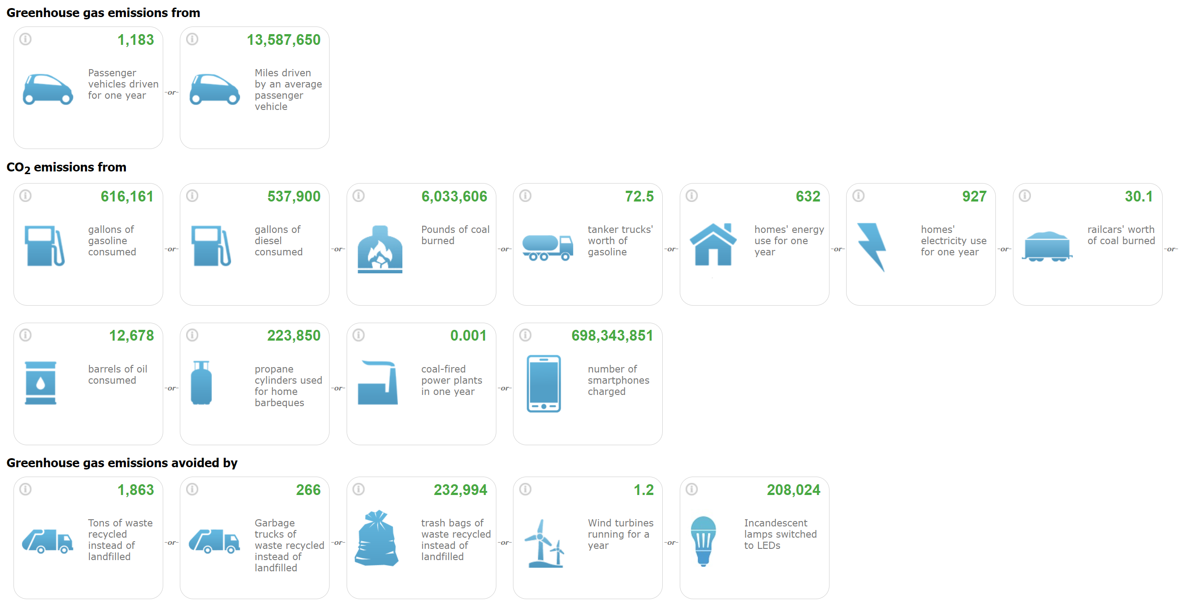
Environmental Impact
13.7M
=
13.7M
Miles Saved

Slide 17
Notes:
High incidence of technical issues
Mobile app users had the lowest instance of technical issues
High incidence of unresolved technical issues
Consider additional technical support options for patients

Slide 19
Patients are still looking for telehealth
Google trends show: 1) the initial spike from COVID has leveled out. 2) the new baseline for telehealth search terms is 3-4x higher than the old baseline.
Notes:
General telehealth searches are the most popular. Not condition specific terms like orthopedics telehealth appointments for example.

Slide 20
Research indicates 50% of patients are willing to switch providers to have virtual care
Commercial payors, Millennials and Gen Xers are significantly more likely to switch.
Kyruus 2020 Patient Perspectives on Virtual Care Report (n=1,000)

Slide 21
Technology – Challenges and What’s Next?
EHR Integrated and Context Aware
Waiting Room
Voice or Video
Screen -shots
Keeping pace for an optimal single solution
Increase Ease of Use
Reduce Confusion for Providers/Patients
Minimize Network Congestion/Slowness
Maximize Compatibility with Client Devices
Enhance Communication Experiences
Augment telehealth with clinical device integration
Create: The Path of Least Resistance!
Patient Device Ready
Multi Party
Video Privacy Backdrops
Closed Caption

Slide 22
Questions?

