Slide 1
Memoirs of a CNIO During a Pandemic
Sherri Hess, MS-IS, BSN, RN-BC, FHIMSS
CNIO Banner Health
Sharon Kirby, MSN, RN-BC
CNIO Mayo Clinic

Slide 2
As a mission-driven non-profit, HIMSS offers a unique depth and breadth of expertise in health innovation, public policy, workforce development, research and analytics to advise global leaders, stakeholders and influencers on best practices in health information and technology.
HIMSS is a global advisor and thought leader supporting the transformation of the health ecosystem through information and technology.
With more than 350 employees, HIMSS has operations in:
North America | Asia Pacific | Europe | Latin America | Middle East | United Kingdom

Slide 3
Learning Objectives
Describe the Informaticist role in a pandemic
Discuss the similarities and differences between 2 large healthcare organizations in response to COVID
Explain the role of technology in a pandemic
Identify lessons learned from a pandemic

Slide 4
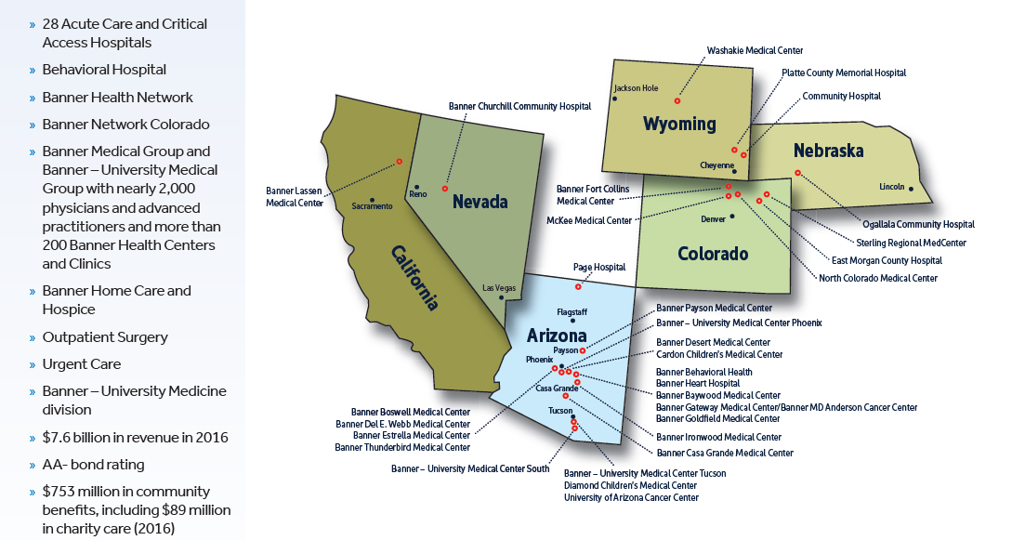
Banner Health
Wyoming Medical Center
Casper
30 Hospitals – Universities, Acute Care & Critical Access
Behavioral Health Hospital
Outpatient Surgery Centers
Urgent Cares
Hospice
Home Care
Banner Health Network
Banner Medical Group &
Banner Univ. Medical 2K MD’s & APP’s
Largest employer in AZ
Over 50,000 employees
“Making Healthcare Easier So Life Can Be Better”
Notes:
Helen

Slide 5
Mayo Clinic
Our most valuable asset
Serving patient needs
65,214
1.3 million
EMPLOYEES
UNIQUE PATIENTS
from every state & 143 countries
4,878
Physicians/Scientists
33% Of people who visit a Mayo Clinic destination medical center locations have complex or highly complex conditions
60,336
Allied health/Administrative
36,330
138 Countries represented by
patients beyond the United States
Rochester
130,000 Patients who have surgery
7,085
Arizona
6,379
Florida
88% Of people who came to Mayo Clinic for a second opinion received a new or refined diagnosis
1,300
Solid organ transplants
15,420
Mayo Clinic Health System
*

Slide 6
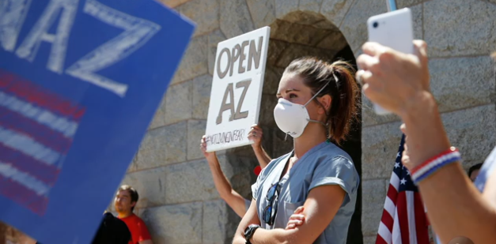
Notes:
On Lauren’s day off from caring for patients at Banner Health University hospital Phx on the COVID-19 unit, she went to the Arizona State Capitol to meet those protesting the state's stay-at-home order.
She stood in a silent protest as, she said, people approached her enraged. And didn’t believe she was a nurse. Some were even carrying rifles.
she understood their anger, saying "we were not there to discredit their suffering" and that "we saw them as our patients.““She wanted to be there as a voice for health care workers, and we wanted to be heard and seen louder than a lot of the misinformation and fear that has sort of been sweeping the nation with this movement to open too soon.
"Nurses are scared to watch their states open up," as they are treating some of "the sickest patients that I have ever cared for in my life.“ We have had nurses say that they can’t go back to where we were – they have PTSD.
Banner is in 6 states 28 hospitals – soon to be 30 – largest footprint in AZ, but also CO, CA, Nebraska, Wy, NV
At Banner, we were hit early in the Colorado region. With the peak around March/April and improving in May
In AZ we were hit later (closed too late and opened too soon, but were more prepared. We starting increasing in late May with our peak in July and late august is when we improved – we were the hotspot in the whole world at one point. AZ was the only state to implement crisis care as a state.

Slide 7
Pandemic Response
Paradigm shift:
150 years steeped in tradition to ‘perfect-enemy-of-good’; novel/nimble
Reprioritization: 400 – 600 projects → 20 projects
60K employees in 5 states, 3 time zones – 1/3 (20,000) transitioned to work-from-home in 6 days
Clinical workflows had to be entirely revamped, Home to home virtual visits
Financial Reductions:
Furloughed 40% of informatics staff
Reduced hours on remaining informatics staff
Focus on COVID change requests, patient safety, financial or regulatory

Slide 8
Banner’s CEO & Senior Leadership Visibility
CEO began weekly emails and video messages
Staff feel connected with senior leadership
Dr Bessel, CCO meeting with governor and news stations in Arizona
Annual Initiatives morphed to COVID focused
“Keep employees safe and save as many lives as possible”
Notes:
Encouraged people to respond with a different theme each week
Town Halls with CCO, COO and Chief Human Resources Officer
Weekly, now bi-weekly
Live event with situational awareness
Ideas for self care
Question and answer
Town halls are recorded
Any questions not answered during the meeting are on toolkit

Slide 9
Value of Informaticist
Illuminated the liaison role and ability to focus and expedite the work
Participated in incident command center
Created COVID workflows and screening processes
60 facility build changes in EHR for surge planning
Part of Labor Pool: Swabbing/screening sites
Retrained staff moving to different areas-curriculum
Created Pandemic and Disaster Navigators
Infectious Disease reporting
EHR Upgrade April 2020

Slide 10
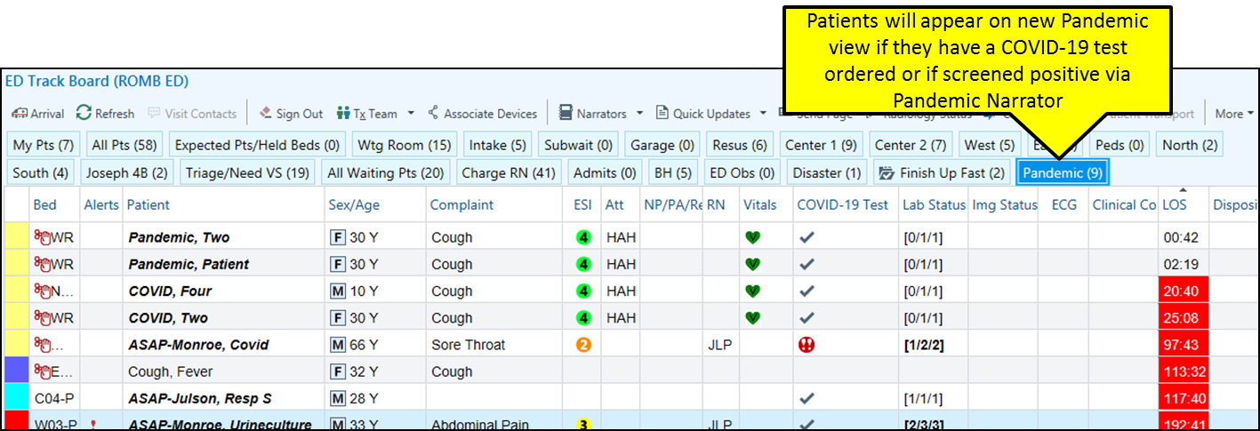
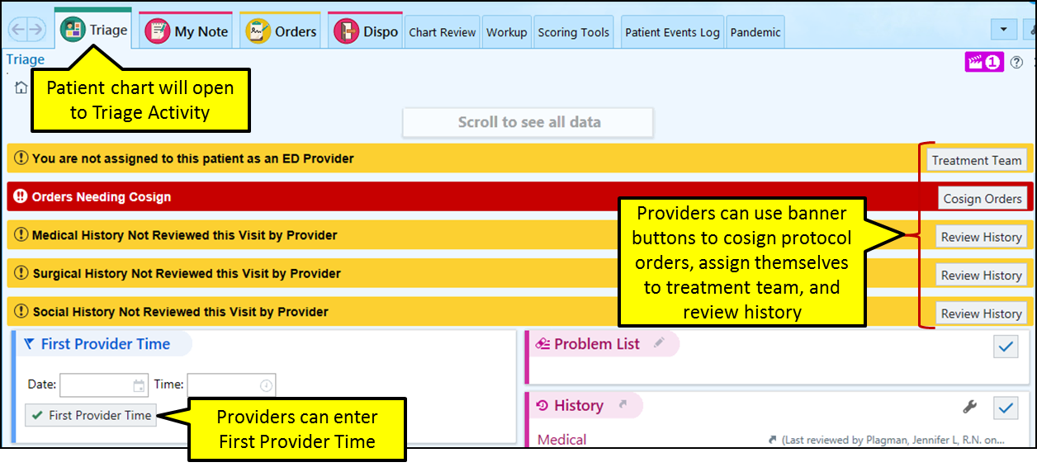
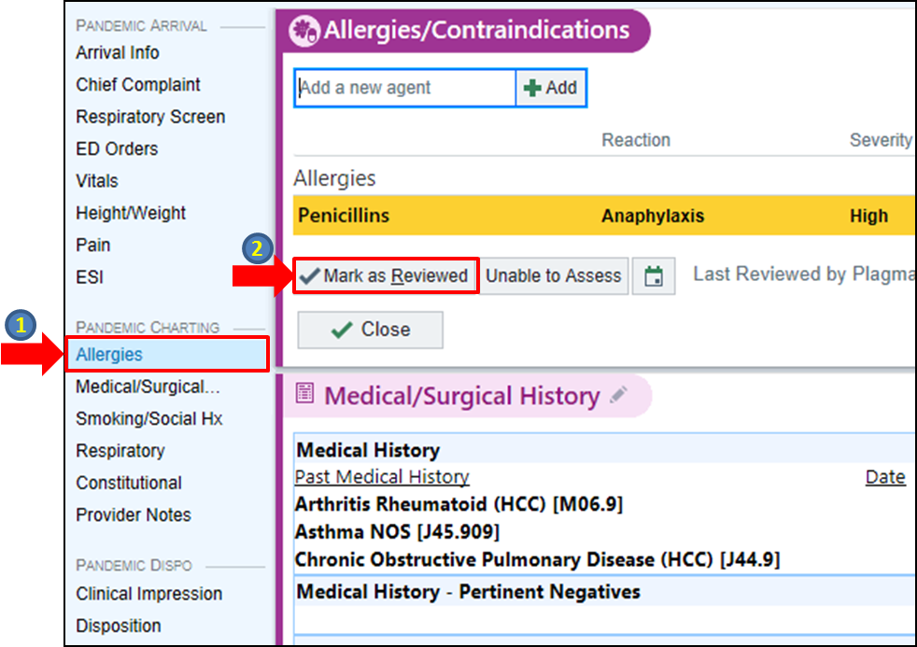
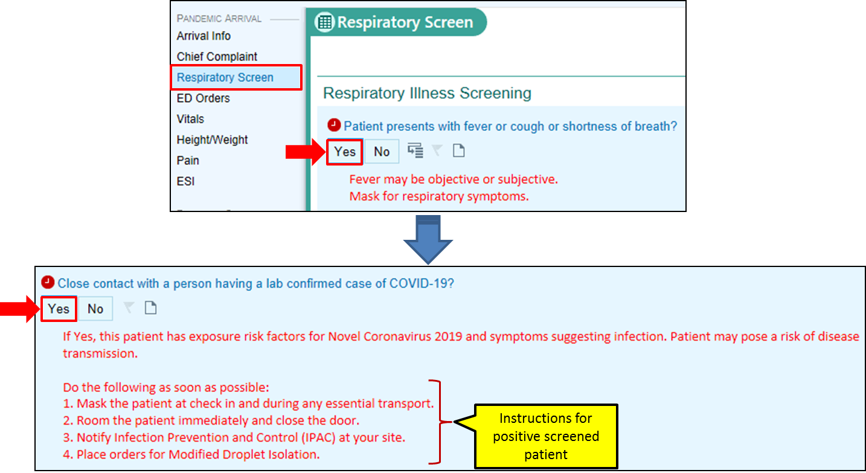
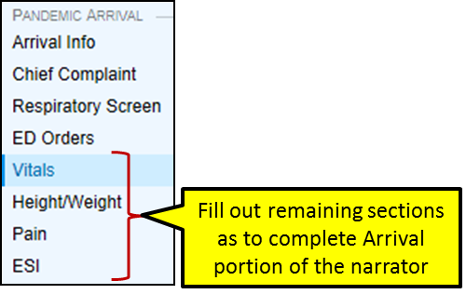
Pandemic Navigator
Provider
Nursing
Discharge
or admit
© 2020 Epic Systems Corporation. Used with permission.

Slide 11
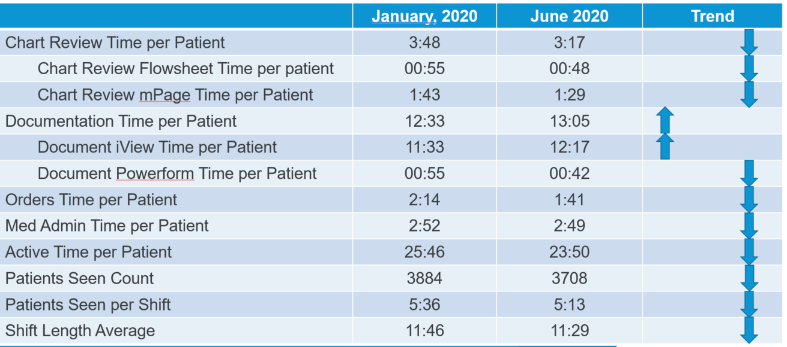
Banner Disaster Documentation
Interdisciplinary team created
Reviewed national standards
Implemented in Colorado in April
Implemented in AZ in June
Opportunities

Slide 12
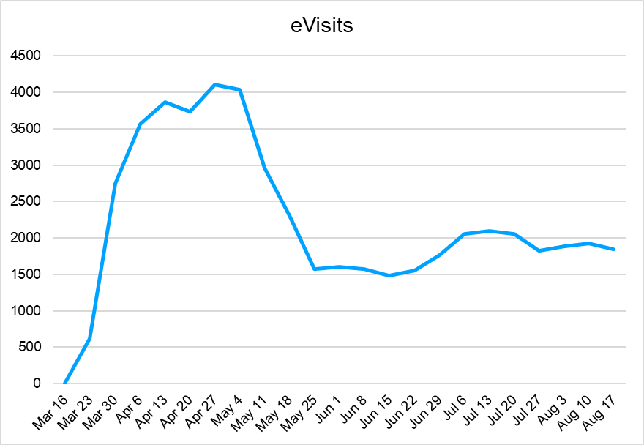
Telehealth Ambulatory Platform
The telehealth ambulatory platform is utilized by over 440+ clinics (primary care, specialty care, urgent care and occupational health) across Banner.
YTD Stats as of Sept 18, 2020
Total Visits: 56,293
Banner Phoenix 70%
Banner Western Region 16%
Banner Tucson 11%
Banner Urgent Care 3%
Avg Overall Visit Exp: 4.86/5.0
Avg Provider Quality: 4.9/5.0

Slide 13
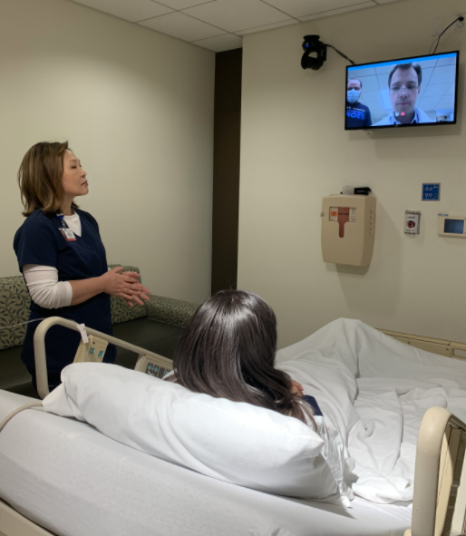
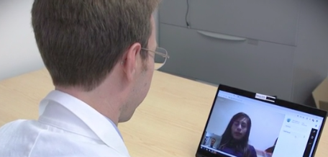
Telehealth Acute Platform
Provides the telehealth platform utilized by all 28 hospitals across Banner
Current Efforts:
VeeKast rooms installed = 853
Reduction of provider exposure
Preserve PPE
Minimize the impact of patient surges
Final room installation goal is 1,114 by Dec.
 | Arizona | Western Region | Academic Division | Total
Emergency Department | 155 | 41 | 25 | 221
Inpatient Unit | 402 | 74 | 156 | 655
Total | 565 | 115 | 196 | 853
Notes:
Telehealth services @ Banner scaled rapidly
Ambulatory Telehealth increased from a volume of zero (2019) to 56,000 (2020) visits
Acute Telehealth increased across multiple specialties in 2020
Standardized technology has been installed in 853 inpatient and ED rooms, with plans to install 261 more rooms by December and 157 additional rooms in early 2021
50 mobile telehealth endpoints are being installed throughout Banner hospitals and clinics
29 additional mobile telehealth endpoints will be installed in early 2021

Slide 14
Telehealth accelerated
Accelerated our 2030 strategy: Cure, Connect, Transform care
COVID Interactive Care Plans-Low risk (21 days)
Remote Patient Monitoring-Complex Care (30 days)
Telehealth visits- 35/day on average pre-COVID; > 3000/day post-COVID
Advanced Care at Home implemented(Florida and Wisconsin)

Slide 15
Thoughts

Slide 16
Questions

