Slide 1
Using Passive network monitors for real time visibility and security management of medical devices
Stephanie Domas
EVP, MedSec

Slide 2
About MedSec
US based, exclusively focused on the unique challenge of security medical devices and healthcare
With Medical Device Manufacturers
Cybersecurity throughout the product lifecycle: design reviews, pentesting, regulatory filings, quality system integration, FIPS, ATO, threat modeling, product incident response, training
With Hospital Delivery Organizations
Medical device management frameworks, governance programs, pre-purchase risk assessments, pentesting, security contractual clauses, training
MedScan, medical device asset and security management tool

Slide 3
The Challenge:
Healthcare organizations are struggling to protect medical devices
Notes:
Practical guidance for HDO’s, with a technology solution and processes focus.
…. Growing awareness including media…

Slide 4
Agenda
The Challenge
Where current solutions fall short
Approaches
How it helps
Where to go from here

Slide 5
Process
People
Technology
Testing
Mitigations
Compensating Controls
Procurement
Onboarding
Policies
Governance
Skilled Staff
User Awareness

Slide 6
You can’t secure it, if you don’t know you have it
The foundation of a medical device cybersecurity program hinges on an accurate asset list

Slide 7
Medical devices represent 15-20% of hospital endpoints

Slide 8
Asset and Inventory Management
Goal: Automation of asset discovery
Asset lists constantly change:
New device purchases
Old devices removed or added to the network
Unapproved devices added to the network
Feeds into other programs, e.g. digital transformation, network segmentation & fleet risk assessments to identify high risk devices
Notes:
Helpful:
- the Mayo Clinic lists asset and inventory management as the number one most useful step a hospital can take to tackle medical device cybersecurity.Requirement
Automation
- so that devices can be quickly located and patched, pulled offline, and/or replaced, as needed, as devise proliferate
Foundational (Fits with policy best practice, Eg NIST CSF)
- Pretty much nothing else can happen until asset management is addressed…

Slide 9
Asset and Inventory Management
Robust and accurate asset inventories have added benefits
Medical Device ‘Behavior Profile’:
Feeds into risk assessments
Input into network segmentation requirements
Used for scheduled maintenance planning
Feeds into device usage statistics

Slide 10
Considerations for Asset Management and Identification Tool Solutions
Traditional IT tools not likely to function well
Scanning do’s and don’ts (no active scanning)
Identification of Medical Device-specific Protocols
More accurate device fingerprinting
Improved PHI identification
Better network modelling

Slide 11
Current Trend - Medical Device Security Programs
Small Hospitals
(50-250 beds)
In-house HTM/ CE Director or Supervisor takes the lead
Outsourced via IT to a 3rd party
Risk assessment process is not finalized
No budget for a passive network monitoring solution
Medium Sized Hospitals
(250-500 beds)
In-house HTM/ CE Director oversees the program
1 or 2 HTM cybersecurity analyst
Perform risk assessments and coordinate threat and vulnerability management process with IT and/ or Information Security
Assessing passive network monitoring solutions for better asset management
Large Sized Hospitals or Integrated Delivery Network
(>500 beds)
HTM Cybersecurity Director or Manager
2-4 HTM cybersecurity analysts
Risk assessments, TVM, and incident response is coordinated with IT and/ or Information Security
Deployed passive network monitoring solution for improved asset management
Active in H-ISAC
Notes:
Reference:
H-ISAC Spring and Fall Summits 2018/ 2019 – Building Medical Device Security Programs – Inhel Rekik, Priyanka Upendra, Keith Whitby, John Rasmussen
MD EXPO Fall 2018 - Building Medical Device Security Programs – Inhel Rekik, Priyanka Upendra
AAMI 2018 – Implementing a Health Technology Security Program for an IDN – Inhel Rekik, Keith Whitby, Priyanka Upendra, Shankar Somasundaram
AAMI 2019 – Implementing a risk management solution for connected medical devices – Priyanka Upendra, Axel Wirth, Shankar Somasundaram, Phil Englert

Slide 12
Connected Device Risk Management Platforms
Passive network monitoring solutions
Sniff the network passively via TAPs, SPANs, Filtered ACLs, SNMP
Pros:
Almost real-time visibility into medical and non-medical devices connecting to the hospital network
Don’t have to install agents on the device itself
Cons:
Implementation cost can be high
Require multiple teams to coordinate tasks so visibility is accurate
Overwhelming amount of information that is new for HTM-CE professionals
Notes:
More information:
https://healthtechmagazine.net/article/2019/09/importance-network-monitoring-clinical-setting-perfcon
https://www.helpsystems.com/resources/articles/network-monitoring-healthcare-field

Slide 13
Alignment with NIST CSF
Identify | Inventory & risk management | Discover attributes of the medical device and build a risk profile
Protect | Vulnerability & risk prioritization Containment & micro-segmentation | Gather vulnerability information from variety of sources, MDS2, and prioritize risk recommendations to generate actionable work orders
Detect | Anomaly & event detection Continuous intrusion monitoring | Gather flow analytics, set baseline behavior, and monitor intrusions
Respond | Communication, analysis & mitigation | Communicate risk recommendations to stakeholders, communicate with NAC and firewall tools
Recover | Recovery, improvements & communication | Enforce policies, mitigation plans, and communicate to stakeholders
Reference: National Health IT Week Webinar – ACCE September 2019

Slide 14
Quality of Asset Management
Current State
Varying asset management procedures between HTM and IT
Manual inventory and tagging of assets (or devices) with unique identification numbers
GRC frameworks between HTM and IT are different
Patch and update notification process is manual
Non-compliance with policies cannot be monitored or managed automatically
Lack of centralized account management for medical device vendors and users
Improved State (w/ passive network monitoring solution)
Automated inventory and each asset is recognized with a unique ID on the network
All fields are preset
Identifies and profiles associated equipment or dependent systems
Patch and update notification is almost real-time as these solutions subscribe to various security providers for threat intel
Policy compliance is automated and monitored real-time
Account management is automated and inbound/ outbound communication is monitored
Notes:
Discuss traditional asset management process for medical devices in health systems – HTM/ ISO/ Biomed
Unsupported/ legacy devices
Large variety of devices to manage
Unique set of data sources to manage and work with
Regulatory and manufacturer constraints for implementation of security controls
Limited visibility in an automated manner
Scheduling conflicts to patch devices
Limited visibility or accountability of patching and cybersecurity management efforts

Slide 15
Importance to a Health System
Accurate inventory bridges gap between varying asset management procedures in HTM and IT
Enhances ability to track new network connected devices
Enhances ability to track missing or lost network connected devices with and without sensitive information
Understanding what is present on the network and its attributes helps with cyber-risk analysis and development of remediation strategies
Identified inventory is fed to the computerized maintenance management system used by HTM to create an active and up-to-date inventory of connected medical devices

Slide 16
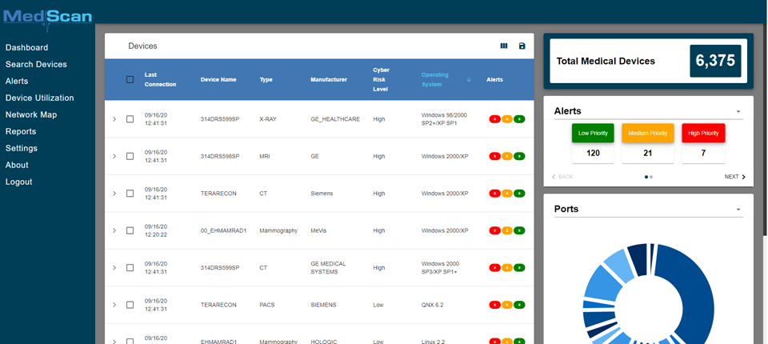
Image Source: MedScan by MedSec
Notes:
Talk about seeing real time the devices

Slide 17
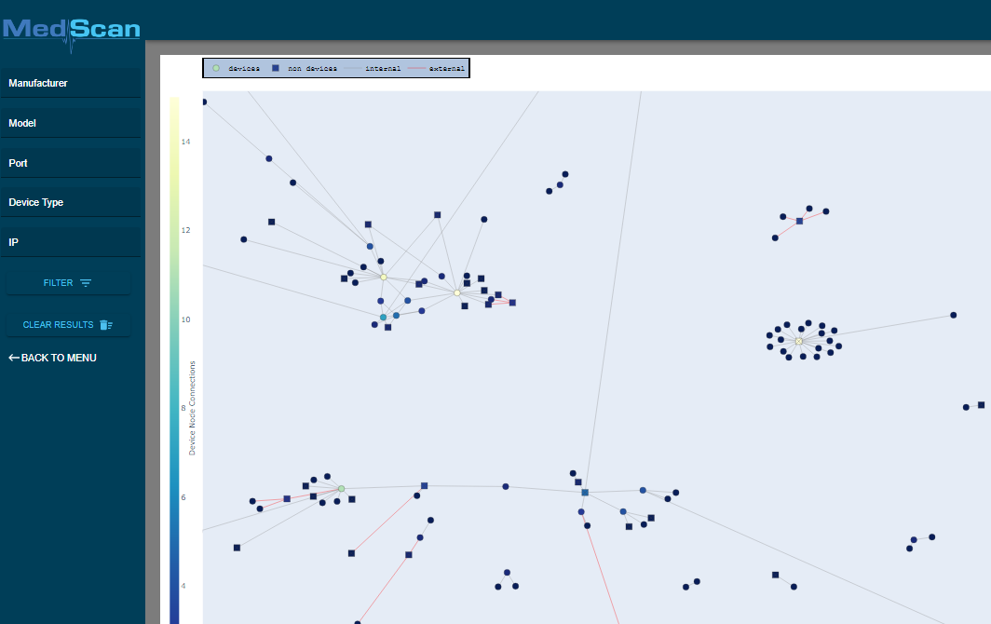
Image Source: MedScan by MedSec
Notes:
See where medical devices are sending data, see if anyone is talking outside of their excepted ‘swim lane’

Slide 18
Risk Profiling
Low
Multi-step manual process if one doesn’t use an automated risk management platform
Automated Risk is a combination of:
Device Operating System
Protocols Used
Use of Encryption
Network Behavior
Clinical function
Known Vulnerabilities
Potential for Patient Harm
Threat to the network
Presents low level of risk, continue to monitor
Medium
Presents a non-negligible risk, action can be taken in a timely manner, or integrated into a routine preventative maintenance
High
Presents an immediate risk, timely action is recommended

Slide 19
Cost of Vulnerability Remediation (in-house)
Manual Device identification
72-96 hours
Manual cross-referencing with H-ISAC and OEM advisory
96-120 hours
Identify
Detect
Protect
Without Real Time Asset Management
Locate device, plan downtime
96-120 hours
If device crashes, fails; locate backup; install & configure
2-3 weeks for OEM validation
48-96 hours
Recover
Device out of service, review change, perform change, validate
72-120 hours
Respond
Notes:
Manual identification
1-2 HTM/ CE/ Biomeds
1 IT Field Services Tech.
1 IS GRC
1 IS Security Architecture
1 HTM/ CE/ Biomed Leader
72-96 hours Approx. $30-50/ hour
====
Manual cross-referencing with H-ISAC and OEM advisory
1 IS GRC
1 IS Security Architecture
1 HTM/ CE/ Biomed Leader
Avg. 3-4 days with OEM
96-120 hours Approx. $50-75/ hour
====
Locate device, plan downtime
1 HTM/ CE/ Biomed
1-2 IT Field Services
1 HTM/ CE/ Biomed Leader
96-120 hours Approx. $30-50/ hour
=====
If device crashes, fails; locate backup; install & configure
1-2 HTM/ CE/ Biomeds
1 HTM/ CE/ Biomed Leader
2-3 weeks for OEM validation
48-96 hours Approx. $50-75/ hour
====
Device out of service, review change, perform change, validate
1-2 weeks Change Board
1-2 HTM/ CE/ Biomeds
2-3 weeks for OEM validation
72-120 hours Approx. $30-50/ hour
======
Reference:
Mathematical calculation adopted from Keith Whitby’s presentation at PartsSource Leadership Summit, August 2018.
AAMI 2018 – Implementing a Health Technology Security Program for an IDN – Inhel Rekik, Keith Whitby, Priyanka Upendra, Shankar Somasundaram
AAMI 2019 – Implementing a risk management solution for connected medical devices – Priyanka Upendra, Axel Wirth, Shankar Somasundaram, Phil Englert
Detect – Protect – review numbers – far higher numbers

Slide 20
Cost of Vulnerability Remediation - Improved
Automated identification
All teams review data almost real-time simultaneously
12-24 hours
Advisories feed into risk management tool
12-24 hours
Identify
Detect
With Realtime Asset Management
Protect
Locate device, plan downtime is automated via CMMS
6-12 hours
If device crashes, fails; backup; install & configure
2-3 weeks for OEM validation
12-24 hours
Recover
Device in service, review change via feed, perform change via feed, validate via real-time utilization data
72-120 hours
Respond
Notes:
Reference:
1. Mathematical calculation adopted from Keith Whitby’s presentation at PartsSource Leadership Summit, August 2018.
2. AAMI 2018 – Implementing a Health Technology Security Program for an IDN – Inhel Rekik, Keith Whitby, Priyanka Upendra, Shankar Somasundaram
3. AAMI 2019 – Implementing a risk management solution for connected medical devices – Priyanka Upendra, Axel Wirth, Shankar Somasundaram, Phil Englert
4. Detect – Protect – review numbers – far higher numbers

Slide 21
Improved Process, Time, and Budget
63%
Spent labor hours
Initial = 552 hours
Improved = 204 hours
$17,400
Cost
@$50/hr
Initial = $27,600
Improved = $10,200
Notes:
Reference:
1. Mathematical calculation adopted from Keith Whitby’s presentation at PartsSource Leadership Summit, August 2018.
2. Current approximations for hours and cost adopted from AAMI Cybersecurity Practice Guide for HTM Professionals, June 2018.
- Cost of all functions versus cost of not doing the cyber related tasks

Slide 22
Conclusion - Passive network monitoring for medical devices
Lowers risk through proactive alerting
Saves money by reducing the man-hours associated with inventory, and incident response
Optimizes your defensive strategy by identifying the highest risk devices to protect first
Realtime look into device performance and activity

Slide 23
Stephanie Domas
Executive Vice President, MedSec
stephaniedomas@medsec.com

