Slide 1
How COVID-19 Changed Telehealth: An Oncologist’s Perspective
Samantha Jaglowski, MD, MPH
The Ohio State University

Slide 2
Disclosures
No disclosures relevant to this talk

Slide 3
Objectives
To discuss the rationale for use of telehealth in cancer patients during the SARS-CoV2 pandemic
To discuss historic and current barriers to the use of telehealth
To discuss the Ohio State approach to implementing the use of telehealth for cancer patients
To discuss potential future directions for telehealth

Slide 5
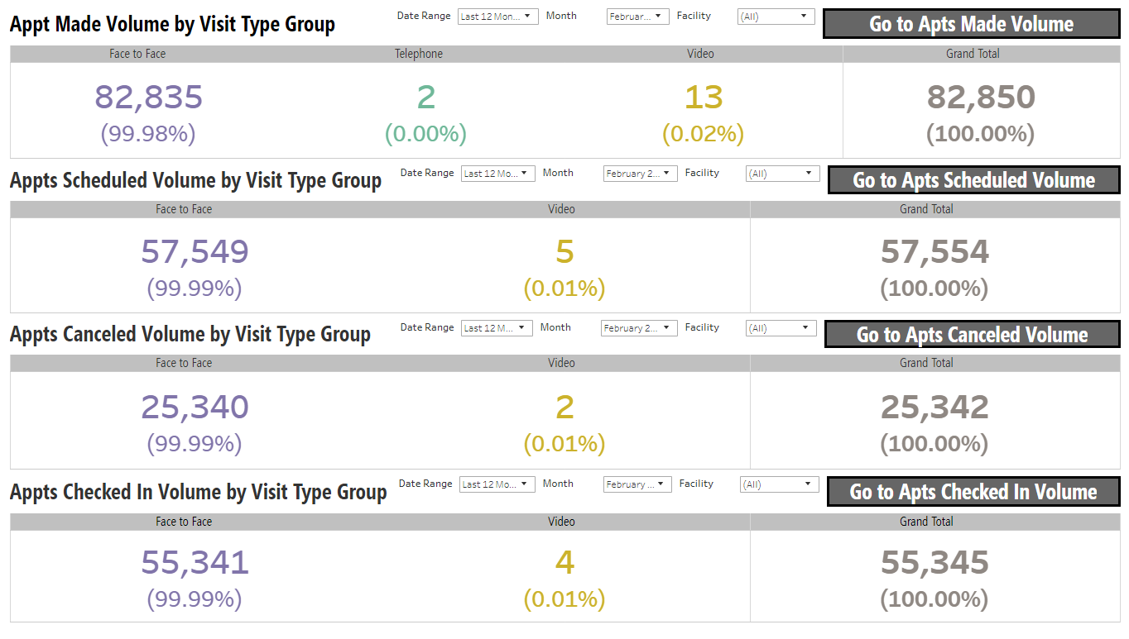

Slide 6
March 2020

Slide 7
March 2020

Slide 8
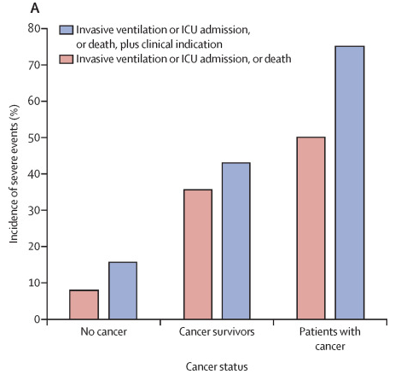
March 2020

Slide 11
What we knew
Potential for rapid spread, overwhelming health care system
Cancer patients fare worse
Most patients travel from areas with lower case numbers

Slide 12
What we knew
Potential for rapid spread, overwhelming health care system
Cancer patients fare worse
Most patients travel from areas with lower case numbers
We needed to be able to care for patients and keep them safe at home

Slide 13
Solution

Slide 14
Solution
Telehealth

Slide 22
Medicare Telehealth Reimbursement before COVID-19
Section 1834(m) of the Social Security Act (42 U.S.C. 1395m(m))
Established telehealth as a Medicare benefit
“Telehealth” (synchronous) vs. “Store-and-forward” (asynchronous)
Telehealth must use an interactive audio and video telecommunications system permitting real-time communication; store-and-forward only permitted for federal demonstration programs in Alaska and Hawaii

Slide 23
Medicare Telehealth Reimbursement before COVID-19
1834(m) Restrictions and limitations
Geographic location
Originating sites (where patient is located)
Eligible physicians and practitioners
Distant sites (where provider is located)
Eligible telehealth services
CMS telehealth services list limited to specific HCPCS/CPT codes

Slide 25
Telehealth statutory changes
Coronavirus Preparedness and Response Supplemental Appropriations Act of 2020
Includes the Telehealth Services During Certain Emergency Periods Act of 2020
Allowed for the waiver of Medicare limitations on telehealth services delivered by qualified providers during the COVID-19 emergency
Permitted telehealth via telephone “but only if such telephone has audio and video capabilities that are used for two-way, real-time interactive communication

Slide 26
Telehealth statutory changes
Coronavirus Aid, Relief, and Economic Security Act
Waives state licensure requirements for practitioners
Waives the preexisting relationship requirement for telehealth services

Slide 27
CMS guidance on telehealth
Telehealth reimbursement
Visits are considered the same as in-person visits and are paid at the same rate
Starting March 6, 2020, Medicare reimburses for professional services furnished to beneficiaries in all areas of the country in all settings
No requirement that the patient be present at any particular kind of originating site

Slide 28
CMS guidance on telehealth
Starting in 2019, Medicare reimbursement is available for:
Virtual check-ins – short patient-initiated communications with a healthcare practitioner
Starting in 2020, Medicare reimbursement is available for:
E-visits – non-F2F patient-initiated communications through an online patient portal

Slide 29
CMS guidance on telehealth
Virtual check-ins
Available through synchronous or asynchronous technologies
Telephone, audio/video, secure text messaging, email, or patient portals all permitted

Slide 30
CMS guidance on telehealth
E-visits
Patient-initiated online E/M service conducted via a patient portal
Patient must generate the initial inquiry
Communications can occur over a 7-day period
Patient must verbally consent to the service

Slide 32
CMS guidance on telehealth
OCR will not impose penalties against covered health care providers for the lack of a BAA with video communication vendors or any other noncompliance with the HIPAA Rules that relates to the good faith provision of telehealth services during the COVID-19 nationwide public health emergency
Skype for Business/Microsoft Teams
Updox
Vsee
Zoom for Healthcare
Doxy.me
Google G Suite Hangouts

Slide 33
Telehealth visit types

Slide 34
Video Visit Delivery Options
 | IHIS Integration |  |  | External
 | Haiku/Canto | Laptop | Desktop / Workstation | Updox (3rd Party) | Other 3rd Party
IHIS Requirements | Video Visit – Visit Type Document in IHIS Encounter | Video Visit – Visit Type Document in IHIS Encounter | Video Visit – Visit Type Document in IHIS Encounter | Video Visit (3rd Party) – Visit Type Registration Documentation | Video Visit (3rd Party) – Visit Type Registration Documentation
Hardware Requirements | iOS Device | Laptop with Web Camera | Installed Web Camera | Device w/ Camera | Device w/ Camera
Software Requirements | iOS Haiku/Canto | Installed Software | Installed Software | Compatible Web Browser Chrome Recommended | 3rd Party Software
Provider Requirements | IHIS Integration Tip Sheets Training Video |  |  | Updox Account | 3rd Party Account
Patient Requirements | MyChart Account Compatible Device E-Check In |  |  | Compatible Device + Browser | May Require 3rd Party App Download

Slide 35
Scheduling Workflow
Organization-wide initiative
Extend telehealth appts to patients – video or telephone
Exceptions – require approval by department/specialty leadership where visits cannot be completed via telemedicine

Slide 36
Day of Visit Check-in Registration Workflow
Advise patient how they’ll connect with the provider
MyChart VV – They can click the video visit 15 minutes before the visit to join through MyChart
3rd Party VV – The provider will send them a link via email or text at the time of their visit
Telephone – The provider will call them at the time of their visit
Registration staff will arrive all visits morning of if patient has not used e-check in via MyChart
Notes:
Add https://onesource.osumc.edu/departments/IHIS/Tip%20Sheets/OSUMyChart/MyChart%20Video%20Visits.pdf

Slide 37
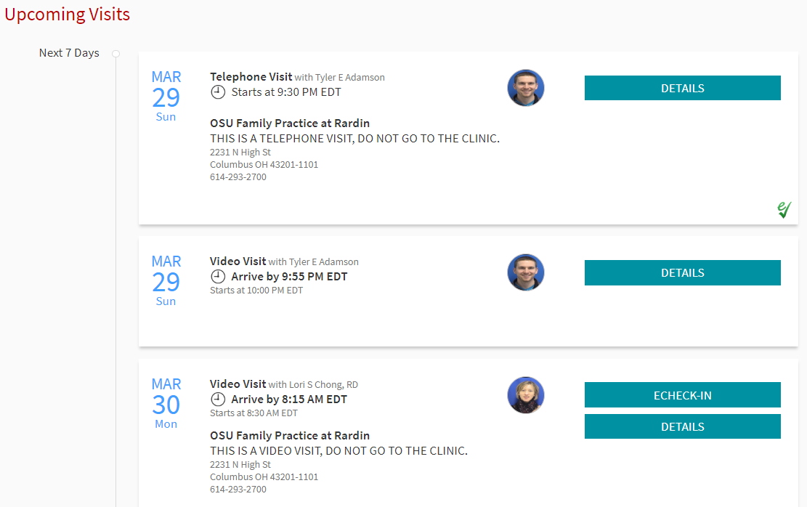
Patient Experience MyChart Upcoming Visits Screen
eCheck-In
Clinic Check-In
Not Checked In

Slide 38
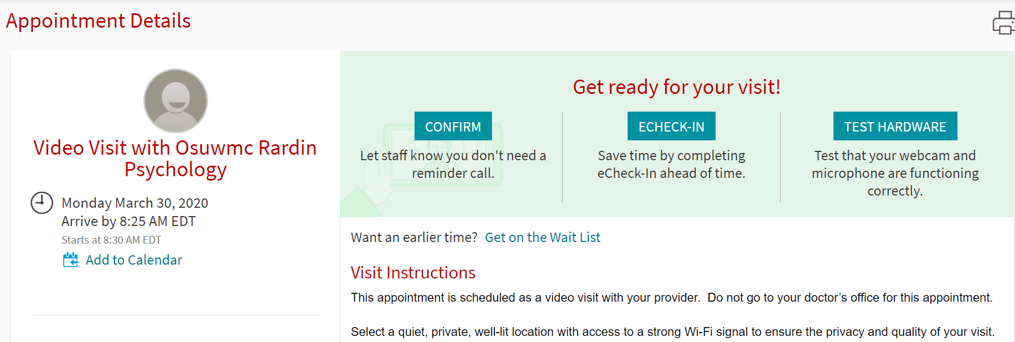
Patient Experience Video Visit Appointment Details Screen

Slide 39
Video Visits – Technology Options 3rd Party Vendors
Preferred Technology Platform – Video Visits through IHIS
COVID-19 pandemic has resulted in relaxed regulations for video visits
Alternate options are secondary and most likely temporary
Alternate platforms in order of preference:
Updox- HIPAA compliant and easy for patients
WebEx- Existing security agreement
Skype - Existing security agreement

Slide 40
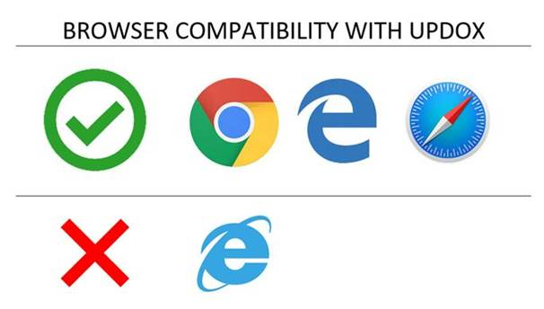
Updox
Is the recommended 3rd party vendor for video visits
Browser:

Slide 41
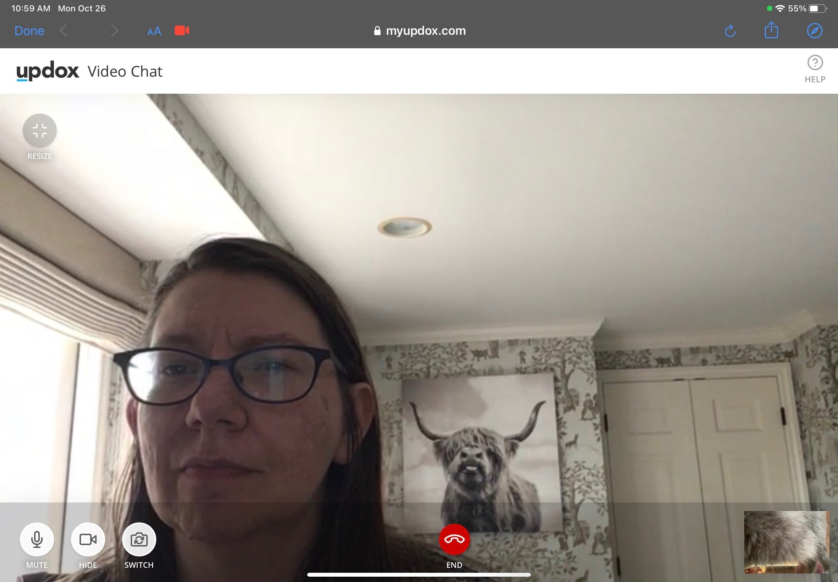
Updox Patient Experience

Slide 42
Updox Patient Experience

Slide 43
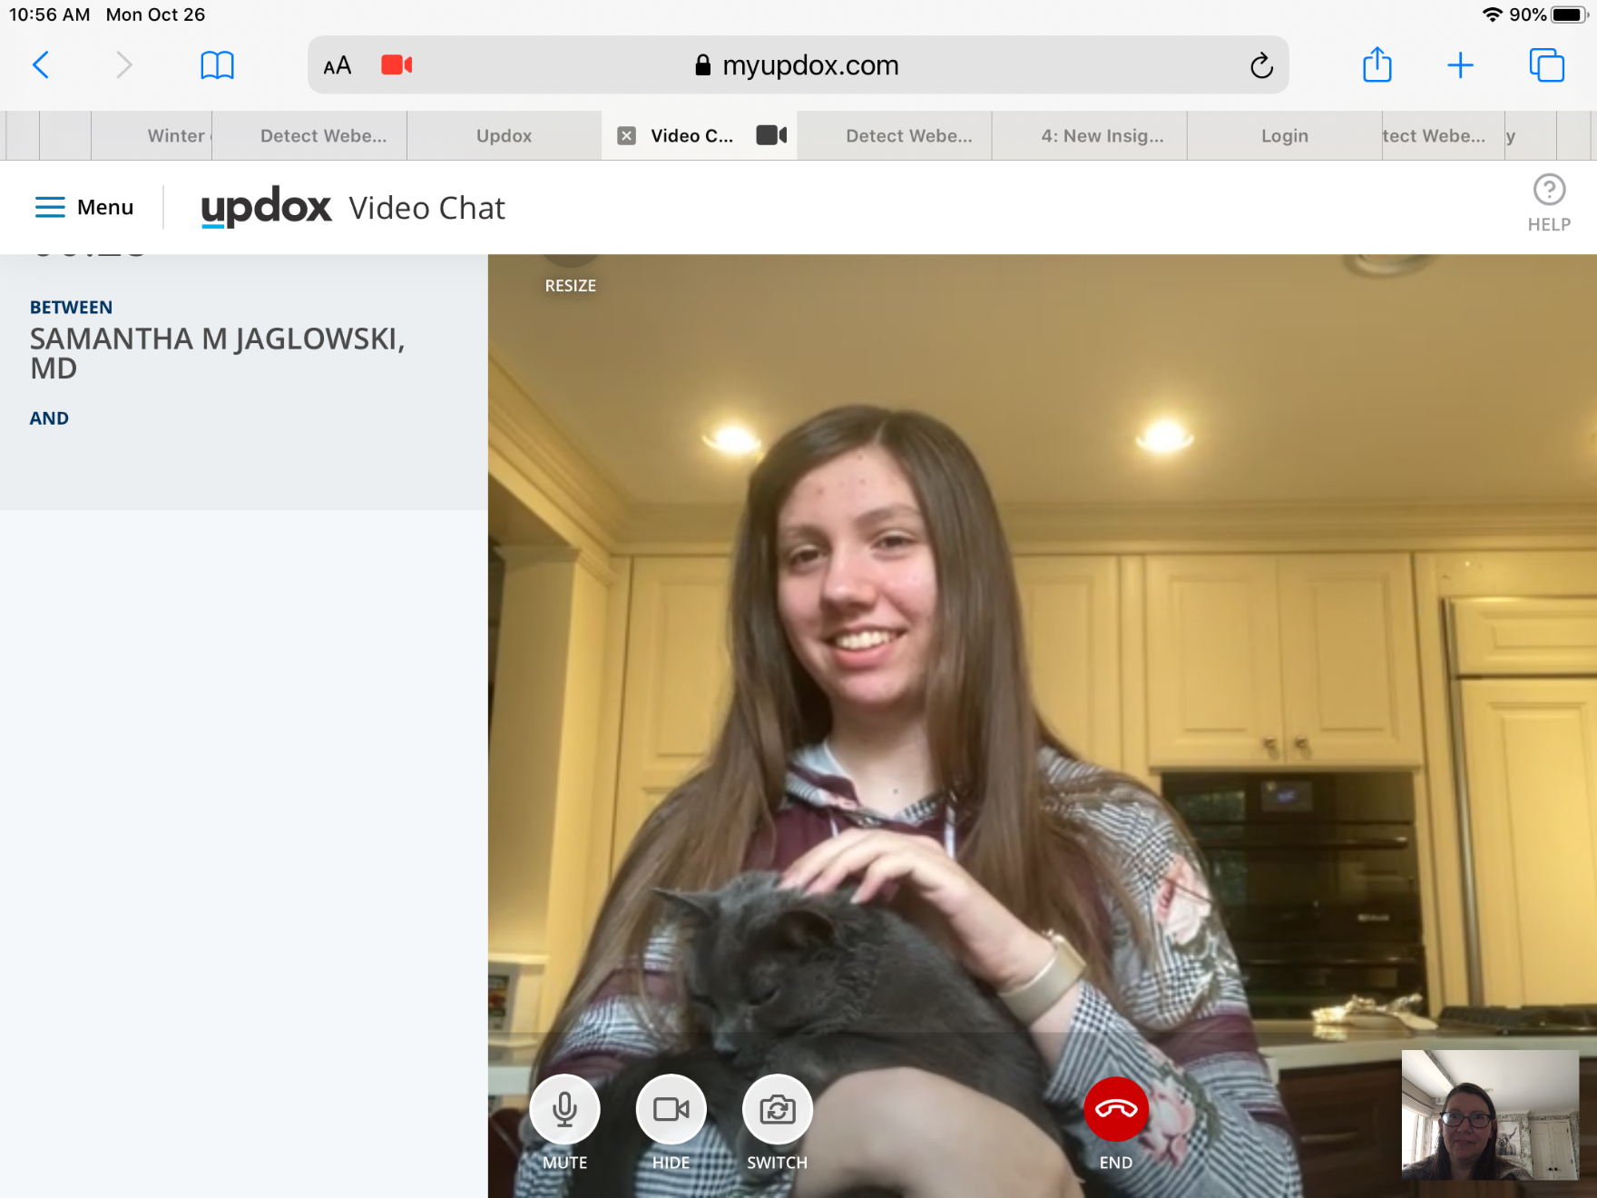
Updox Provider Experience

Slide 44
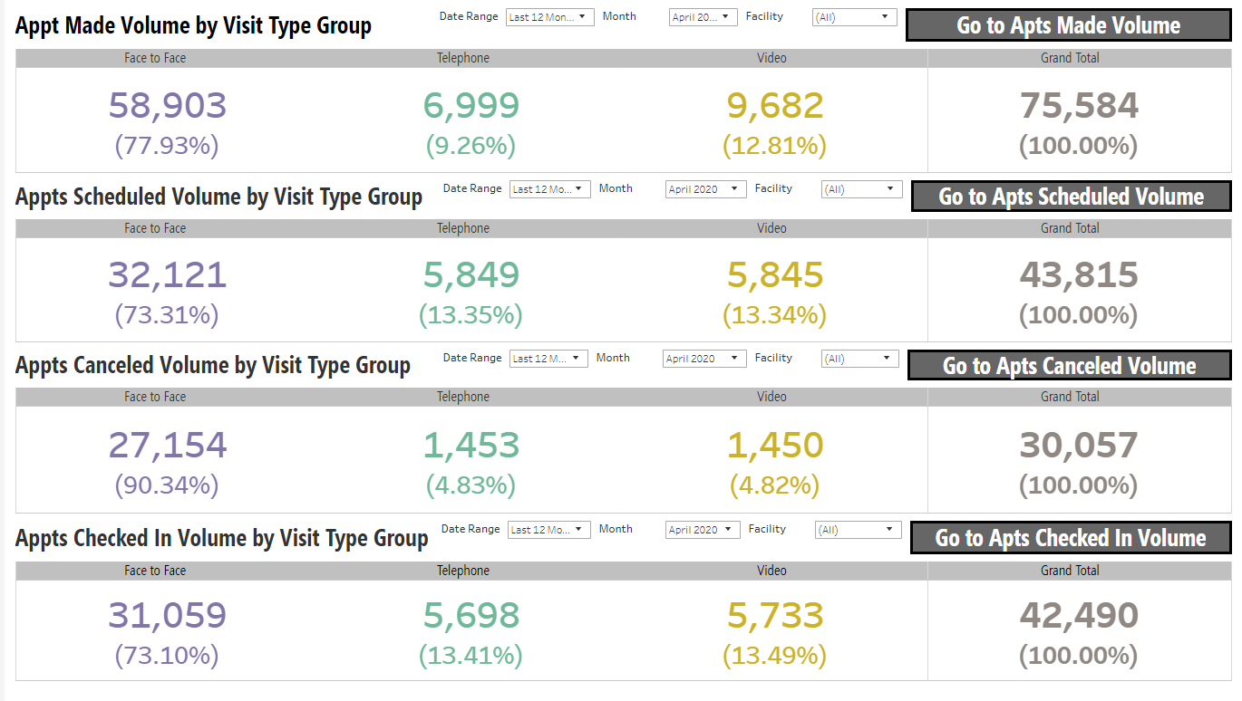

Slide 45
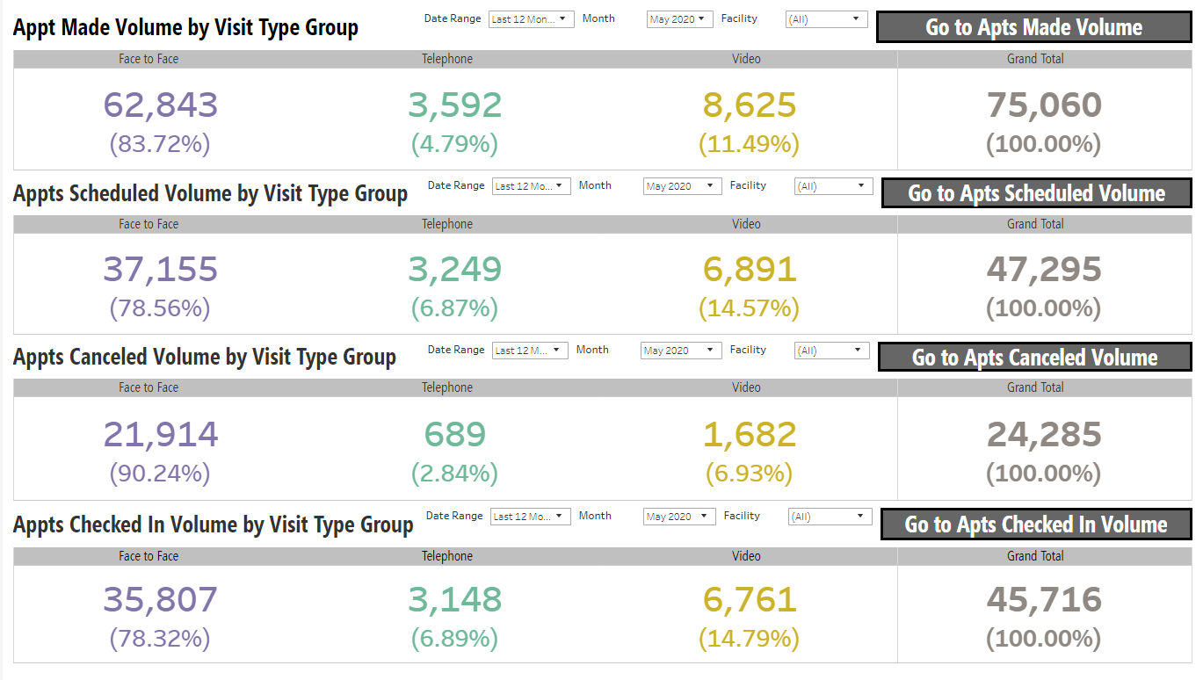

Slide 46
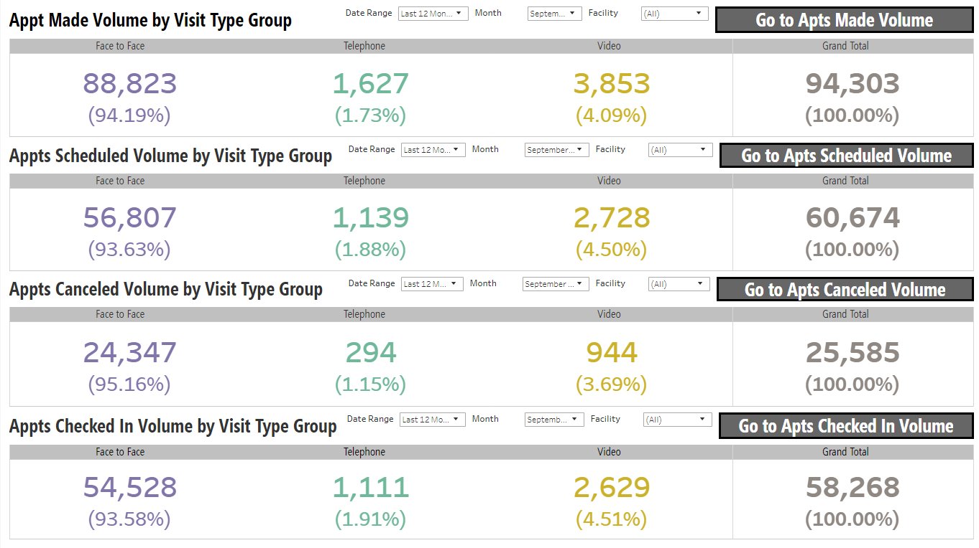

Slide 47
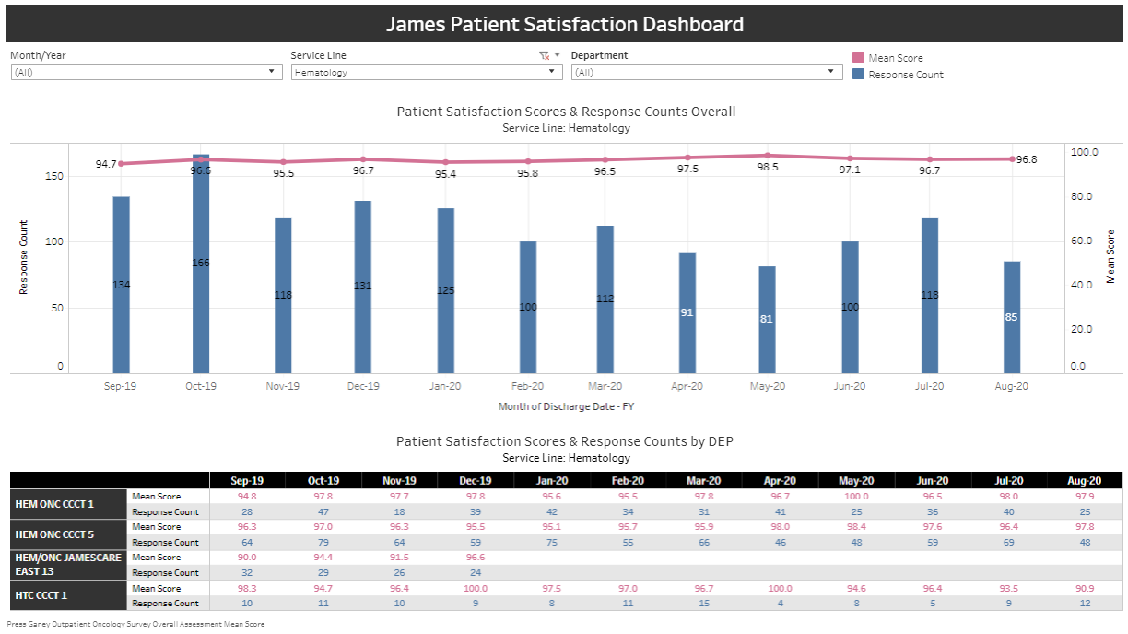
How did we do?

Slide 48
How did we do?
>550,000 patients reported to CIBMTR

Slide 49
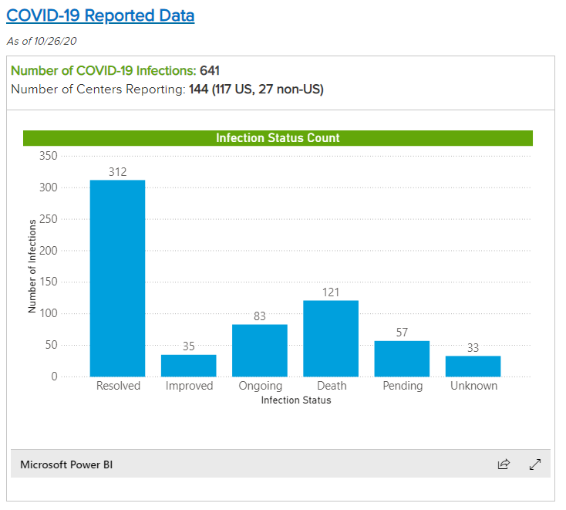
How did we do?
>550,000 patients reported to CIBMTR

Slide 50
CMS guidance on telehealth
Per CMS Administrator Seema Verma:
13,000 individuals received telehealth services per week before COVID-19
1.7 million received telehealth in the last week of April
22% of rural beneficiaries, 30% of urban beneficiaries received telehealth

Slide 51
Barriers to telehealth
Patient access to devices
Patient access to broadband
Patient training to use telehealth platforms

Slide 52
CMS guidance on telehealth
Per CMS Administrator Seema Verma:
“Telehealth will never replace the gold-standard, in-person care. However, telehealth serves as an additional access point for patients, providing convenient care from their doctor and health care team and leveraging innovative technologies that could improve health outcomes and reduce overall health care spending.”
“CMS is reviewing the temporary changes we made and assessing which of these flexibilities should be made permanent through regulatory action. As part of our review, we are looking at the impact these changes have had on access to care, health outcomes, Medicare spending, and impact on the health care delivery system itself.”

Slide 53
Potential uses
Second opinions
Urgent care/triage
Post-hospitalization follow-up to reduce readmissions
Psychosocial oncology
Survivorship visits
Increased access for rural patients/patients with transportation issues

Slide 54
What next?

Slide 55
What next?
It depends

Slide 56
What next?
It depends
Maintenance of relaxed telehealth restrictions

Slide 57
What next?
It depends
Maintenance of relaxed telehealth restrictions
Continued reimbursement parity

Slide 58
What next?
It depends
Maintenance of relaxed telehealth restrictions
Continued reimbursement parity
Out-of-state licensing reciprocity

Slide 59
Thank you
Questions?
Samantha.Jaglowski@osumc.edu

