Slide 1
Telehealth 2.0
Time to rethink models of care?
Ujjwal Ramtekkar, MD, MPE, MBA
Medical Director ,Tele/Virtual Health – Behavioral Health | Nationwide Children's Hospital
Associate Medical Director, Behavioral Health| Partners for Kids
Clinical Associate Professor, The Ohio State University

Slide 2
Telehealth 2.0
Time to rethink models of care?
Ujjwal Ramtekkar, MD, MPE, MBA
Medical Director ,Tele/Virtual Health – Behavioral Health | Nationwide Children's Hospital
Associate Medical Director, Behavioral Health| Partners for Kids
Clinical Associate Professor, The Ohio State University

Slide 3

World will never be the same….
March 2020
April 1993
May 2000

Slide 4
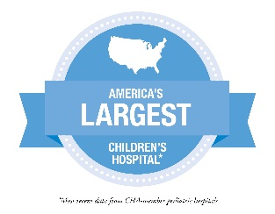


Nationwide Children’s Hospital
Accountable Care Organization (ACO) with over 300,000 covered Medicaid lives
669-bed Hospital
Top 6 Research Center
> 1.5 million patient visits annually
Referrals from all 50 states and 35 countries
Over 13,000 employees across 75 locations
Department of Pediatrics for The Ohio State University
800+ employed physicians
Notes:
*ACO care over 300,00 medicare lives
669 licensed bed
Top 5 recent news had been top 6
Over 12,000 employees
Largest freestanding peds hospital in country based # staffed beds
Beds include leased off sites as well

Slide 5

The Abigail Wexner Research Institute at NCH
6th ranked freestanding children’s research center
13 Research Centers of Emphasis with >195 scientists and physicians and >1,300 employees
  >1,500 publications annually
  >400 inventions
  >10 start-up companies
Notes:
The Research Institute at NCH has developed the entire spectrum of bench to bedside research. The 13 Centers of Emphasis align with our clinical programs and produce over 150,000 articles influencing child health worldwide.

Slide 6
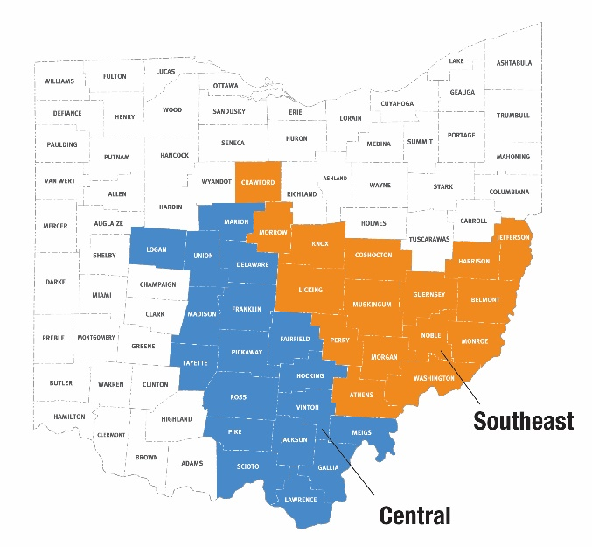
Partners For Kids (PFK)
One of the nation’s oldest and largest accountable care organizations (ACOs)
Southeast and Central Region
  Partnership between NCH and >1,800 providers caring for >325,000 children
West Central Region
  Partnership between Dayton Children’s local providers caring for ~93,000 children
Notes:
Explain capitated and implications – set amount of money per member per month, pts may come in and out of eligibility
Capitated- we receive certain amount per month for each member enrolled in medicare- regardless of what services they receive. Interesting, Medicaid population don’t always maintain eligibility they can go on/off Medicaid
Partners For Kids was established in 1994. Since its founding, PFK has proven that it can provide high-quality care at a lower cost. PFK was formed as a joint venture (PHO) between Nationwide Children’s Hospital, NCH-employed physicians and contracted community physicians. Today, PFK is recognized as both a 501(c)3 organization and an intermediary organization that accepts financial risk. Partners For Kids is one of the nation’s oldest pediatric accountable care organizations (ACO) that helps children who are most in need get the best care at the best value.
PFK is a Physician-Hospital Organization (PHO) formed in 1994.
Joint venture between Nationwide Children’s Hospital, its employed physicians & contracted community physicians
Ohio taxable, not for profit private entity
900 physicians total (275 primary, 530 specialty)
Ohio Department of Insurance considers PFK to be an “intermediary organization”
Accepts financial risk but not a health plan
Must maintain reserves and stop loss coverage
Accountable care organizations can have many underlying structures: PFK is structured as a non-profit Physician-Hospital Organization.
PHO allows us to be single source contracting agent w/ 900 physcisians in our service area. & they can receive better contracted rates than if they were to do this alone
Allows us to come together common goal of quality.
Cover couple of the bullets on the slide
PFK provides support for practices that see a significant number of children in the PFK population with the ultimate goal of providing high-quality care at a lower cost.
Current mission: Improving the health of children through high value, innovative care and community partnerships.
Current vision: A system of care that promotes best outcomes in child health.
Partners For Kids is committed to:
Creating and sustaining a dynamic partnership between Nationwide Children’s Hospital, its affiliated healthcare providers and its contracted managed care organizations.
Ensuring access to highest quality care for its members via various data measuring projects and specialized programs.
Aligning its mission, vision and goals with those of Nationwide Children’s Hospital.

Slide 7

Big Lots Behavioral Health Pavilion

Slide 8
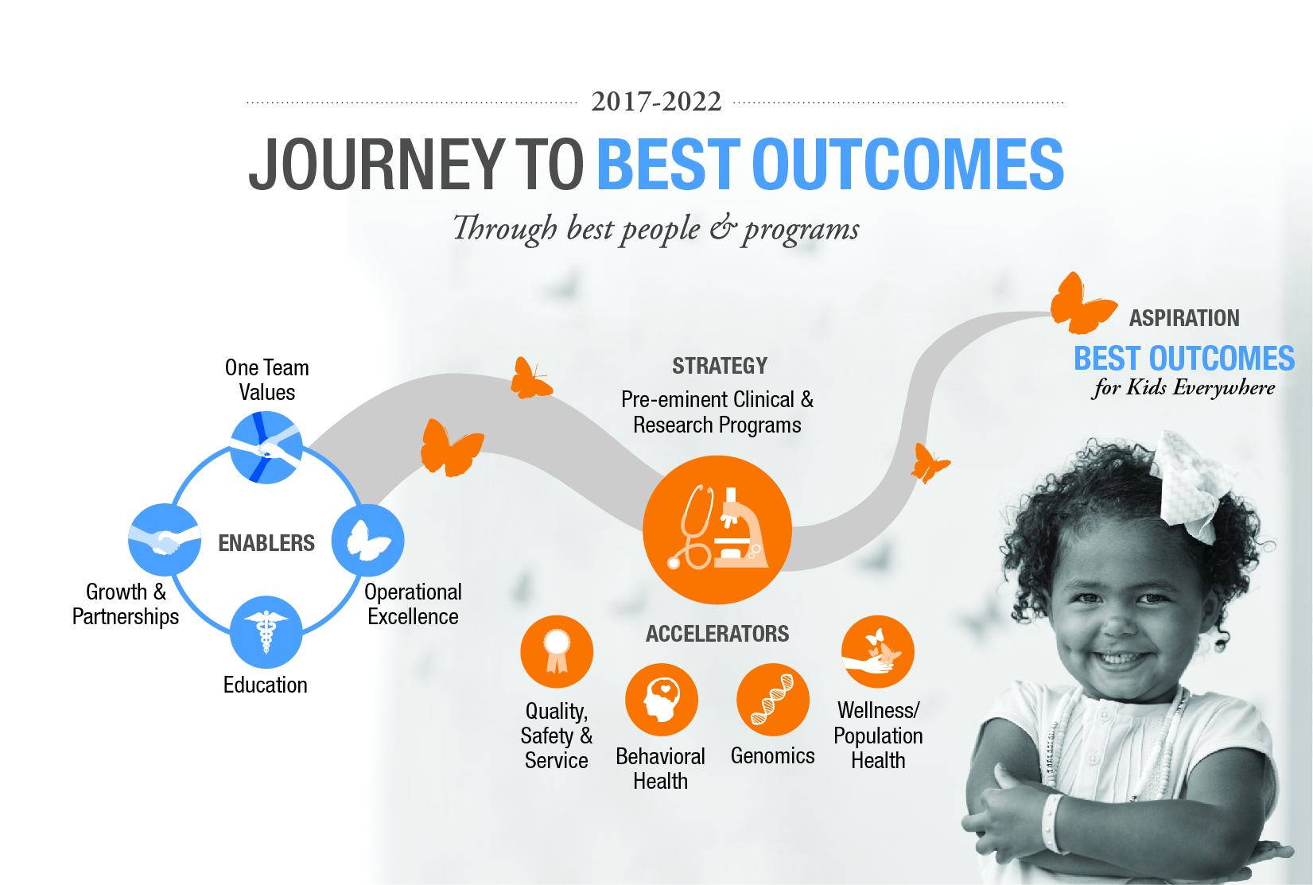
Notes:
This is our strategic plan which you are all very familiar with.
That summarizes the strategic plan but it is us - who deliver on the Promise of Best Outcomes.
Vital for each of us to see our connection into the strategic plan – our unique contribution to achieving our vision.
The future is very bright at Nationwide Children’s – most importantly the promise held for patients and families we serve.
What does the future hold for Nationwide Children’s over the next five years?
Together we will deliver best-in-class, evidence-based outcomes
Re-define quality in pediatric healthcare
Fully integrate physical and mental health services
Discover genetic causes – and cures – to disease
Deliver improved health to our entire population, regardless of their zip code or income level
...we will achieve all this by fueling a collaborative environment that is respectful, inclusive and results-oriented. Creating a culture that makes us proud to work at Nationwide Children’s.

Slide 9

Zip code should not decide the care received by children…

Slide 10
Telehealth helps address gaps in care
Medical & Behavioral Barriers
Medically fragile patients
Behavioral challenges in clinic environment (example: autism)
Access Barriers
Live in rural areas
Have transportation barriers
Have difficulty taking time off work
Struggle to find childcare for siblings
Stigma for teenage patients
Disconnect from the home environment

Slide 11


Slide 12


Overall Telehealth Encounters
March 17 to Sept 30, 2020
Telehealth Visit Volume by Service Line (YTD)
+55
Number of Clinics Live
+231,000
Telehealth Encounters Completed
Modality for week of 7/6/2020*
93% by video
6% by telephone
*1% unknown or other

Slide 13
Overview of September Tele Volume
N = 29,778

Slide 14
2020 Telehealth Visits by Month
March-September 2020
YTD = 231,842

Slide 15
BH Outpatient Volume
Year over Year by Week

Slide 16
BH Telehealth Outpatient Visit Volume by Week
Memorial Day
Not all children can be completely assessed by video visits, however the majority can be easily and well assessed by video visit. We are finding that +92% of our patients can have an effective psychological evaluation by telehealth.
Eric Butter, PhD, Chief - Pediatric Psychology & Neuropsychology
Source: EDW
Notes:
Psychiatry about 10% below expected volume
Completed, Arrived visits with a charge posted to a BH cost center with a GT, GQ or 95 modifier (excluding CPST telephone) regardless of visit type (excludes BH DOC ONLY (BILLABLE), BH PHONE CALL (BILLABLE) )
OR
Completed, Arrived visits with a visit type of MYCHART VIDEO VISIT, MYCHART VIDEO VISIT F/U, MYCHART VIDEO VISIT NP, TELEHEALTH PHONE CALL, TELEHEALTH PHONE CALL F/U, TELEHEALTH PHONE CALL NP regardless of whether charges have been placed.

Slide 17

Telehealth Lessons Learned:
Transformation
Better insight
More ecologically valid
Efficient
Perceived/real comfort
May be benefit to alternating in-person and virtual care, especially for families who travel long distances

Slide 18


Telehealth Lessons Learned:
Infrastructure & Innovation
preparation (technical, expertise, education)
organized effort with support of leadership allowed us to accelerate
Infrastructure
Inventing tele adaptation of usual assessments
Leveraging technology to perform groups when in person poses challenges
access to rural areas
earlier diagnosis
outcomes
↓ cost reduction
Innovation

Slide 19


Telehealth Lessons Learned:
Challenges & Limitations
Network Difficulties
Richness of interaction
Digital Chasm
Disparities
Privacy
May exacerbate health disparities, we need to consider these factors when rolling out
Notes:
Complexity of using EPIC MyChart
Quality of connection varied, complexity to determine if the patient end vs. NCH network limitations
Richness of interaction is reduced
Gaps at the outset, will need solutions for how to overcome in the long-term
Metric screening questionnaires are not integrated, yet
Psychological testing not designed for remote implementation
Limited ability for physical exam (vitals, muscle tone, gait)
Challenges to effectively manage crises (acute suicidality)

Slide 20
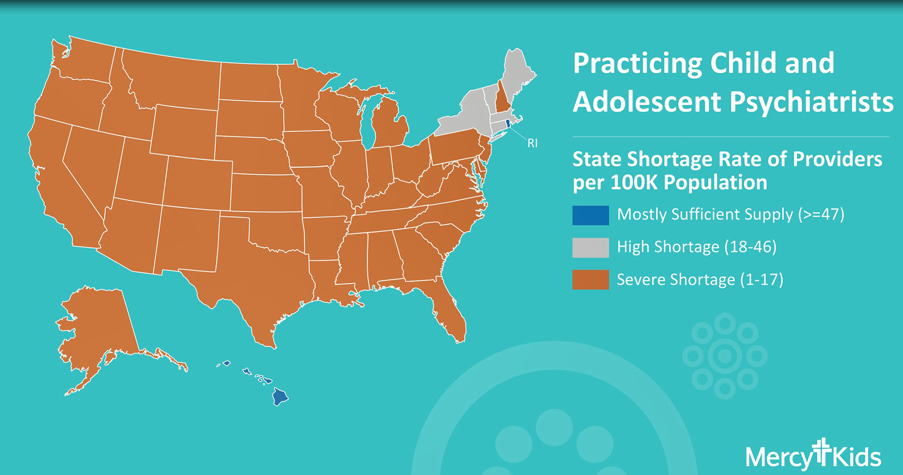
1. We need alternative models of care
Source: AACAP.org

Slide 21
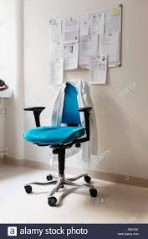
Zero sum game?

Slide 22


2. We need to leverage technology to build capacity
Child Behavioral Health

Slide 23
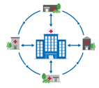
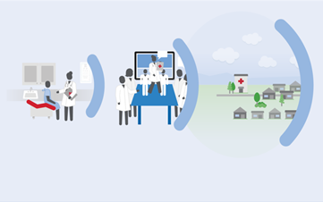
Project ECHO
(Extension of Community Health Outcomes)
Hub and Spoke
System of care for communities
23

Slide 24
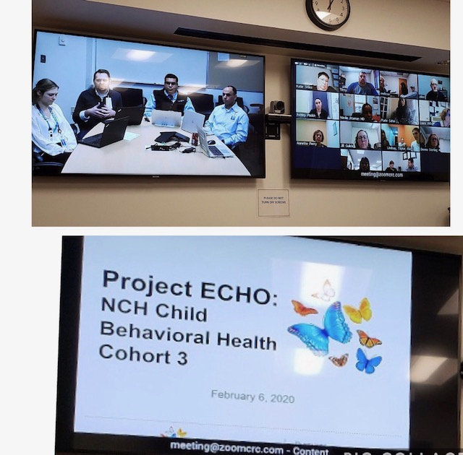

Slide 25
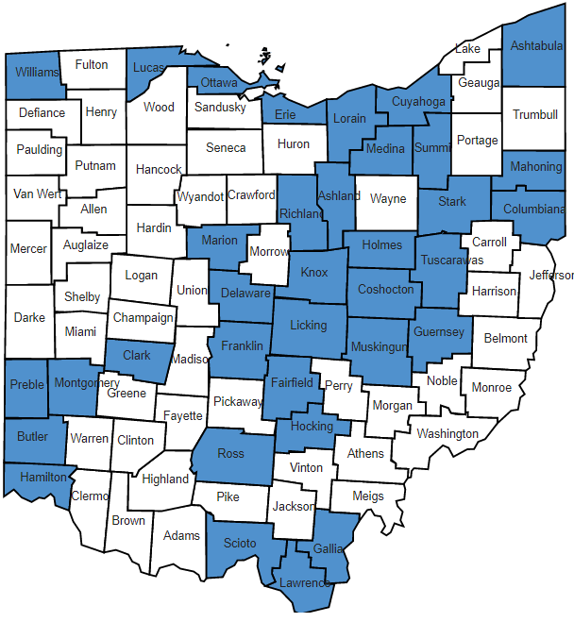
2020 BH ECHO County Reach
To date, NCH BH ECHO has reached 38 counties
Updated 10/08/2020
Notes:
https://www.createaclickablemap.com/counties-ohio.php?maplocation=oh
Red 80, Green 145, Blue 205
Hex 5091cd

Slide 26
BH Knowledge and Competence before and after ECHO

Slide 27
3. We need to look at alternative places
School
Primary Care
Remote Hospital
Home

Slide 28
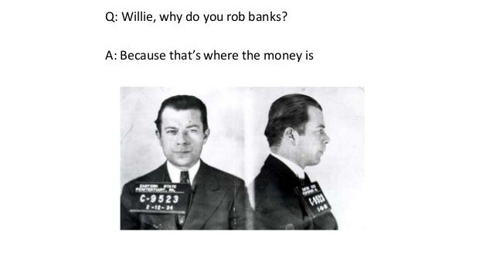

Slide 29
Scope of telehealth based BH models
School
Integrate BH to school
Primary Care
Integrated Primary Care
Remote Hospital
Triage Assessments
Home
Parent Education Programs
Suicide Prevention
PAX good behaviors
Psychology consultation
Direct: Case Consultation
Indirect: Collaborative care
CME/Education
Psychology Testing Feedback
Autism Parent Education
Consultation for boarders
Crisis/Treatment Plan

Slide 30
Scope of telehealth based BH models
School
Integrate BH to school
Primary Care
Integrated Primary Care
Remote Hospital
Triage Assessments
Home
Parent Education Programs
Suicide Prevention
PAX good behaviors
Psychology consultation
Direct: Case Consultation
Indirect: Collaborative care
CME/Education
Psychology Testing Feedback
Autism Parent Education
Consultation for boarders
Crisis/Treatment Plan

Slide 31
Scope of telehealth based BH models
School
Integrate BH to school
Primary Care
Integrated Primary Care
Remote Hospital
Triage Assessments
Home
Parent Education Programs
Suicide Prevention
PAX good behaviors
Psychology consultation
Direct: Case Consultation
Indirect: Case Reviews
CME/Education
Psychology Testing Feedback
Autism Parent Education
Consultation for boarders
Crisis/Treatment Plan

Slide 32
Scope of telehealth based BH models
School
Integrate BH to school
Primary Care
Integrated Primary Care
Remote Hospital
Triage Assessments
Home
Parent Education Programs
Suicide Prevention
PAX good behaviors
Psychology consultation
Direct: Case Consultation
Indirect: Collaborative care
CME/Education
Psychology Testing Feedback
Autism Parent Education
Consultation for boarders
Crisis/Treatment Plan

Slide 33
Scope of telehealth based BH models
School
Integrate BH to school
Primary Care
Integrated Primary Care
Remote Hospital
Triage Assessments
Home
Parent Education Programs
Suicide Prevention
PAX good behaviors
Psychology consultation
Direct: Case Consultation
Indirect: Collaborative care
CME/Education
Psychology Testing Feedback
Autism Parent Education
Consultation for boarders
Crisis/Treatment Plan

Slide 34

4. We need to think beyond ‘video’ visits

Slide 35












Telehealth → Virtual care
Modalities
Patient-to-provider
Provider-to-provider
Real-time virtual visits
Virtual visits
E-consults
Remote patient monitoring
Wearables
Implantables
Asynchronous store-and-forward
Secure messaging
Second opinion consults

Slide 36
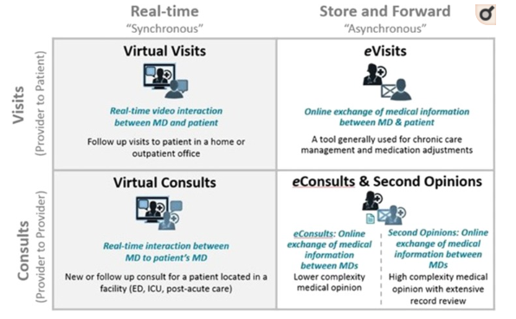
5. We need to evolve to improve access
Schwamm, et al, 2020

Slide 37
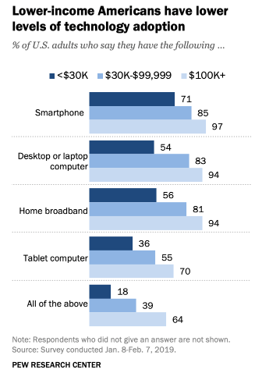
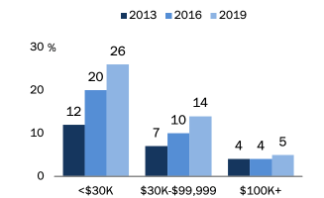
Technology Adoption & Income
6. We need to be equitable in our offerings.

Slide 38

7. We need to be outcome focused
“Quality problems occur typically not because of failure of goodwill, knowledge, effort or resources devoted to health care, but because of fundamental shortcomings in the way care is organized…..”
Key quality metrics (ongoing)
  Patient & provider satisfaction
  Reliability of the diagnosis
  Implementation outcomes
  Cost effectiveness and cost savings
  Treatment outcomes
  Health disparities in telehealth

Slide 39
8. We need to organize and support academic
‘Centers of Excellence’
Clinical service
Research
Education
Trainees
Community providers
Project ECHO
Research Institute
Quality improvement
Grants
Direct Service
E-Consult
Provider to provider

Slide 40
“We are here to make another world.” W. Edwards Deming
P
D
P
D
A
S
Equity
Digital literacy
P
D
A
S
Quality
Sustainability
P
D
A
S
A
S
Healthcare systems
Technology and connectivity
Notes:
Compare against SAMSHA levels
Nomenclature: Telehealth -- Telemedicine --- Distance Medicine --- Teleconference (Which evokes the correct mental image)

Slide 41
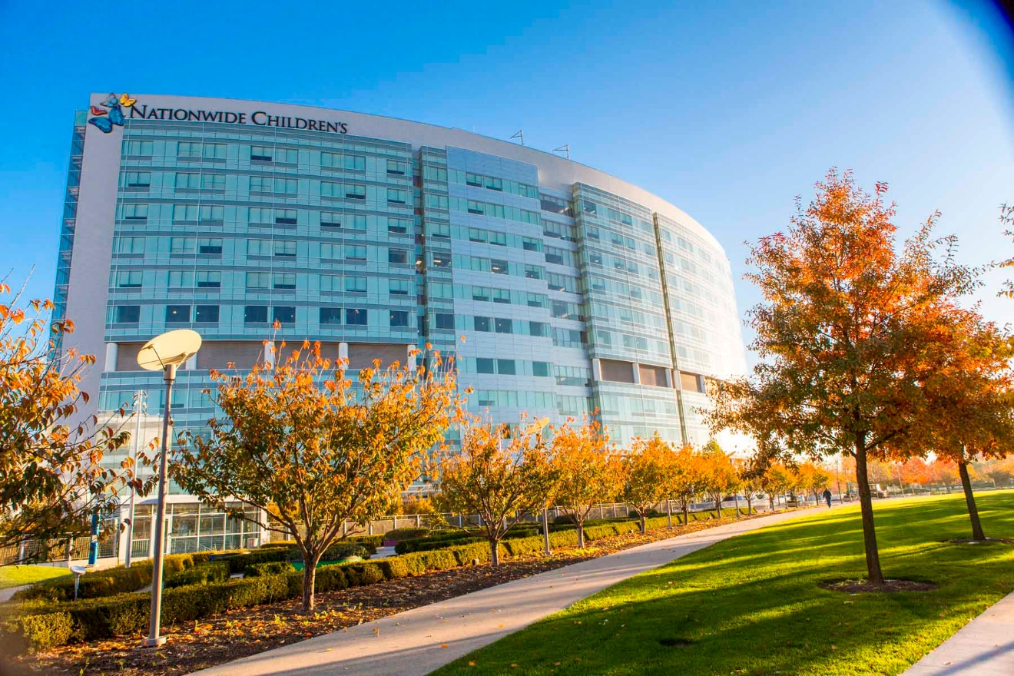
Thank You

