Slide 1
Healthcare Executives Guide to Ransomware Threats
Troy Ament
Field CISO – Healthcare Fortinet

Slide 2
Troy Ament
Field CISO – Healthcare Fortinet
Fortinet Field CISO for Healthcare brings more than 20 years of experience to Fortinet transforming information technology and security programs, with 14 years in the healthcare sector as an executive overseeing clinical technology implementations and serving as the Chief Information Security Officer at two of the largest integrated health delivery systems in the United States.

Slide 3
What is Ransomware?
a type of malicious software designed to block access to a computer system until a sum of money is paid.

Slide 4
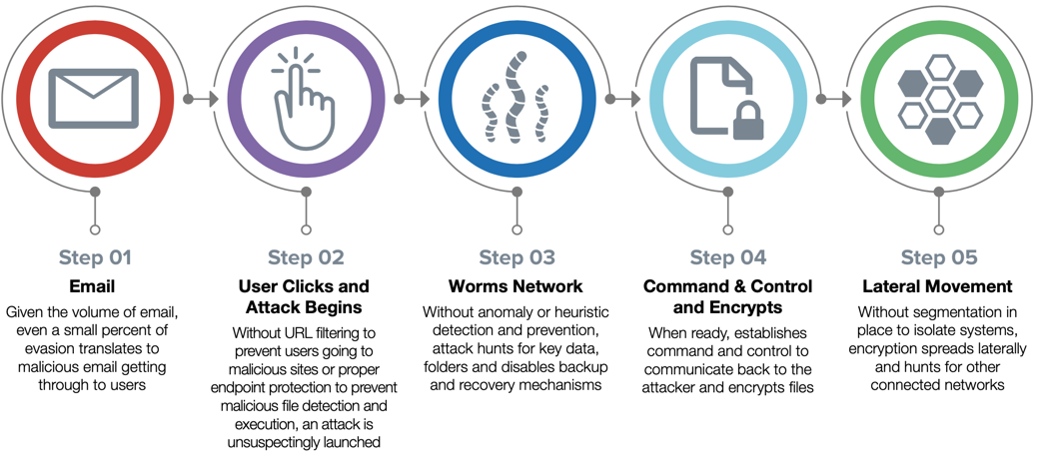
How Does Ransomware Typically Work?

Slide 5
How does ransomware get into health systems and what are some key statistics from 2019 and 2020?

Slide 6
Email Threats & Phishing
90%
of attacks that leverage email
Preys on social engineering
Presume security installed and safe
Not looking for minor irregularities in communications
Attachments
Pop-ups that ask for action
“Invoice attached”
Embedded Links
Lead to malicious websites and downloads
Often in the attachment
Verizon 2019 DBIR

Slide 7
Network Threats
30%
of Ransomware attacks started with malicious content from a website
Malicious Websites & Advertising
Careless browsing
Drive-by downloads
Spoofed – think we’re safely downloading
Malicious Downloads
“Download additional” things
Scareware – You’re Infected!
Open Door
“Free-WiFi” and no VPN
Open ports like RDP
2017 Ponemon institute

Slide 8
Endpoint Threats
Minor entry point but possible
External Devices
USB drives
External hard drives
Other peripherals

Slide 9
Business Impact of Breaches for Healthcare
41% of healthcare organizations suffered an operational outage that affected productivity
39% had an operational outage that put clinical safety at risk
32% experienced a breach that damaged brand awareness
31% suffered impacted revenue
25% lost business-critical data¹
Repercussions Are Dramatic:
72% of healthcare data breaches leak medical data²
$6.45 million is the average cost of a healthcare data breach³
¹ Slide findings based on a series of survey studies with different retail/hospitality/travel personas conducted by Fortinet. Research report forthcoming.
² “2019 Data Breach Investigation Report,” Verizon, May 8, 2019.
³ “2019 Cost of a Data Breach Report,” IBM Security and Ponemon, July 23, 2019.

Slide 10
Healthcare Providers Must Protect a Growing Attack Surface
Attacks are Ongoing
An estimated 87% of healthcare providers use Internet of Things (IoT) devices¹
79% of healthcare providers are making cloud adoption a strategic priority²
59% of healthcare data breaches are carried out by internal threats³
Attacks against healthcare increased by over 60% year over year⁴
41% of healthcare data breaches are caused by email⁵
18.7% of ransomware attacks target healthcare, making it the second most targeted industry⁶
Adam Oldenburg, “Why IoT Devices Are a Worthy Investment for Hospitals,” HealthTech Magize, August 22, 2019.
“HIMSS Technology Outlook Survey:The Outlook for Cloud,” HIMSS Media and Perficient, June 2019.
“2019 Data Breach Investigation Report,” Verizon, May 8, 2019.
Robert Lemos, “Attacks on Healthcare Jump 60% in 2019 - So Far”, November 14, 2019.
“2020 Horizon Report, The State of Cybersecurity in Healthcare,” Fortified Health Security, December 2019.
"Ransomware Costs Double in Q4 as Ryuk, Sodinokibi Proliferate,” Coveware, January 22, 2020.

Slide 11
Healthcare Compliance Requirements
Struggling with Compliance:
51% of healthcare providers fail to comply with Health Insurance Portability and Accountability (HIPAA) Right to Access¹
83% of physicians recognize that HIPAA compliance is not enough to address cyber threats²
Healthcare organizations average 72% compliance with the HIPAA Security Rule³
…Achieving security compliance requires understanding healthcare cybersecurity challenges.
Jessica Davis, “Majority of Providers Fail to Fully Comply with HIPAA Right of Access,” Health IT Security, August 16, 2019.
“Patient Safety: The Importance of Cybersecurity in Healthcare,” American Medical Association, October 2018.
Mike Miliard, “Healthcare organizations lagging behind NIST Cybersecurity Framework, HIPAA guidance,” Healthcare IT News, April 11, 2019.

Slide 12
2020 Ransomware during Global COVID-19 Pandemic
75% Increase in Reports of Ransomware Attacks on Healthcare.¹
Large Midwest Academic Health System suffers 1 week of EMR downtime in September.
Large National/Global Health System suffers 2 weeks of EMR and system downtime in October.
“75% Increase in Reports of Ransomware Attacks on Healthcare Entities,” Security Magazine, June, 2020.

Slide 13
What are key strategies to protect from Ransomware?
Academic
Medical Centers
Home Health
Long Term
Care
Pharma
HIE
Hospitals
ACOs
Government
Telehealth
Diagnostic
Imaging Centers
Secure
Patient Data
Industry
Payers
EHR
Lab Facilities
Physician
Offices
Medical
Suppliers
Ambulatory
Pharmacies
Private
Insurance
Registries

Slide 14
Healthcare Cyber Security Strategies
Information Technology Governance
Enterprise Risk Management (Security Charter)
Information Security Policy, Compliance, Internal Audit Oversight
Executive Leadership and Board Support
Information Security Framework (NIST, SANS, HiTrust)
Information Security Plan/Roadmap

Slide 15
CIS Top 20 Critical Security Controls (Ransomware)
Inventory and Control of Hardware Assets
Inventory and Control of Software Assets
Continuous Vulnerability Management
Controlled Use of Administrator Privileges
Secure Configurations Devices, Servers
Maintenance, Monitoring, and Analysis of Audit Logs
Email and Web Browser Protections
Malware Defenses
Limitation and Control of Network Ports, Protocols, and Services
Data Recovery Capabilities
Security Configuration of Network Devices
Boundary Defense
Data Protection
Controlled Access based on Need to Know
Wireless Access Control
Account Monitoring and Control
Implement a Security Awareness and Training Program
Application Software Security
Incident Response and Management
Penetration Tests and Red Team Exercises

Slide 16
Security Technology/Partner Strategy
Enterprise Security Fabric/Platform
Utilize high 90% of technology products and features
Partners
Understand complex Healthcare Cyber Threat Landscape
Comprehensive Portfolio Security Products
Incident Response and Ransom Negotiation
Invest in Security Staff Training and Development
Threat Intelligence Partnerships
National and Regional Information Security Collaborations

Slide 17
THANK YOU!
Troy Ament
Field CISO – Healthcare
tament@fortinet.com
healthcare@fortinet.com

