Slide 1




Memoirs from 2020:
Central & Southern Ohio HIMSS Chapter
Justin Gernot: Justin@healthbox.com
Healthbox: info@healthbox.com
Justin Gernot: linkedin.com/in/justingernot/
Healthbox: linkedin.com/company/healthbox/
@jgernot
@healthbox
www.healthbox.com
For live polling:
  Join now at slido.com
  Enter: #22346
  Or, scan this code:
Justin Gernot
November 6, 2020
Notes:
Slido: info@healthbox.com
PW: Password1

Slide 2



What do you remember about your grandparents’ stories from the 1940s?
Notes:
My grandparents and great grandparents were from the east side of Cleveland. After moving from Italy to mine coal in West Virginia and Pennsylvania, they quickly made their way to Ohio for factory jobs and a better life during the depression. Things took a turn for the worse when WWII began, and my 17 year old grandfather forged his father’s signature to join the Navy in the South Pacific. My great grandmother was a single mother of two at a time when that socially and financially infeasible. She worked her way up from doing laundry for physicians and professors in Cleveland’s Murray Hill neighborhood where both University Hospitals and Cleveland Clinic are located to a job in Roosevelt’s WPA, then her final job as a drill press operator for Tapco before the war started. When my grandfather and his four other brothers returned from the war, they all took jobs in the factories that were expanding or starting to support the rebuilding of the entire world.

Slide 3
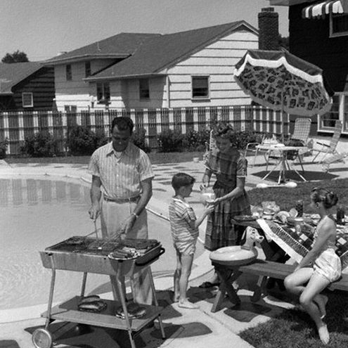


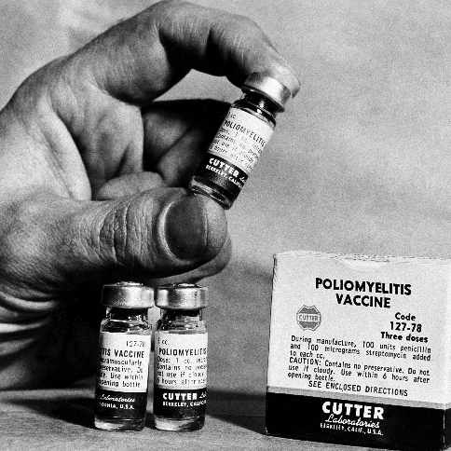


What came from those times?
Notes:
And the rebuild went exceedingly well. By the 60s, my grandfather had moved to the suburbs and bought one of the first Mustangs and color TVs. America was also leading with technological and societal change, making good on the promise of a free society and leading the world in so many ways.

Slide 4
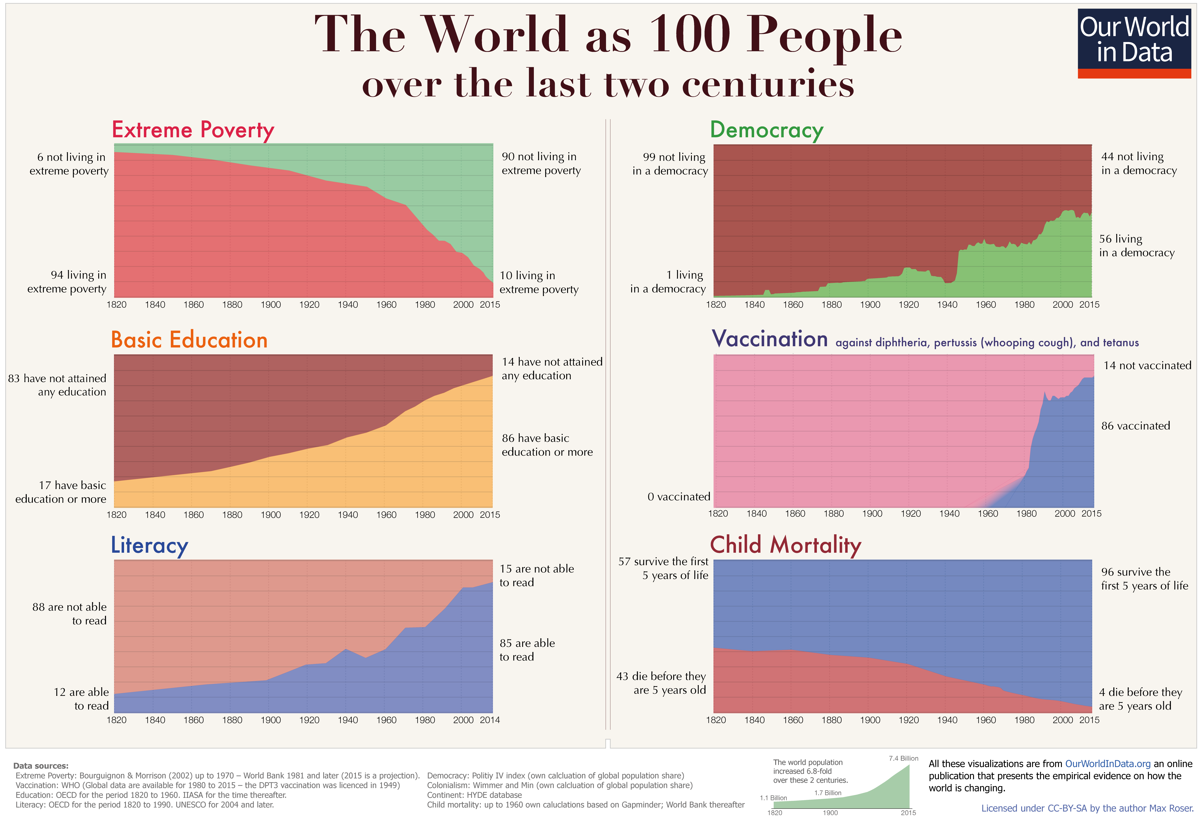
Notes:
We’ve seen significant improvement since 1940 in global poverty, education, literacy, democracy, vaccinations, and child mortality rates. Even with this success, however, there is still large room for improvement. 1 out of 10 people still live in extreme poverty today.
More than 9 out of 10 people do not think that the world is getting better, even though empirical evidence points otherwise. An understanding that knowing we have come a long way in improving living conditions and the notion that our work is worthwhile to us is a necessary condition for self-improvement, and we can continue to get better as a human race.
https://ourworldindata.org/a-history-of-global-living-conditions-in-5-charts

Slide 5

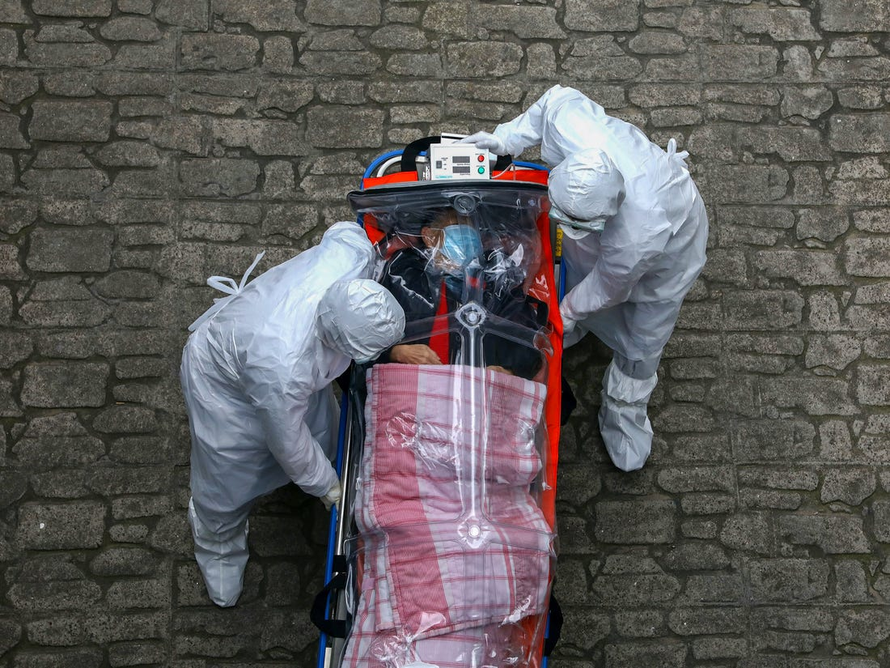
Worldwide War to Worldwide Pandemic
Notes:
World was unprepared
Exposed the flaws of a decentralized, private health system in the US
Globalization mostly helps, but sometimes hurt – lack of trust and transparency

Slide 6

Where do we go from here?
Notes:
Feel free to delete out the text here

Slide 7
HIMSS BY THE NUMBERS

Slide 8







HIMSS brings together thousands of members to serve the greater good
80,000
75,000
100,000
HIMSS provides value through
Individual Members
Annual Event Attendees
Virtual Learning Subscribers
Thought-leadership
HIMSS offers a unique depth and breath of expertise in health innovation, public policy, workforce development, research and analytics
20,000
20,000
650
Health 2.0 Individual Members
Annual Volunteers
Corporate Members
Social networking
HIMSS operates globally, linking thousands of global leaders, stakeholders and influences
600,000
729,400
480
Annual Hours of Online Learning
Social Media Followers
Organizational Affiliates
Personal development
HIMSS empowers its members to continuously learn and advance their careers through online course offerings and certifications
830,000,000
470
Patients in health systems
that use HIMSS Analytics
Non-Profit Partners
Notes:
Background on figures:
600K annual hours: no. of hours members and others participating in CE spend viewing educational content, e.g., in HIMSS Learning Center (live, on-demand, archived conference content), community-based live/on-demand content (e.g., Emerging Healthcare Leaders Community), content offered through prof. dev. partners (e.g., Bellevue College, Carnegie Mellon, National Ming Yang University); TIGER Virtual Learning Platform, HIMSS TV, etc.
830M patients: calculated by taking the population in the market surrounding the hospitals that take part in HIMSS Analytics Maturity Models programs. This is not to say that this is the actual number of patients treated, it's the potential to treat and the assumption that one hospital's performance impacts its nearby hospital's performance. [Taken from HIMSS Analytics marketing slide]
HIMSS is a leading convener in digital health, bringing together tens of thousands of members, affiliates, and followers around the world
This scale allows HIMSS to connect members and partners within the digital health ecosystem in a way no other organization can
While the considerable scale of the HIMSS network is a strong advantage, HIMSS key focus has always been on delivering value to the single member.
This value proposition to members is driven by 3 core elements: thought-leadership, social networking, personal development

Slide 9
ABOUT HEALTHBOX

Slide 10
About Healthbox
Healthbox, a HIMSS Solution, is a healthcare advisory firm that leading organizations trust with innovation and digital strategy development and execution.
Innovation Programs
Commercialization
Strategy
Solution Sourcing
Strategic
Investing
INNOVATION PRODUCTION
INNOVATION CONSUMPTION
Develop programs and workshops that engage employees
Assess the potential
of employee-led
projects and support commercialization efforts
Build innovation and digital strategies that align with enterprise strategy
Source innovative solutions from the market
Invest in solutions that align with strategic goals

Slide 11
HEALTHBOX PANDEMIC PREDICTIONS

Slide 12
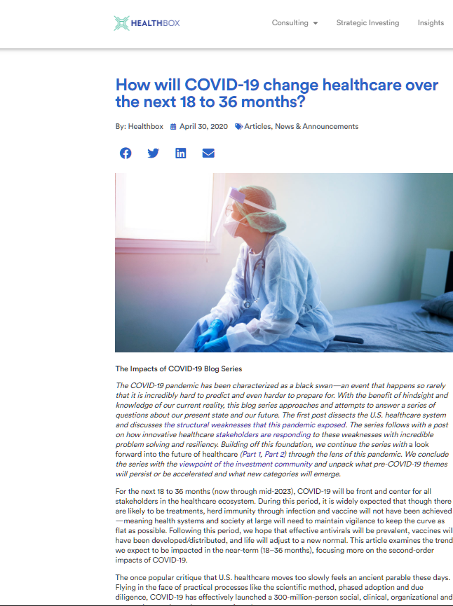
Healthbox predictions during the pandemic
Consolidation will be accelerated
Agility will no longer be a “nice to have”
Telemedicine super usage will tip a long line of dominos
Shift to value-based payments will hit a speed bump
Emerging care/coverage models will see significant growth
Notes:
http://www.healthbox.com/blog/how-will-covid-19-change-healthcare-over-the-next-18-to-36-months/
Consolidation – Intermountain and Sanford
Agility – who hasn’t noticed the parts of their orgs that aren’t agile? Notice the war rooms and daily huddles – AGILE!
Telemed risen, then fallen a bit, but here to stay
VBC is challenged but will be back, likely in new care models
Too early to tell on emerging care and coverage models

Slide 13
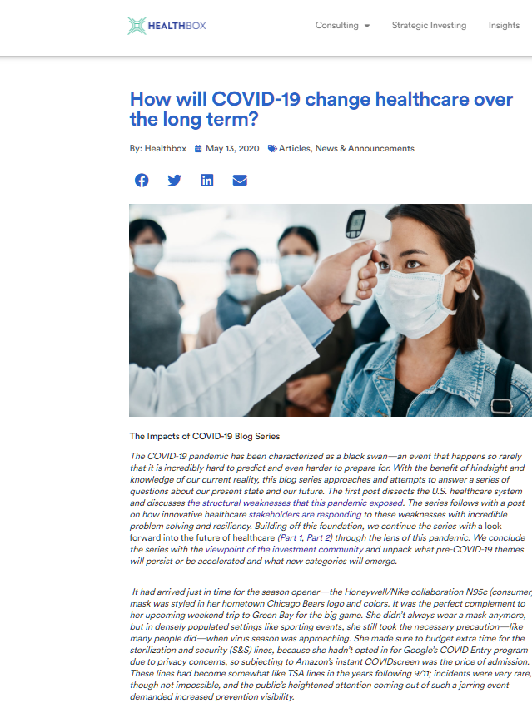
Healthbox predictions after the pandemic
Consumer expectations of hospitals will shift for the worse
New entrants will be emboldened
Cash on hand will widen the wealth variance across hospitals
Pandemic preparedness and innovation in supply chain
Social determinants of health commercial viability will accelerate
Universal coverage debate will persist
Notes:
http://www.healthbox.com/blog/how-will-covid-19-change-healthcare-over-the-long-term/
Consumer expectations – consumers continue to avoid hospitals
New entrants – Amazon, Walmart, CVS, Walgreens, and others have all doubled down on delivering care. Expect them to be provider of choice in rural and other underserved areas.
Cash is king, as always. If you can secure a loan, you can do almost anything.
Pandemic preparedness – more PPE available than in spring, but unsure we can deploy it smartly. That will change.
Social Determinants – partnership w/PCCI, every large system says now is the time
It may not be universal coverage, but there’s an opportunity to strike a bipartisan deal that citizens will support.

Slide 14
LET’S DISCUSS

Slide 15

Where did healthcare fail during the pandemic?
Live Poll:
Slido.com
#22346 or scan:
15
Notes:
What are the choices? Fill in the blank instead?

Slide 16



Where did we fail?
Personal
Political
Societal
Notes:
Personal – We failed to understand the science and take appropriate, consistent action. We often made decisions on headlines, not deep understanding --- think sound bite versus reading for 2-3 minutes. Nixon/JFK debates w/15 minute answers vs. maybe 2 minutes now.
Political – We were uncoordinated, inefficient and ineffective, regardless of which party was in power in a particular state.
Too often, federal, state and local leaders were not aligned
Societal – Politics dominated the conversation and hardened already deep divisions
We cannot predict the economic fallout of massive stimulus and a murky plan to end the pandemic
Will of large companies, particularly pharma, is impressive

Slide 17
Where did healthcare succeed during the pandemic?
Live Poll:
Slido.com
#22346 or scan:
17
Notes:
What are the choices? Fill in the blank instead?

Slide 18
Where did we succeed?
Personal
Political
Societal
Notes:
Personal – sacrifices by caregivers and those who support them
Decisions emboldened.
Political – some states got it right by following the science (Ohio and Illinois did well)
Societal – we found a bit of compassion, slowed down, and focused on family and friends. Jim Tressel’s Attitude of Gratitude.

Slide 19

What did we learn?
Notes:
Workforce safety and burnout
Supply chain inefficiencies
Need for proactive instead of reactive care (predictive analytics)
Growth of telehealth and desire for at-home personalized care
Need for digital transformation – and the advantage of those already transforming (Amazon vs. Mom and Pop)

Slide 20
COVID-19 Has Accelerated Increases in Drug Abuse and Mental Health Disorders
Anxiety
Depression
Substance Abuse
Suicide Consideration
2020
25.5%
24.3%
13.3%
10.7%
2019
8.1%
6.5%
11.2%
4.3%
Sources: CDC, EHSToday
Notes:
Every year the CDC releases an annual surveillance report of drug related risks and outcomes. This year’s report was released in late June and revealed significant increases in mental health disorders and both illicit and opioid related drug abuses.
The survey shows that reports of anxiety disorder symptoms were about three times those reported in the second quarter of 2019 (25.5% versus 8.1%), and depressive disorder was about four times that reported in Q2 2019 (24.3% versus 6.5%). CDC also said 13.3% (versus 11.2%) of respondents reported starting or increasing substance abuse (including drugs and alcohol).
In addition, more than twice as many respondents reported serious consideration of suicide in the previous 30 days than did adults in the U.S. in 2018, referring to the previous 12 months (10.7% versus 4.3%).
Atop of these statistics, there was an increase of 32% for nonprescribed fentanyl, 20% for methamphetamine, 12.5% for heroin and 10% for cocaine, accompanied by an 18% increase in suspected drug overdoses.
https://www.ehstoday.com/covid19/article/21139889/drug-abuse-on-the-rise-because-of-the-coronavirus

Slide 21
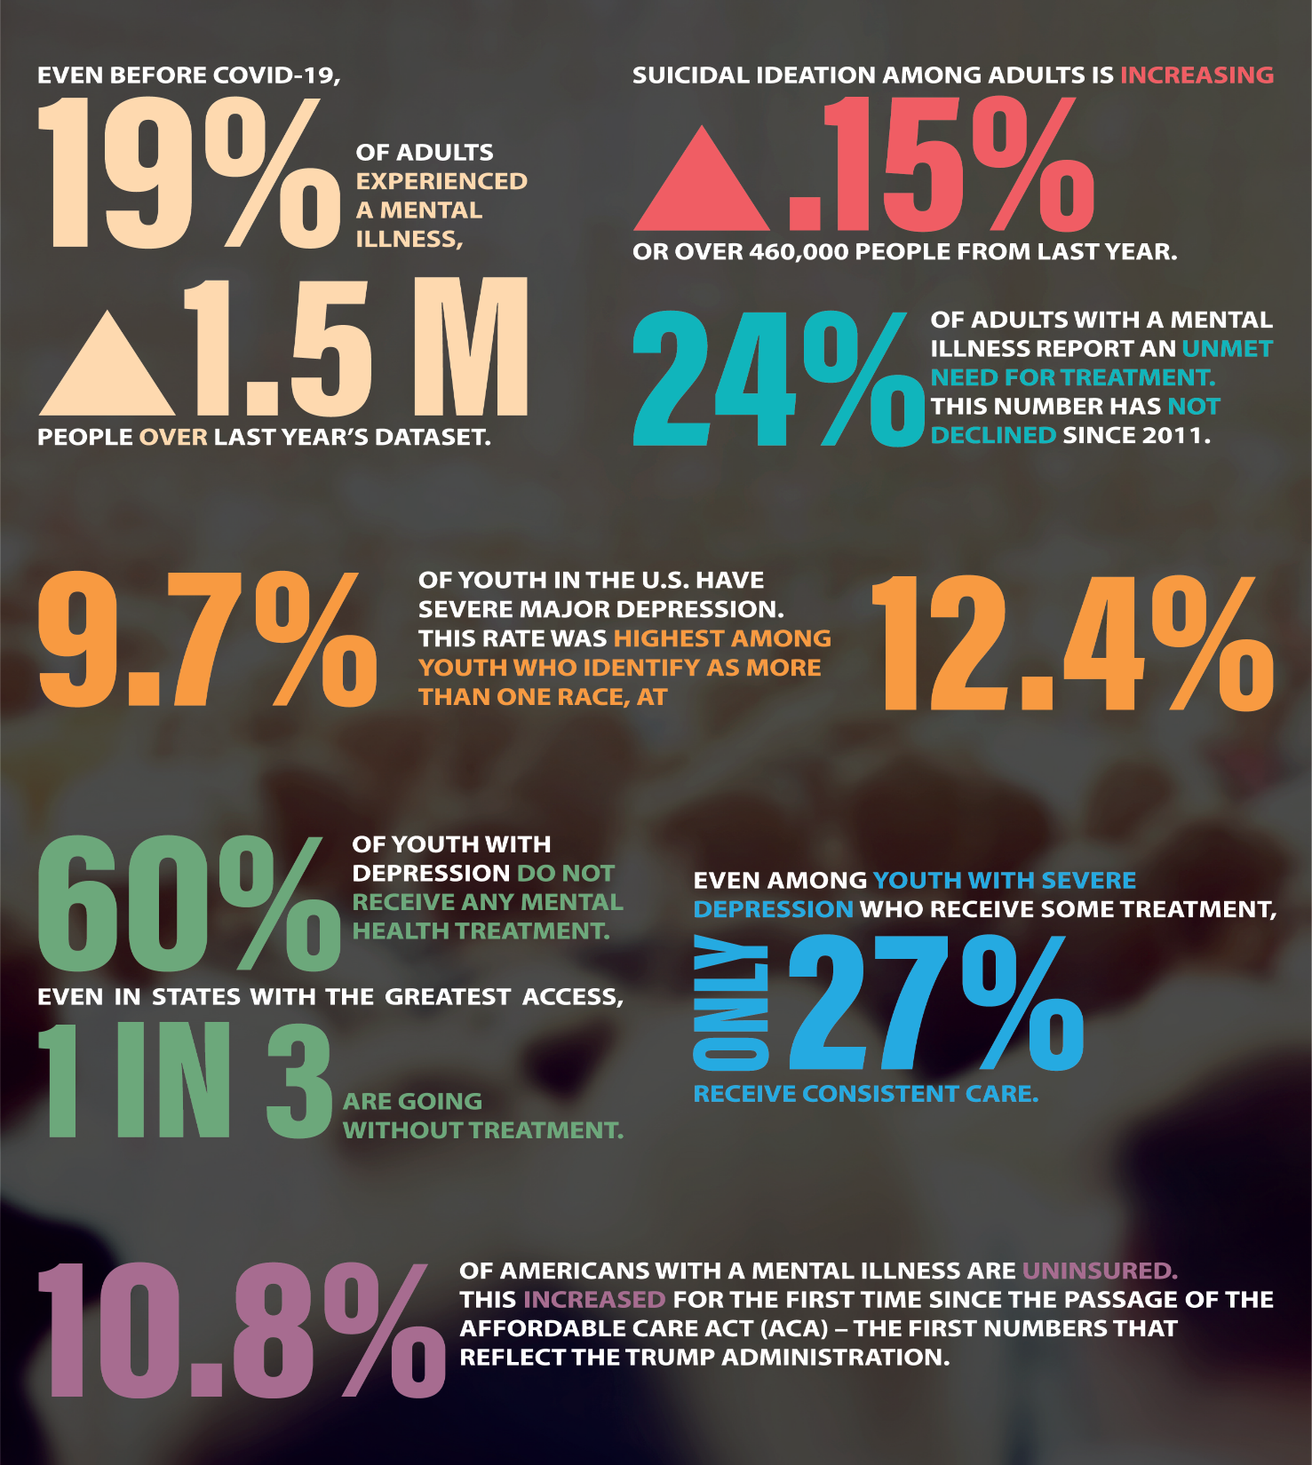
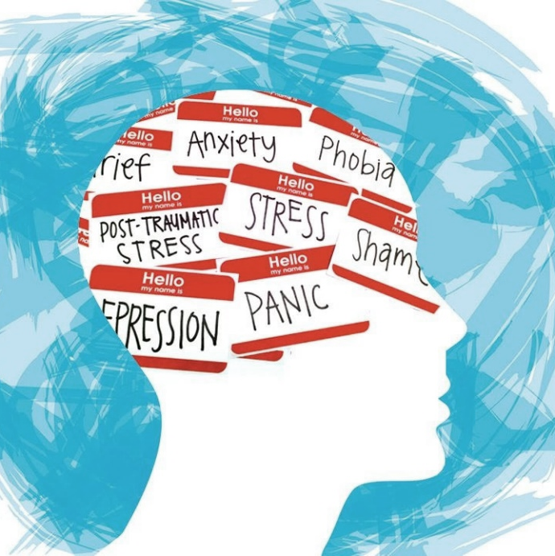
Behavioral Health in America
Source: MHA National
Notes:
We don’t have treatment of behavioral health correct; those that are treated should be treated differently, others that aren’t treated for behavioral health issues should be treated for it.
Quick stats:
1. Youth mental health is worsening – 9.7% have severe major depression
2. Even before COVID, the prevalence of mental illness among adults was increasing – 19% experienced a mental illness
3. Suicidal ideation among adults is increasing – increasing .15% YoY
4. There is unmet need for mental health treatment among youth and adults – 60% do not receive treatment
5. The percentage of people with mental illness who are uninsured increased for the first time since the ACA – 10.8% are uninsured
50 years from now we want our kids to look back and know we worked to advance behavioral health
https://www.mhanational.org/issues/state-mental-health-america

Slide 22
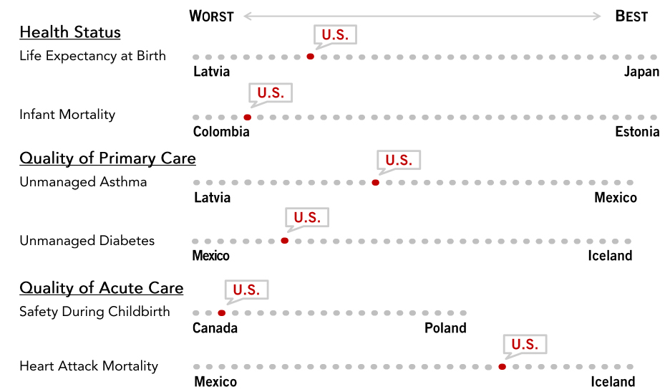

How Does US Health Stack up Globally?
Source: PGPF 2020
Notes:
So, how does the US stack up against the world in healthcare?
The US spends more on healthcare per person than any other wealthy country.
Although the united states spends more on healthcare than other developed countries, its health outcomes are generally not any better. In fact, the US actually performs worse in some common health metrics like life expectancy, infant mortality, and unmanaged diabetes.
Healthcare spending is typically driven by utilization; however, the US defies this by using price as the primary driver of healthcare cost differences amongst other wealthy nations. Additionally, the US spends up to $937/person, or four times more than the global average on administrative costs. Meanwhile, the US only spends $516/person on long term healthcare.
Even worse, our younger generations are getting sicker much sooner. A 2019 BCBS study showed that millennials have a significantly higher incidence of 8 out of the top 10 health conditions, with depression, hypertension, hyperactivity, type II diabetes, and tobacco use showing the largest increases.
These findings can reduce the quality of life and life expentancy of our younger generations, something we need to focus on and fix immediately for following generations of kids.
https://www.pgpf.org/blog/2020/07/how-does-the-us-healthcare-system-compare-to-other-countries
https://www.advisory.com/daily-briefing/2019/04/26/millennial-health

Slide 23
HOW WILL WE RESPOND?

Slide 24
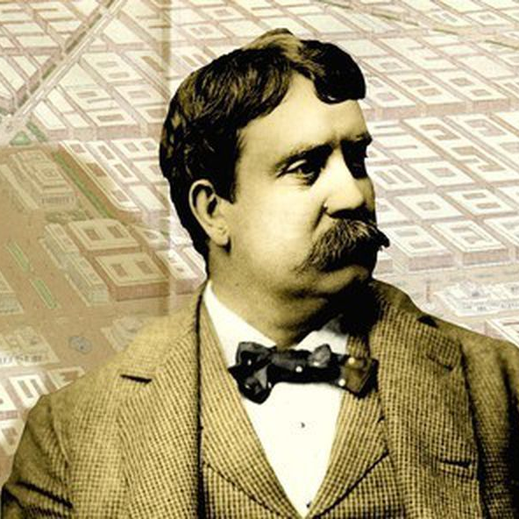
“Make no little plans; they have no magic to stir one's blood and probably themselves will not be realized. Make big plans; aim high in hope and work, remembering that a noble, logical diagram once recorded will never die, but long after we are gone be a living thing, asserting itself with ever-growing insistency. Remember that our children and our grandchildren are going to do things that would stagger us. Let your watchword be order and your beacon beauty.” – Daniel Burnham

Slide 25



Improving the Three E’s
Equity
+
Efficiency
+
Effectiveness
Notes:
Equity – no matter who pays for it, we know we can and should do better. No reason for poor outcomes in the US.
Combine to reduce the trillion in healthcare waste
Existing and emerging technologies - think bots and robots, and also genomics and therapeutics, will radically increase the effectiveness of our healthcare

Slide 26
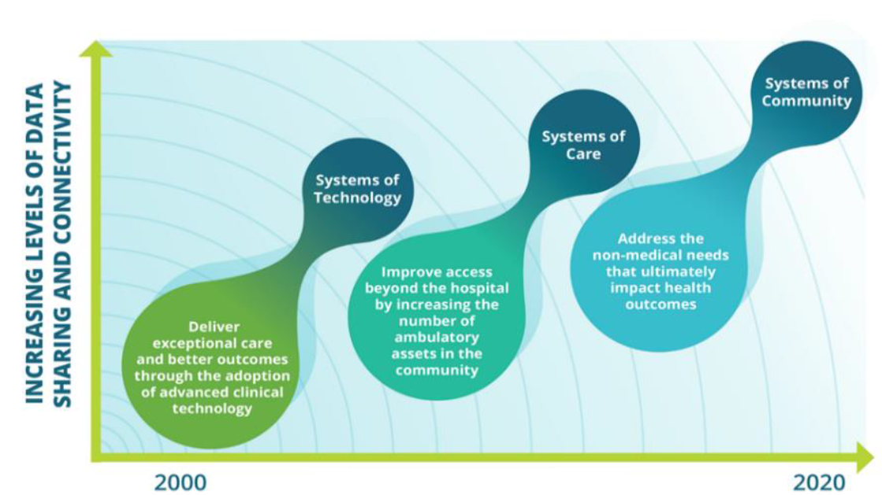

In partnership with
Social Determinants of Health (SDOH)
to create connected communities of care
Notes:
Early in my career, it was an arms race – devices (stents and CT scanners), pharma, and more
Then it shifted to systems, moving care from the higher cost inpatient areas
Now was know and can act on the root causes of health, address the non-medical needs that determine our health future. Zip code matters more than genetic code.

Slide 27


We’re not far off from expectations
Notes:
We have the robots – we very nearly have the flying cars.

Slide 28
What healthcare technology would you most like to see in the future?
Live Poll:
Slido.com
#22346 or scan:
28

Slide 29

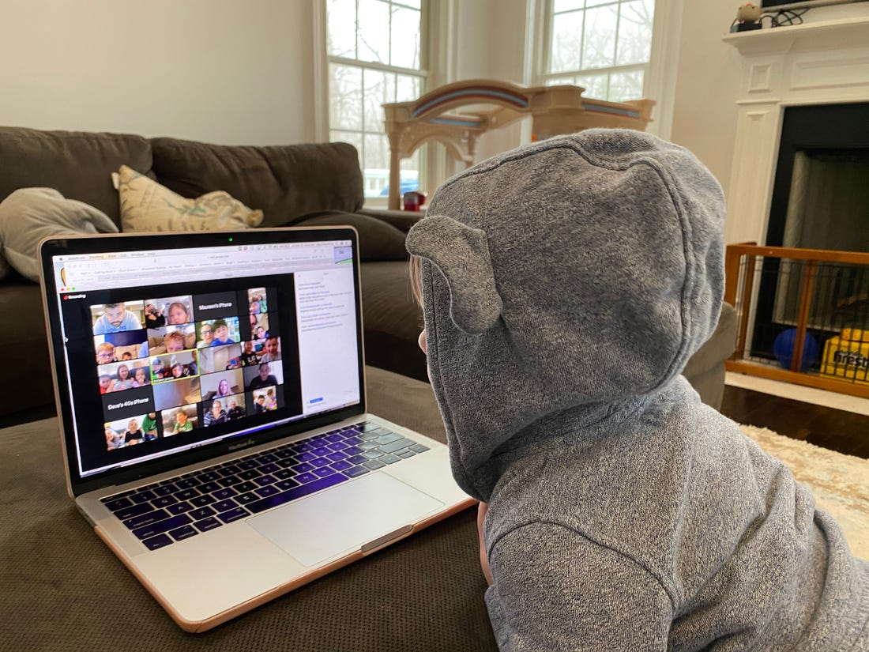
The Shift to Home
Notes:
Our legacy – a big world centered around our loved ones
Sustainability supported with little to no commute
Dutch government demanding move to home care to support sustainability

Slide 30


Notes:
Travel occasionally, not constantly
Efficiency can deliver strong, healthy families, which is the foundation on which we’ll build for the future.

Slide 31

Justin Gernot: Justin@healthbox.com
Healthbox: info@healthbox.com
Thank you!
Questions?
Justin Gernot: linkedin.com/in/justingernot/
Healthbox: linkedin.com/company/healthbox/
@jgernot
@healthbox
www.healthbox.com
Notes:
Slido: info@healthbox.com
PW: Password1

