Slide 1
COVID-19’s Impact on
Medication Access
Melissa Weant, Ph.D.
Senior Manager, Provider Analytics
CoverMyMeds

Slide 2
Welcome

Slide 3
Agenda
Medication Access Barriers
Affordability
Getting to the doctor or pharmacy
The Healthcare Shift
Patients
Providers
Pharmacies
The Future
What is likely to stay
What still needs improved
Continuous Innovation

Slide 4
Medication Access Barriers

Slide 5
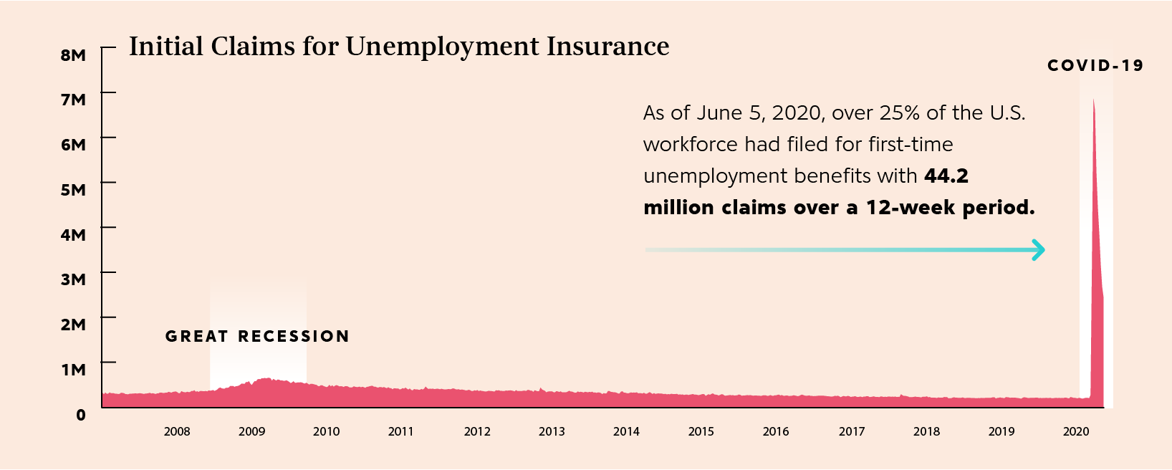
The Underinsured
Source: Unemployment Insurance Weekly Claims, Department of Labor, 2020
Notes:
Prior to COVID-19, 109 million Americans were exposed to the full cost of their medications due to being under or uninsured

Slide 6
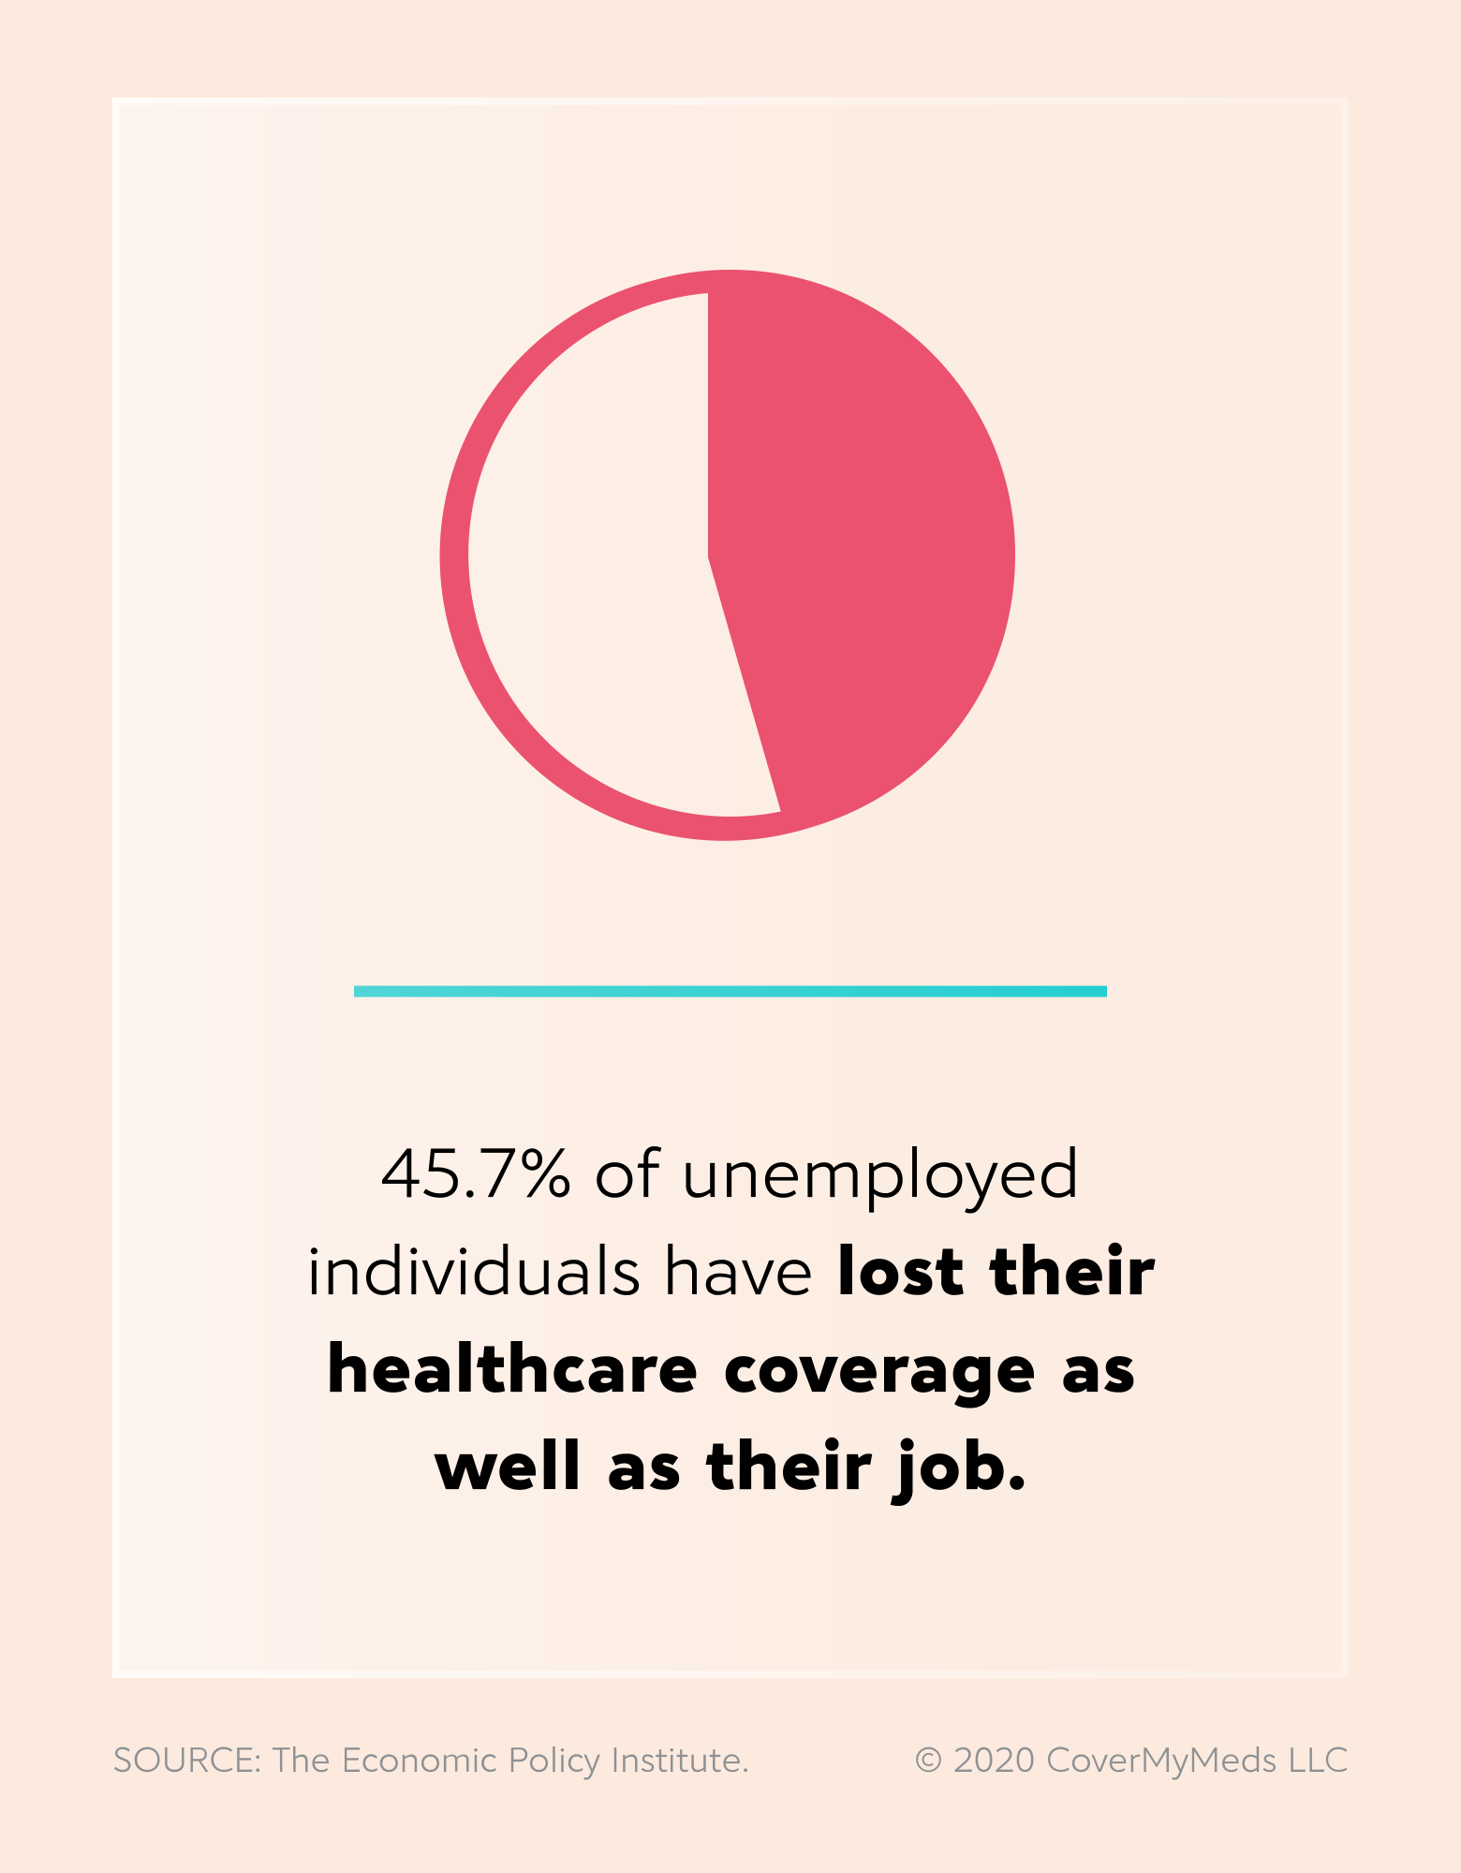
Coverage Options
COBRA
Those electing to use COBRA to extend their coverage during unemployment become responsible for the full share of employee and employer coverage
Medicaid and The Affordable Care Act
While expanded in many states, 5.7 million Americans won’t qualify.¹ Others are delaying in hopes of getting their job back, or simply accepting the full cost of their medications and healthcare²
¹Kaiser Family Foundation, 2020
²Why Losing Your Job Means Losing Your Psychiatric Medication, The Nation, 2020
Notes:
Millions of Americans now find themselves facing healthcare insecurity due to lost coverage or an inability to pay for health services on their current income. While some may qualify for continued employer-sponsored coverage under COBRA, the costs are staggering. Those electing to use COBRA to extend their coverage during unemployment become responsible for the full share of employee and employer coverage.
In 2019, the average cost for an individual’s annual coverage under an employer plan was over $7,000, and over 20,000 for family coverage — unattainable for many who are suddenly without income.⁴2019 Employer Health Benefits Survey, Kaiser Family Foundation, 2019 Losing the security of a paycheck and health coverage is unsettling under normal circumstances — it’s especially daunting during a global pandemic.
The 53 million Americans who fall into the category of low-wage workers face a particularly harsh reality in the event of a job loss: 45 percent have employer-based health insurance, and 21 percent are uninsured.⁵Realism About Reskilling, Brookings, 2019 Those who remain employed are likely working in environments where they are at high risk of contracting COVID-19, including the 3.5 million Americans who work in the healthcare and social services industries.
While Medicaid and Affordable Care Act programs have expanded in many states, 5.7 million Americans won’t qualify.⁷As Unemployment Skyrockets, KFF Estimates More than 20 Million People Losing Job-Based Health Coverage Will Become Eligible for ACA Coverage through Medicaid or Marketplace Tax Credits, Kaiser Family Foundation, 2020 Others are holding out on completing a sea of paperwork in hopes of getting their jobs back or simply accepting the full cost of their medications and healthcare.⁸When Losing Your Job Means Losing Your Psychiatric Medication, The Nation, 2020
One in ten adults has experienced trouble affording prescription medications, health insurance or medical bills since the COVID-19 outbreak began.⁹KFF Health Tracking Poll - May 2020, Kaiser Family Foundation, 2020 And, it’s likely many of these people are on therapy that requires daily prescription medications — like nearly half the U.S. population.¹⁰

Slide 7
30% of providers cite affordability as an access barrier ¹
Since the beginning of COVID-19, more than 1 in 5 patients said they’ve used a cash payment program to help afford medications²
¹ CoverMyMeds COVID-19 Provider Survey, 2020
² CoverMyMeds COVID-19 Patient Survey, 2020
Notes:
One in ten adults has experienced trouble affording prescription medications, health insurance or medical bills since the COVID-19 outbreak began.⁹KFF Health Tracking Poll - May 2020, Kaiser Family Foundation, 2020 And, it’s likely many of these people are on therapy that requires daily prescription medications — like nearly half the U.S. population.¹⁰Nearly One in Two Americans Takes Prescription Drugs: Survey, Bloomberg, 2020
In a survey of nearly 3,000 providers, when asked what medication barriers their patients are experiencing due to COVID-19, 30 percent said their patients are unable to pay for prescriptions.¹¹CoverMyMeds COVID-19 Provider Survey, 2020 When it comes to medication, many patients are now looking at changed, reduced or even eliminated access channels. Since the beginning of COVID-19, more than one in five patients surveyed said they’ve used a cash price program to help afford medications.

Slide 8
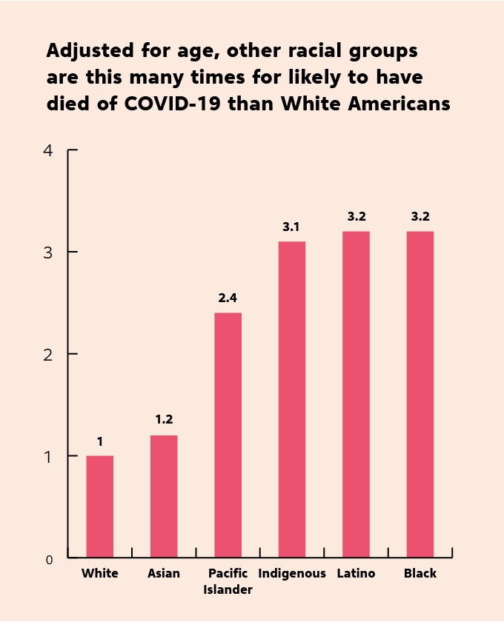
Minority Bias
Social determinants of health have historically prevented racial and ethnic minority groups from having fair opportunities for economic, physical and emotional health. These include:
Healthcare access and utilization
Income and wealth gaps
Occupation
Housing
¹ The Color of Coronavirus: COVID-19 Deaths by Race and Ethnicity in the U.S., AMP Research Lab, 2020
Notes:
Note for MW: The majority of this content has been pulled from this article by the CDC from July: https://www.cdc.gov/coronavirus/2019-ncov/community/health-equity/race-ethnicity.html#fn1
Long-standing systemic health and social inequities have put many people from racial and ethnic minority groups at increased risk of getting sick and dying from COVID-19. The term “racial and ethnic minority groups” includes people of color with a wide variety of backgrounds and experiences. But some experiences are common to many people within these groups, and social determinants of health have historically prevented them from having fair opportunities for economic, physical, and emotional health. ^{[1]}
Healthcare access and utilization: People from some racial and ethnic minority groups are more likely to be uninsured than non-Hispanic whites. ^{[10]} Healthcare access can also be limited for these groups by many other factors, such as lack of transportation, child care, or ability to take time off of work; communication and language barriers; cultural differences between patients and providers; and historical and current discrimination in healthcare systems. ^{[11]} Some people from racial and ethnic minority groups may hesitate to seek care because they distrust the government and healthcare systems responsible for inequities in treatment ^{[12]} and historical events such as the Tuskegee Study of Untreated Syphilis in the African American Male and sterilization without people’s permission. ^{[13], [14], [15], [16]}
Occupation: People from some racial and ethnic minority groups are disproportionately represented in essential work settings such as healthcare facilities, farms, factories, grocery stores, and public transportation. ^{[17]} Some people who work in these settings have more chances to be exposed to the virus that causes COVID-19 due to several factors, such as close contact with the public or other workers, not being able to work from home, and not having paid sick days. ^{[18]}
Educational, income, and wealth gaps: Inequities in access to high-quality education for some racial and ethnic minority groups can lead to lower high school completion rates and barriers to college entrance. This may limit future job options and lead to lower paying or less stable jobs. ^{[19]} People with limited job options likely have less flexibility to leave jobs that may put them at a higher risk of exposure to the virus that causes COVID-19. People in these situations often cannot afford to miss work, even if they’re sick, because they do not have enough money saved up for essential items like food and other important living needs.
Housing: Some people from racial and ethnic minority groups live in crowded conditions that make it more challenging to follow prevention strategies. In some cultures, it is common for family members of many generations to live in one household. In addition, growing and disproportionate unemployment rates for some racial and ethnic minority groups during the COVID-19 pandemic^{[19]} may lead to greater risk of eviction and homelessness or sharing of housing.
[1] U.S. Department of Health and Human Services. Social Determinants of Health [online]. 2020 [cited 2020 Jun 20]. available from https://www.healthypeople.gov/2020/topics-objectives/topic/social-determinants-of-healthexternal icon

Slide 9
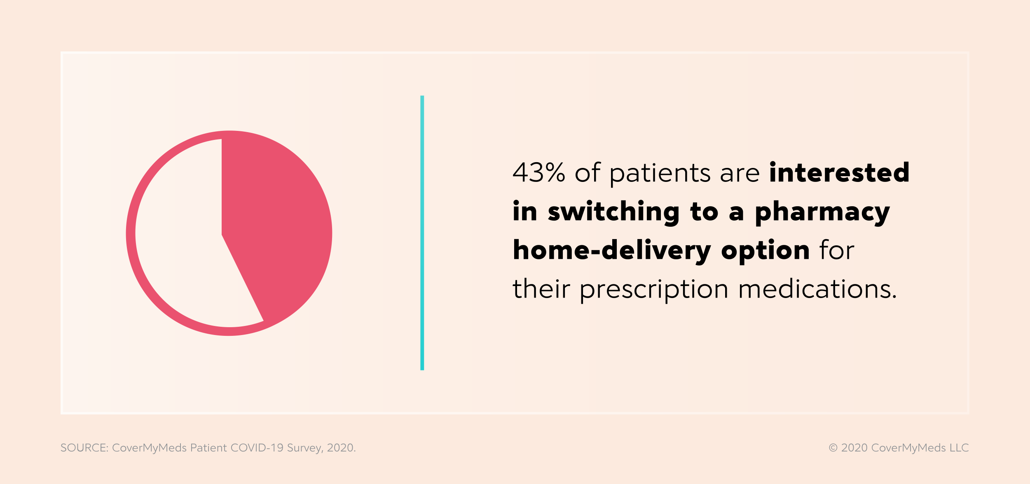
Getting to the doctor or pharmacy
42% of patients have cancelled or delayed an in-person appointment and 44% have moved to telehealth visits¹
While 84% of patients currently pick up their medications at a retail pharmacy, 43% are interested in switching to a pharmacy home delivery option¹
¹ CoverMyMeds COVID-19 Patient Survey, 2020
Notes:
Offices reduced normal business hours, stopped accepting new patients, combined locations, and began only seeing patients on an as needed basis.
From our most recent patient survey, over the past six months, 50% of patients receive their medication in-person from their local pharmacy, 25% are doing a mix of in-person and mailed, 13% are doing home delivery through local pharmacy and 12% are using a mail-order pharmacy. So 50% of patients are avoiding the local pharmacy at least some of the time - even several months after the start of the pandemic.

Slide 10
In response to medical offices closing and stay at home orders, many health plans including government-sponsored plans relaxed or waived restrictions for many prescription refills¹
However, from January to May there was a 25% decrease in acute care prescriptions compared to just 3% in chronic care prescriptions, indicating patients may not be seeking medical care for acute conditions²
Chronic
VS
Acute
¹ Prior Authorization Policy Changes Related to COVID-19, American Medical Association, 2020, Kaiser Family Foundation, 2020
² COVID-19 Prescription Trends, Pembroke Consulting, Drug Channels Institute, 2020
Notes:
When it comes to appointments resulting in prescriptions, telehealth visits are behind office visits. This could be due to fewer labs and diagnostic tests in telehealth appointments and prescribers may be less willing to initiate new therapy remotely.
Retail and mail areas of the pharmaceutical marketplace are trending stronger than the overall marketplace, likely due to lower oncology drug sales, as many patients were unable to visit the oncologist during pandemic shutdowns.
(Source: https://www.iqvia.com/library/white-papers/monitoring-the-impact-of-covid-19-on-the-pharmaceutical-market)

Slide 11
The Healthcare Shift

Slide 12
Patients
Telehealth
Patients are opting into more convenient options for their provider visits by scheduling virtual appointments
Price Transparency and Affordability Options
Through prescription drug comparison websites and apps
A 64.3% increase in demand for telehealth is expected in 2020 ²
Notes:
Virtual Interfaces
including telehealth platforms and prescription drug comparison apps, also allow patients to quite literally take scheduling, pharmacy selection and record management into their own hands, without the pressure of on-the-spot decision making. When asked what patients found helpful about telehealth services, the most-listed response was convenience¹
Price Transparency and Affordability Options
The preference for patients to act as consumers of their own healthcare has been on the rise and COVID-19 has accelerated the amount of patients looking for the best way to afford their medications by investigating savings and options on their own²
¹ CoverMyMeds COVID-19 Patient Survey, 2020
² Telehealth to Experience Massive Growth with COVID-19 Pandemic, Says Frost & Sullivan, PR Newswire, 2020

Slide 13
Providers
New Responsibilities and Dynamics
Frontline COVID-19 roles, remote settings and logistics are impacting providers
Remote Communication
85% of provider say they’ve started telemedicine since the pandemic¹
Leveraging Technology
Providers are adjusting to leaning on telehealth in relationship to existing EHR workflows
¹ CoverMyMeds COVID-19 Provider Survey, 2020
Notes:
New Responsibilities and Dynamics
When the COVID-19 pandemic hit the U.S., the provider space scattered in several directions. Some went to the frontline to help treat COVID-19 patients, others to work remotely as offices shut down and some to continue their original standards of treatment in a completely new landscape
Remote Communication
85% of provider say they’ve started telemedicine since the pandemic¹. Although providers likely have mixed feelings on telehealth, the ability to offer it is extending a lifeline to their patients in a time where they’re feeling isolated and likely need it the most
Leveraging Technology
As providers newly adopt or lean on existing telehealth functions more heavily, easily accessing the patient’s benefit information, health records and pharmacy information is critical. Seamlessly navigating these can be a challenge but there are some tools, such as real-time benefit check solutions for the EHR that can help ease the burden

Slide 14
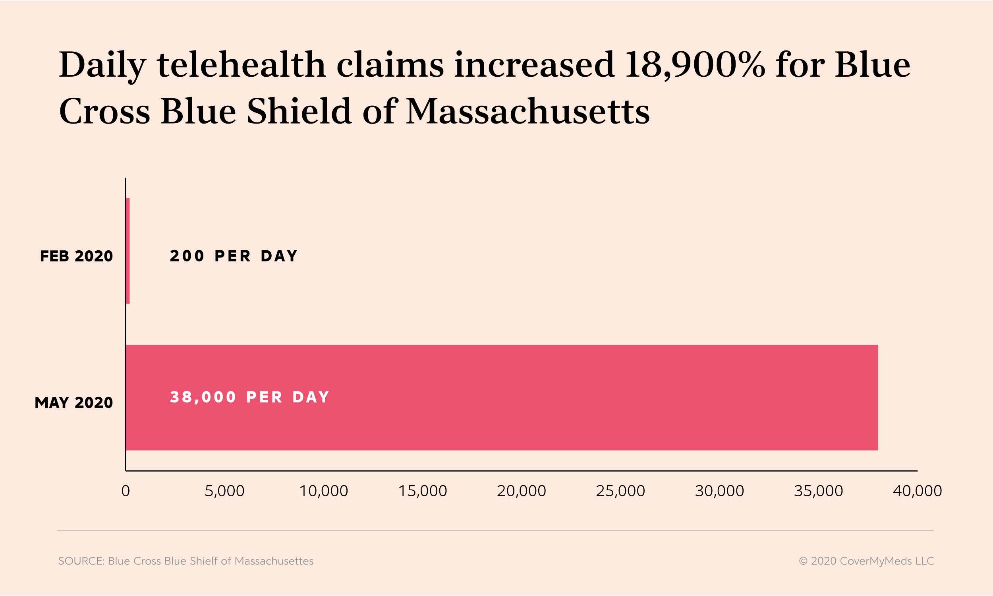
An Increasing Demand for Telehealth Options
Notes:
While office and institutional in-person visits have started to pick up again, they are still below baseline visit levels. And while telehealth visits have dropped by around 30 percent since their peak earlier this year, they are up by over 50 percent compared to normal baseline levels.
(Source: https://www.iqvia.com/library/white-papers/monitoring-the-impact-of-covid-19-on-the-pharmaceutical-market)

Slide 15
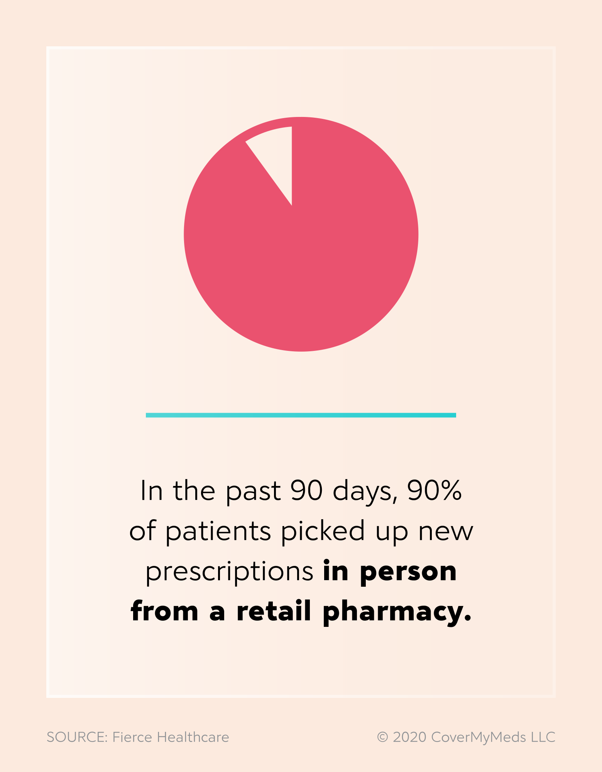
Pharmacies
Maintaining Service with Added Responsibilities
Pharmacies are as acting as testing sites, offering delivery options and keeping up with supply chain pressure¹
Shifting to Health Hubs
Pharmacies are employing nurse practitioners and other medical staff for quick diagnoses
Leveraging Technology
Technology can help pharmacists keep up with changing benefit requirements and regulations
¹ Survey: COVID-19 Will Have Lasting Changes in the Way Local Pharmacies Operate, National Community Pharmacists Association, 2020
Notes:
Maintaining Service with Added Responsibilities
56% of pharmacists said they expect an increased scope of practice as a result of COVID-19 changes such as acting as testing sites, offering delivery options and keeping up with supply chain pressure¹
Shifting to Health Hubs
Some retail pharmacies are employing nurse practitioners and other medical staff for quick diagnoses and allow pharmacists to practice at the full extent of their license with more patient education involvement
Leveraging Technology
In addition to increased workload, pharmacists are also tasked with staying on top of changing benefit requirements and regulations. Technology that is integrated within their pharmacy system software such as electronic prior authorization and drug-switch capabilities are helping pharmacists mitigate access barriers for their patients with real-time data

Slide 16
The Future

Slide 17
Longer Prescription Fills
In an effort to reduce trips to the pharmacy, many states relaxed prescription quantity limits to allow patients who would normally receive a 30-day fill of their prescription to receive 90-day fills.¹
64% of patients with a chronic condition or caring for someone with one listed longer prescription fills as a positive healthcare adaptation they would like to see continue ²
¹ COVID-19 Information From the States, National Alliance of State Pharmacy Associations, 2020
² CoverMyMeds COVID-19 Patient Survey, 2020
Notes:
For retail, 90-day fills are still up 7% while 30-day fills are down 12.5%
(Source: https://www.iqvia.com/library/white-papers/monitoring-the-impact-of-covid-19-on-the-pharmaceutical-market)

Slide 18
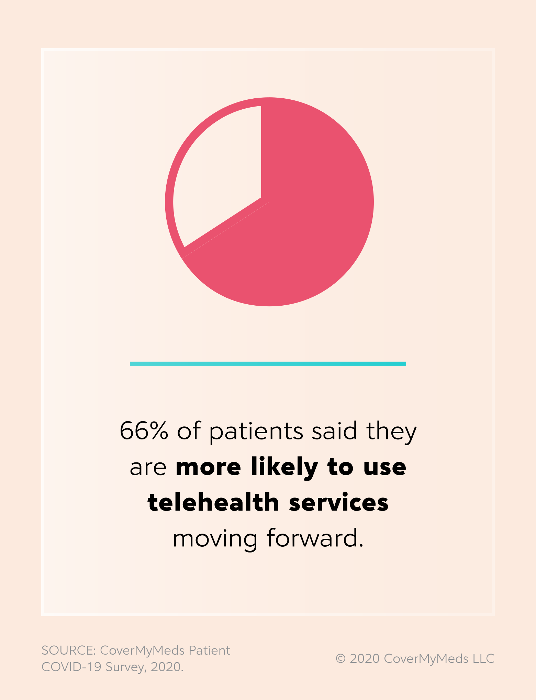
Fewer In-Person Doctor Visits
Telehealth visits in 2020 could exceed 1 Billion¹
Prior to COVID-19, only 17.6% of patients said they would use telehealth if provided the option. However, two out of three of patients stated they are more likely to use these services moving forward.²
In addition to convenience, teleheath could be a newly accessible option for patients in rural areas.
¹Telehealth visits are booming as doctors and patients embrace distancing amid the coronavirus crisis, CNBC, 2020
² CoverMyMeds COVID-19 Patient Survey, 2020
Notes:
In the wake of the pandemic, many workers who previously thought or were told their job couldn’t be done from home, suddenly found it possible. And so followed healthcare. You’ve likely heard anecdotes of friends and family renewing prescriptions, receiving dermatology diagnoses and even engaging in physical therapy without ever reaching for car keys.
The astronomical increase in telehealth appointments — as high as 8,000 percent for some health systems¹ — expedites the triage process and keeps patients out of germ-riddled waiting rooms. It’s no wonder 54 percent of patients surveyed listed this as a keeper for healthcare moving forward.²
While technology can’t replace all appointments, it’s a no-brainer option, especially for those with chronic conditions requiring multiple follow-up appointments or for an initial assessment of a sudden, non-life-threatening illness or injury.³
And while not all patients may be comfortable with videoconferencing, telehealth can come in many forms: elderly patients tend to prefer and respond well to telephone conversations, while other patient populations fare better with asynchronous appointments, not unlike a text or email conversation they would have with a friend or colleague.⁴
WVU Medicine to waive telehealth co-pays through May 31, WVU School of Medicine, 2020
COVID-19 Patient Survey, CoverMyMeds, 2020
Is telehealth as good as in-person care?, The Conversation, 2020
Possibilities and Limits of Telehealth for Older Adults During the COVID-19 Emergency, Kaiser Family Foundation, 2020

Slide 19
Virtual Communication with the Pharmacy
With patients seeing their pharmacist up to 10 times more often than their physician, open, accessible communication channels with the pharmacy can be crucial for patient medication access and adherence¹
¹Pharmacists as accessible primary health care providers: Review of the evidence, National Institute of Health, 2018
Notes:
51% of patients said virtual communication with their pharmacy was a telehealth aspect they’d like to see moving forward.²
² CoverMyMeds COVID-19 Patient Survey, 2020
In our most recent survey, we found 72% of patients regularly ask their pharmacist questions about their medications, and 1 in 4 patients said they rely more on their pharmacist to provide information regarding their condition and medication since COVID-19.

Slide 20
Prescription Price Shopping Tools
When both a diagnosis and prescription are likely to come via telehealth appointment, an ideal scenario allows patients to use the same technology to compare prescription cost and payment options.
34% of patients are looking at prescription price-shopping tools as a new mainstay¹
Notes:
Patients should be able to consider the cash price of their medication, whether they have health insurance or not. Since the beginning of COVID-19, more than one in five patients surveyed said they’ve used a cash price program to help afford medications.¹
¹ CoverMyMeds COVID-19 Patient Survey, 2020

Slide 21
What still needs improved
EHR Interoperability and Security
It is more important than ever that providers have a single, reliable source of truth for patient and prescribing information
NEED FOR CONTINUED INNOVATION
The healthcare industry needs continued innovation— for everyone involved.
With much of the newly adopted technology’s framework having existed for several years, it’s critical that healthcare information technology to map out the future steps to best suit provider and patient needs moving forward.
Algorithms for Social Determinants of Health
Healthcare disparities due to race and gender bias through healthcare algorithms. The proportion of Black patients referred for complex care programs would increase nearly 30% if bias was removed from a widely used healthcare algorithm.¹
Access and Understanding of Technology
80% of providers identify patients’ lack of technology skills as a telemedicine challenge²
¹ Science Magazine
²CoverMyMeds COVID-19 Provider Survey, 2020
Notes:
Telehealth adoption happened quickly, with office staff building the plane as they were flying. But much of the framework has existed for several years: In a 2019 American Well survey of physicians, results showed telehealth adoption increased by 340 percent from 2015 to 2019. With many more now taking the leap into existing technology, it’s time for healthcare information technology to pioneer next steps that best suit provider and patient needs moving forward.
EHR interoperability and security- To continue on progress made, the healthcare industry needs more interoperability.Telehealth: A quarter-trillion-dollar post-COVID-19 reality?, McKinsey & Company, 2020 More than 30 percent of providers surveyed said lack of integration within EHR and privacy concerns were challenges they’ve faced with telemedicine.¹¹CoverMyMeds COVID-19 Provider Survey, 2020 Sharing data can be cause for concern, but many healthcare stakeholders have already proven we can efficiently transcend previous barriers to enable patients and providers to connect from afar. The more various health tracking and record systems can connect, the better everyone can meet patients where they are, in their health and in their lifestyles
At one time, patients had to obtain a subpoena if they wanted to view their own medical record.⁹Today, health records access is much easier to obtain for patients. Still, more than half of patients surveyed listed easier access to their own records as one key aspect of healthcare they’d like to see improve moving forward. As of 2017, 52 percent of patients reported they were offered online access to their medical record through their provider or health plan.¹⁰ But only twenty-eight percent actually viewed their record at least once within the year.¹⁰
Patients need easy access to their own health records, especially in a world where health data no longer sits in a stationary file at the family doctor’s office. In fact, at least a quarter of Americans don’t have a primary care provider, and could stand to benefit from nimbler, more patient-facing health records across health systems.¹⁰
Providers can help with this by updating their EHRs to allow the most current bi-directional data sharing with patients. This can also cut down on administrative work by allowing patients to supply necessary data ahead of time and update in real-time. They can also simply mention online health records: 63 percent of patients who viewed their medical records were encouraged to do so by their providers.¹⁰
EHR vendors can embrace and promote open application programming interfaces (APIs) for their clients to open the door for more tools and apps. These enhance the patient experience and allow them a greater hand in their healthcare, no matter where they’re receiving care.
The Office of National Coordinator for Health Information Technology (ONC) Cures Act Final Rule passed earlier this year laid the groundwork for future API use and patient data transparency while enabling data privacy and safety.¹²
Algorithms for social determinants of health- These social determinants include healthcare disparities due to race and gender bias. Black Americans are 2.3 times more likely to die from COVID-19 than white or Asian Americans.²⁹The Color of Coronavirus: COVID-19 Deaths by Race and Ethnicity in the U.S., APM Research Lab, 2020 The COVID-19 numbers are a microcosm of a larger problem: In an analysis of health status measures, including infant mortality, mental health and chronic condition mortality rates, black, Hispanic and Native Americans fared far worse than white Americans.³⁰Health Disparities are a Symptom of Broader Social and Economic Inequities, Kaiser Family Foundation, 2020
Certainly, efforts to address these disparities need to extend across industries, but discrimination must even be dismantled within healthcare algorithms.
A study of a widely adopted algorithm used to refer over 200 million patients to complex care programs found that the average black patient was measurably sicker than the average white patient and received $1,800 less in care, annually.³¹
Individuals’ use of online medical records and technology for health needs, ONC Data Brief, 2018
Characteristics of Americans With Primary Care and Changes Over Time, 2002-2015, JAMA Network, 2019
ONC Cures Act Final Rule, Office of the National Coordinator for Health Information Technology, 2020

Slide 22
Thank You
Melissa Weant, Ph.D.
Senior Manager, Provider Analytics
CoverMyMeds
mweant@covermymeds.com

