Slide 1
Implementation of Electronic Safety Checks-Strategies for Engaging Clinicians
Becky Whitt and Beth Campbell-Smit

Slide 2
Welcome

Slide 3
Presenters
Becky Whitt
Beth Campbell-Smit
Clinical Applications Consultant
Senior Training and Optimization

Slide 4
As a mission-driven non-profit, HIMSS offers a unique depth and breadth of expertise in health innovation, public policy, workforce development, research and analytics to advise global leaders, stakeholders and influencers on best practices in health information and technology.
HIMSS is a global advisor and thought leader supporting the transformation of the health ecosystem through information and technology.
With more than 350 employees, HIMSS has operations in:
North America | Asia Pacific | Europe | Latin America | Middle East | United Kingdom

Slide 5
Problem
Inpatient BH patients are to be checked at minimum every 15 minutes. Some patients require 2 times every 15 minutes. Documentation was being done on a clipboard with multiple patients on the same paper. We want to utilize our electronic health system to capture this information electronically and promote patient safety.

Slide 6
How will making this digital help?
Provides visibility within Epic to Psychiatric staff
Measurable information
Compliance with quality initiatives
Specifically national patient safety goal 15.
Align with policy regarding frequency of documentation

Slide 7
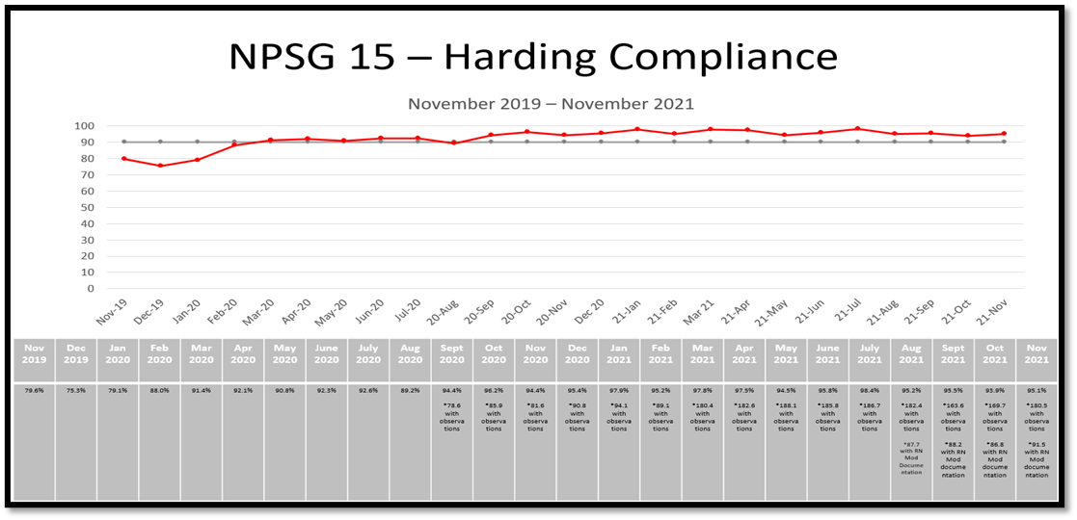
Safety check reporting- Power BI

Slide 8
Stakeholders
Patient Safety
Nursing
Patient Care Techs
Case Managers
Quality
Social Workers
Physicians and Advanced Practice Practitioners

Slide 9
Resources/ IT teams
Clinical Documentation
Orders
Behavioral health
Handheld devices
Training
Network/ Field Services
Project Management

Slide 10
People Matter! Keys to a successful implementation
Leadership
A nursing leader (educator, manager, etc.) who is dedicated to being consistently available and someone the staff can trust and count on
Champions
Nursing staff superusers or champions who can help support, round, and promote the initiative
Technology
The right technology that works and fits the workflow of the staff using it
IT Support
Continuous 24-hour on-site IT support, especially in the first two weeks of Go-Live
Follow Up and Re-evaluation

Slide 11
Culture – Change is Necessary Implementing *helpful technology at the bedside
Attitudes
How will this help me?
Beliefs
Will this really work?
Barriers
But we’ve always done it this way

Slide 12
Timeline
Design and build
3/11/2020
Devices
Obtained
June- August 2020
On Unit Training
9/2/20220
Go Live
9/8/2020

Slide 13
Devices- What do you have, what will you be using?

Slide 14
Cases, charging, and updates- have a plan
Work with infection control departments, and consider patient safety
Plan for enough devices to charge on a rotation
Devices need to be connected to Wi-Fi in order to get updates
Vendor updates as well as OS updates will need to take place

Slide 15
Training and Engagement “Tell me what I need to know”
“Open House” training sessions were held on the unit
Hands on use of device
Computer(s) and Rover(s) were available in the training room
Scheduled the week before Go Live
A total of four short and efficient sessions on two days
Captured all shifts (day, evening, night) 0600 and late afternoon 1500.
Ability to ask questions and prepare for Go Live in a small and informal group setting, tip sheet provided

Slide 16
Meeting People Where They Are With Technology
© 2022 Epic Systems Corporation
Notes:
Continuous Staff Input into workflow

Slide 17
A TRUE Success Story!
The implementation of electronic safety checks in our department was much bigger than technology. It is a story about how technology brought together teams to improve patient safety… and that is what it is all about.

Slide 18
Nurse Educator Champion
Engage staff throughout project
Go live rounding to each unit
Leaders identified for every area
Tracking of issues at go live

Slide 19
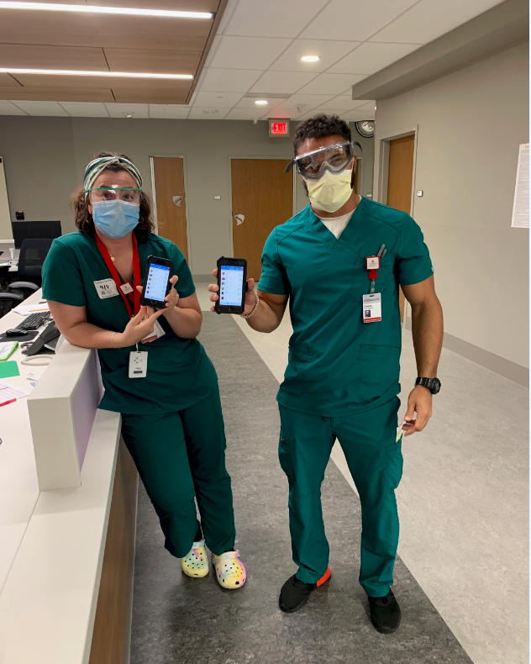
Thank You!
Becky Whitt, AT
Rebecca.Whitt@osumc.edu
Beth Campbell-Smit, RN
Elizabeth.Campbell@osumc.edu
Notes:
New Rover Devices in Use

