Slide 1
How Ambient Technology is Transforming the Provider-Patient Experience
Rizwan Pasha, MD
CMIO

Slide 2


Welcome
Rizwan Pasha
CMIO

Slide 3
Today’s Agenda
Current state in Ambient AI
Apply AI to improve patient provider documentation
Use case and path to full automation
Outcomes and vision

Slide 4
Barriers to achieving a good healthcare experience for healthcare organizations, providers, and patients
Operational inefficiencies
  50% of physicians time spent documenting care
  Countless visits not billed due to unsubmitted documentation
  3-5% lost revenue due to insufficient documentation and inaccurate coding
Growing provider burnout
  42% of physicians are burned out
  64% say burnout intensified due to the pandemic
  $4.6 billion a year attributed to the cost of provider burnout
  90,000 physician shortage predicted by 2025
Sub-optimal provider-patient experience
  75% of U.S. Consumers wish their healthcare experiences were more personalized
  61% of patients would visit their healthcare provider more often if the communication experience felt more personalized

Slide 5
A scribe (program) is born
When: Born in the 1970’s; took off due to the HITECH Act in 2009
Why: Reduce data entry on healthcare providers
How many: From 15,000 in 2015 to approximately 100,000 in 2020
Where: Over 1200 locations

Slide 6




What is Ambient Clinical Intelligence?
The power of the cloud
Delivering a new generation of solutions
The power
of AI
The power of IoT
Slide 6
Notes:
Still very much in its infancy, ambient clinical intelligence offers the opportunity to bring together the power of the cloud, AI, and the internet of things in order to deliver a new generation of solutions that can reduce the burdens on clinicians and transform the delivery of care for patients.
Of course, ambient intelligence is not new—the term “ambient intelligence” dates back more than 20 years.
“If you’ve ever ordered something for delivery with just your voice or asked the room to play a song…get a lot of heads nodding…if you have you’ve used ambient intelligence
It grew out of work in the late 1990s to explore a vision for ubiquitous, context-aware, personalized computing for consumers that would understand their preferences and anticipate and adapt to their needs.
What was wildly ambitious two decades ago is now tantalizingly near at hand.
Cloud computing, AI-enabled cognitive computing capabilities like speech recognition and computer vision, and the proliferation of sensors in our lives have laid the foundation for technology that understands our intentions based on our words and actions, senses what is going on in the world around us, pulls relevant information from myriad sources, and then uses all of it to execute tasks on our behalf.

Slide 7
Improve the Provider – Patient Experience
© 2022 Nuance Communications, Inc. All rights reserved.
7

Slide 8



A new approach to today’s challenges
Ambient AI
Natural
conversation
Complete
clinical note

Slide 9
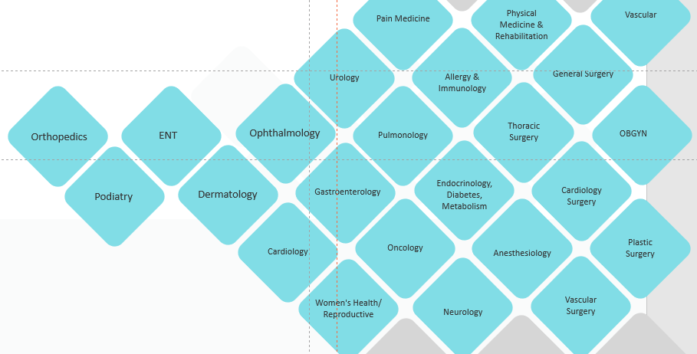
Support specialty sampling:
ambulatory care, urgent care, primary care, and telehealth

Slide 10








The Workflow: From Patient Encounter to Final Note
ENCOUNTER
CLOUD
EHR
Patient
…The pain is just in the small of my back. It’s also very stiff and it hurts to bend over…
…The muscles on either side of your lower spine are in spasm. The spine itself is non-tender. And your reflexes and sensation are normal...
AI
Provider
AI generated clinical note
Quality review + AI learning loop
Provider signs note in EHR
Capture encounters
in person or virtual consults
Notes:
BIG IDEA: Here’s an example of an encounter conversation being processed into high quality clinical documentation.
DAX can be used for all ambulatory specialties, urgent care and primary care.
Encounters can be used with the mobile app or an ambient device.
DAX surrounds the encounter with artificial intelligence that converts conversations into a structured note.
During an encounter, conversations between clinicians and patients are securely recorded and automatically converted into AI-generated clinical notes.
The encounter conversation and data are routed through a quality review process that ensures accuracy of the final note.
The process continuously learns, and the AI grows more and more accurate and efficient with each word.
Resulting docu­mentation is presented to clinicians to review and approve quickly and easily in the EHR as part of their day-to-day workflow.
Physicians don’t touch the note until they see it in the EHR.
Once the note is in the EHR, providers can follow their normal workflow

Slide 11
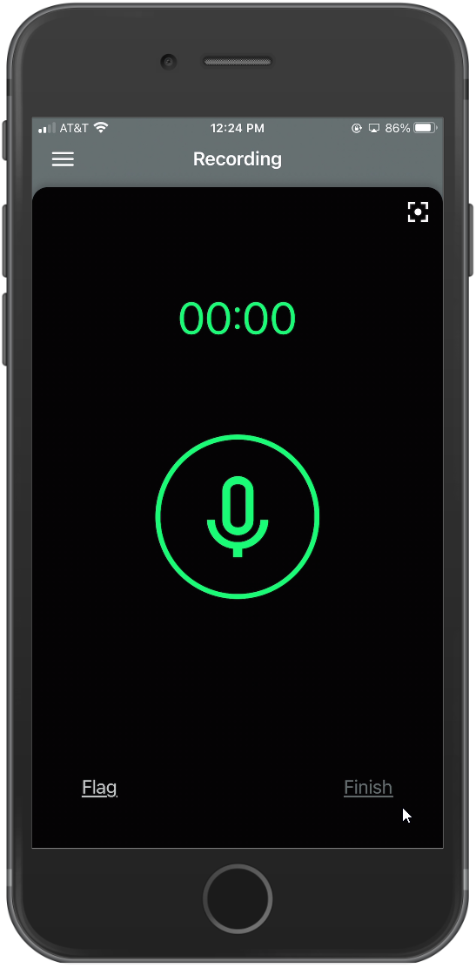

Secure mobile app
Use for in person or telehealth and virtual visits
It’s simple:
Launch the DAX mobile app along with your video conferencing or telehealth application
Securely capture the conversation during the virtual visit
Sign the final quality reviewed note directly in the EHR
Use any video conferencing application
Use any
telehealth application
OR
…and many more
…and many more

Slide 12
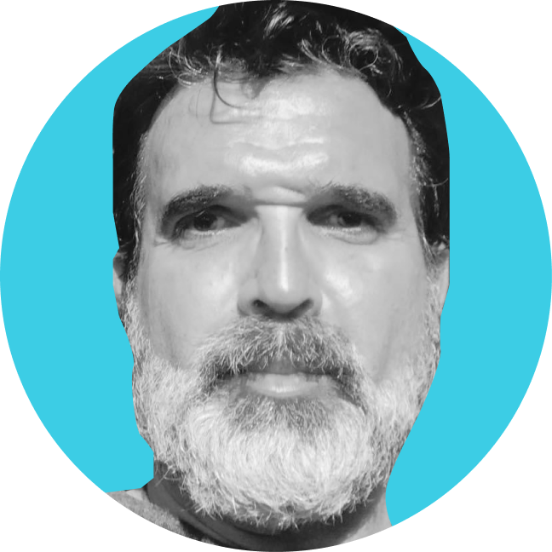
Accurate note in the EHR
Multiple issues/ AI-generated Draft Note
Quality Reviewed Final Note
So I know the nurse told you a little bit about DAX. I’d like to tell DAX a little bit about you, okay. So Dave is a 55-year-old male with a past medical history significant for depression, type two diabetes, and hypertension, who presents today for follow-up of his chronic problems. So David what’s going on?
Yeah, I think every weekend this summer we’ve had house guests. We’re getting ready to help my son move apartments and it’s just been a very stressful summer, surprisingly. So, I’m really concerned about my blood pressure and monitor it, but it’s just been in the last week or so.
Yeah, we’ve had the same experience. We haven’t seen anyone for a year and now they’re all coming back and it’s been a lot I agree, it can be stressful. So tell me a little bit about your blood pressure. Is it elevated all the time? Or how often do you check it?
Um, for probably maybe the last two weeks or so I’ve been checking it regularly in the afternoon and it seems to be higher than usual so I’m really concerned, hence the appointment that I wanted to set with you.
HPI
CC: Follow Up
HPI: David ___ is a 55-year-old male with a medical history significant for depression, type 2 diabetes, and hypertension who presents today for follow-up of his chronic problems. Mr. ___ reports that every weekend this summer they have had ___ and they are getting ready to help his son move apartments. This has been a very stressful summer. He is concerned about his blood pressure. He has been checking it regularly in the afternoon over the last 2 weeks and it seems higher than usual. He is on the maximum dose of lisinopril.
Dave Pashayan
03/30/1965 (55)
PCP: Dr. Andrea Barrett
HPI
CC: Follow up chronic problems.
HPI: David Pashayan is a 55-year-old male with a past medical history significant for depression, type 2 diabetes, and hypertension who presents today for follow up of his chronic problems. Mr. Pashayan reports that every weekend this summer they have had guests staying with them. They are also getting ready to help his son move apartments. This has been a very stressful summer. He is concerned about his blood pressure. He has been checking it regularly in the afternoon over the last 2 weeks and it seems higher than usual. He is on the maximum dose of lisinopril. Regarding his diabetes, he has been checking his blood sugars twice a day during the business week. He admits forgetting to check these regularly on the weekends due to being busy. They seem to be within range for the most part. He is taking metformin. The patient endorses some congestion due to allergies and heat. He denies chest pain, shortness of breath, abdominal pain, nausea or vomiting.
REVIEW OF SYSTEMS
Constitutional: Denies fevers, chills, or weight loss.
Ears, Nose, Mouth and Throat: Denies ear pain, hearing loss, or discharge. Endorses nasal congestion from allergies and the heat.
Cardiovascular: Denies chest pain or dyspnea or exertion. Endorses elevated blood pressure.
Respiratory: Denies cough, shortness of breath, or wheezing.
Gastrointestinal: Denies hematemesis, hematochezia, melena, or heartburn.
Genitourinary: Denies urinary urgency, pain, or incontinence.
Musculoskeletal: Denies joint pain, swelling, or muscle pain.
Neurological: Denies headaches, syncope, paresthesia, or seizure.
Integumentary: Denies itching, rash, or other concerning skin lesions.
Psychiatric: Denies anxiety. Endorses depression.
PHYSICAL EXAMINATION:
Constitutional: Well-developed, well-nourished, in no apparent distress.
Neurological/Psychological: Alert and oriented to person, place, and time. Appropriate mood and affect. Neurologically intact. Grip strength equal bilaterally.
Head and Face: Normocephalic and atraumatic.
Neck: Supple without thyromegaly or lymphadenopathy. No carotid bruits appreciable.
Respiratory: Normal respiratory effort. Lungs are clear to auscultation bilaterally. No wheezes, rales, or rhonchi.
Cardiovascular: Regular rate. 2/6 systolic ejection murmur. No murmurs, gallops, or rubs. No extra heart sounds.
Gastrointestinal: No masses or tenderness to palpation. Bowel sounds normal in all 4 quadrants.
Musculoskeletal: No clubbing, cyanosis, or lower extremity edema.
Integumentary: No rash or lesions. Normal capillary refill and perfusion.
ASSESSMENT/PLAN
David Pashayan is a 55-year-old male with a past medical history significant for depression, type 2 diabetes, and hypertension who presents today for follow up of his chronic problems.
DEPRESSION:
Medical Reasoning: The patient reports personal stressors, but he is doing well on Zoloft daily.
Medical Treatment: Continue Zoloft at current dose.
DIABETES TYPE 2:
Medical Reasoning: He has been compliant with metformin, but his recent hemoglobin A1c was slightly elevated.
Medical Treatment: We will increase his metformin to 1000 mg twice a day.
Additional Testing: Repeat hemoglobin A1in 3 months.
HYPERTENSION:
Medical Reasoning: This appears to be uncontrolled at this time. The patient reports that personal stressors are contributing to his high blood pressures recently.
Medical Treatment: Continue lisinopril 40 mg daily. Add Norvasc 5 mg daily.
Additional Testing: We will go ahead and order a lipid panel, as well as an echocardiogram to assess his 2/6 systolic ejection murmur.
PATIENT AGREEMENTS: The patient understands and agrees with the recommended medical treatment plan.
VITALS REVIEWED
Blood Pressure: Elevated at 156/94 mmHg.
DISCRETE DATA
MEDICATION ORDERS:
Continue Zoloft.
Increase metformin to 1000 mg twice a day.
Hemoglobin A1c in 3 months.
Add Norvasc 5 mg once a day.
Continue lisinopril.
Echocardiogram to assess heart murmur.
Lipid panel.
PROBLEMS:
Elevated blood pressure.
PAST MEDICAL HISTORY:
Depression
Diabetes Type 2
Hypertension
REVIEW OF SYSTEMS
Ears, Nose, and Throat: Positive for congestion.
Cardiovascular: Negative for chest pain.
Respiratory: Negative for shortness of breath.
Gastrointestinal: Negative for abdominal pain, nausea, or vomiting.
Psychiatric: Positive for depression.
PHYSICAL
EXAM
CONSTITUTIONAL:
General Appearance: Well developed and nourished, no apparent distress.
NEUROLOGICAL / PSYCHOLOGICAL
Orientation: Alert and Oriented x 3
Attention: Alert
Mood and Affect: Appropriate
NECK
General Examination: Neck is supple without thyromegaly or lymphadenopathy.
RESPIRATORY
Assessment of Respiratory Effort: Normal respiratory effort.
Auscultation of Lungs: Clear bilaterally. No wheezes, rales, or rhonchi.
CARDIOVASCULAR
Auscultation of Heart: Regular rate and rhythm. Grade 2/6 systolic ejection murmur, which I have not heard in the past.
MUSCULOSKELETAL
Examination: No lower extremity edema.
ASSESSMENT
/PLAN
DIABETES:
Medical Reasoning: We will increase his metformin to 1000 mg twice a day. I want to go ahead and order Jardiance 5 mg a day to help get his blood pressure under better control. I also want to go ahead and order an echocardiogram to evaluate that murmur that he had on the physical exam. I want to go ahead and order a lipid panel. I will be in touch with the patient through the patient portal with the results.
HYPERTENSION:
Medical Reasoning: Blood pressure is not controlled.
Medical Treatment: He is on lisinopril 40 mg and I want to go ahead and add some Norvasc 5 mg a day to help get his blood pressure under better control.
HYPERLIPIDEMIA:
Medical Treatment: We will go ahead and order a lipid panel.
Patient Agreement: The patient understands and agrees with the recommended medical treatment plan.
12

Slide 13
Use Case
Use case

Slide 14
The full path to automation
Express Mode

Slide 15
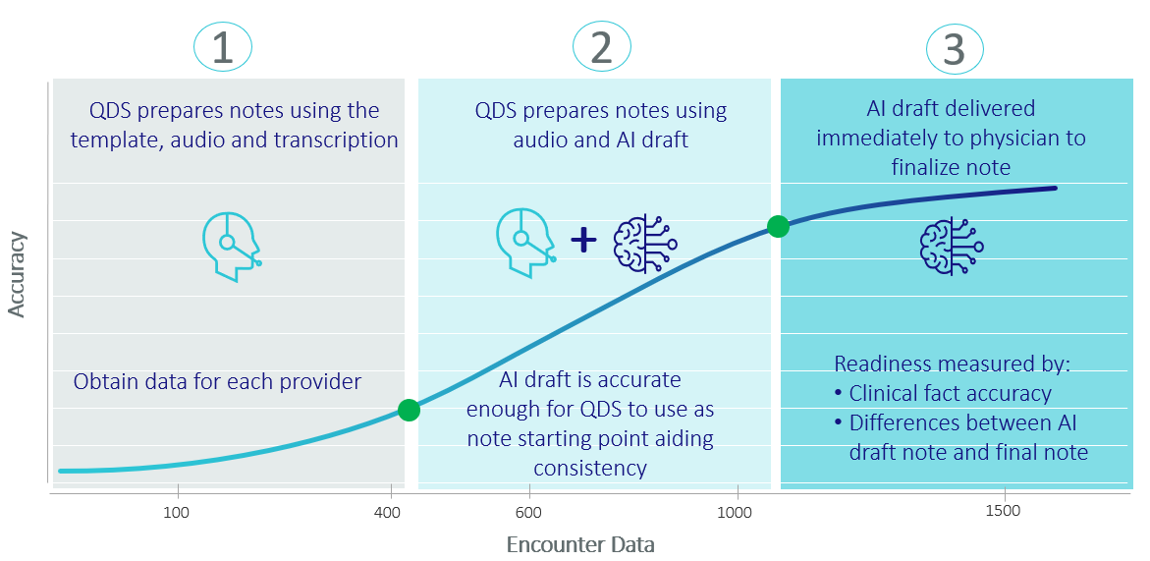
Automated note delivery process

Slide 16
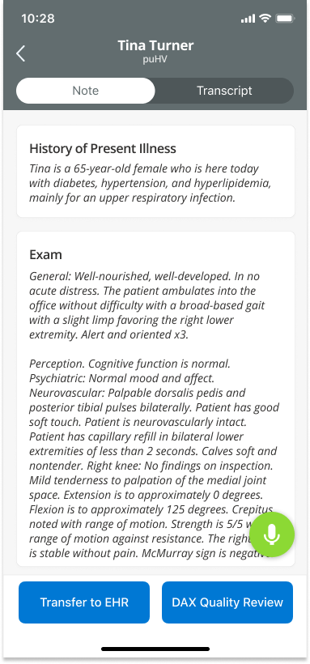
Two note delivery options
Flexible note delivery options for each encounter
Nelson
Quality reviewed notes
Quality reviewed within the committed TAT
Available today for all providers
Express note delivery in seconds without a quality review
Providers can quickly review the AI draft note in the Mobile app and then finalize it the EHR
Now available for Epic and athenahealth customers (alpha testing)
General availability in mid 2022 for Epic and athenahealth customers for providers with high enough AI accuracy
Notes:
BIG IDEA: In mid 2022, we will be providing two note delivery options for Epic and athenahealth customers. A quality reviewed note delivered within the committed TAT, or a note delivered in seconds that is not quality reviewed, which we refer to as Express Mode. Providers can quickly review the AI draft note from within the DAX mobile app and then finalize it directly within the EHR.
Providers can choose which note delivery method they want for each encounter.
These note delivery options enable flexibility. For example, perhaps a provider will choose to have their morning notes quality reviewed but their afternoon notes delivered via Express Mode. Or maybe they would like their notes quality reviewed Mon – Thursday but on Friday afternoons they want them delivered via Express Mode so all their notes are closed for the week.

Slide 17
Note auto populates into appropriate EHR fields
Currently in alpha for athenahealth and Epic, additional EHR’s to follow
ACI output
Epic note
HPI
The patient reports that he has gained weight over the past couple months. He has been monitoring his blood pressure from home and it has been higher.
Exam
Clinical exam today demonstrates heart has regular rate and rhythm. Lungs are clear.
Plan
Hypertension
I discussed the diagnosis with the patient. We discussed treatment options. We discussed weight loss versus medication. We will start hydrochlorothiazide 25 mg daily. I will order a basic metabolic panel. He will keep monitoring his blood pressures from home and send me a message if he notices any changes. He will follow up in 2 weeks.
Notes:
BIG IDEA: Each section of the note is automatically populated into the correct section of the EHR.
Physicians edit and finalize the note in the EHR.
Here is an example of the note populated in Epic.

Slide 18
Outcomes

Slide 19



Real-world outcomes across specialties and care settings
OPERATIONAL EFFICIENCY
PHYSICIAN SATISFACTION
DOCUMENTATION QUALITY
PATIENT EXPERIENCE
93%
79%
83%
7 ^{mins}
of physicians
state ACI
improves
documentation
quality
saved per encounter
would be disappointed if they no longer had access to ACI
say their physician is more
personable and conversational
Reducing documentation time by 50%
40%
increase in first-time approval of prior authorizations
81%
say their physician
is more focused
3-5
9 out of 10 physicians
recommend ACI
FINANCIAL OUTCOMES
70%
$100-500k
75%
additional appointments added on average per clinic day
reduction in feelings of
burnout and fatigue
incremental revenue potential
(varies by specialty)
say their physician spends less time on the computer

Slide 20
Ambient Clinical Intelligence (ACI) Survey – Executive Summary
Results from received responses
TIME
SAVINGS
60%
of providers reported saving time on documentation
PROVIDER SATISFACTION 60%
would be “very or somewhat disappointed” if ACI was no longer available
PATIENT EXPERIENCE
80%
reported improvements in the patient experience
QUALITY
70%
reported increased quality of documentation
Notes:
Merger with Intermountain, CIO for Intermountain. April 1 … larger investment on MSFT on some topics. Larger investment on DAX.
Dr. Mike Radke, CMIO Intermountain EAst … responsible for region speak to experience … much bigger story to tell. How many licenses at Intermountain. Dr. Tyler Haverlee Intermountain. Really good KPIs. This is what Interountain did to prepare for DAX, live for months. Outcomes. Intermountain KPIs. SCL early adopter Intermountain fast follower.
New health system coming together Intermontain West
Stats KPI for Intermountain
Craig – little Introde for relationship with Nuance and Intermountain East
Tyler Intermountain West

Slide 21
Sample Outcomes from EHR Signal Data and Surveys:
ACI Monthly Encounter Trend
Encounters have steadily increased over the past 4 months (May to August).
Total encounters 5,426

Slide 22
Sample ACI Outcomes: Average TAT Monthly Trend
Steady decline in TAT over the last 4 months
5.26 in May to 2.19 in September

Slide 23
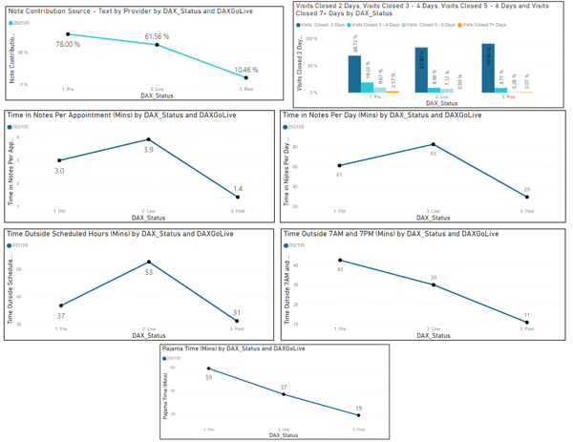
ACI Signal Data (Go Live Date – 5/7/21 )
Note Contribution Source – We want to continue to see a decrease in note contribution from the providers that are using DAX. Decrease in contribution indicates lower edit rates from the providers.
Decrease from 78 % to 10.46 %
Visits Closed in 7+ Days –
Decrease from 2.57 % to 0 %
Visits Closed in 2 Days –
Increase from 68.72 % to 90.94 %
Time In Notes Per Appointment –
Decrease from 3 mins to 1.4 mins
Time In Notes Per Day –
Decrease from 61 mins to 29 mins
Time Outside Scheduled Hours –
Decrease from 37 mins to 31 mins
Time Outside 7am and 7pm –
Decrease from 43 mins to 11 mins
Pajama Time –
Decrease from 59 mins to 19 mins

Slide 24

Who ACI works best for
Has the following characteristics
Involvement:
Main contributor to patient notes, whether by dictation or self
Experiencing:
Documentation Burden
Added Stress
Documentation time outside of clinic
-documentation
EHR usage behavior:
Not as proficient in the HER
Has consistent:
Schedule
Patient Volume
Comfortable with:
Verbalizing information during exam
Stylistic modifications to format

Slide 25
Our vision

Slide 26
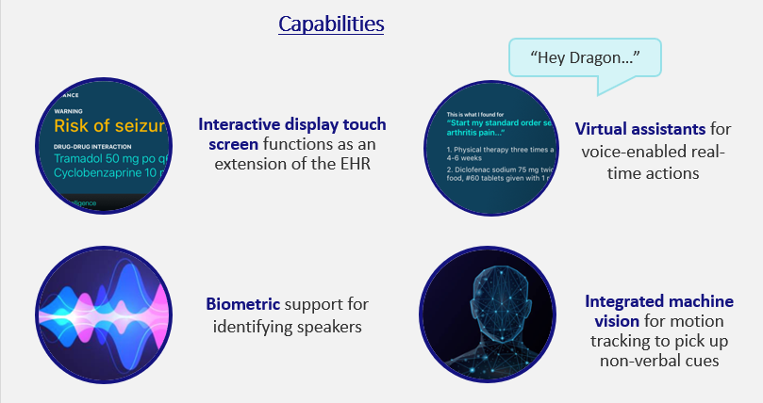



Ambient hardware
Multi-sensory, wall-mounted, unobtrusive– for the exam room
Ambient device renderings
Notes:
BIG IDEA: We are working on creating an ambient device for the exam room. This will be additional way for providers to use DAX. Just like the mobile app, the DAX ambient device will capture the conversation and automatically create a clinical note for placement in the EHR from that conversation.
We envision some additional capabilities with the ambient device:
Biometric support for speaker identification
Machine vision for motion tracking to pick up on non-verbal cues
Interactive touch screen so physicians don’t need to go to the computer to see key information
An access point for voice-enabled virtual assistant capabilities and advanced skills.

Slide 27
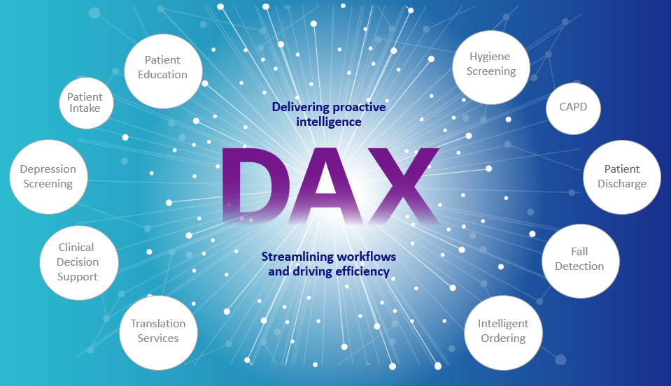
An interconnected ecosystem

Slide 28
Thank you
Thank you!
© 2022 Nuance Communications, Inc. All rights reserved.
28

