Slide 1


The webinar will begin promptly at noon.
CSOHIMSS Lunch & Learn Webinar
Implementing a Successful Electronic Prior Authorization Solution
Presented By
Caitlin Graham, Director, Provider Engagement, CoverMyMeds
&
Brian Kolligian, CarePATH Ambulatory Team Lead Manager, Mercy Health
This webinar requires that you utilize the integrated audio functions (your computer speakers or headphones); there is no dial-in number.

Slide 2
Lunch & Learn Webinar Series
Wednesday
July 12, 2017

Slide 3

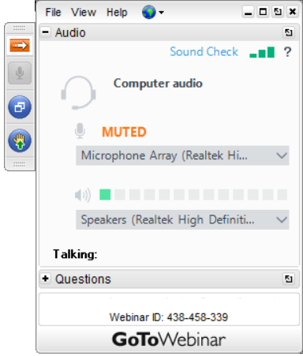
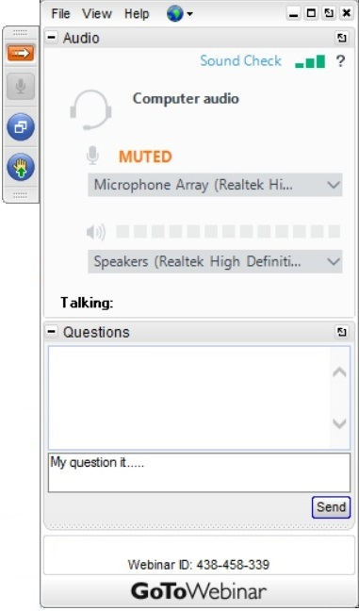
To Ask a Question During the Presentation
Open the
Control Panel
Expand the
Question Window
Type in
Your Question
Notes:
CSOHIMSS website (Events & Education -> Past Events)

Slide 4
Handouts
CPHIMS/CAHIMS CEU form & Presentation Slides available on:
  Handouts function in GoToWebinar
  CSOHIMSS website
    under Events & Education -> Past Events
Recording of presentation will be available on:
  CSOHIMSS YouTube Channel
  https://www.youtube.com/user/csohimss/videos
Notes:
CSOHIMSS website (Events & Education -> Past Events)

Slide 5


Contacts
Webpage – http://csohio.himsschapter.org
Email – csohio.president@himsschapter.org
Email – csohio.info@himsschapter.org

Slide 6
Social Media
Facebook – http://www.facebook.com/csohimss
Twitter – http://www.twitter.com/csohimss
LinkedIn - https://www.linkedin.com/grp/home?gid=844577

Slide 7
Sponsors

Slide 8



Premier Sponsors

Slide 9




Premier Sponsors

Slide 10








Elite

Slide 11







Elite

Slide 12
Upcoming
CSOHIMSS
Events

Slide 13
Events – Fall Conference
Late October 2017 in Cincinnati
Have an interesting topic to share?
Need experience as a presenter?
Let us know and we’ll send you a Call for Speakers form!
See csohio.himsschapter.org details as they develop

Slide 14

Events – 11th Annual OHIT Day
Wednesday, April 25, 2018
Ohio Statehouse Atrium
Watch http://csohio.himsschapter.org/events for more info!

Slide 15
Events – Spring Conference
Have an interesting topic to share?
Need experience as a presenter?
Friday, May 18th, 2018
The Conference Center at OCLC
6600 Kilgour Place, Dublin, OH
See csohio.himsschapter.org for agenda andetails

Slide 16

Events – Lunch & Learn Webinars

Slide 17
Events – Lunch & Learn Webinars
Wednesday, August 9, 2017, noon – 1:00 PM
Topic: Eliminating fax for the sharing of clinical and administrative documents in Ohio in 12 months
Presented by: Mike Hurley, Onbase
Registration Link:
https://attendee.gotowebinar.com/register/6986175219543732482
Presentation Description: Coming Soon!

Slide 18
Events – Lunch & Learn Webinars
Wednesday, September 13, 2017, noon – 1:00 PM
Topic/Theme: Competing on Analytics - Using Data Analytics to Drive Success under Value-Based Payment
Presented by:Jim Garnham, VP Network Contracting & Provider Consulting, EagleDream Health, Inc.
Registration Link:
https://attendee.gotowebinar.com/register/5968607994514065410
Presentation Description: Coming Soon!

Slide 19
Events – Lunch & Learn Webinars
Wednesday, October 11, 2017, noon – 1:00 PM
Topic/Theme: Humans at Scale: How AI Can Affect Your Organization
Presented by: CrossChx
Registration Link:
https://attendee.gotowebinar.com/register/8270422393123617026
Presentation Description: Coming Soon!

Slide 20
Events – Lunch & Learn Webinars
Wednesday, November 8, 2017, noon – 1:00 PM
Topic/Theme: Presentation Needed!
Presented by: Speaker Needed!
Registration Link:
https://attendee.gotowebinar.com/register/5190603462304479490
Presentation Description: Coming Soon!

Slide 21
Events – Lunch & Learn Webinars
Wednesday, December 6, 2017, noon – 1:00 PM
Topic/Theme: Presentation Needed!
Presented by: Speaker Needed!
Registration Link:
https://attendee.gotowebinar.com/register/2026670792448846338
Presentation Description: Coming Soon!

Slide 22
Events – Lunch & Learn Webinars
Wednesday, January 10, 2018, noon – 1:00 PM
Topic/Theme: Presentation Needed!
Presented by: Speaker Needed!
Registration Link:
https://attendee.gotowebinar.com/register/2650059800537408002
Presentation Description: Coming Soon!

Slide 23
Events – Lunch & Learn Webinars
Wednesday, February 14, 2018, noon – 1:00 PM
Topic/Theme: Presentation Needed!
Presented by: Speaker Needed!
Registration Link:
https://attendee.gotowebinar.com/register/4798699035258226690
Presentation Description: Coming Soon!

Slide 24
And now, today’s CSOHIMSS
Lunch & Learn Webinar
Notes:
Enter questions in Question box within the GoToWebinar application at left hand side or top of your screen.
Every question will be answered, even if we run over the allotted time.

