Slide 1
Data Driven Health System
J.D. Whitlock
CIO, Dayton Children’s

Slide 2
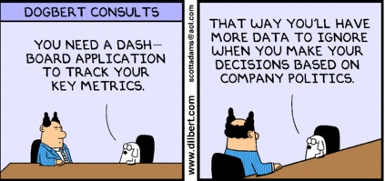

Slide 3
Data on the Success of Data-Driven Organizations
A study in 2020 surveyed almost 1,000 business leaders about the role data plays in their organizations
Organizations deemed mature in data-driven capabilities (compared to those that were not) achieved:
81% advantage in growing revenue
173% advantage in better complying with regulations and requirements
58% advantage in exceeding their revenue goals
https://www.prnewswire.com/news-releases/survey-shows-data-centric-businesses-are-58-more-likely-to-exceed-revenue-goals-301060363.html

Slide 4
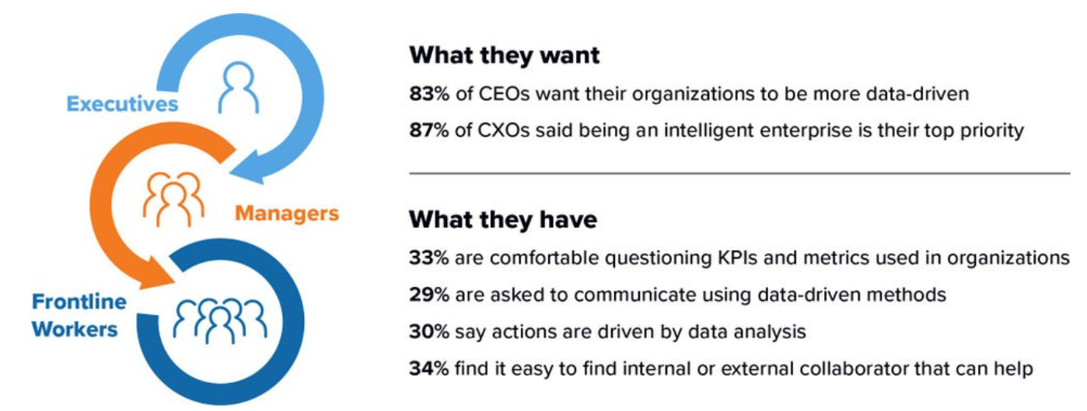
What Leaders Want vs. What They Have
https://www.forbes.com/sites/tableau/2021/07/06/5-trends-that-set-data-driven-companies-apart

Slide 5
https://hbr.org/2021/02/why-is-it-so-hard-to-become-a-data-driven-company

Slide 6
Why is it So Hard to Become a Data-Driven Company?
“Findings from this year’s survey suggest that even with record levels of committed investment, firms are continuing to struggle to derive value from their Big Data and AI investments and to become data-driven organizations. Often saddled with legacy data environments, business processes, skill sets, and traditional cultures that can be reluctant to change”

Slide 7
Why is it So Hard to Become a Data-Driven Company?
“Most tellingly, just 24% of respondents said that they thought their organization was data-driven this past year, a decline from 38% the year before — a figure that suggests that efforts to incorporate data into decision-making processes were not as successful as leaders had previously believed.”

Slide 8
Why is it So Hard to Become a Data-Driven Company?
“What’s at the root of this slow progress? For the fifth consecutive year, executives report that cultural challenges — not technological ones — represent the biggest impediment around data initiatives.”

Slide 9
Why is it So Hard to Become a Data-Driven Company? … Recommendations:
Focus data initiatives on clearly identified high-impact business problems or use cases
Data flows like a river through any organization. It must be managed from capture and production through its consumption and utilization at many points along the way
Data-driven business transformation is a long-term process that requires patience and fortitude

Slide 11
Lt Gen (Dr) Bruce Green -- Air Force Surgeon General 2009-2012
Gen Green had a passion for data driven culture “before it was cool” back in 2006-2008
As Deputy Surgeon General of the Air Force (COO of a $6B, 40K employee organization), he led the transformation of the Air Force Medical Service into a data driven organization
Monthly meetings with all 75 hospital commanders. Both “Top 5” and “Bottom 5” performer hospitals on each KPI had to report to the group

Slide 12
Surgeon General’s Executive Global Look (SG EGL)
Air Force Surgeon General’s Balanced Scorecard
Financial, Customer, Internal Process, Learning and Growth
Mature analytics and data visualization (for 2006)
Robust statistical control charting

Slide 13
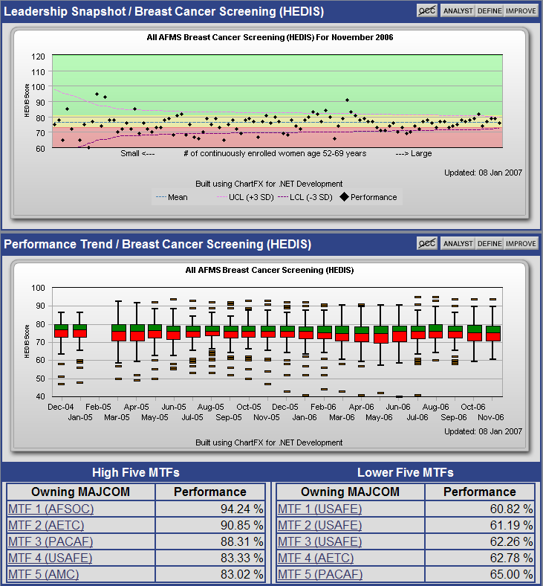
SG EGL Metric View: Quality Control Charts
“P-Charts” help visualize special versus normal cause variation
“Bar and Whisker Plots” depict changes in process variation over time
Top and Bottom performers help drive lessons learned

Slide 14
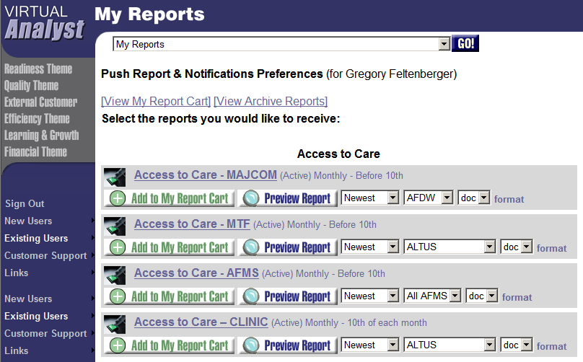
Virtual Analyst Push Reports

Slide 15
Surgeon General’s Executive Global Look (SG EGL): Takeaways
Successfully built a culture of data driven accountability in a large organization, 15 years ago
Key components:
Visionary leadership
Leveraged healthcare quality improvement knowledge and experience

Slide 16
Fast-Forward 10 Years …
In 2016 I am working in the private sector for Mercy Health (now Bon Secours Mercy Health), a health system similar in size to the Air Force Medical Service ($6B)
Similar job focused on enterprise analytics, but now with a team of 35 data engineers and Business Intelligence developers (instead of government contracts)
Once again, blessed to be working for visionary leaders focused on building a data driven organization (COO and Chief Clinical Officer)

Slide 17
COPR Overview
Development
Leadership heavily involved in developing and setting performance targets for KPIs
Many KPIs also have self-service drilldowns provided
Each KPI is assigned a clinical and operational owner in each market, as well as a system leader and data analyst
Deployment
Reported at the system and (7) market levels
Distributed to 700 Directors (and above) and 2,400 CIN providers on a monthly basis
Each KPI has a dedicated SharePoint intranet site to encourage sharing of best practices and other collaboration
Notes:
Produced monthly in .pdf, printed quarterly for board meetings (with addition of President’s Report)
“many” (not all) KPIs have drilldowns because it is not relevant / feasible / desired for all KPIs (e.g. some of the financial KPIs are tough to drill below Region level)
“Distributed to …” refers to email from CCO and COO each month on third Thursday of the month. However it is also shared with all of Mercy via the following week’s enterprise-wide “Mercy Matters” email

Slide 18
2018 COPR KPIs
Strategic Initiative KPIs COPR KPIs
Net Revenue Growth
Reducing Avoidable Readmissions
Patient Safety
Primary Care Access
Disease Prevention (Primary Care 6)
Reducing Opioid Dependency
Inpatient & ED Patient Experience
7 Day Follow Up (High Readmission Risk ACO)
Medical Practice Patient Experience
Profit/Loss per MCARE Patient by Condition
Hospital Salaries & Supplies/WEIPA
Domestic Admissions to Improve Quality
CIN PCPs as a % of all PCPs in the Market
Ambulatory Care Sensitive Condition Admissions
RN Voluntary Turnover
Reduce Epic Documentation Time
Notes:
Probably best to have KPI glossary with you to answer questions
Strategic Initiative KPIs: Performance determines bonuses (assuming threshold measures for margin and community benefit are met)
Foot-stomper: This incentive plan is pretty innovative … fundamentally different model from incenting hospital CEO for volume and ACO manager for value-based measures

Slide 19
COPR Roles (Per KPI)
System Leader
Overall lead for the KPI, convenes regional Dyad Owners to share best practices
System Data Analyst
Responsible for data quality, answering data questions
14 (7 x 2) regional “Dyad Owners” held accountable for KPI performance
Clinical
Business
Notes:
16 KPIs = 16 system leaders and 16 data analysts
16 KPIs x 7 Regions x 2 Dyad Owners per Region = 16 x 14 = 224 Dyad Owner roles
(explain what we mean by Dyad … Clinical + Business leadership)

Slide 20
Actionability & Accountability
“Dyad Owners” (and ultimately Regional CEO) held accountable for KPI performance
Expectations set related to collaboration with other markets’ Dyad Owners
KPI drilldowns provided where most beneficial
Culture of performance transparency
E.g. provider level performance is not blinded
Notes:
Each Region can handle business processes for KPI performance however they want, but typically Dyad Owners report on KPI progress and initiatives at each Region’s Exec meetings
Dyad Owners expected to attend virtual meetings and collaborate on best practices for their KPI with Dyad Owners in other Regions
Wherever beneficial / feasible, drilldown BI tools / reports are provided that make the data actionable and transparent (e.g. see where the good performance is in other Regions / facilities / practices / providers so you can ask other Dyad Owners about their best practices)

Slide 21
KPI: Patient Portal Message Response Timeliness
Links to KPI-dedicated
site on intranet which
includes:
-Drilldown Analytics
-Discussion Forum
-KPI Profile Document
-Dyad Owner Roster
-Collaboration Documents
Email links to Dyad Owners for this Market
Notes:
This shows the typical graphic presentation of KPIs at both System and Region level (1 + 7 = 8). Performance trend is most important so line graphs are used most often.
12 month rolling average is also shown (in addition to monthly performance) on some KPIs where appropriate
“KPI Profile Document” = two to three page standardized format document with extensive info on detailed KPI definition / data sources / business rationale for KPI, etc.

Slide 22
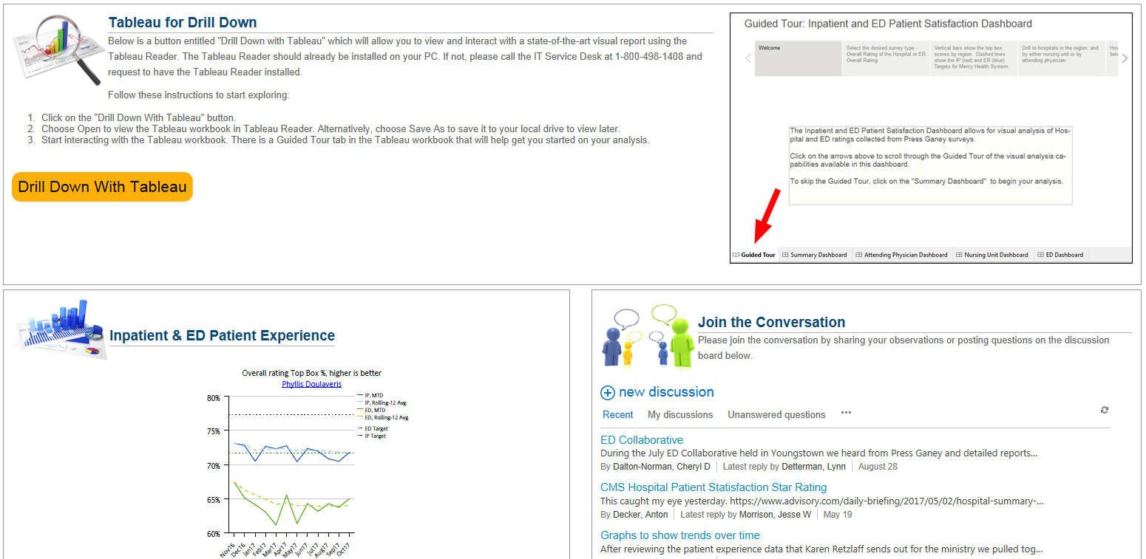
COPR KPI Intranet Site
Notes:
This graphic shows a few of the items listed on last slide that are included on every KPI site: Drilldown (this one in Tableau), discussion board, and a visual of the line graph
Mercy intranet is OnPrem SharePoint 2013. We are currently working on integrating OnPrem PowerBI Server data visualizations into intranet sites for some of the KPI drilldowns (i.e. live views of data as opposed to clicking on file of Tableau report)

Slide 23
3 “Key Takeaways” from COO/CCO Each Month
Notes:
CCO and COO send out “3 Key Takeaways” each month shortly after COPR is published
Always at least one attaboy and one problem area (shown here is cherry-picked attaboy, but often they are critical)
Links to dedicated KPI page
Generates a lot of discussion

Slide 24
More Than Charts
Market Execs contribute text for Executive Summary which includes:
Clinical KPI progress
Operational KPI progress
Strategic KPI progress
Patient Story
Clinician Story
Notes:
Part of what makes the COPR special is the integration of analytics and commentary on the analytics. Executive Summaries (1 system + 7 regions = 8) are where Execs describe their initiatives to improve performance on measures
Also, patient story and clinician story (often but not necessarily specifically tied to a KPI) makes the report more compelling to read

Slide 25
Flip Builder for Online Presentation
Notes:
In order to make the online version of the COPR more visually appealing, we use a web app called “Flip Builder” that gives the impression of flipping through a paper report

Slide 26
COPR Miners
A lot of data shoveling is involved in producing the COPR
Not realistic that all the data for all the KPIs is sitting in a data warehouse
Tough choices on what to fully automate vs. monthly flat file transfer
Centralized data warehouse (COPR Mine) and data warehouse team (COPR Miners) for COPR production and some of the KPI drilldowns
De-centralized analyst teams for drilldowns where more appropriate
Notes:
At the end of every year we update COPR KPIs for the following year. Some KPIs are straightforward, don’t change year-to-year, are defined by industry-standard specifications, and all the data is sitting in our EDW already
Other KPIs (e.g. Reducing Opioid Dependency) are complex composites of sub-KPIs that we have just “invented,” come from multiple different data sources, and would not be easily ingested into our EDW (juice not worth the squeeze). Therefore for some of these KPIs we simply take flat files and build a graph in the COPR Mine BI platform
COPR report itself is standardized and built in Cognos (industrial strength BI tool good for pixel-perfect visualization), but the KPI drilldowns are not standardized – different teams with expertise in that KPI’s data use the most appropriate BI tool for them (combo of Tableau, Lumira, PowerBI)
Evolution of COPR naming … COPR to COPR Mine, COPR Mine to COPR Miners
(make a joke about our EDW team actually looking like the guy in the photo)

Slide 27
Finding a Balance with Standardization
Standardized look,
production, process.
Putting the “K” in KPI
Important measures,
but juice-not-worth-
the-squeeze for
standardization
Notes:
In addition to not standardizing every COPR KPI drilldown, we also do not standardize every department scorecard with hundreds of KPIs on them
The trick is to find the right balance of standardization vs. effort
If a department has an Excel based scorecard, that may be perfectly adequate for their needs
We choose to focus our EDW BI team’s effort on the next big enterprise reporting project rather than standardizing department scorecards just to make them prettier (e.g. Practice reporting on next slide)

Slide 28
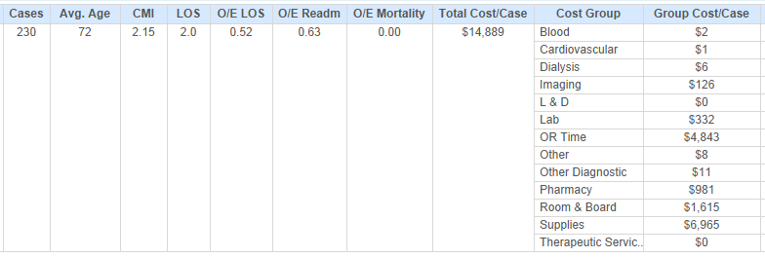
Drilldown Example: Cost Per Case
Notes:
This is an example of a KPI drilldown, and shows one orthopedic surgeon’s data on knee replacements. The key is that it shows both cost and quality data together. Good example of a drilldown on data that is already in our EDW and uses sophisticated acuity adjustment to show quality performance in a way that prevents the “my patients are sicker” conversation (O/E = observed / expected given the acuity of this physician’s patients)
The associated COPR KPI is “Profit / Loss per Medicare Patient by Condition” (Medicare Break Even) but we add in quality aspects because you can’t talk to physicians about cost without including quality
This is produced in Tableau and allows anyone to drill down to provider level (and encounter level without PHI)

Slide 29
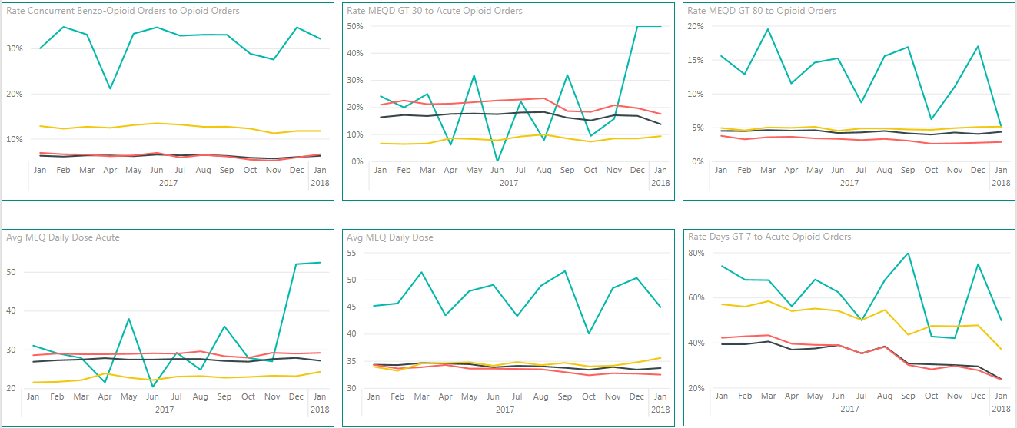
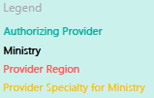
Drilldown Example: Opioid Metrics
Notes:
This shows a drilldown to provider level on a series of opioid prescribing measures we have developed. It compares the provider’s opioid prescribing habits to peers of same specialty as well as all providers in their Region and all providers in the organization.

Slide 30
Challenges
Opportunity cost of all the development effort
KPI du jour sometimes means the hot new KPI this year drops off COPR next year
E.g. Patient portal message responsiveness
Finding the balance between the “perfect” KPI and data oblivion
Frustration with lack of progress on the most-difficult-to-improve KPIs, e.g.:
E.g. Acute care utilization rates
E.g. Patient satisfaction
Notes:
Important to recognize the level of effort that goes into COPR could (obviously) be used for other things
Story on MyChart message responsiveness is that we found out the deeper you drill, you get into workflow complexities amongst different practice team members that make it difficult to always assign responsibility. We also may have created unintended consequence of office staff responding before the time target to get credit for the KPI without fully resolving the patient’s issue. Therefore this KPI was not continued for 2018.
Sometimes it is better to use industry standard measures rather than “improve” a KPI with local input to the point it is too difficult to measure / understand / communicate
Despite all of the effort, some KPIs are just resistant to improvement, things the entire industry struggles with … for example (next slide)

Slide 31
COPR Key Success Factors
Teaming of Execs, Business Intelligence, and marketing results in a report that is actually fun to read
BI team bandwidth dedicated to COPR production each month
Collaboration sites + responsible parties being told to use them
Exec bonuses tied to common Strategic Initiative KPIs
Notes:
Self-explanatory

Slide 32
Recommendations
Is your leadership onboard with driving the strategy, and willing to assign accountability for KPI outcomes?
If not, stop, do not pass GO
Formalize roles-per-KPI and assign the right people to them
Figure out the communications / collaboration strategy that works for your organization
Figure out the right balance of Business Intelligence standardization that works for your organization
Right size total enterprise scorecard level of effort for your organization
Notes:
Self-explanatory

Slide 34
Data Governance 101
Information
Management
Lifecycle
Master data &
Metadata
Management
Data Quality
Reporting
Stewardship
Data Governance
Security,
Privacy,
Compliance
Organizational Awareness
Risk
Management

Slide 35
Not enough data governance looks like:
Decentralized, uncoordinated data analysis resources – human and technology
Inconsistent analytic results from different sources, attempting to answer the same question
Poor data quality
When data quality problems are surfaced, there is no formal body nor process for fixing those problems
Inability to respond to new analytic use cases and requirements

Slide 36
Too much data governance looks like:
Unhappy data analysts … and unhappy data customers
Everything takes too long:
Loading new data
Making changes to data models to support new analytic use cases
Getting access to data
Resolving data quality problems
Developing new reports and analyses

Slide 37
Goldilocks Data Governance
Identify and fix the big data quality problems
Centralized data governance committee referees tough decisions between business units
Well defined KPIs

Slide 38
“Getting in Front on Data”
Data Quality must be led by the business (not IT):
“Many companies mistake metadata for an esoteric IT problem …. It is a business issue and must be addressed as such”
“Everything about data quality is political"
Don’t boil the ocean, focus on biggest pain points for business leaders:
“Meet the most important needs of the most important customers”
"90% of the data is never used for anything by anyone“
"Don't overreach …. Even the most complex organizations require no more than 100 common data definitions"
Detailed “Voice of the Customer” process
Formalized process to identify and fix the most important data quality problems
https://www.amazon.com/Getting-Front-Thomas-Redman-Ph-D/dp/1634621263/ref=sr_1_3

Slide 39
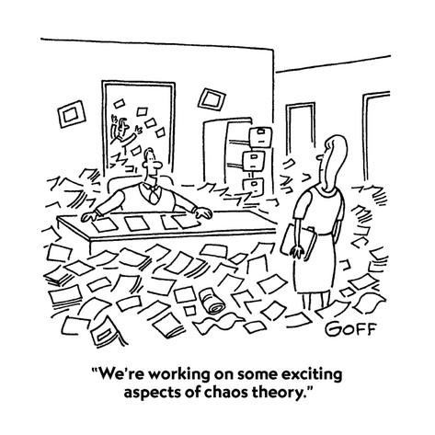
Analytics Governance 101

Slide 40
Without Analytics Governance …
First in, first out?
Squeaky wheel gets the grease?
Business Intelligence Analysts making decisions on prioritization?

Slide 41
Analytics Governance 101
Prioritization decisions should be made by business leaders not IT
Representative of stakeholders given your organizational structure
Goal of enterprise reporting standardization whenever feasible

Slide 42
Analytics Governance Team Members
Appropriate variety and seniority of operational leadership
Able to balance operational requirements with enterprise perspective
Able to say “no”
Include report requesters as “guest stars” to explain requirements and advocate for the importance of their request

Slide 43
Analytics Governance: What Good Looks Like
Maximize “enterprise bang for the buck” per hour of BI developer time
Leadership is satisfied with balance between size (cost) of analytics team and requirements being met
Analytics governance groups are satisfied they have the right amount of input
BI developers are satisfied they are working on the most important projects

Slide 44
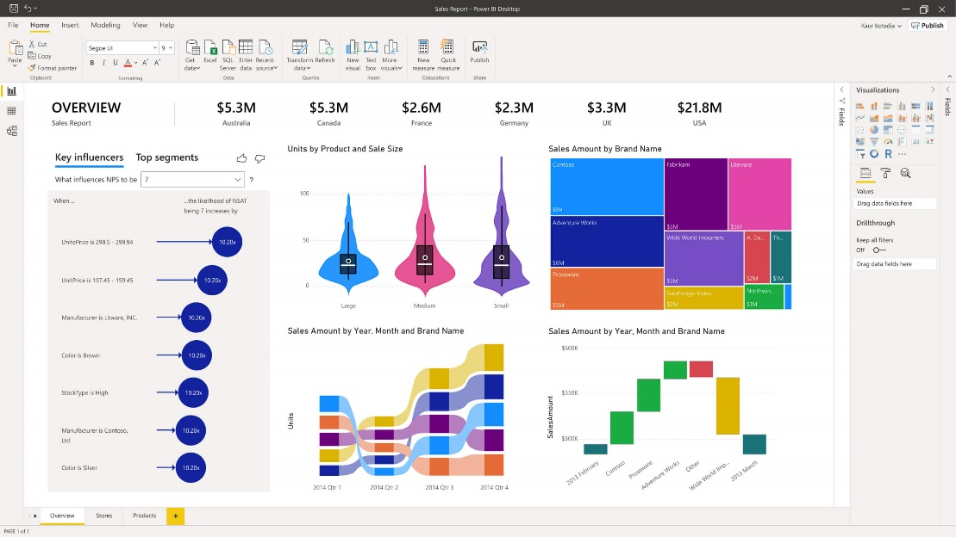
Quality Improvement Science 101
The good news: with modern BI tools like PowerBI, (almost) everyone can build pretty dashboards!
The bad news: with modern BI tools like PowerBI, (almost) everyone can build pretty dashboards, whether or not they understand anything about quality improvement science or basic statistics!

Slide 45
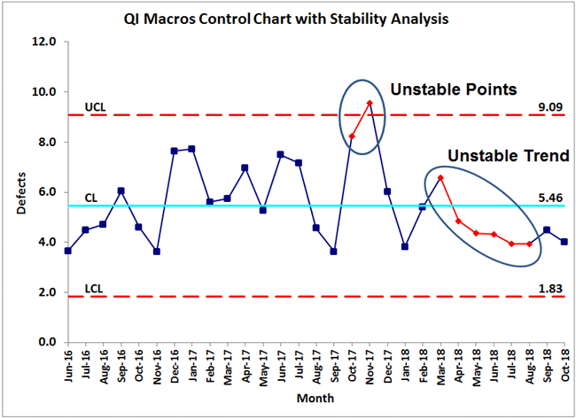
Quality Improvement Science 101
First, do no harm!
The worst thing you can do in analytics is waste a lot of time and effort developing and sharing incorrect conclusions from data
Understand the difference between special cause variation and normal cause variation
Don’t over-react to common cause variation!

Slide 46
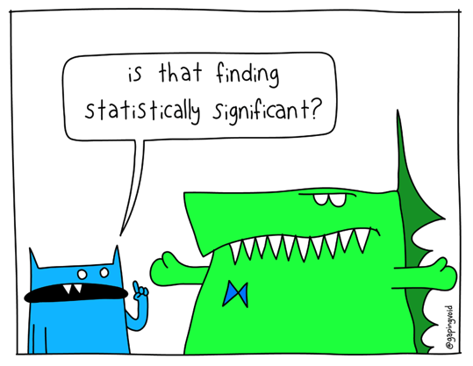
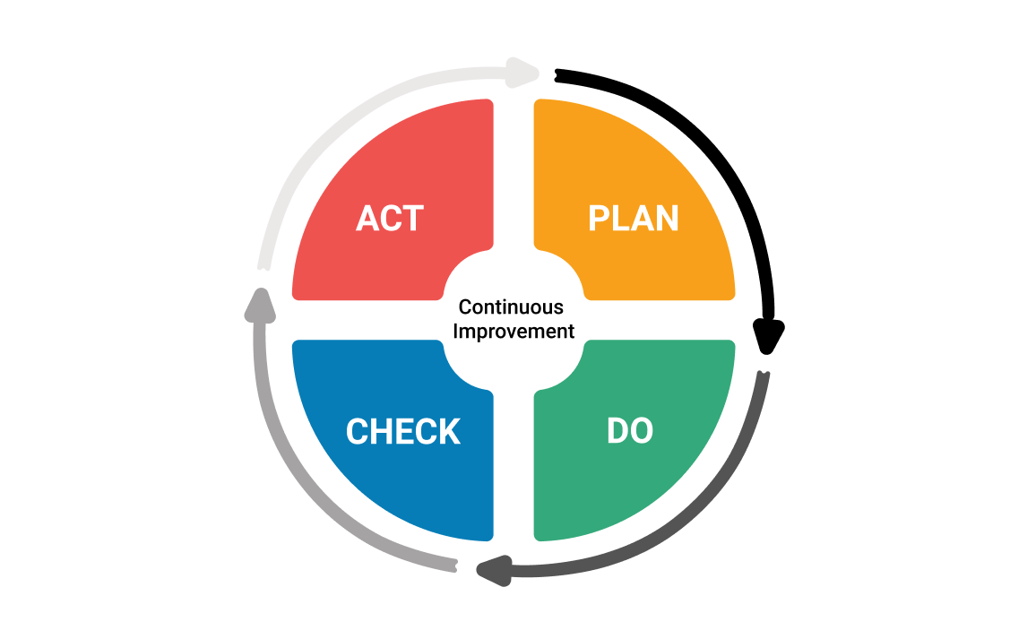
Quality Improvement Science 101
Ensure a minimum knowledge of statistics among analysts / data customers
Socialize statistical significance (or lack thereof)
Bag of marbles analogy
Plan / Do / Check / Act
Disciplined process of demonstrating progress or acknowledging failure

Slide 47
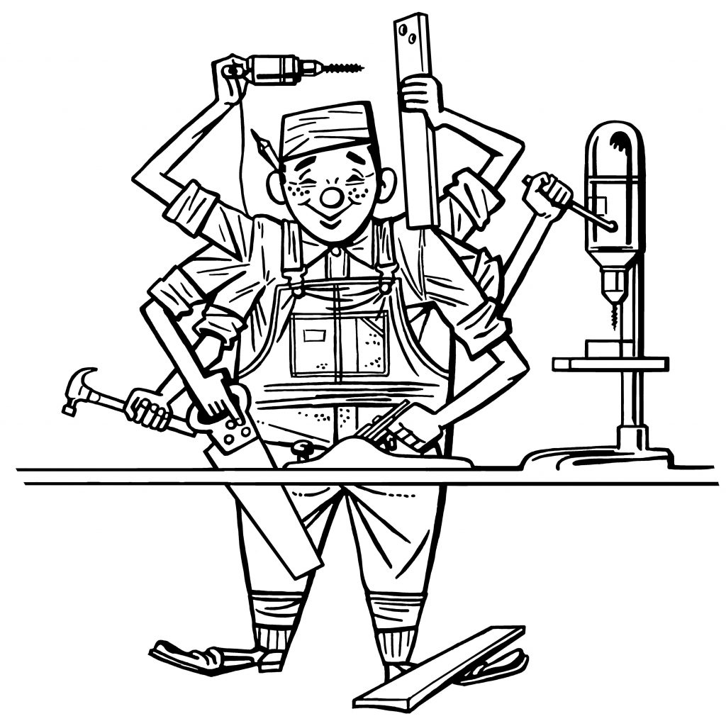
Right tool for the right job
Respect the need for, and implement well, 3 types of analytics
Top-down, leadership led, focus on top KPIs
“I need this reporting / analytics in order to get better results from my department”
Bottom-up, but productionized and built by analysts
Self-service analytics
For the subset of enterprise data that can be predicted to be important and commonly re-used

Slide 48
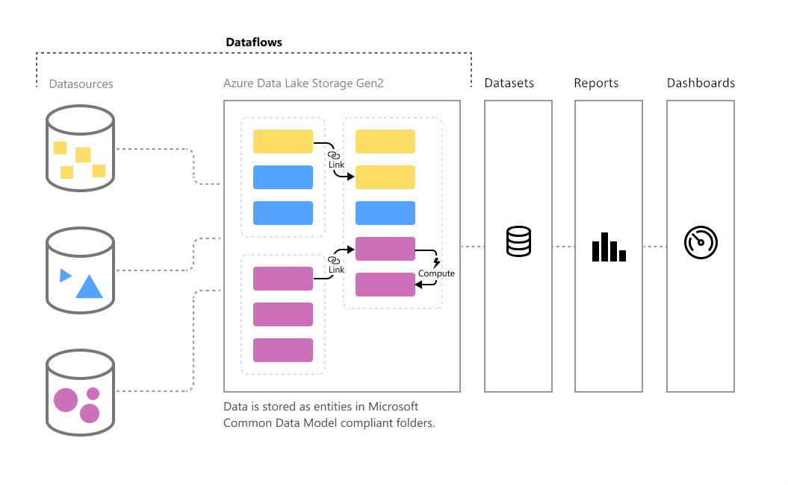
Self-Service Analytics

Slide 49
There seems to be a growing trend that analytics is a 'thing' or a tool (bright shiny object) that someone can purchase. I personally believe that analytics is about 80% smart people, 15% good organization and operation and only 5% or less about the tools. Too many people are chasing a magic solution, but have not focused enough on developing a culture of analytics and the 'smart people' who can make them work.
-- Mark Probst, (former) CIO, Intermountain Healthcare

