Slide 1
Time Capsule 2020:
Pandemic Memoirs for Future Healthcare IT Workers
CSO HIMSS Virtual Fall Conference 2020
Day Two

Slide 2
Welcome

Slide 3
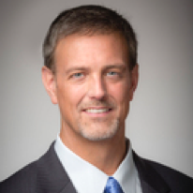
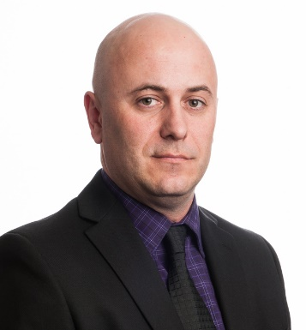
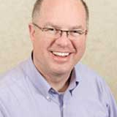
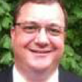
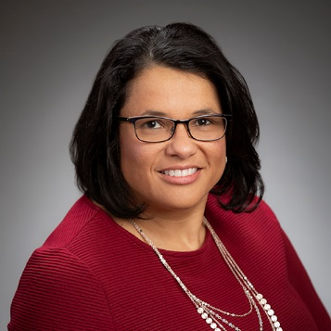
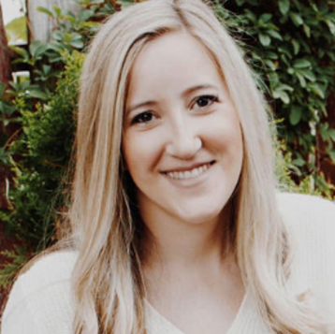
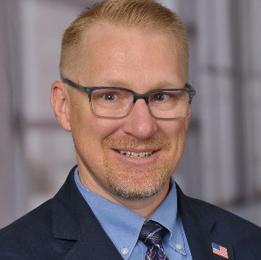
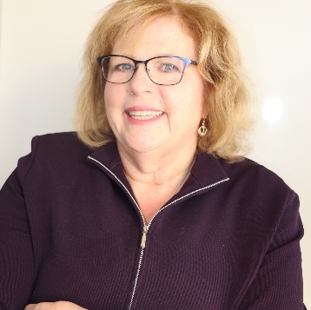
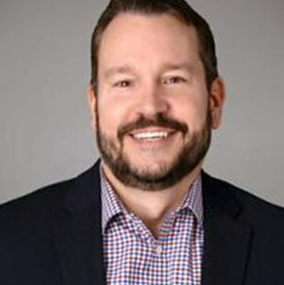
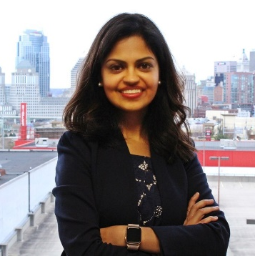
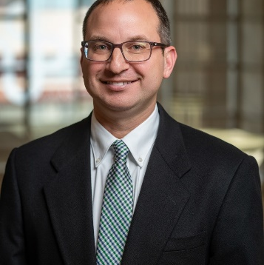
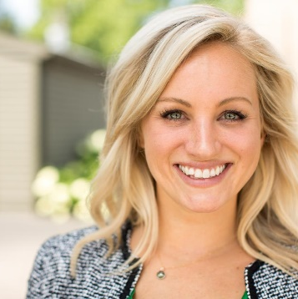
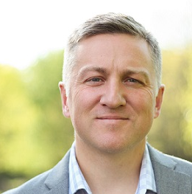
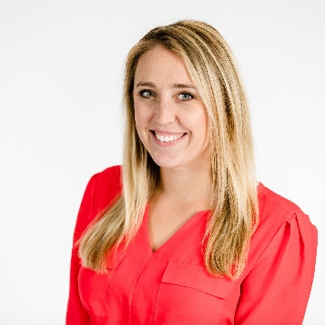
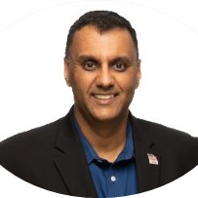
CSO HIMSS BOARD
2020-2022
Alex Vaillancourt, President
Scott Mash,
President-Elect
Russ Hessler, Board Secretary
Victor Simha, Treasurer
Donna Carter, Marketing Chair
Megan Anderson-Baker, Membership Chair
Robert Stillman, Program Chair
Donna Evans, Scholarship Chair
Mark Lemperle, Sponsorship Chair
Neha Matta, Advocacy Chair
Andrew Nixon, HIE Liason
Caitlin Graham, Board Member
Jeff Haas, Board Member
Samantha McCarthy, Board Member
Ajay Sharma, Past- President

Slide 4
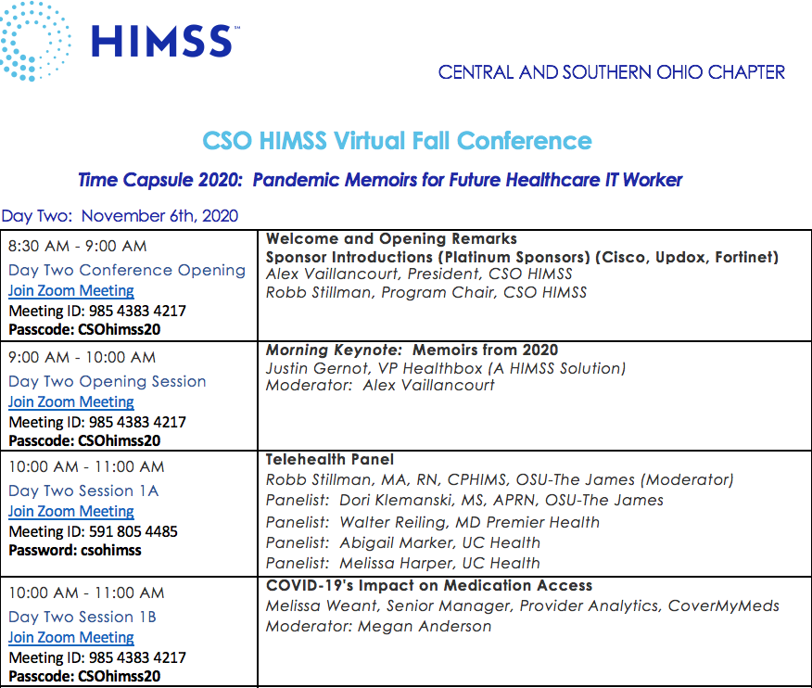
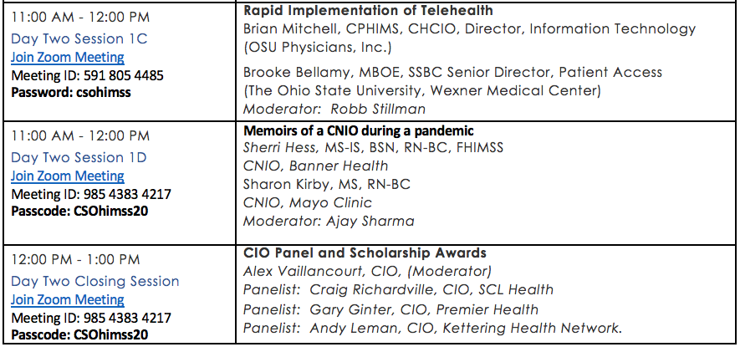
Today’s AGENDA
Robert Stillman, Program Chair

Slide 5
Conference Logistics
The Q&A function is enabled for all Auditorium sessions (this Zoom). CSOHIMSS encourages your questions throughout the sessions and will be followed up at the end of each session by the Moderator & Presenter.
There are two breakout sessions during the 10am and 11am hours. Attendees & Presenters will need to log off this Zoom and join their favorite Breakout session, then rejoin this Auditorium Zoom for the noon CIO Panel, Scholarship Presentation and final wrap up.
This Auditorium Zoom will remain open even throughout the Breakout sessions.
Robert Stillman, Program Chair

Slide 6
Huge Thank You to our session and program Sponsors

Slide 7
In collaboration with Platinum Sponsors
www.fortinet.com
www.cisco.com
www.updox.com

Slide 8
In collaboration with Premier Sponsors
www.covermymeds.com
www.virtustream.com
www.nordicwi.com

Slide 9
In collaboration with Elite Sponsors
www.trinisys.com

Slide 10
Thank You

Slide 11
Morning Keynote
Justin Gernot, VP Healthbox (A HIMSS Solution)
9:00 AM
CSO HIMSS
Virtual Fall Conference

Slide 12
Telehealth Panel
Robb Stillman, MA, RN, CPHIMS, OSU-The James
Dori Klemanski, MS, APRN, OSU-The James
Dr. Walter Reiling, Premier Health
Abigail Marker, UC Health
Melissa Harper, UC Health
10:00 AM
Virtual Fall Conference Session 2020

Slide 13
COVID-19s Impact on Medication Access
Melissa Weant, Senior Manager, Provider Analytics, CoverMyMeds
10:00 AM
Virtual Fall Conference Session 2020

Slide 14
Rapid Implementation of Telehealth
Brian Mitchell, CPHIMS, CHCIO, Director, Information Technology
&
Brooke Bellamy, MBOE, SSBC Senior Director, Patient Access
11:00 AM
Virtual Fall Conference Session 2020

Slide 15
Memoirs of CNIO during a pandemic
Sherri Hess, MS-IS, BSN, RN-BC, FHIMSS CNIO
& Sharon Kirby, MS, RN-BC CNIO
11:00 AM
Virtual Fall Conference Session 2020

Slide 16
CIO Panel
Moderator: Alex Vaillancourt, CIO, The Health Collaborative
Craig Richardville, CIO, SCL Health
Gary Ginter, CIO, Premier Health
Andy Lehman, CIO, Kettering Health Network
11:00 AM
Virtual Fall Conference Session 2020

Slide 17
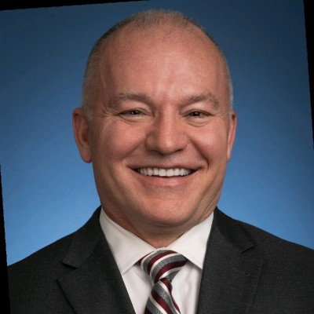
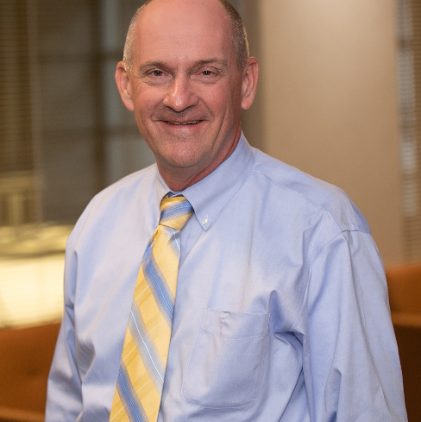
CIO Panel
Alex Vaillancourt
Moderator
Craig Richardville, CIO, SCL Health
Gary Ginter, CIO, Premier Health
Andy Lehman, CIO, Kettering Health Network

Slide 18
Congratulations To Our 2020 Scholarship Winners

Slide 19
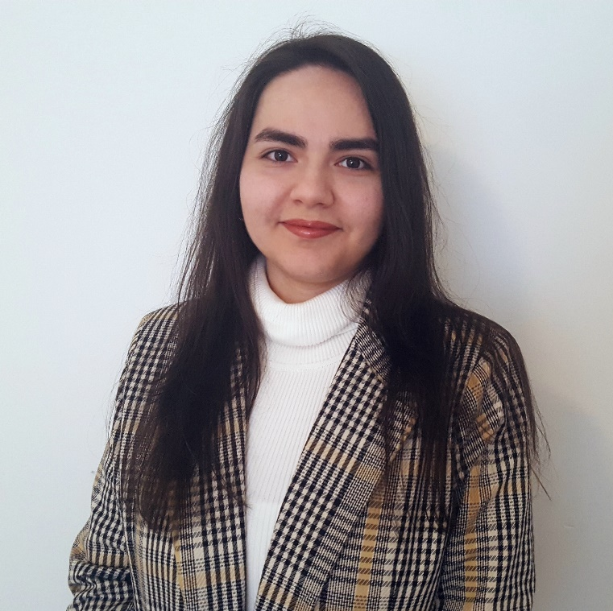
2020 CSOHIMSS Scholarship Winners
Mame Seck
CSOHIMSS Student Scholarship
Roshanak Basty
Jane Blank Scholarship

Slide 20
CSO HIMSS Student Scholarship
The CSO HIMSS Student Scholarship
is awarded to a student who demonstrates academic excellence and the potential for future leadership in the healthcare information and management system. Our winner, Mame Seck, is a Senior at Miami University Health Information Technology Bachelor degree program.
Mame Seck

Slide 21
Jane A. Blank Scholarship
The Jane Blank Scholarship
Scholarship is awarded in honor of Jane A. Blank, an early leader in Health IT. The scholarship is awarded to a student who demonstrates academic achievement, service activities, technical skills, career goals, and demonstration of leadership potential. Our winner, Roshanak Basty, is a student at University of Cincinnati Master of Health Informatics program.
Roshanak Basty
Jane Blank Scholarship

