Slide 1
Climbing Down the CDS Mountain
Jessica Hehmeyer, MHA
Manjusri Nguyen, MBA, RHIA

Slide 2
Place subtitle here or remove slide
Nationwide Children’s Hospital
Columbus, Ohio
Add subtitle
Best outcomes in everything we do, together delivering the best health care for children.
“
”
Notes:
MJ

Slide 3
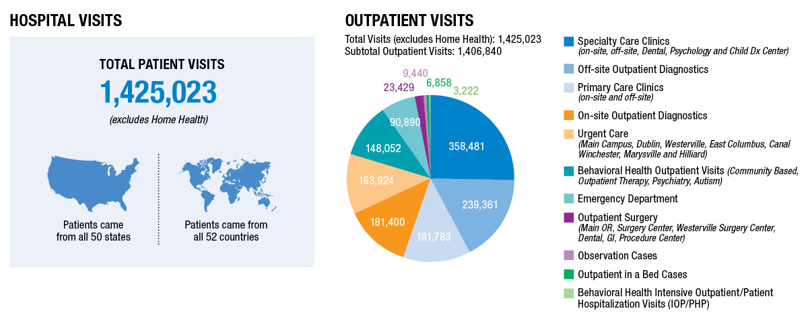
Place subtitle here or remove slide
Nationwide Children’s Hospital
Columbus, Ohio
Add subtitle
Do the Right Thing
Create a Safe day Every day
Promote Health and Well Being
Are Agile and Innovative
Get Results
Notes:
MJ

Slide 4
What is CDS?
Epic Proprietary Screenshot
(unable to distribute)
© 2018 Epic System Corporation
Notes:
MJ

Slide 5
Current State
BPA creation steadily increasing
Firing rate continuously increasing
No actual governance of best practice alerts
Notes:
JESS

Slide 6
Current State
Alerts shown to Providers: 30-35k per month
Feb 2018: 32,945
Top 10 alerts overridden at 73%
Notes:
MJ

Slide 7
Multiple Alerts on Open Chart
Epic Proprietary Screenshot
(unable to distribute)
© 2018 Epic System Corporation
Notes:
JESS

Slide 8
Commonly Ignored BPAs
Why are they ignored/cancelled?
Influenza
Doesn’t account for external administrations
Health maintenance
Orders placed via smartset
Epic Proprietary Screenshot
(unable to distribute)
© 2018 Epic System Corporation
Notes:
JESS

Slide 9
More Commonly Ignored BPAs
Problem List
Wrong time, wrong place (IP fires every 4 hours at open chart)
Cosign Order
Wrong person (moonlighting Fellows, Anesthesia, consultant)
Tobacco
Wrong place (fires at open chart)
Notes:
JESS

Slide 10
All Other Problems
No build standards
No governance
No intake
You request, you get
Notes:
MJ

Slide 11
Intrusive Alert Team (IAT) Goals
Investigation of BPAs always on the back burner
Nice to have but not important enough to dedicate full resources
Started with 2 system analysts (us)
Discovery/Investigation started
Lots of AHH HA! and WOAH! moments…
Realized we needed some reinforcements!
Insert doctors (Juan and Corey)
Notes:
MJ

Slide 12
IAT Goals
Alert Reduction for Providers
For top 10 interruptive alerts shown to providers, reduce volume of alerts by 20% and sustain for 6 months
Reduction of ~4,600 x 12 months = 55,000 fewer alerts annually
Notes:
MJ

Slide 13
IAT Goals
Style guide for BPAs
Fonts
Icon/graphics use
Templated Layout
Style guide for OrderSets (EBM)
Notes:
MJ

Slide 14
What Are We Targeting?
Zero alerts is not the goal, but zero incorrect or unhelpful alerts is.
Establish target baselines for each alert
What is an acceptable false-positive or over-fire rate?
Notes:
JESS

Slide 15
Looking at “bad” BPA Build
Create robust reporting
Identifying high-override BPAs
Spot checking BPA firings
Reviewing data for irregular firing patterns
Feedback from end-users
Full review of BPA when end user request modifications
Notes:
JESS

Slide 16
Can we fix this…
Will this actually matter….
How are we going to fix this…
Notes:
JESS

Slide 17
The 5 Rights of CDS
Well developed and deployed clinical decision support interventions must provide:
who
- to the right person
?
what
where
the right information -
- through the right channel
when
how
at the right point in workflow -
- in the right format
Notes:
JESS

Slide 18
BPA Intake Form
Notes:
JESS

Slide 19
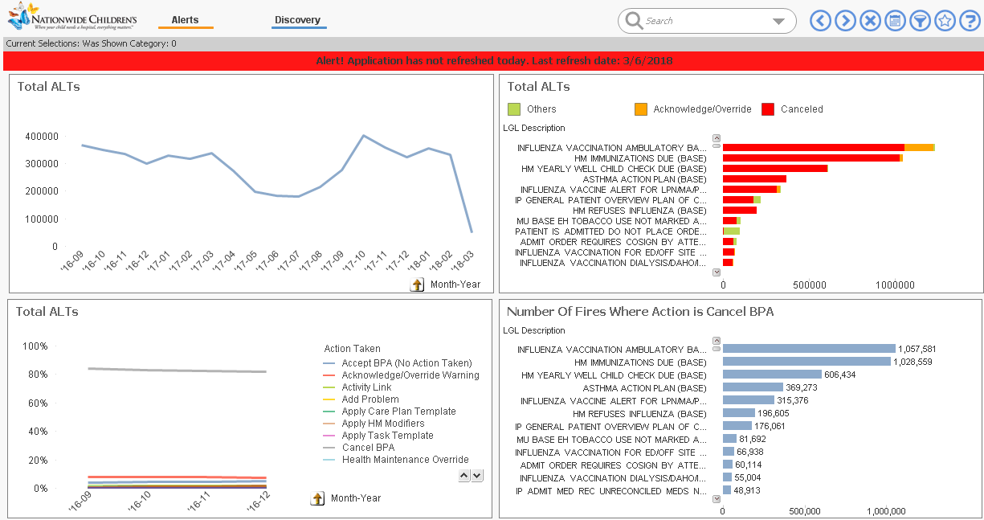
Data Visualization Tool
Notes:
MJ

Slide 20
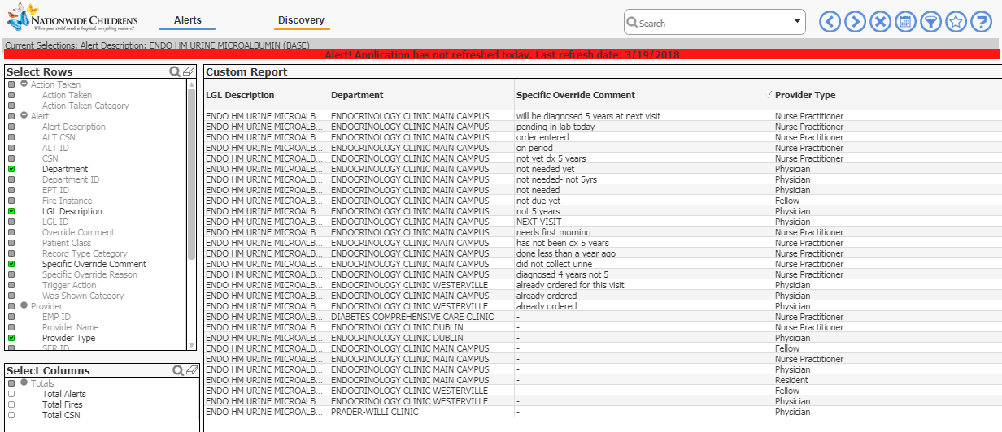
Data Visualization Tool
Notes:
MJ

Slide 21
Build Updates
Newly Designed BPAS!
Graphics
Meet “Kevin Kidney”
Epic Proprietary Screenshot
(unable to distribute)
© 2018 Epic System Corporation
Notes:
JESS

Slide 22
Build Updates
Newly Designed BPAS!
Graphics
Sepsis Risk
Epic Proprietary Screenshot
(unable to distribute)
© 2018 Epic System Corporation
Notes:
MJ

Slide 23
Build Updates
Newly Designed BPAS!
Pop-Up FLO
Antibiotic Challenge
Epic Proprietary Screenshot
(unable to distribute)
Notes:
JESS

Slide 24
Build Updates
Newly Designed BPAS!
Pop-Up Activities
Cosign Orders
Epic Proprietary Screenshot
(unable to distribute)
© 2018 Epic System Corporation
Notes:
MJ

Slide 25
All Together Now
Incorporating 5 rights of CDS
Reviewing and improving text directions
Including icons for easier communication
Removing non-functioning or unnecessary alerts
Hold SME accountable for reporting an follow-up on BPAs
Notes:
JESS

Slide 26
Build Standards
Update all LGLs with Provider type of Physician Assistant (PA)
Standardize BPA text
Epic Proprietary Screenshot
(unable to distribute)
© 2018 Epic System Corporation
Notes:
MJ

Slide 27
Build Standards
Defer to Primary Service
Department Groupers
Epic Proprietary Screenshot
(unable to distribute)
© 2018 Epic System Corporation
Notes:
MJ

Slide 28
Lessons Learned
Testing vs actual
Testing sometimes not authentic
Discovery of unidentified issues afterwards
Notes:
JESS

Slide 29
Next Steps
Continue monitoring
Continue to update old BPA builds
Keep each other accountable to new build standards
Notes:
JESS

Slide 30
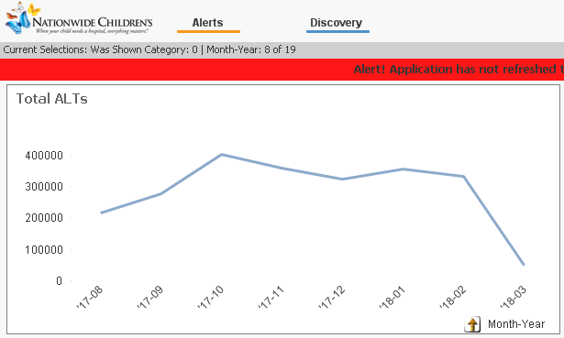
Change Is Happening!
Notes:
MJ

Slide 31
Questions?

Slide 32
Contact Information
Jessica Hehmeyer, MHA
Jessica.Hehmeyer@nationwidechildrens.org
Manjusri Nguyen, MBA, RHIA
Manjusri.Nguyen@nationwidechildrens.org

