Slide 1
Optimizing the Physician EMR Experience
Kara Scott, Sr. IT Training & Optimization Consultant

Slide 2
Goals
Identify EMR optimization needs for physicians
Understand an effective structure for optimization sessions
Gather tools for planning and conducting instructor-led optimization sessions
Learn how to develop and monitor program success metrics

Slide 3
Background: Keeping Up with an Evolving EMR

Slide 4
Current Physician Training Program
Physicians were trained on the EMR at go live or when they started at the medical center
No formal ongoing training program
EMR changes frequently, with monthly updates and yearly upgrades
Challenging to effectively communicate updates to physicians
Typical channels (email messages, newsletters, super users, faculty meetings) don’t necessarily reach all physicians at the right time

Slide 5
EMR Effects on Physician Efficiency and Satisfaction
Literature shows that physicians are increasingly at risk for burnout, and EMRs may contribute to this¹
Specifically at OSUWMC, we receive data from our EMR vendor that identifies efficiency opportunities for each physician.
Can helping physicians be more efficient in the EMR help them feel more satisfaction?
¹Shanafelt, TD, Dyrbye, LN, Sinsky, C, et al. Relationship Between Clerical Burden and Characteristics of the Electronic Environment With Physician Burnout and Professional Satisfaction. Mayo Clinic Proceedings. 2016: 91, 7, 836-48.

Slide 6
Physician Satisfaction and the EMR
KLAS Arch Collaborative report² suggests that several characteristics may contribute to physician satisfaction with the EMR:
6 hours or more of initial training
Several hours of annual ongoing training
Degree of personalization in the system
Organizational culture (may be difficult to define)
¹Davis, T. Creating the EMR Advantage: The Arch Collaborative EMR Best Practices Study. https://klasresearch.com/report/creating-the-emr-advantage/1337 Updated December 2017. Accessed 18 April 2018.

Slide 7
Building an Efficiency Program
If we were to provide additional ongoing training, which topics could bolster efficiency and satisfaction the most?
Time-saving strategies
Efficient documentation
Streamlined workflows
Finding information in the chart
Personalization
Macros
Filters
Templates
Ordering tools

Slide 8
Developing the Physician Optimization Program

Slide 9
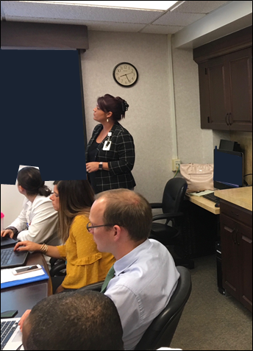
Coaching + Class = Workshop
Why we decided to create efficiency workshops
One-on-one coaching was great, but we needed to get to more people
Wanted to mesh coaching and training classes together
Group setting provides accountability and provider to provider learning

Slide 10
Pilot Workshop with One Department
One specialty at our organization offered its physicians a wide range of wellness opportunities.
What did physicians say they wanted the most?
EMR Assistance!

Slide 11
Pilot Workshop with One Department
The Medical Director approached our EMR training team about providing additional training resources, and the workshop was born.
To prepare for the workshop, we:
Reviewed EMR data to assess opportunities for efficiency and personalization
Learned more about the department’s operations: workloads per day, common patient conditions, etc.
Discussed physicians’ EMR perceptions with the medical director
Booked rooms for several sessions, secured laptops
Medical Director set expectations via email: Recalled the wellness initiative and stated that the session was required

Slide 12
Pilot Workshop Improvements
Minutes

Slide 13
Planning and Conducting Efficiency Workshops

Slide 14
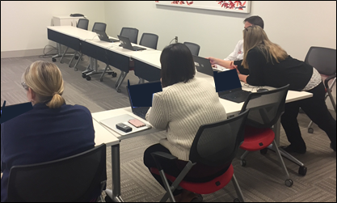
Program Expansion
After the first session and positive data results, we decided to expand the program:
Presented at leadership meetings
Word-of-mouth among physicians and leaders
More and more clinics and departments requested sessions
Developed a program “package” that we could adjust and repeat for different specialties and groups

Slide 15
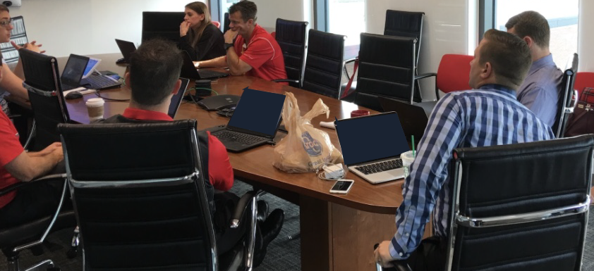
Efficiency Workshop on Wheels (eWOW): Logistics
Focus on small group (less than 15)
Schedule workshops for 2 hours at convenient times for the physicians (early mornings, evenings, lunches)
Work with managers, administrators, lead physicians to identify times and locations

Slide 16
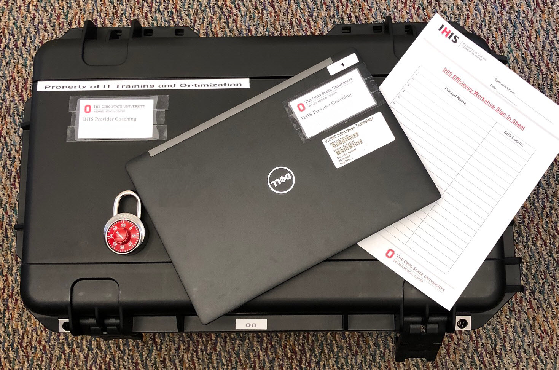
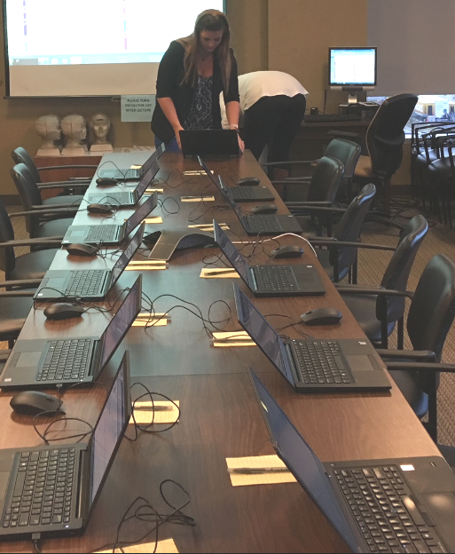
Efficiency Workshop on Wheels (eWOW): Technology
We bring laptops to a conference room at their location
Physicians create templates, ordering tools, filters, macros and other personalization tools in production so they can begin using them immediately

Slide 17
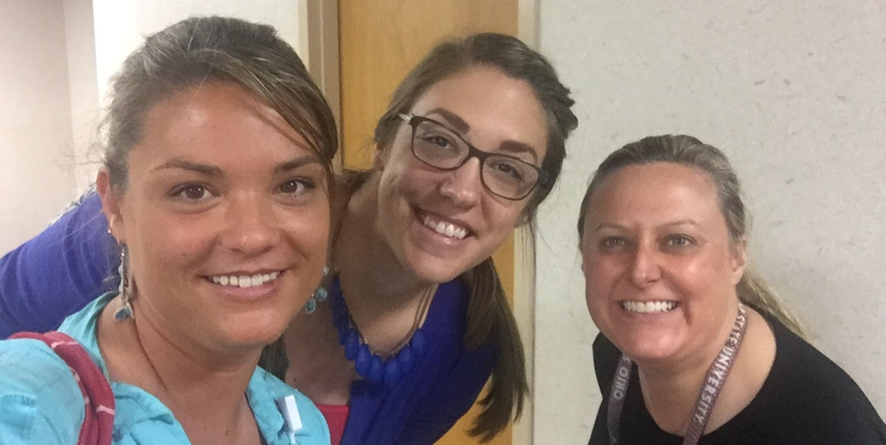
Efficiency Workshop on Wheels (eWOW): Trainers
4-6 trainers per session
1 trainer lead
Other trainers available in the room to answer questions and provide individualized support
Trainers specialized in a wide variety of workflows:
Inpatient
Ambulatory
Surgical
Specialties: Cardiology, Radiology, Women and Infant, ED, Oncology, Ophthalmology, Orthopaedics, Transplant

Slide 18
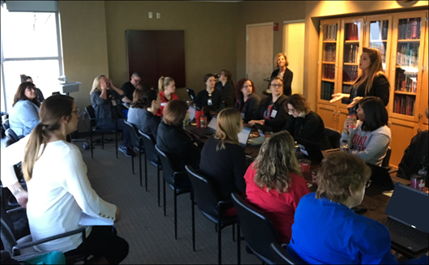
Efficiency Workshop Agenda
Tailoring the workshop to the specialty is key, but the topics are generally the same.
Tools to quickly find information in the chart
Specialty specific documentation tools
Messaging and communication tools within the EMR
Customized ordering tools
Reporting

Slide 19
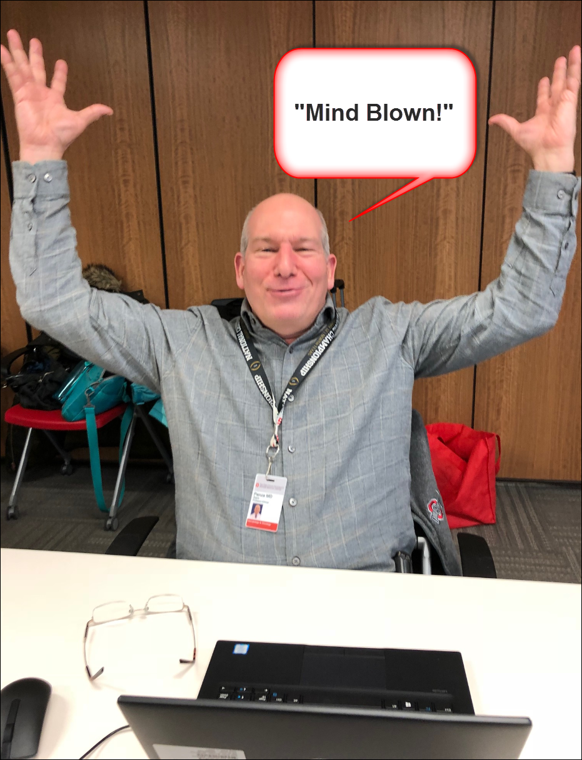
Promoting the Sessions
Present about the program at leadership, chair and faculty meetings to gather interest
Present at new provider orientation and resident program coordinators meeting

Slide 20
Offering CME Credit
Efficiency workshops qualified for 2 AMA PRA Category 1 Credits
Icing on the cake for getting people interested

Slide 21
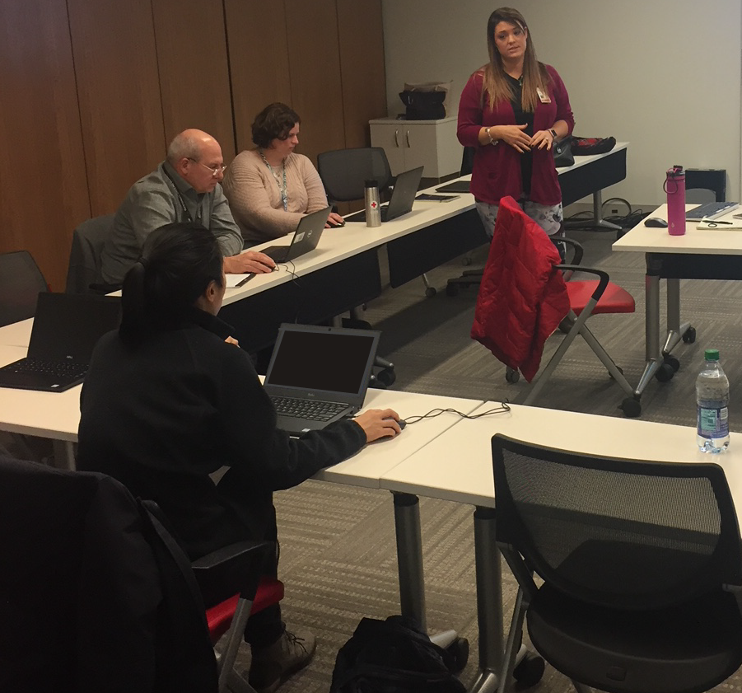
Post-Workshop Support
Send email to all attendees after the session with links to supporting training materials and additional resources, such as individual coaching
Workshop trainers accessible at a “Physician Coach” email address

Slide 22
Evaluating Program Effectiveness

Slide 23
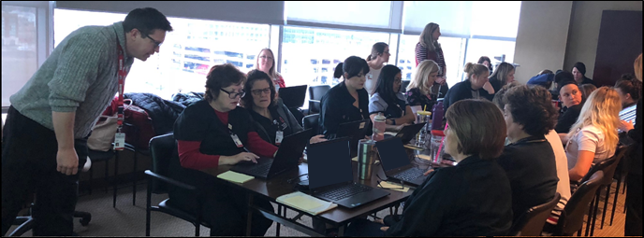
Tools and Metrics
How do we measure effectiveness?
CME evaluations
EMR data from our vendor
Post session surveys
Provider feedback (email, word of mouth, referrals)

Slide 24
Provider Feedback
“This has saved me, literally, hours in my week.”
“I learned a number of techniques that enabled me to more rapidly document during encounters.”
“These sessions are very helpful.”
“I have saved significant time in result documentation as well as documentation during clinic time.”
“All providers have found it very useful!”
“You and your team were fantastic!”

Slide 25
Provider Feedback
“The usefulness of the group sessions cannot be underestimated. We had the chance to ask questions, learn from each other, and learn in a setting where people were asking questions we may not have thought of individually.”
“I believe the protected time to sit, learn, and build efficiency tools is an invaluable investment in our faculty and staff.”
“I can honestly say that all involved were blown away by the things they didn't know they didn't know and the opportunities to improve their efficiency in the EMR.”

Slide 27
Case Study: Before and After
On a monthly basis, our EMR vendor provides data on how efficiently each provider uses the system
As we began holding more workshops, we compared whether providers who attended the workshops showed any improvements in the monthly efficiency reports.

Slide 28
Most Improved Providers from Each Workshop
Points

Slide 29
Most Improved Providers from Each Workshop

Slide 30
Building Your Own Program

Slide 31
Building Your Own Program
The organization needs to prioritize physician efficiency
Understand the importance of physician EMR efficiency
Support physicians taking time out of their schedules to attend workshops
Embrace specialty-specific training experts
It’s not “one and done”
Because the EMR evolves so quickly, physicians need ongoing support to enhance their EMR skills
A variety of settings works best
One-on-one coaching, group sessions for peer learning
Hands-on training in production is best so physicians can leave the workshop with new tools
Active engagement from physicians – get them excited!

Slide 32
Questions and Discussion

