Slide 1
Never let a good crisis go to waste.
Transforming hospital capacity data during a pandemic
Tyler French
AVP – Capacity Management/Flow
UC Health Cincinnati, Ohio
Notes:
Its not to make light of the situation, but you will hear from me and from many sessions today, how out of sheer apocalyptic necessity, we had to push our analytics. And how we cannot let it fall to the wayside, now is the time to step on the pedal. To introduce myself, I am Tyler French. AVP of capacity management (great idea). Also, I have no analytics, I developed my passion around a practical need and almost an obvious click. So I am convert, or created enthusiast. (when I say we, I mean folks in this room that I have to thank you. More than just capacity)

Slide 2
The Modern Hospital
“
the most complex form of human organization we have ever attempted to manage”
-Peter Drucker
Notes:
We don’t often have truly appreciate the complexity of these systems, and as such we underestimate the necessary tools. This is where analytics is so vital. I often got a response that implied these things are “nice to have”

Slide 3

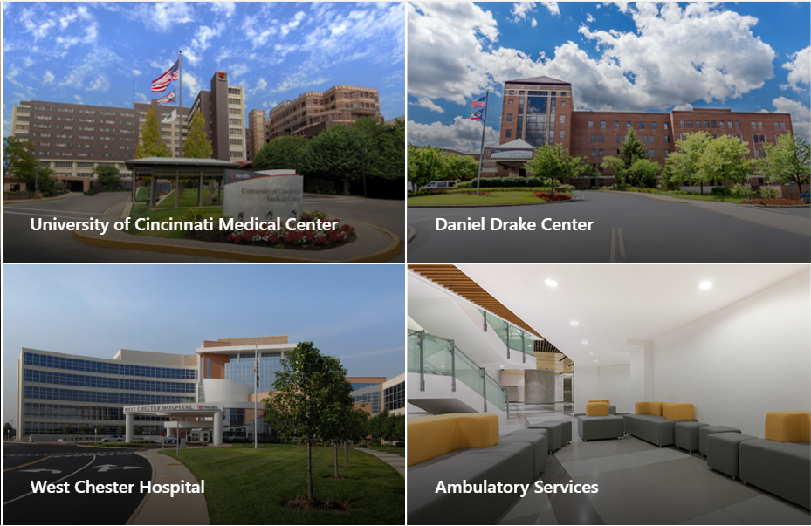
About
Level 1 Academic Medical Center
Community Hospital
Skilled Nursing Facility/LTAC
Ambulatory Clinics

Slide 4
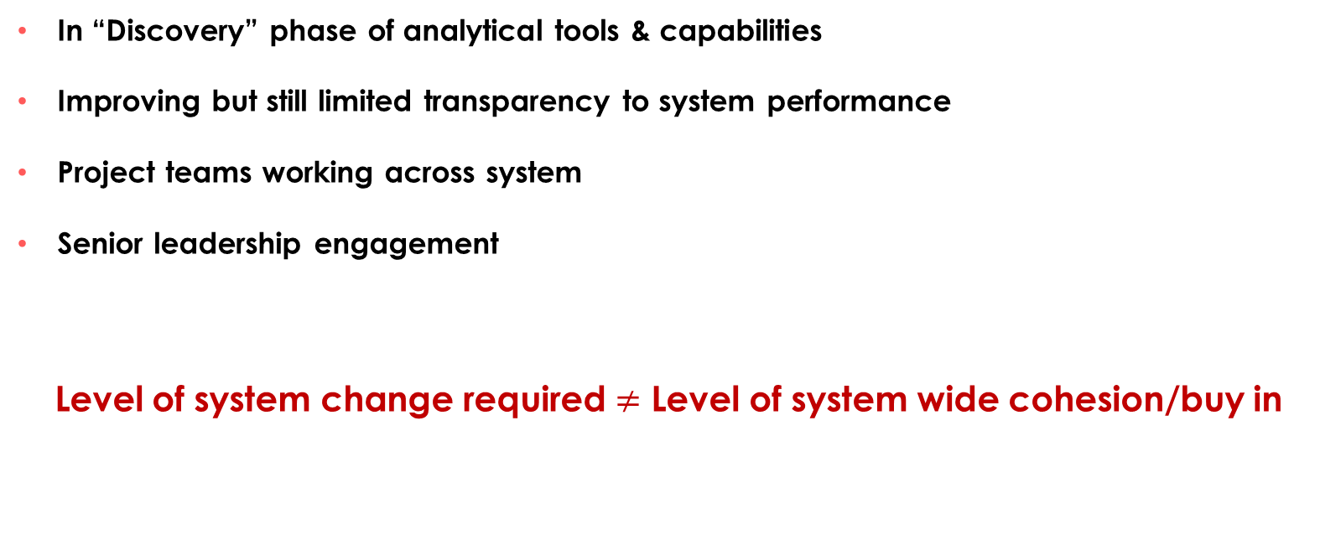
Where we were..
In “Discovery” phase of analytical tools & capabilities
Improving but still limited transparency to system performance
Project teams working across system
Senior leadership engagement
Level of system change required $≠$ Level of system wide cohesion/buy in
Notes:
We knew capacity was important. Leadership was understanding the importance, enough to create what we call traction teams, focused on mostly flow & capacity management. The issue was the change curve was steep. We were attempting to disrupt multiple areas with multiple interventions across the system, and the necessary buy in required would need to be vast. For example with the OR, wanted to smooth schedules. Silos= The good news is flow is everyones problem. The bad news is it is everyones problem

Slide 5
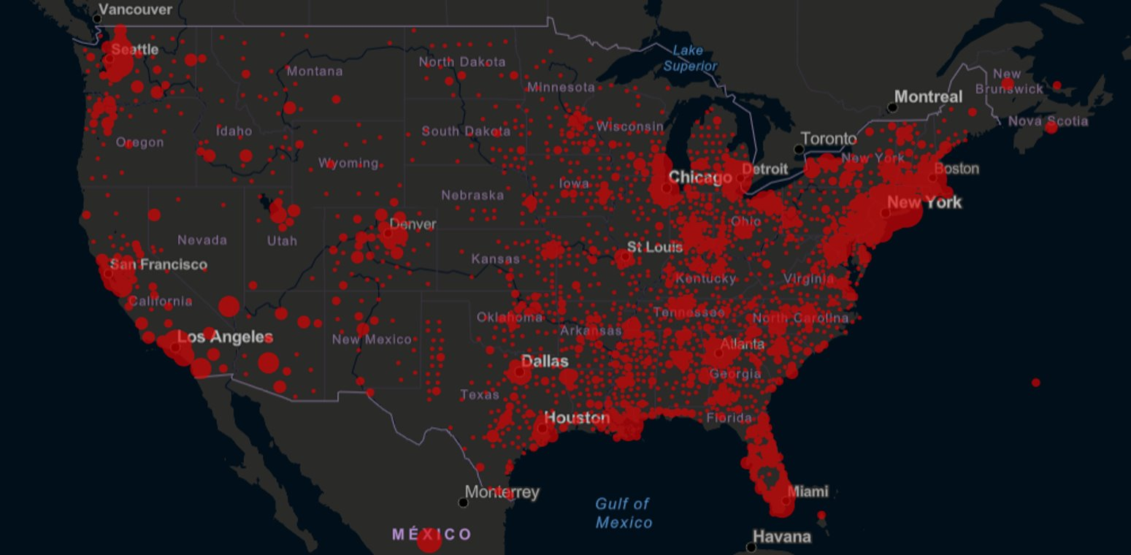
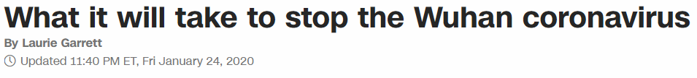
Notes:
COVID Hits. The situation: A sudden unexpected population wave hits hospitals. Need to understand every day
where we were at, and where we were going to be
Analytics pushed to the brink

Slide 6
Our Approach
Real Time Monitoring
Historical/Trending Data
Prediction/Forecasting

Slide 7
Key Questions​
​
What is our expected peak demand?
  How fast will the growth occur?​
What is our current & potential capacity to accomodate this peak demand?​
  What is our trigger for expansion?​
  How do we prioritize the progression of expanded capacity?​
  What are the implementation needs of each site & how long will it take?​
Notes:
Prediction Analysis – Take 1: Our first prediction was broad. How bad is it going to be?

Slide 8
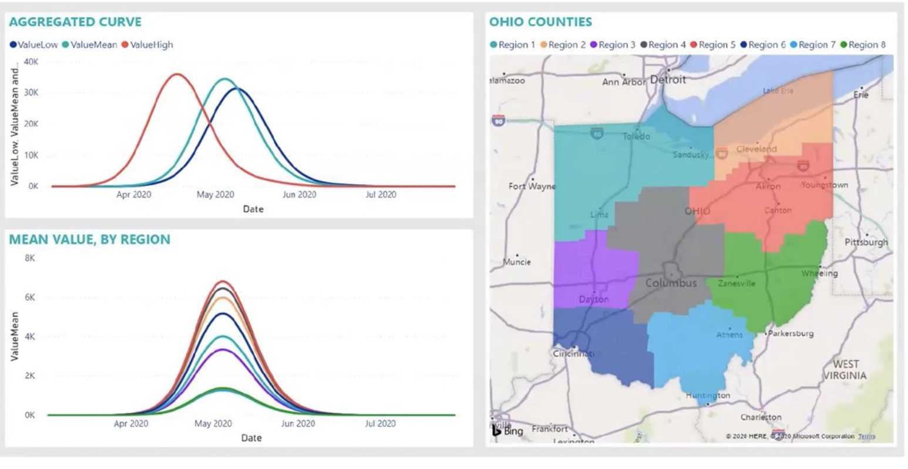
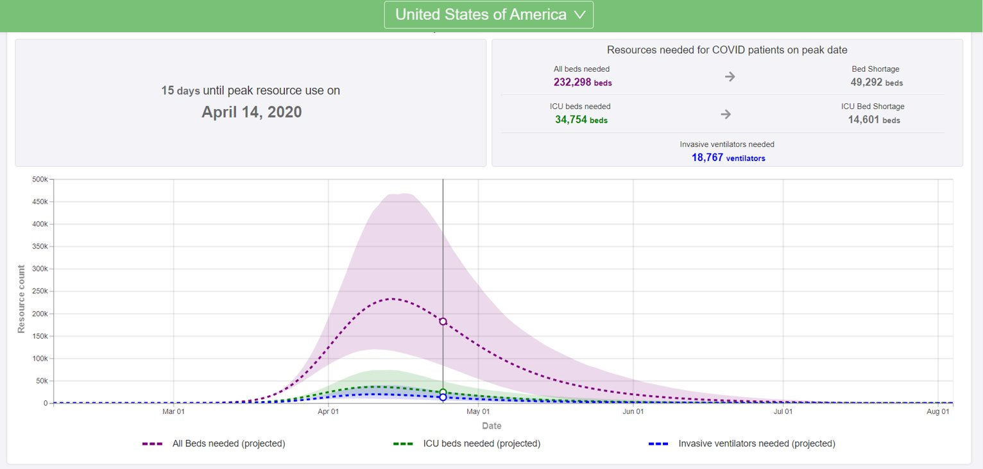
Incorporating State/Regional Models
Notes:
We started to see analytics in play to start understanding our projection. Un of Washington, Penn State, Cornell, Ohio State & OHA models. These outside resources were vital. However our challenge was not only deciphering what was “correct”, but how do we assess national, state, regional, and direct hospital data all to come to a sufficiently reliable conclusion about where we could be?

Slide 9
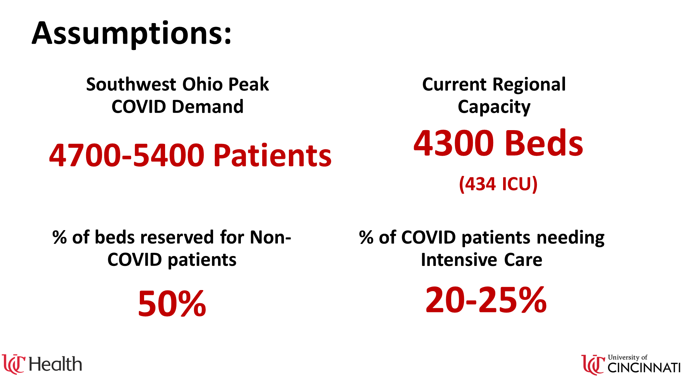
Notes:
Had to use outside resources. National, regional, hospital. Un of Washington, Penn State, Cornell, Ohio State & OHA models

Slide 10
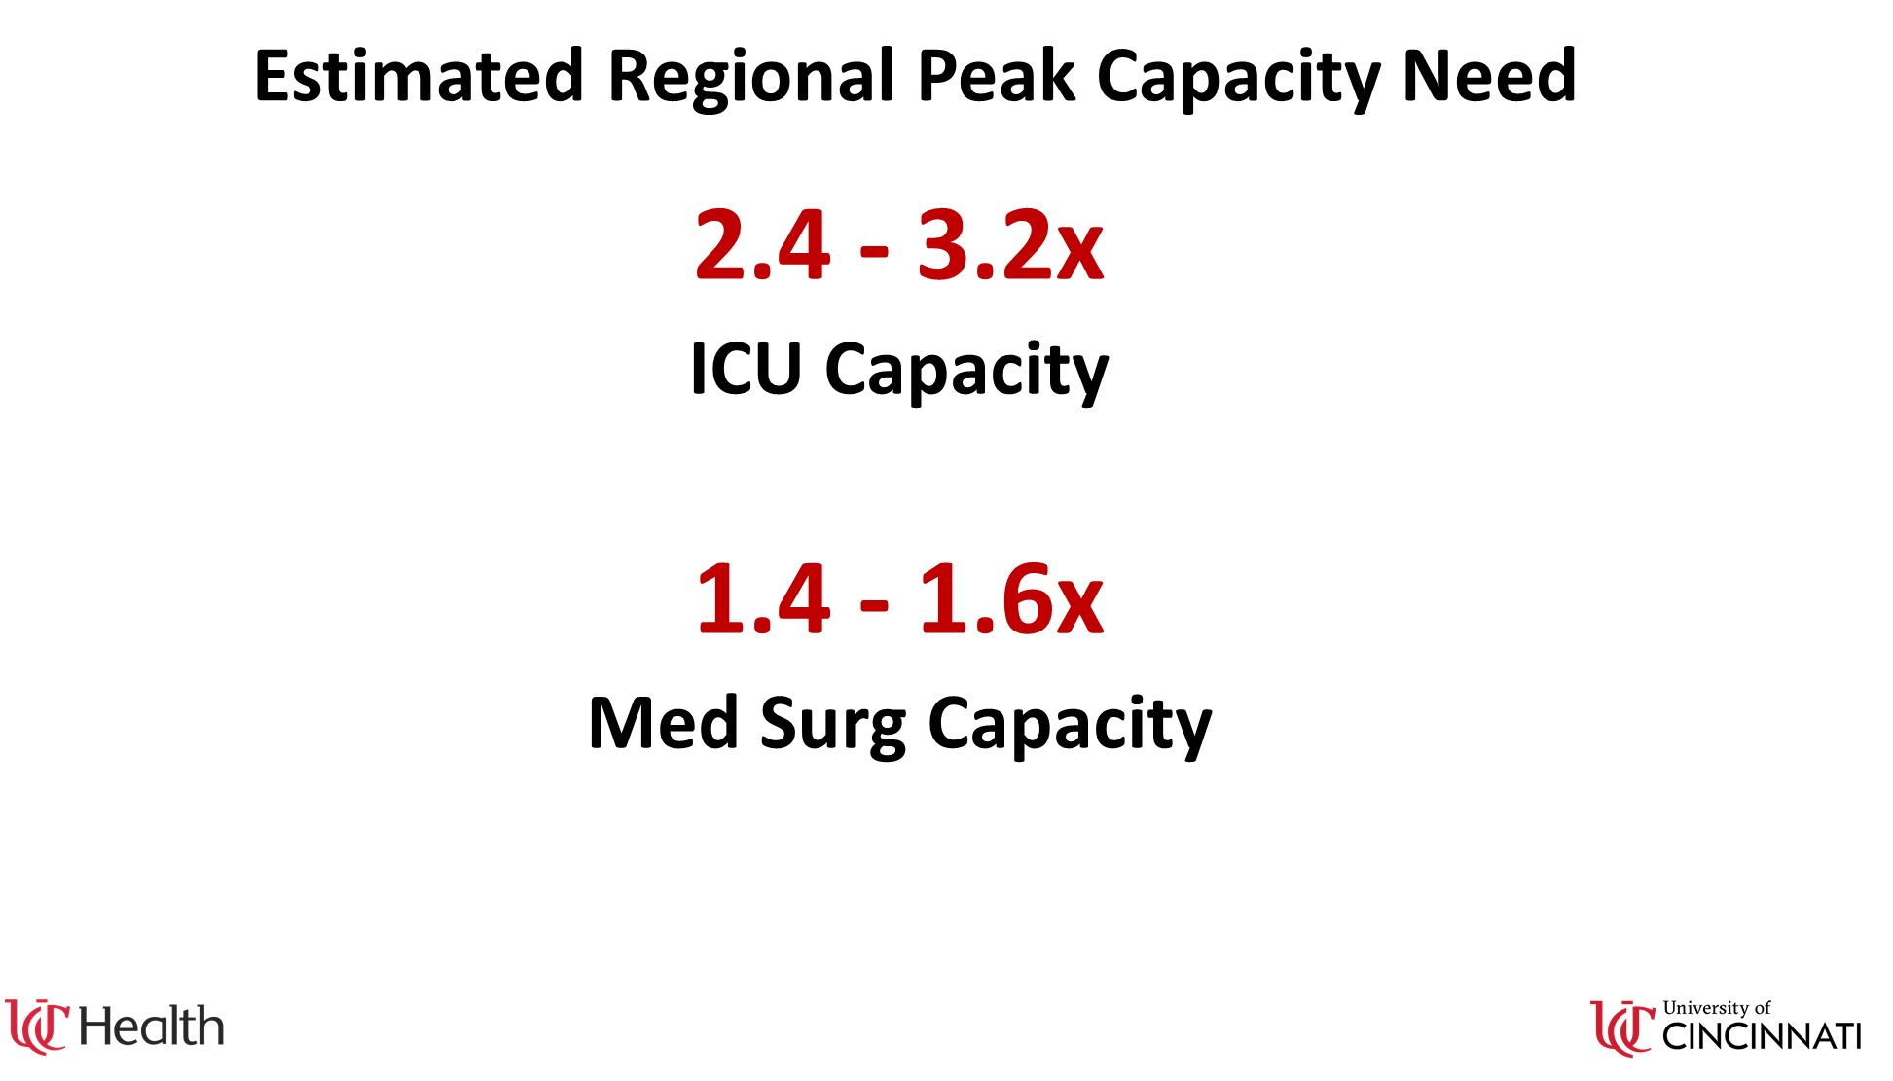
Notes:
Had to use outside resources. National, regional, hospital. Un of Washington, Penn State, Cornell, Ohio State & OHA models

Slide 11
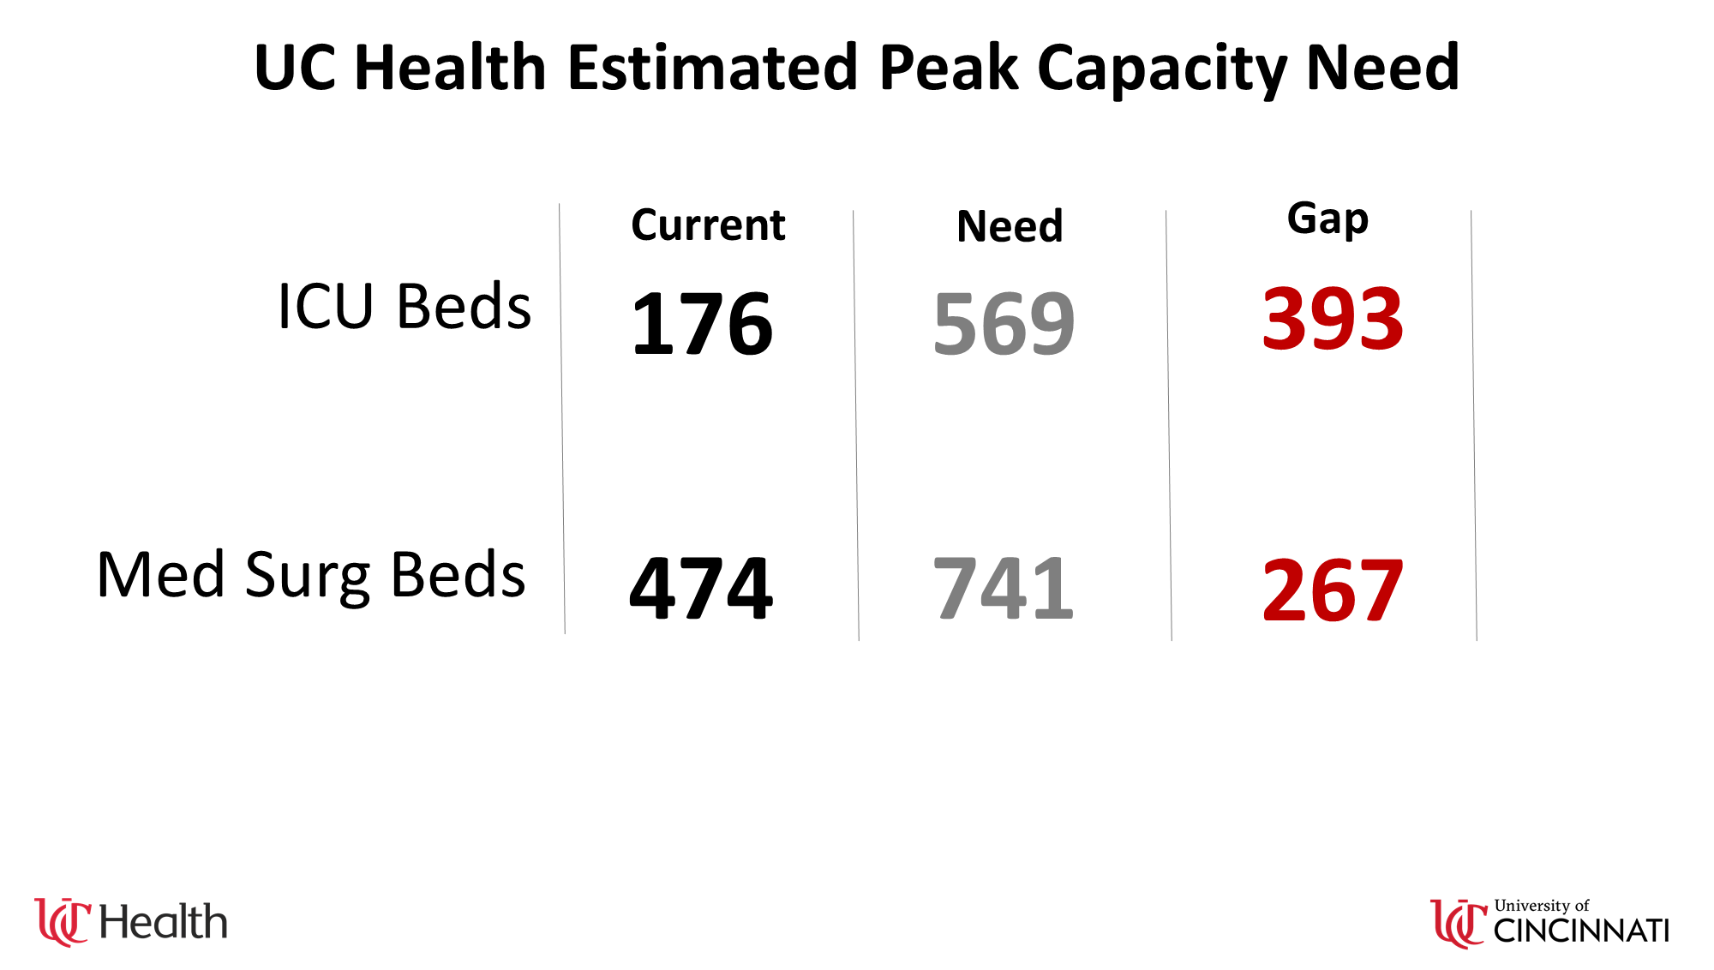
Notes:
We estimated nearly 400 additional ICUs needed. And 300 additional med surg beds. This was a sobering moment which drove home the seriousness of this situation. So in this case, the analysis was able to bring clarity, a goal, and a level of severity. And what mobilized a large leadership team to begin asking the question, how do we do this??

Slide 12
Real Time
What is the current state of each facility, unit?
  Harnessing/evolving current Epic Radar Dashboards
  Daily view of COVID Occupancy, PUI in every Facility
  Integration into Daily leadership tiered huddles & COVID huddles

Slide 13
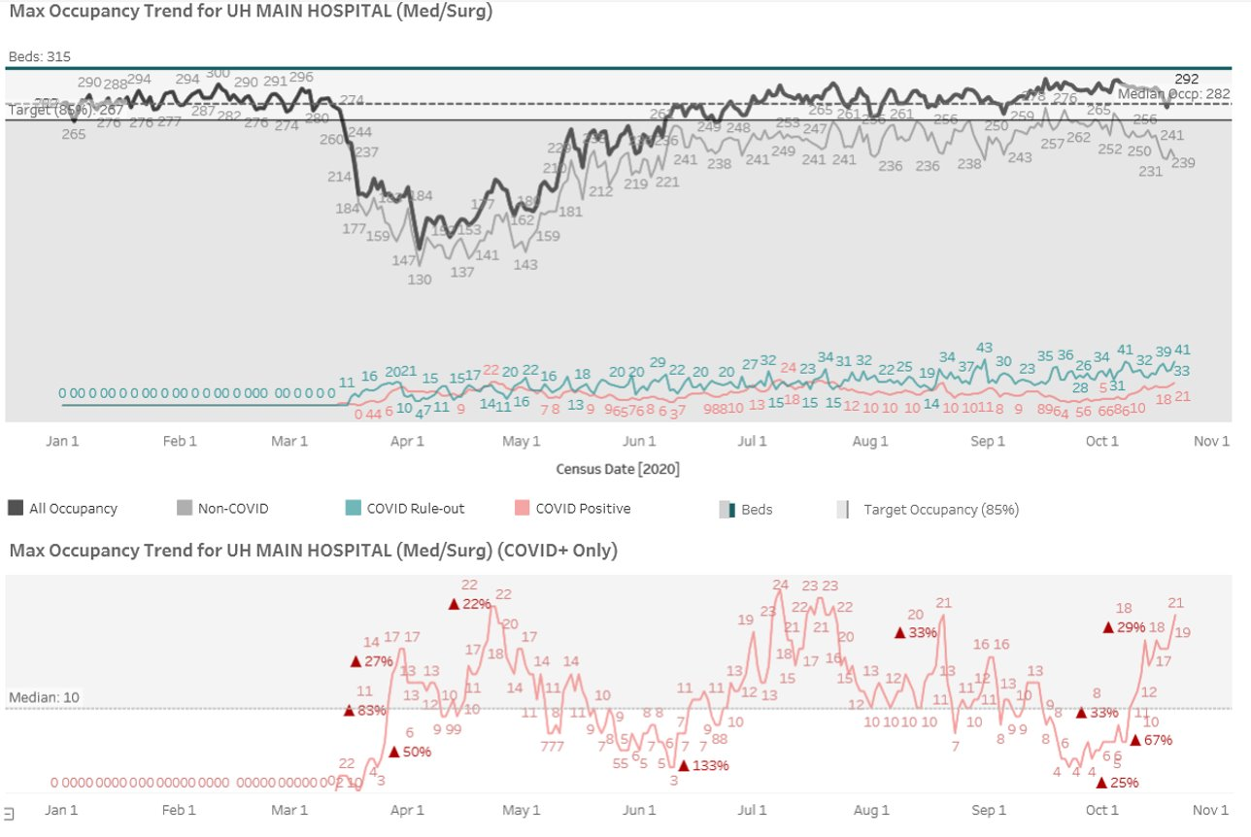
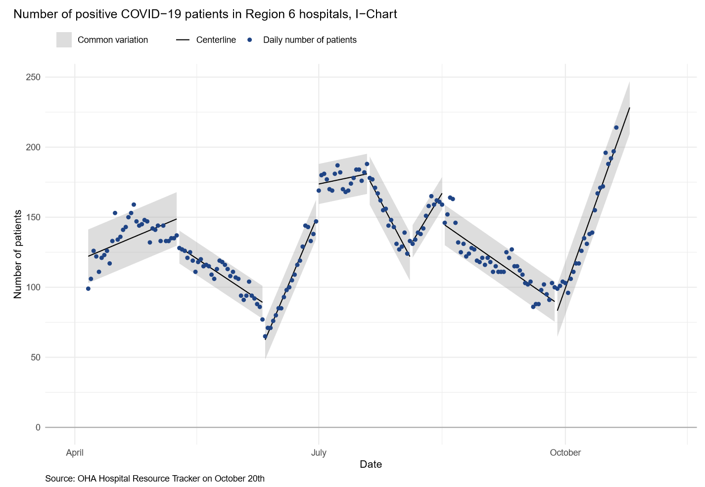
Trending
UC Health
Local/Regional
*Analysis created by Cincinnati Children’s Hospital
Notes:
Now that we were able to manage the day to day visibility, know where we potentially could be heading, we then needed a way to understand our trends to answer that question, are we matching what was predicted? When do we need to open more beds? We needed to quickly grasp our occupancy better than we ever had before.
Rebuild our measure to look at peak occupancy each day
This was also a vital part of the equation for eventually getting to forecasting/prediction

Slide 14
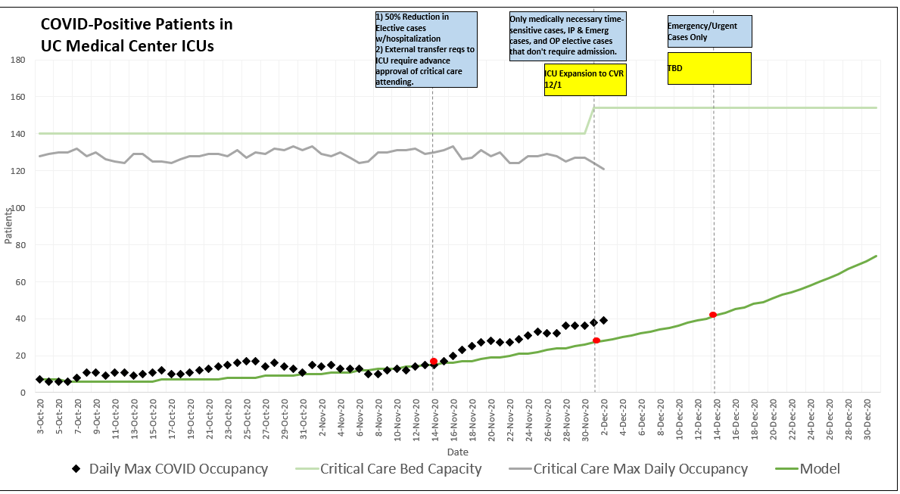
Projection & Mitigation Tracker
Notes:
We took it from large numbers to more refined analyses
Where have we been
Where are we now
What factors do we have to add that might impact current trend
Added: What are we going to do about it???
How will that impact us our ability to accommodate?
PREDICTING COVID IMPACT & NECESSARY ADJUSTMENTS. TO PREDICT, WE NEED:
Predicting COVID Impact (Regional partnership, regional modeling & site modeling with internal trending)
Understanding our portals of entry (OR Admission rates, transfer processes)
Transfer Criteria (communicating beds saved by doing so)
Ambulatory Telehealth

Slide 15
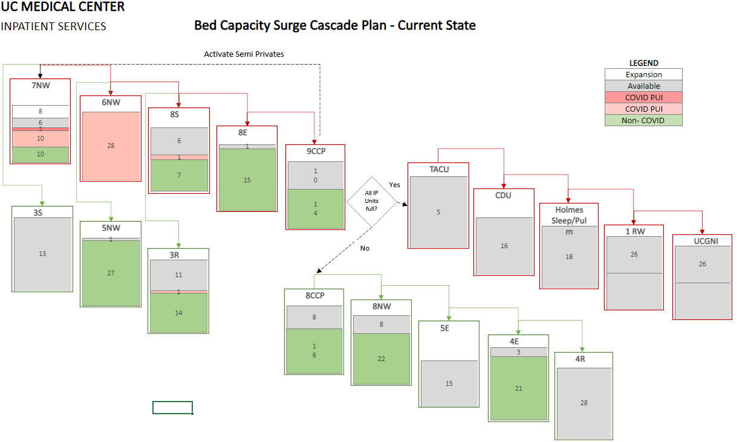
Cascade Plan
Notes:
This analysis prompted a huge, sobering reaction from leadership, and mobilized the groups to look at many options

Slide 16

Lessons Learned
Don’t underestimate stakeholder engagement
Embracing relentless iteration
“Train hard, fight easy”
Show the wins
Loop
Notes:
Stakeholder engagement was a neverending balancing act. The usual issues of correct stakeholder involvement to get feedback and buy in (data is wrong). To get our planning set, we needed a ton of actual accurate data, but also accurate information on operational realities such as potential capabilities & resources.
Constantly improve the data.

Slide 17
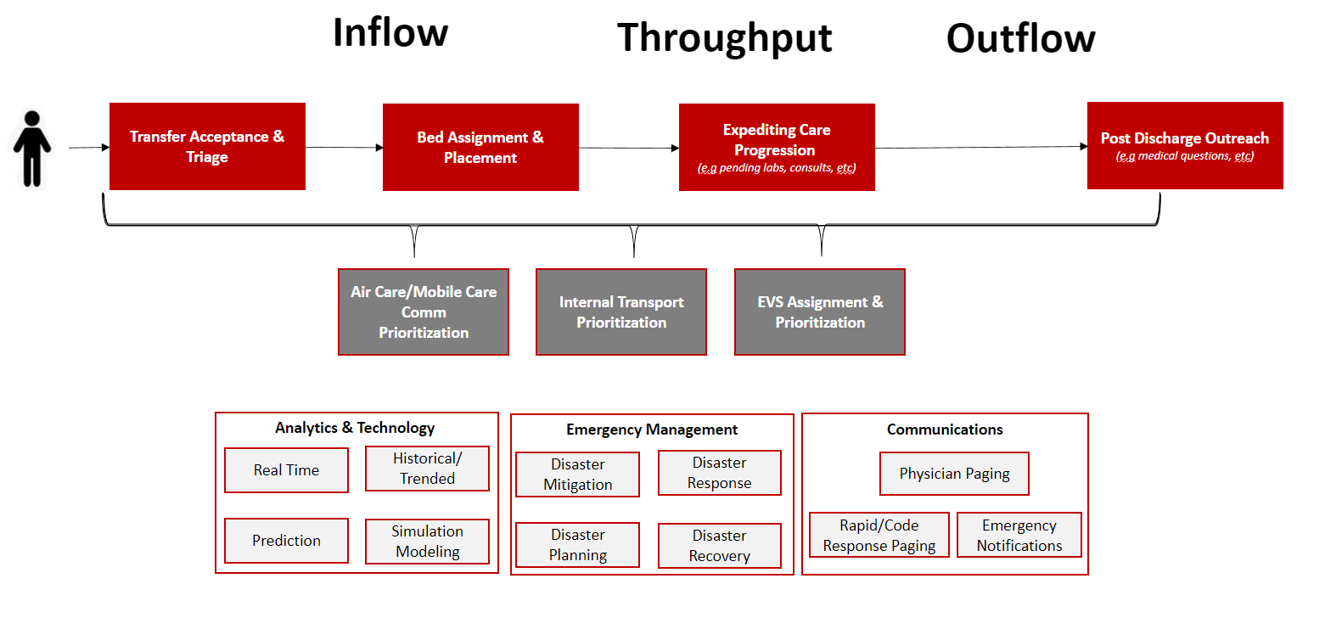
Looking Forward
System Operations Center
Create a “Central Nervous System”
  Full system real time visibility
  Robust/Dynamic historical dashboards
  Utilize advance analytics
Connecting Virtual Health/Medical Home to Center
Notes:
Capacity is so complex it is perfect for discrete event simulation modeling, machine learning & AI. We have been on this journey prior to covid, but people have experienced first hand the urgency, and vital need for us to push our thinking, drag ourselves into this. COVID gave us a push, now its our job to “keep our eye on the prize”. Because our patients deserved, our staff deserve. Regional learning. Manage our portals

Slide 18

Q&A

