Slide 1
CSO HIMSS Presents
Data Driven Digital Transformation: Utopia or Reality?
Spring Conference 2022

Slide 2
Welcome

Slide 3
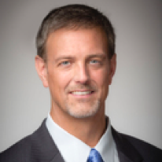
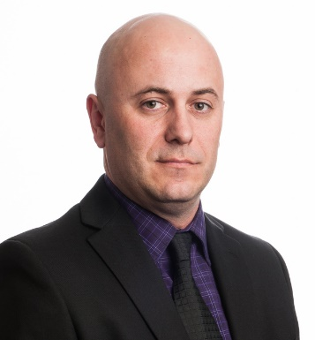
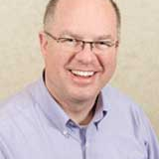
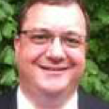
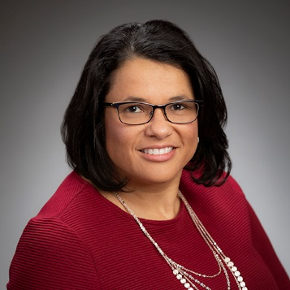
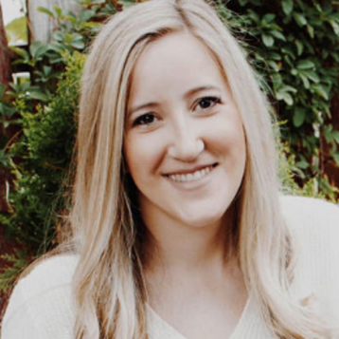
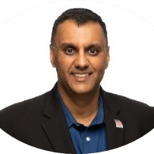
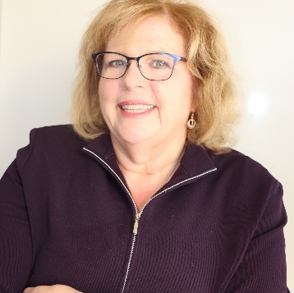
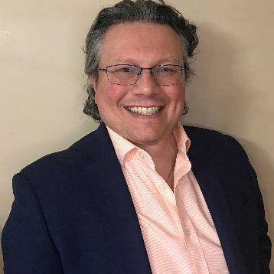
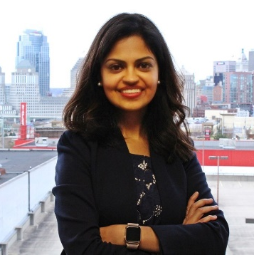
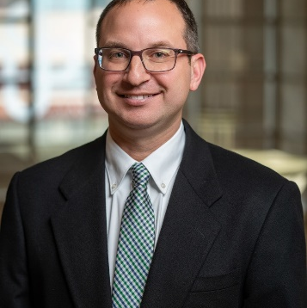
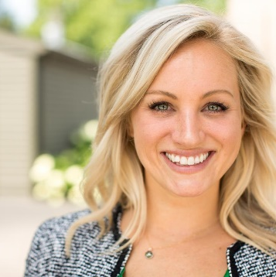
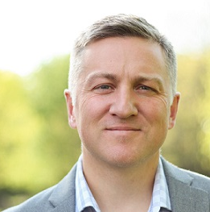
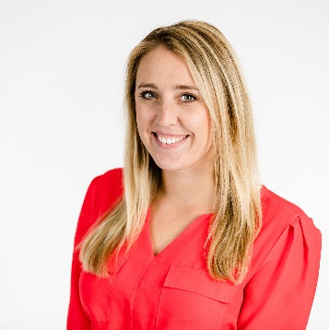
CSO HIMSS BOARD 2020-2022
Alex Vaillancourt; President
Scott Mash, President-Elect
Russ Hessler; Board Secretary
Victor Simha; Treasurer
Donna Carter; Marketing Chair
Megan Anderson-Baker; Membership Chair
Ajay Sharma; Program Chair & Past President
Donna Evans; Scholarship Chair
Kristos Zagorianos Sponsorship Chair
Neha Matta; Advocacy Chair
Andrew Nixon; HIE Liason
Caitlin Graham; Board Member
Jeff Haas; Board Member
Samantha McCarthy; Board Member

Slide 4
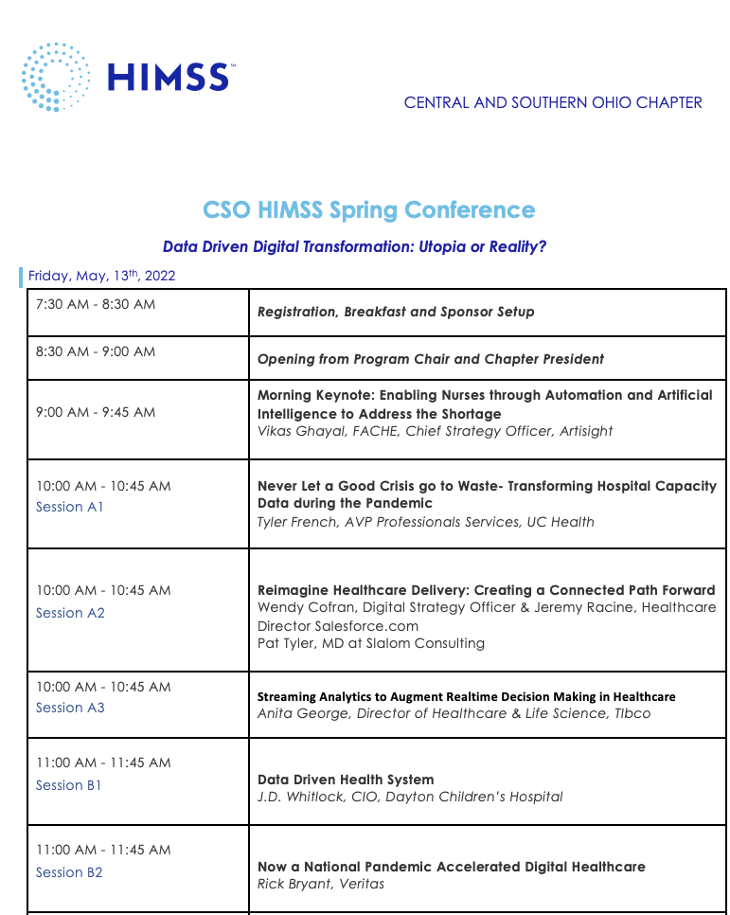
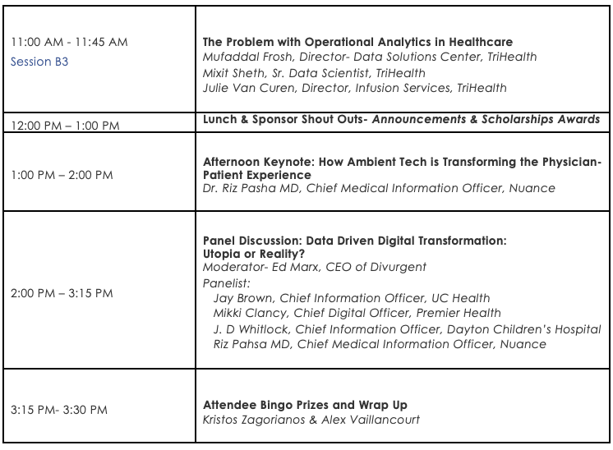
Today’s AGENDA
Ajay Sharma; Program Chair & Past President

Slide 5
Central Southern Ohio HIMSS Board is proud to announce that its scholarship program has been expanded to include a scholarship for High School students. Thank you for your support as we continue to encourage developing talent to join our industry and support the goal of improved healthcare for all. Please check our website later in the fall for more details.

Slide 6
Thank You

Slide 7
Welcome & Introductions
Ajay Sharma, CSOHIMSS Past President
Alex Vaillancourt, CSOHIMSS President, CIO The Health Collaborative
Donna Evans, CSOHIMSS Scholarship Chair
8:30 AM
CSO HIMSS
Spring Conference 2022

Slide 8
Morning Keynote: Enabling Nurses through Automation and Artificial Intelligence to Address the Shortage
Vikas Ghayal, FACHE, Chief Strategy Officer, Artisight
9:00 AM
CSO HIMSS
Spring Conference 2022

Slide 9
A1
Never Let a Good Crisis go to Waste-Transforming Hospital Capacity Data during a Pandemic
Tyler French, AVP Professional Services, UC Health
10:00 AM
Spring Conference Session 2022

Slide 10
A2
Reimagine Healthcare Delivery: Creating a Connected Path Forward
Wendy Cofran, Digital Strategy Officer
Jeremy Racine, Healthcare Director Salesforce.com
Pat Tyler, MD at Slalom Consulting
10:00 AM
Spring Conference Session 2022

Slide 11
A3
Streaming Analytics to Augment Realtime Decision Making in Healthcare
Anita George, Director of Healthcare & Life Sciences, Tibco
10:00 AM
Spring Conference Session 2022

Slide 12
B1
Data Driven Health Systems
J.D. Whitlock, CIO, Dayton Children’s Hospital
11:00 AM
Spring Conference Session 2022

Slide 13
B2
How a National Pandemic Accelerated Digital Healthcare
Rick Bryant, Veritas
11:00 AM
Spring Conference Session 2022

Slide 14
B3
The Problem with Operational Analytics in Healthcare
Mufaddal Frosh, Director-Data Solutions Center, TriHealth
Mixit Sheth, Sr. Data Scientist, TriHealth
Julie Van Curen, Director Infusion Services, Trihealth
11:00 AM
Spring Conference Session 2022

Slide 15
Lunch & Sponsor Shout Outs
12:00 PM
Spring Conference Session 2022

Slide 16
Huge Thank You to our session and program Sponsors

Slide 17
In collaboration with Platinum Sponsors

Slide 18
In collaboration with Premier Sponsors

Slide 19
In collaboration with Elite Sponsors

Slide 20
In collaboration with Scholarship Sponsors

Slide 21
Congratulations To Our 2021 Scholarship Winners

Slide 22
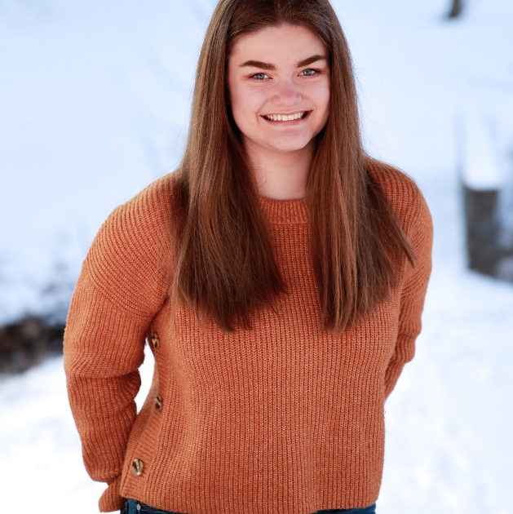
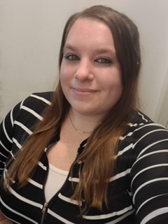
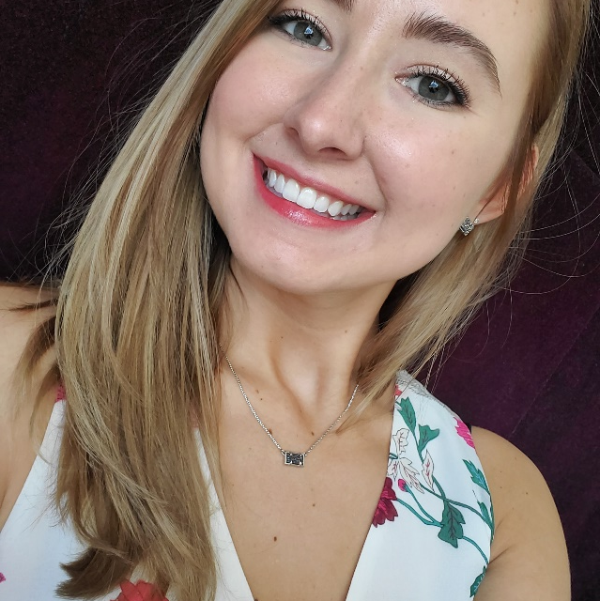
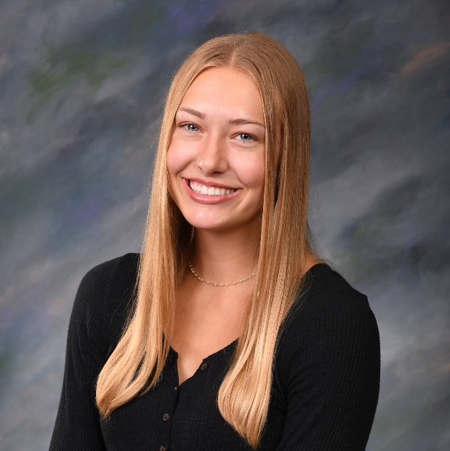
2021 CSOHIMSS Scholarship Winners
Julia Peter
CSOHIMSS High School Carter Consulting Scholarship
Brandi Bernardi
Jane Blank Scholarship
Marlenia Rollinson
CSOHIMSS College Student Scholarship
Mallory Gedeon
CSOHIMSS High School Scholarship

Slide 23
CSOHIMSS High School Scholarship
As of 2022 CSOHIMSS presents a BRAND NEW scholarship for High School sponsored by
Julia Peter
CSOHIMSS High School Carter Consulting Scholarship

Slide 24
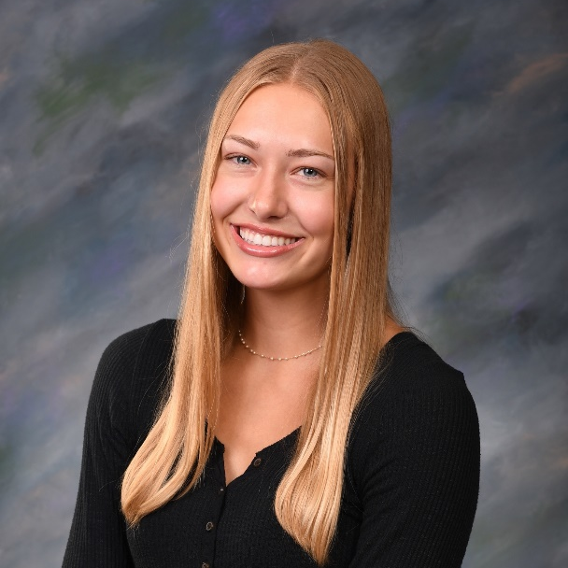
CSOHIMSS High School Scholarship
As of 2022 CSOHIMSS presents a BRAND NEW scholarship for High School sponsored by
Mallory Gedeon
CSOHIMSS High School Scholarship

Slide 25
CSOHIMSS College Student Scholarship
Scholarship to encourage students in the Health IT discipline
Marlenia Rollinson

Slide 26
Jane Blank Scholarship
Scholarship to encourage students in Health IT discipline and to honor one of our retired members, Jane A. Blank.
Brandi Bernardi
Jane Blank Scholarship

Slide 27
Afternoon Keynote
How Ambient Tech is Transforming the Physician-Patient Experience
Dr. Riz Pasha, Chief Medical Information Officer. Nuance
1:00 PM
Spring Conference Session 2022

Slide 28
Panel: Data Driven Digital Transformation: Utopia or Reality?
Moderator: Ed Marx , CEO of Divurgent
Jay Brown, Chief Information Officer, UC Health
Mikki Clancy, Chief Digital Officer, Premier Health
J.D. Whitlock, CIO Dayton Children’s Hospital
Riz Pasha, Chief Medical Information Officer, Nuance
2:00 pm
Spring Conference Session 2022

Slide 29
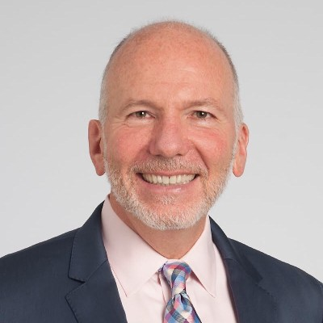
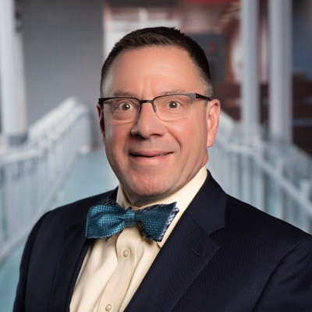
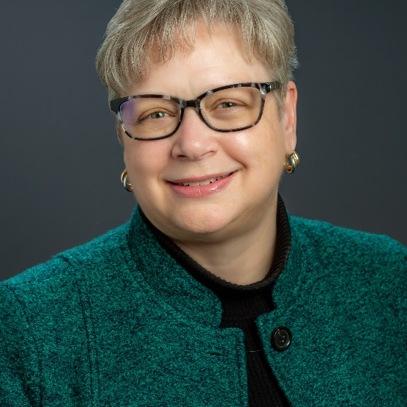
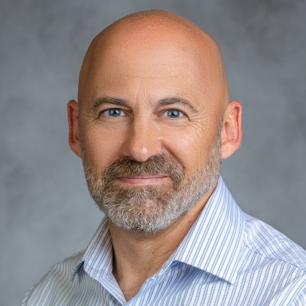
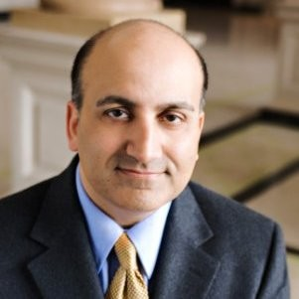
Data Driven Digital Transformation: Utopia or Reality? Panel
Ed Marx, CEO Divurgent
Moderator
Jay Brown
Chief Information Officer, UC Health
Mikki Clancy,
Chief Digital Officer Premier Health
J.D. Whitlock,
Chief Information Officer
Dayton Children’s Hospital
Rizwan Pasha MD,
Chief Medical Information Officer
Nuance

Slide 30
Prizes and Wrap Up
Alex Vaillancourt, President
Kristos Zagorianos, Sponsorship Chair

Slide 31
Sponsors Websites
www.talkdesk.com
www.enterprise.spectrum.com
www.olahht.com
www.tibco.com
www.carahsoft.com
www.salesforce.com
www.covermymeds.com
www.deliverhealth.com
www.amtelco.com
www.kashtechllc.com
www.slalom.com
www.fortinet.com
www.zivaro.com
www.veritas.com
www.nuance.com

