Slide 1
The Problem with Operational Analytics in Healthcare

Slide 2
Julie Van Curen
Director, Infusion Services
Experience: Joined TriHealth in 1985 and have worked in Med/Surg, Dialysis & Oncology. Nurse Manager for Dialysis & Oncology and Current Director for Infusion
Education: RN from Good Sam School of Nursing in 1985, BSN from MSJ in 2010
Certifications: Oncology Certified Nurse, OCN
Hobbies: Golf, Reading, Travel

Slide 3
Mixit Sheth
Sr. Data Scientist, Data Science Solution Center
Experience: Joined TriHealth as Data Scientist in 2017 and currently serving as Sr. Data Scientist
Education: MS in MIS & BTech in Industrial Engineering
Certifications: Certified Azure AI Cloud Engineer
Hobbies: Learning & exploring new cutting edge technologies in Healthcare, Like to travel & big foodie!

Slide 4
Mufaddal Frosh
Director, Data Solution Center
Serving a team of data engineers and data scientists who solve problems faced by our health system (TriHealth). I have an analytics, industrial engineering, and software development background along with a relentless drive in delivering the full spectrum of analytics from data ops to prescriptive analytics and everything in between. Stated goal is to improve the health status of our patients.

Slide 5
5 Hospitals
11 Ambulatory Centers
7 Retail Clinics
12,000+ Team Members
600+ Employed Providers
5 Urgent Care Centers

Slide 6
Awards for Clinical Quality & Technical Excellence

Slide 7
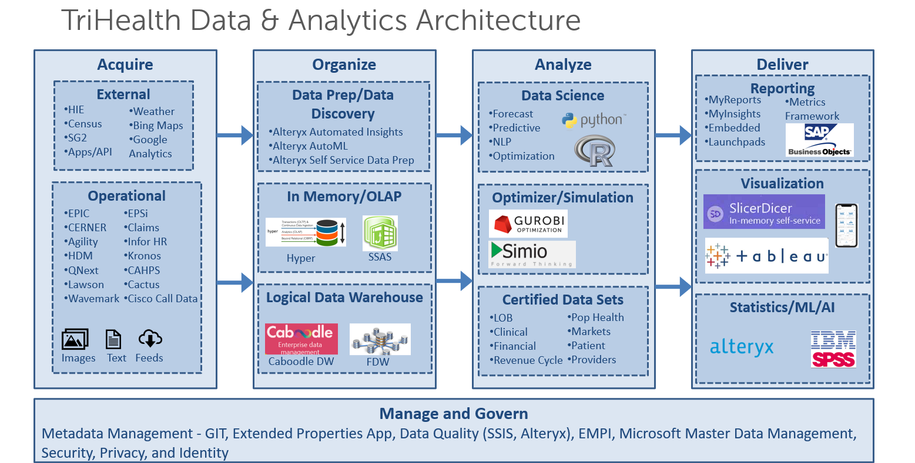
Notes:
Speaker - Frosh

Slide 8
Audience Engagement
How many of you work for UPS or an airline?
How many of you remember linear programming from your operations research class in business school?
How many of you used excel solver to solve a problem in your class?
How many of you thought you could use the same technique to improve operations in health systems? But solver ….

Slide 9
The problem…
The 9 infusion centers in TriHealth are always trying to match variable infusion treatment demand with a limited supply of clinical nursing staff, physicians, and infusion chairs
The great resignation is not helping matters…

Slide 10
This is not just a problem for Infusion Depts…
The reason for the systemic inefficiency comes down to the problem of matching supply and demand for every single appointment [1]
[1] Agrawal, Sanjeev ; Giridharadas, Mohan . Better Healthcare Through Math: Bending The Access And Cost Curves (p. 14). ISBN: 978-1-95086-334-1

Slide 11
This is a problem for all areas of the health system
Turns out, it is very difficult to align an unpredictable pattern of demand for appointments with a limited supply of physicians, staff, equipment, and rooms—a supply that is further restricted by a host of real-world constraints. [1]
[1] Agrawal, Sanjeev ; Giridharadas, Mohan . Better Healthcare Through Math: Bending The Access And Cost Curves (p. 14). ISBN: 978-1-95086-334-1

Slide 12
A lot of us use….
Skill, knowledge, intuition, and reliance on historical data, dashboards, and reports to improve operational efficiencies.
Nothing wrong with that except try some secret sauce…

Slide 13
Secret Sauce
Collaboration with Infusion Services
Special mention to Mark G. Witte, Vice President, Clinical Service Lines
Analytics does not stand alone
Digital platform and coordination with Information Systems for ‘last mile’

Slide 14
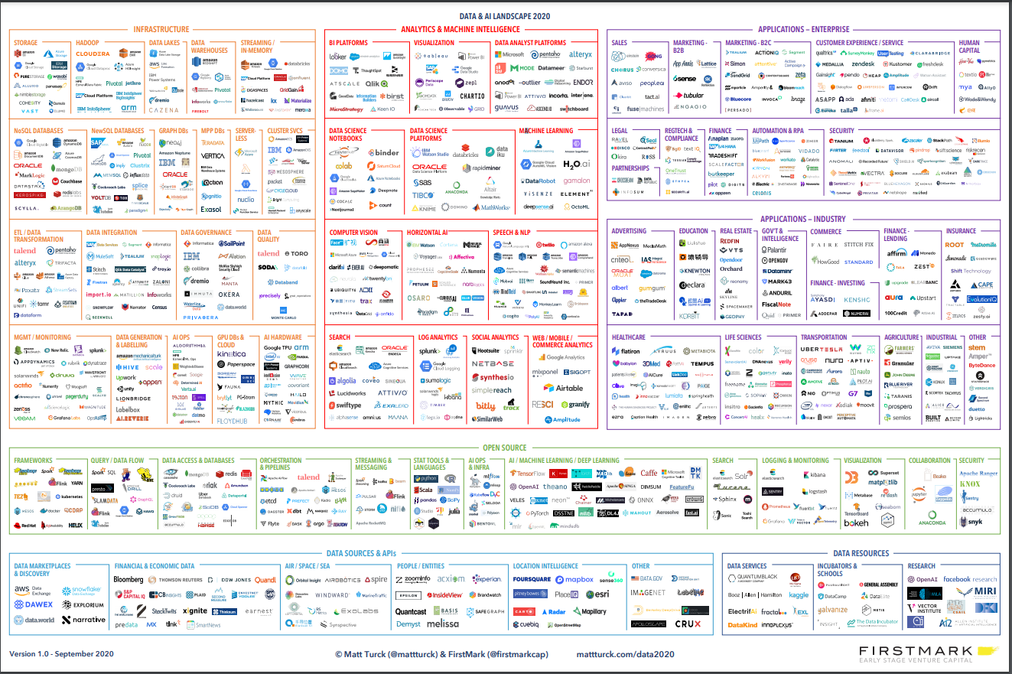
There is a point to this slide you cannot read!

Slide 15
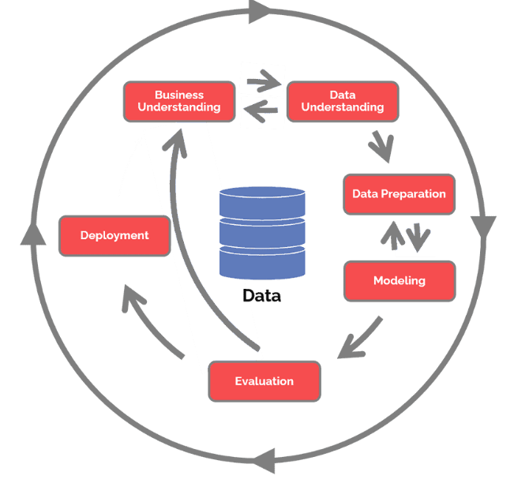
TriHealth Data Science Lifecycle – CRISP DM
Phase 1 – Business Understanding
Phase 2 – Data Understanding
Phase 3 – Data Preparation
Phase 4 – Modeling
Phase 5 – Evaluation
Phase 6 – Deployment
Notes:
Title: Proposed System – CRISP DM
Can we expand the CRISP DM? Move the explanation to the notes?

Slide 16
Business Understanding - ‘Supply-Demand’ Solution Focus
Increase infusion chair utilization to deal with higher volumes of patients
Reduce patient wait times during Infusion
Allocate the right nurse to the right patient at the right time

Slide 17
Data Understanding – Infusion Departments Demand
10K
80K
9
PATIENTS
ENCOUNTERS
LOCATIONS
Average # Patients annually
Average # Encounters annually
Current # Locations

Slide 18
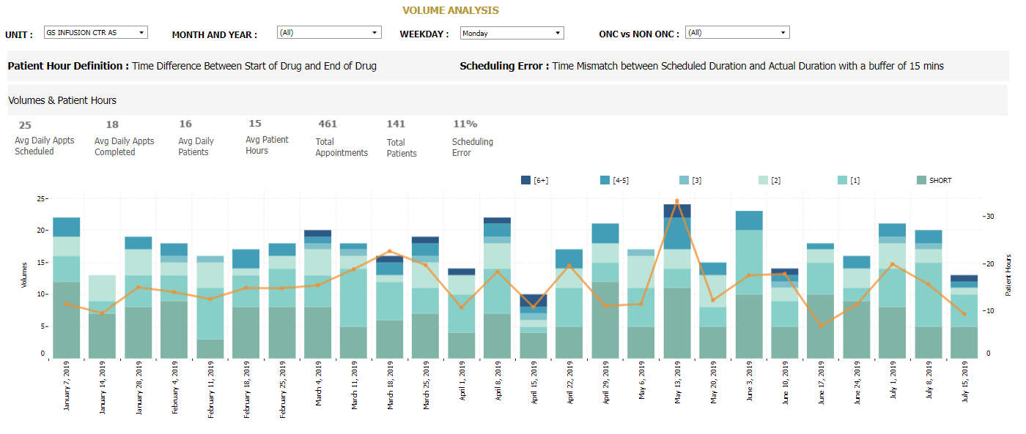
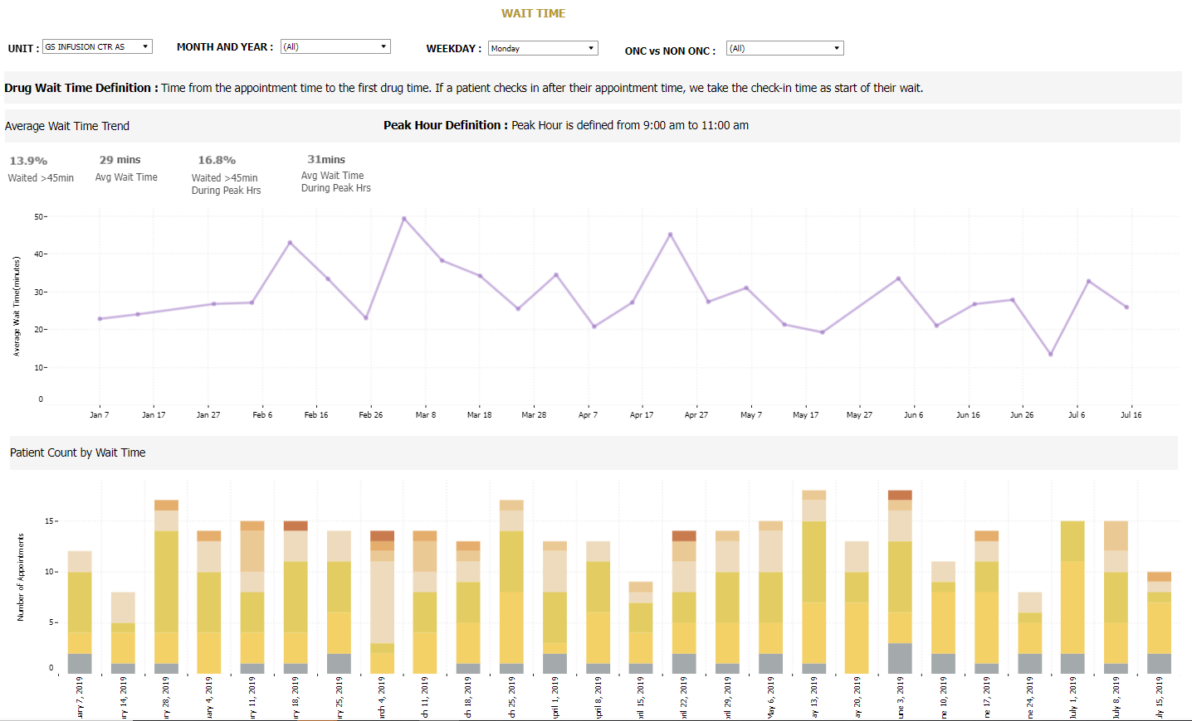
Data Understanding - Retrospective Analytics/Metrics
Metrics -
Volume
Patient - Time spent in system
Wait time analysis
No-Shows/Add-Ons
Utilization
Notes:
Should we include a list of all metrics with the dashboards as a supporting image?

Slide 19
Supply-Demand Solution
Forecasting
Pattern and trend analysis to understand historical infusion demand patterns
Optimization
Mixed-Integer Programming optimization model
TriHealth Infusion Departments
Scheduling System
An optimal scheduling model was proposed for the infusion area of cancer clinics at TriHealth
Notes:
Mixed-Integer Programming optimization model developed with the objective of maximizing resource utilization, while balancing human workload

Slide 20
Modeling- Forecasting
Design of Experiment
Historical data analysis for trend and seasonality patterns in patient demand
7 patient variability treatment length (15min, Injection,1Hr, 2Hr, 3Hr, 4-5Hr, 6+Hr)
5 working days for infusion departments
Co-variate Analysis
Weekday/Month statistical analysis impact on actual patient demand overtime
Forecasting model per treatment length
SARIMA forecasting statistical technique with minimal forecasting errors in patient demand

Slide 21
Modeling – Mathematical Optimization
Objective Function
Increase resource utilization
Maintaining or decreasing patient waiting times
Constraints
No new arrivals during lunch time period
No Nurse overtime
Evenly Distributed Load across the day
Minimum 70% of Short Appointments during first half of the day
Patient arrival is based on number of nurses
And many more….
Solver
Gurobi commercial license was used to solve the model. It is tailored for complex, large scale modeling applications.

Slide 22
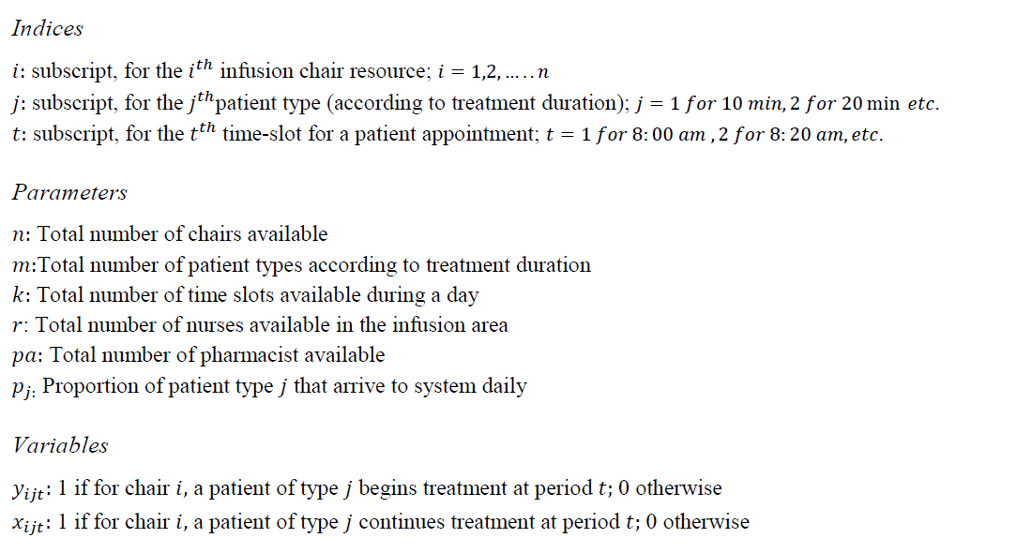
Modeling – Mathematical Optimization

Slide 23
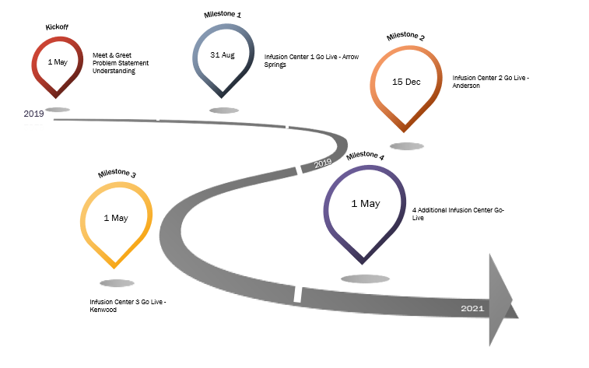
Deployment – Timelines RoadMap
5/1/2019 - Kickoff
8/31/2019 – Infusion Center 1 Live
12/15/2019 – Infusion Center 2 Live
5/1/2020 – Infusion Center 3 Live
5/1/2021 – 4 Additional Centers Live

Slide 24
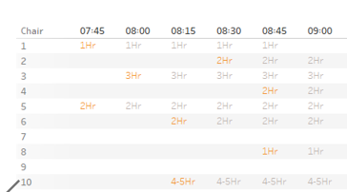
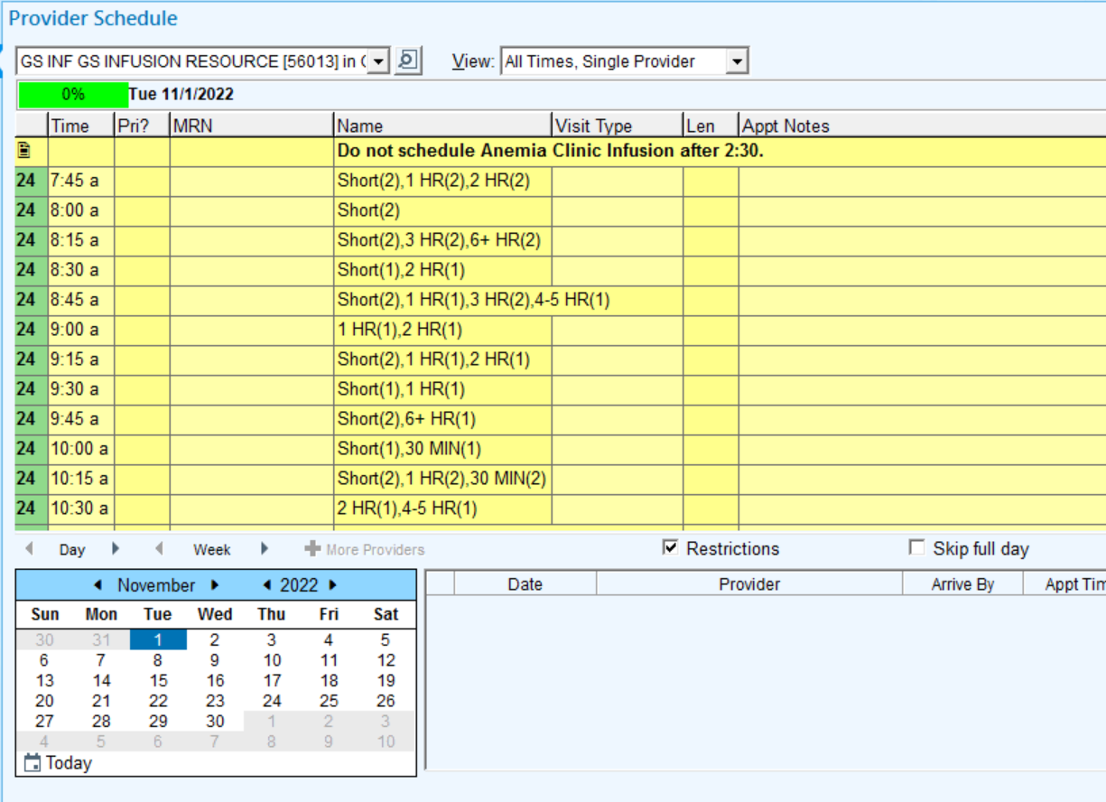
Deployment – Scheduling ‘infusing analytics’ in the EMR
Optimal schedule for weekly infusion appointments

Slide 25
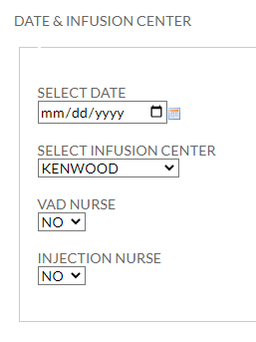
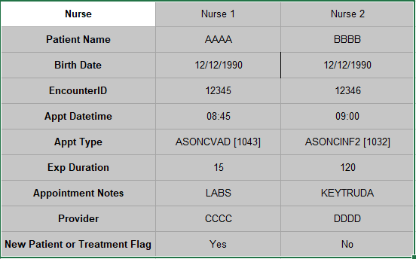
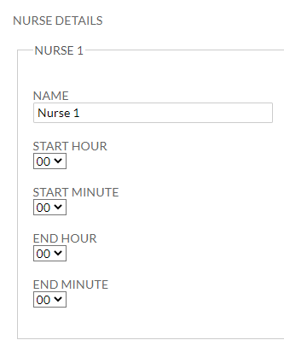
Deployment – Nurse Allocation Tool
Right nurse to the right patient at the right time

Slide 26
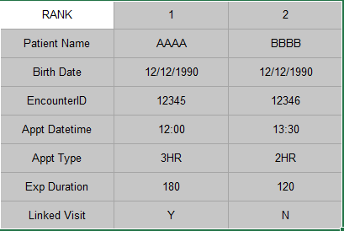
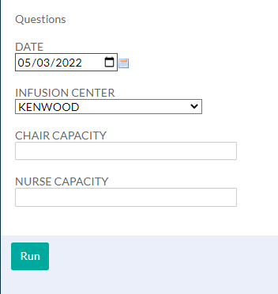
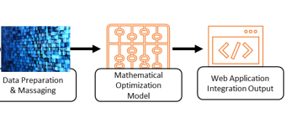
Deployment – Schedule Shifter Tool
Recommender - Restructure a future day’s schedule
Improve the experience for patients and staff and
Keep your center functioning optimally

Slide 27
Post-Optimization Results (wish ROI on every data science project was like this one!)
Increase in average monthly encounters
Template compliance rate
53%
8
66%
$5.8M
Reduction in Median Wait Time (in minutes)
Increase in Actual Margin
Notes:
Title: Proposed System – Results
Increase in average monthly encounters with 7 infusion departments live with mathematical templates
Increase in Actual Margin calculated Annually by DSS

Slide 28
What’s next…
Infusion
Simio – Simulating the infusion center workflows for efficiency improvements
Predicting infusion patient risk of ED Admissions
Optimizing Inpatient Nurse Scheduling
Optimizing PCP Office Staffing
Optimizing Throughput in Hospitals, Hospice

Slide 29
Reference

