Slide 1
“TIPs” for Healthier Specialty Physicians and Patient Experience
Dr. JP Giliberto – UC Health - Otolaryngology
Dr. Michael Donaworth - UC Health - Orthopaedics
Ajay Sharma – UC Health IS&T – IT Project Manager
Notes:
Welcome and thank you for your support and participation in the Technology Improvement Process for Otolaryngology. We appreciate your support of this engagement to collaborate to help make your departments better and more efficient in it’s use of technology within your Ambulatory ecosystem.

Slide 2
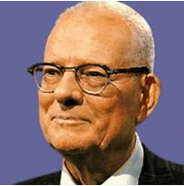
“It is not necessary to change. Survival is not mandatory.” - W. Edwards Deming
― W. Edwards Deming, Father of Total Quality Management and the Deming Prize

Slide 3

Agenda
TIP’s Need & Project Purpose
Project Methodology
A Typical TIP Timeline
What we Uncovered
  TIP ENT Incidents
  TIP Orthopaedics Incidents
Scope of Operations
  TIP Single Source of Truth
Why do a TIP Project?
Varying degrees of involvement in IT
  Inertia and physicians that see the EMR as an impediment
  Physician Burnout
    Increased Regulatory Documentation – Physician’s Perspective
  Improving the Patient Experience
    Approaching EMR Optimization – Physician’s Perspective
Notes:
Physician Burnout – We can look at reasons for physician burnout and physician burnout rates.
Approaching EMR Optimization – Since UC Health adopted Epic in 2012 as it’s new EHR, it was natural that providers learned workflow at that time and take some time to adjust to using the new technology.
However, after using the EHR for a while, in order for it to be more meaningfully impactful, the practice and the organization reassess how the system is working within the speciality care setting and look for ways to be more impactful in it’s usage. (Examples)
Using the data analytics that the BI team was able to provide. – co present - Donaworth & Giliberto
Interventions and effective ways to reduce the amount of physician burnout. One of the many things that they looked at to lessen the burden. Diving into the particular studies. This is a tool to decrease that epidemic.
APEC committee – Physician Builder course intro course together up in Verona – Need to network with like minded physicians.
TIP is improving the Physician and Patient Experience with it.

Slide 4

TIP’s Need & Project Purpose
Need:
UC Health had identified the need for technical assessments of the specialty areas in the ambulatory setting. The assessment was requested to address a better provider user experience around issues related to possible software and technology deficiencies as well as a better, more streamlined patient experience.
Project Purpose:
The Leadership of UC Health determined that the purpose of the TIP projects were to assemble a core IT team with the assistance from key personnel in areas such as the EMR Ambulatory, Business Intelligence, Client, Network and Integrated Services (PMO) to complete site and clinical and operational workflow assessments for the specialty departments.
The assessment then identified opportunities for clinical and operational improvements (training, technology remediation, workflow, etc.) that is then be prioritized with Clinical & Operational Leadership of the Specialty Department.
The prioritized work was then addressed based on the approval of a Steering Committee, made up of relevant stakeholders from IT and the specialty department. All project work fits into a 90 day window.
Notes:
As part of our process within the Project Management Office, we have a process that we follow for all of our initiatives. One of those is to develop an Introduction to our projects.
We have noted that the business need for this project is that the organization has identified the need for technical assessments of the specialty areas in the Ambulatory setting. The assessment is requested to address provider and staff issues related to possible software and any technology deficiencies.
Our project purpose is to assemble an IT core team, assistance from key personnel in IS&, Clinical Engineering, Pharmacy (if required) and other UC Health teams to complete site and workflow assessments for the specialty clinics.
This assessment will then identify opportunities for improvement (training, technical, workflow, etc.) that will then be prioritized with the Clinical & Operational Leadership.
The prioritized work will then be addressed based on the approval of the Core IS&T Group, Clinic Managers and the Project Sponsor. All project work will fit into a 90 day window per specialty.

Slide 5
Project Methodology – “90 Day” Engagement
Pre-Assessment
Assessment
Review
&
Recommend
Build
Implement
Train
Project Close
Support
Pre-Assessment Phase –This Phase identifies the Project Stakeholders, Physician Champion, Operational Champion, the Ambulatory Locations that are in scope for the Ambulatory team (Infrastructure teams cover all the clinic locations), the scheduling of IT team site visits, communication about the project to the department and Registration and Scheduling surveys to the clinic managers or points of contact. This flows into the Project Kickoff Meeting.
Assessment Phase – In this Phase, the IT teams performed a discovery and assessment of the clinic locations. Different teams covering areas from infrastructure assessment to clinical workflow review were part of this phase. In addition, the IT team develop a process to encourage and support direct collaborative requests from end users within their clinic environment on challenges they may be currently experiencing.
Review & Recommendations Phase – As the assessments were completed, the teams reviewed the information and shared their findings with department leadership through a Steering Committee Meeting (IPR) . The department stakeholders then collaboratively reviewed the recommendations/requests and prioritized those requests. It was recommended that the Physician Champion pulled a committee of other providers together to collaborate with the Epic Ambulatory Team to prioritize the list of Epic incidents that had been logged in to Footprints for the Ambulatory team to focus on as their scope of work.
Build/Implement/Train Phase – As the work is prioritized by the Assessment, the IT team implements the recommendations/requests by the department and identified a training format with the Operational and Physician Champions.
Project Close – At the end of the 90 days, once the project was completed, a summary of the project and lessons learned is shared with the Steering Committee at a Project Conclusion Meeting to wrap up the project. The TIP Team will transition any remaining items to a Standard Support Team.
Post Project Support – After the 90 days, the department transitions to the normal IS&T Standard Support Model through our helpdesk methodology.
Notes:
The project methodology that we have established for this initiative is a tried and tested soup to nuts approach from Pre-Assessment to Support and return to IS&T Standard Support Model.
As part of the assessment phase, will perform a discovery and assessment of the clinic locations with different teams covering areas from infrastructure assessment to clinical workflow review will be part of this phase. In addition, we will also develop a process to encourage and support direct collaborative requests from end users within your clinic environment on challenges they may be currently experiencing.
When the assessments are complete we will move in to the review and recommendations phase, where the teams will review the information and share their findings with leadership within the department. The department leadership will then collaboratively review the recommendations/requests and prioritize these requests.
In the Build, Implement and Train phase, the work is prioritized by assessment, the IS&T team will implement the recommendations/requests that have been approved within the clinics. We will conclude this phase by sending our TIP analysts onsite to the clinics where they will support the providers and staff of ENT with the build that they have implemented over the course of the project.
Once that has been completed, towards the end of the 90 day timeline as part of the Project Close Milestone, a summary of the project and lessons learned will be shared with the project stakeholders for the clinic leadership as part of our Conclusion Review. The TIP Team will transition any remaining items to the Specialty Team and the department will return to the IS&T Standard Support Model.

Slide 6

A Typical TIP Project Timeline
Transition to Standard Support
Mon 4/30/18 - Fri 5/4/18
TIP-Assessment Phase
Mon 2/12/18 - Thu 3/1/18
TIP - Ortho -Project Kickoff Meeting
Tue 2/6/18
Clinical Prioritization
Mon 2/26/18
Implement-Build-Train Phase
Mon 3/5/18 - Fri 4/27/18
Onsite Training of Build
Mon 4/30/18 - Fri 5/4/18
Ortho Steering Committee Meeting - IPR
Mon 3/5/18
Feb 11, '18
Feb 25, '18
Mar 11, '18
Mar 25, '18
Apr 8, '18
Apr 22, '18
Start
Tue 2/6/18
Finish
Fri 5/4/18
Project Close
Fri 5/4/18
Attend TIP-Ortho Project Conclusion Meeting
Tue 5/1/18

Slide 7
What we uncovered - TIP ENT Incidents
Notes:
380 & 394 Footprints Incidents logged at start and finish
284 & 394 - Epic TIP Footprints Tickets Logged at start and finish
2 Network Services Tickets Logged
68 Client Services Tickets Logged
5 for the BI projects
22 and 26 for other incidents that were assigned to other teams.

Slide 8
TIP Orthopaedics Incidents
Notes:
Update with latest Footprints chart
We started with 309 incidents and during the project, we added additional Epic workflow tickets
197 - Epic TIP Footprints Tickets Logged in total by the end of the project
6 Network Services Tickets Logged around telephony or a faulty UPS
128 Client Services Tickets Logged, out of which about 25% of the total PCs or laptops were End of Life
3 for the BI projects (we’ll look at that later in the presentation)

Slide 9

Reviews aare in…
“This is totally awesome and helps us tremendously!
Thank you for your help”
An SLP about the “Learning Home Dashboard” during the Training Week
“Everything you guys have done has been great!”
A Medical Assistant about the TIP Team during Training week
“This project was like Christmas!”
Ambulatory Manager during the Training Week
“Very Interesting stuff! It’s got great potential”
Physician & Chair of Department after training

Slide 10

Physician Burnout

Slide 11
Productivity Paradox of EMR
Change
  Barriers: Inertia and Education
  Decades of refining their way of practicing
Increasing time to document
  Barrier: Time
  Decreased direct care of the patient
  Decreased eye contact (More time multitasking)
  Or increase cost → scribe
Delegation
  Barrier: Knowledge Gap
    Easy to hand an RN or APP a piece of paper
  Barrier: Understanding tradeoffs:
    If taste takes the MD 30 secs vs RN or MA 10 mins

Slide 12

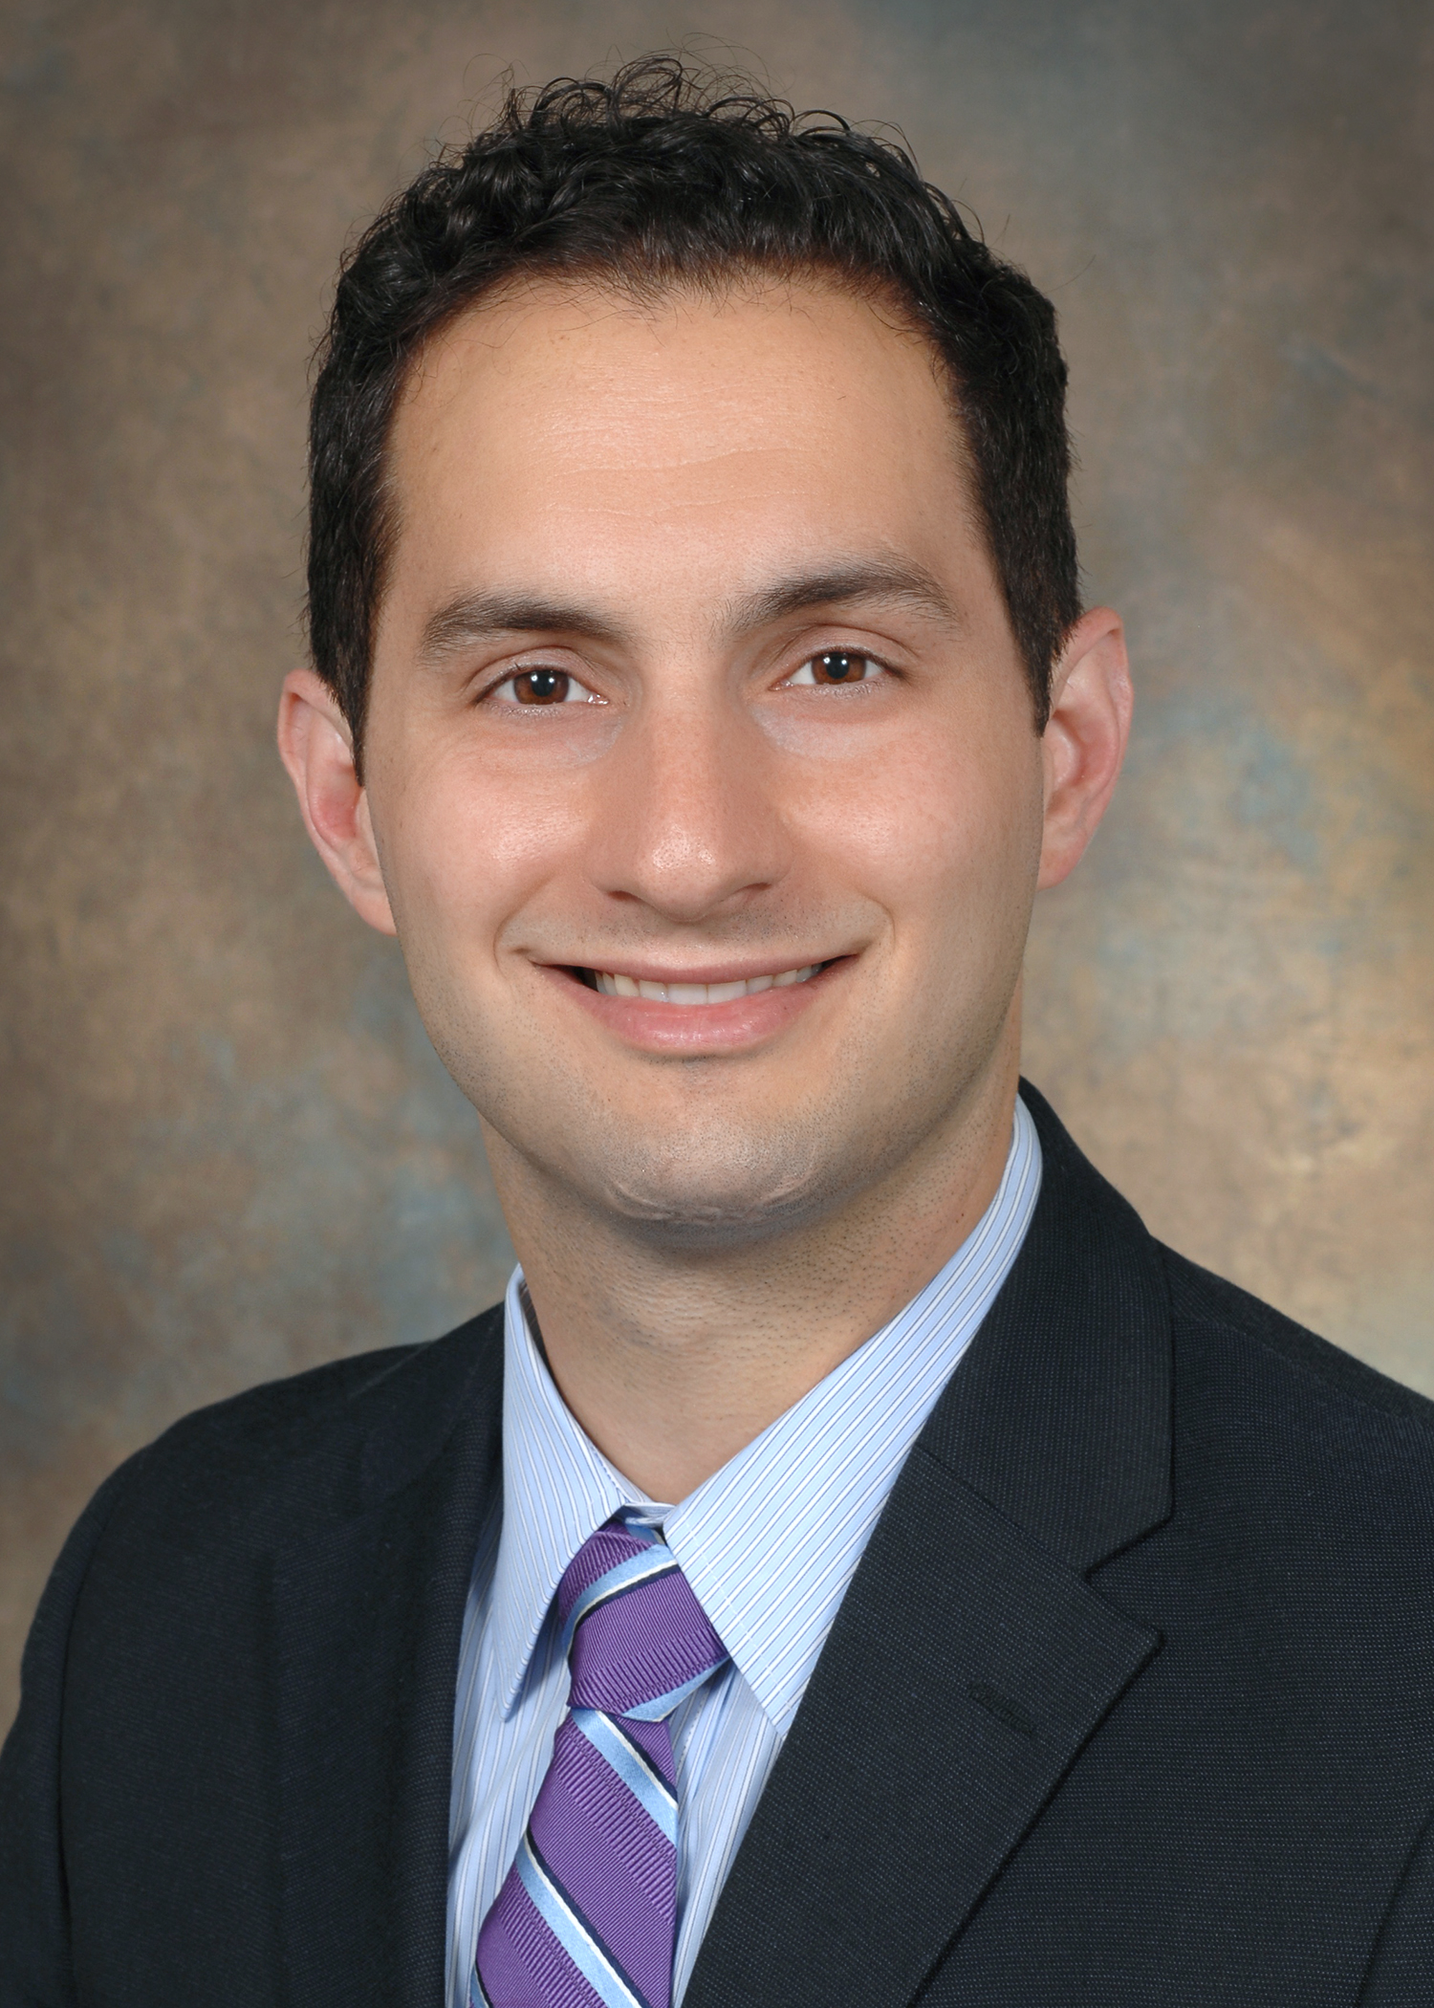
Physicians wear many hats
Admin-
istrative
Teacher
Mentor
Personal
PR
Patient
Care
EMR
Scribe
Tech
Support
MPH
Student
Family
Counselor
National
Research
Grant
Author
Son,
Brother
Husband
Notes:
ETC

Slide 13
Physician Burnout – What is it
Over the past two decades there has been a better appreciation of physician burnout and its consequences (41 articles on surgeons alone)
Emotional Exhaustion
  a loss of enthusiasm for work.
  Emotionally Overextended
Depersonalization
  Feelings of cynicism
  Callous or dehumanized perception of others
A low sense of personal accomplishment
Notes:
Being is physician is an immensely fulfilling profession

Slide 14
Physician Burnout – How Common?
Shanafelt et al (2009) 7905 Surgeons (before EMR)
40% of responding surgeons were burned out
30% screened positive for symptoms of depression,
28% had a mental QOL score ⬎1/2 standard deviation below the population norm.
Notes:
Being is physician is an immensely fulfilling profession

Slide 15
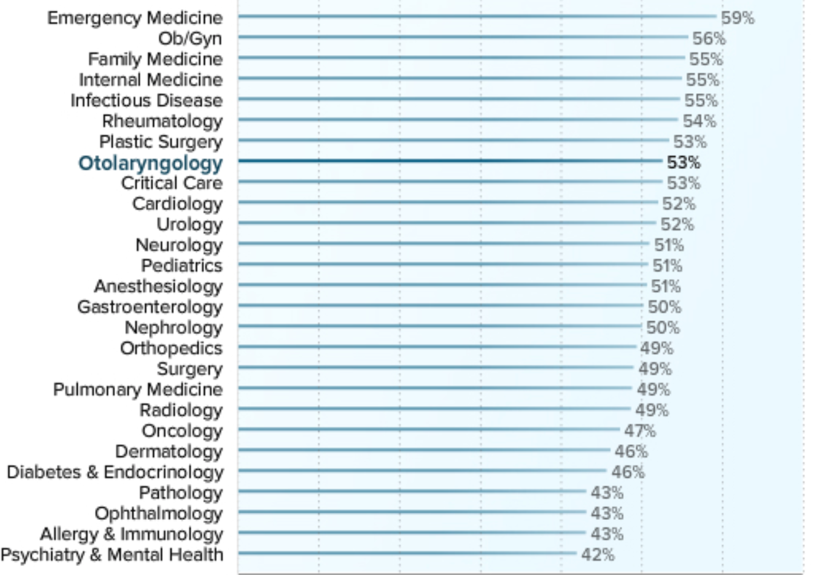
Prevelance of Burnout
.

Slide 16
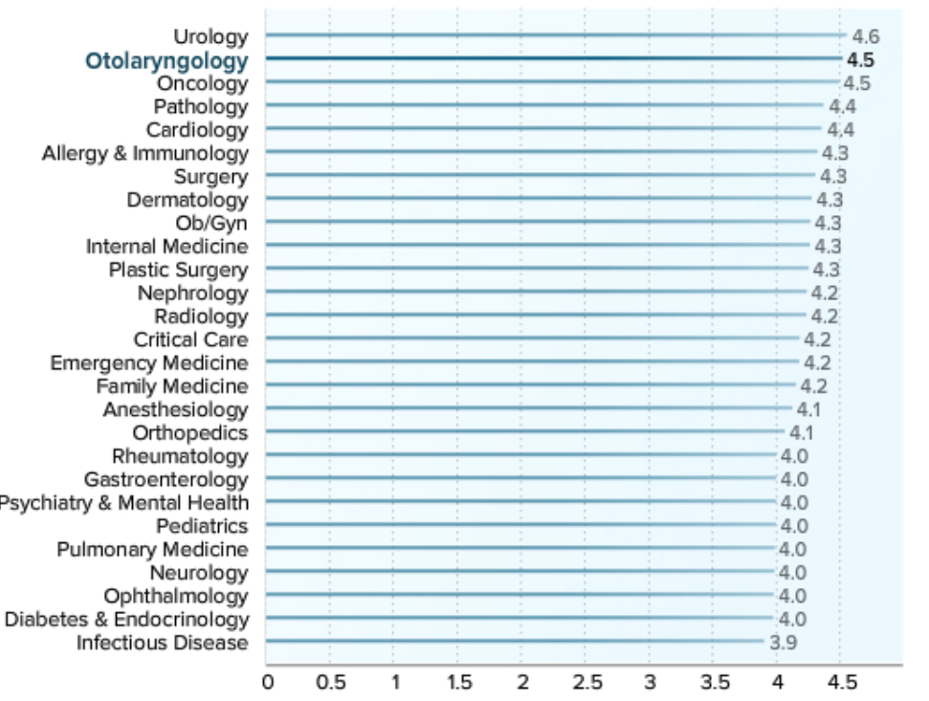
Severity of Burnout
.
Notes:
Scale of the severity of burnout, 1 to 7. 1 = it does not interefere with my life and 7 = It is so severe that I’m thinking of leaving medicine altogether. Ave is 4.5

Slide 17

Physician Burnout – Why?

Slide 18
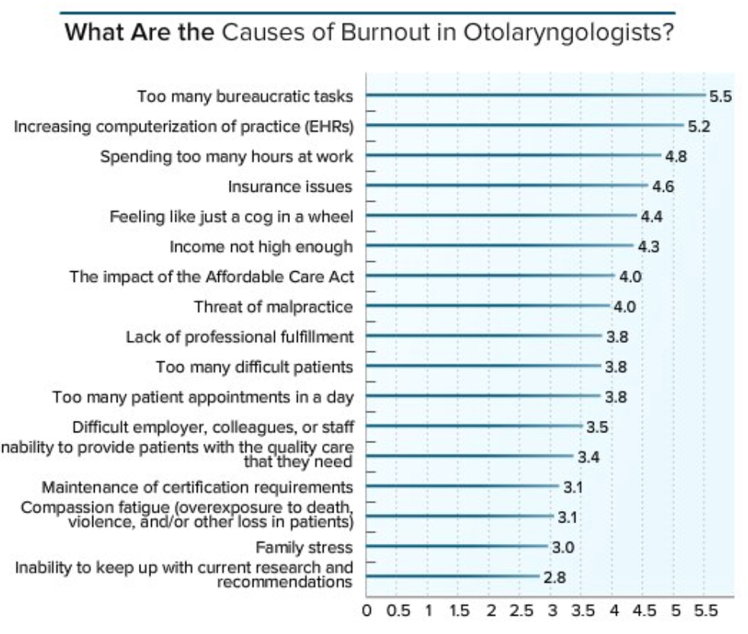
Notes:
1 = Does not contributes
7 = Significantly Contributes.

Slide 19
EMR is not paper charting…
It will never be as efficient
  Document a visit faster than you can login
But EMR is not paper…
  It can help address other contributors of burnout
    Streamline documentation, billing for simple, routine and repetitive patient encounters
    Facilitate research
    Metadata → Productivity

Slide 20
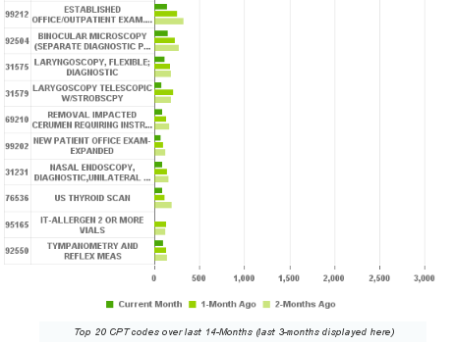
Productivity Tools

Slide 21


Slide 22

What is Patient Engagement?
Having the patient be an active part of his/her own healthcare
Involving the patient in the decision making process
Educating patients about themselves and their diagnosis.
How are we doing with patient engagement?

Slide 23
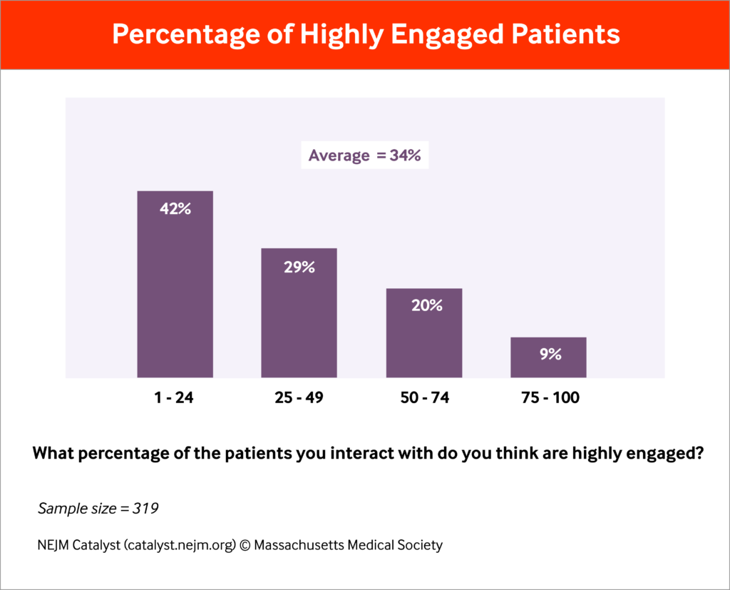
How Are We Doing?
Notes:
NEJM Catalyst Insights Council survey on Patient Engagement in 2016
Responses from qualified executives, clinical leaders, and clinicians
44% of respondents were clinicians.
42% said ¼ of their patients were highly engaged
Over 70% responded that less than half of their practice was highly engaged.

Slide 24
How Can TIP Help?
Decrease physician burden
  Allow physicians more time to interact with patients
  Less time with EMR
  Decrease burnout
Find ways to make the EMR work for the patients as well
  Allow easier patient involvement
  Increase access to healthcare information

Slide 25

Examples of Changes
Waiting room experience
Pre-visit planning/questionnaires
Notes:
In the waiting room we are using Chromebooks to allow patients access to their medical record and complete intake paperwork.
Information is loaded directly into the EMR. Verified by MA’s
Data is now usable and accessible as well as searchable
From home, patients can complete intake paperwork if already established.
Questionnaires are sent out at appropriate times for quick responses.
-Post Op
-Research
-Concussion

Slide 26

Before TIP

Slide 27
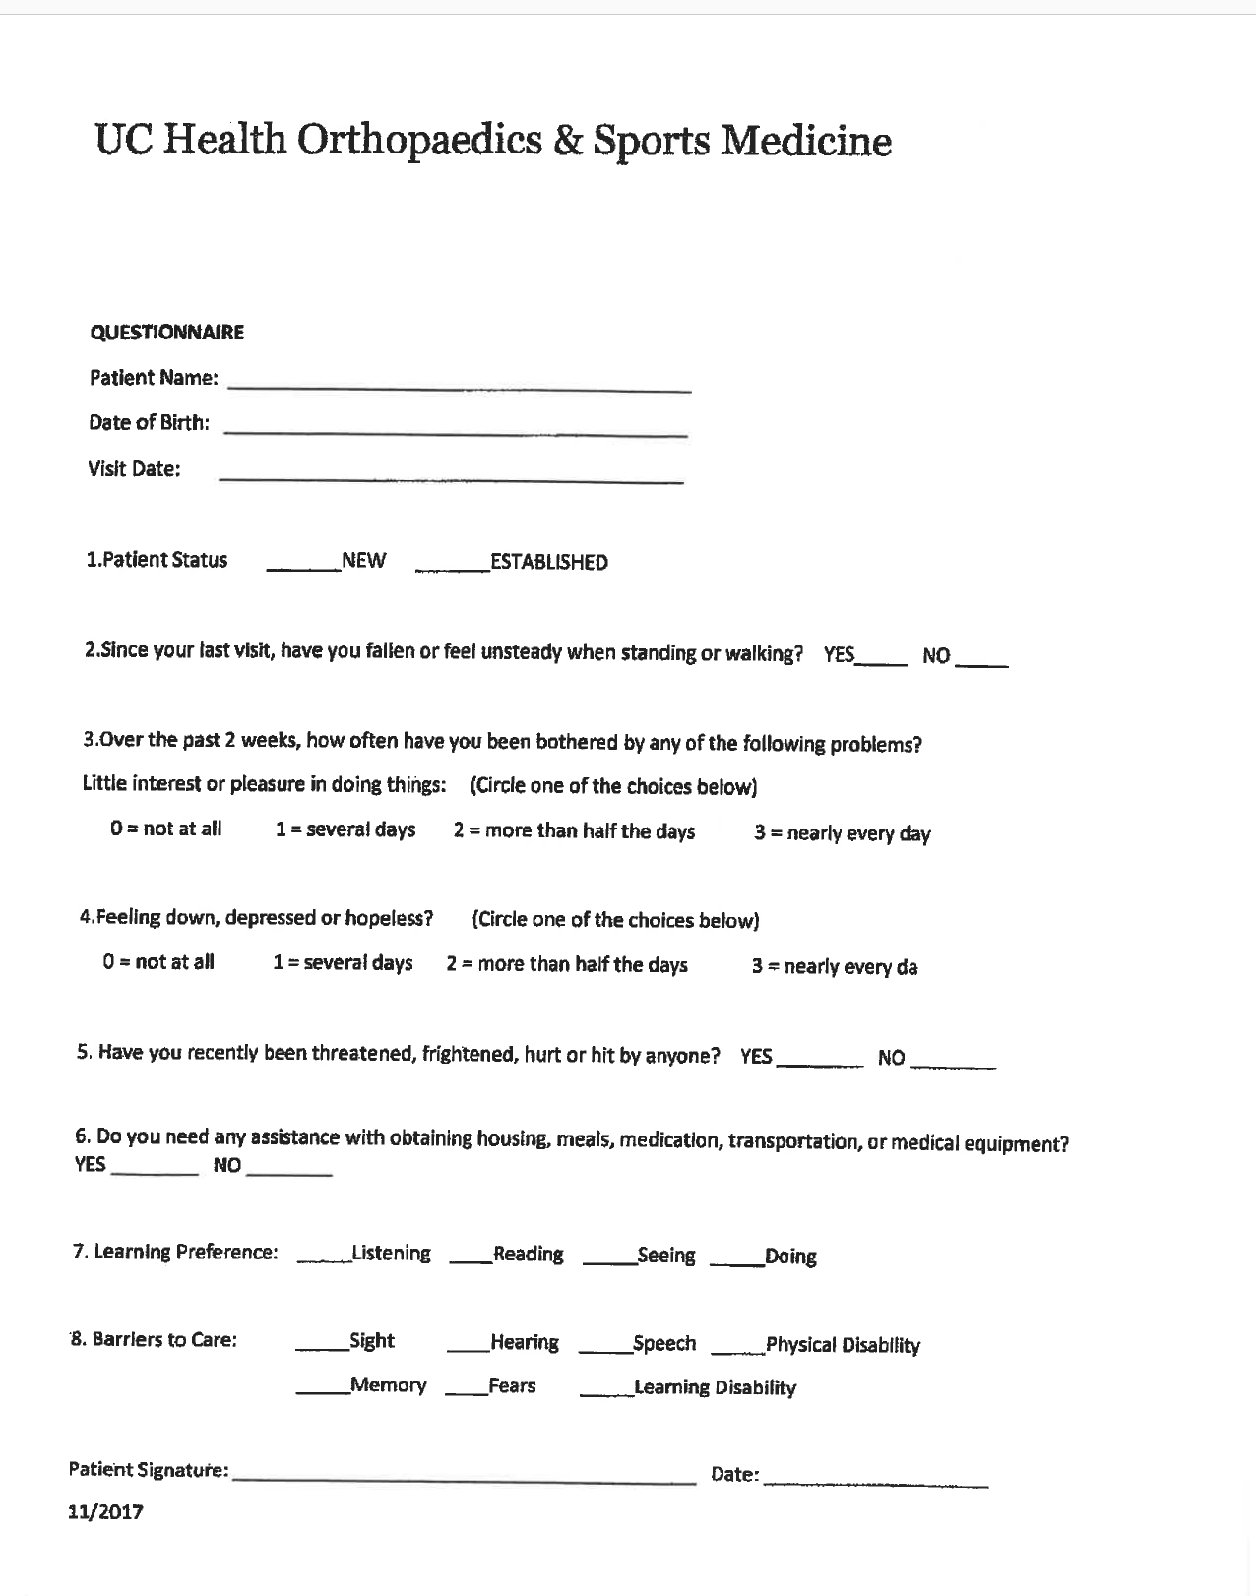

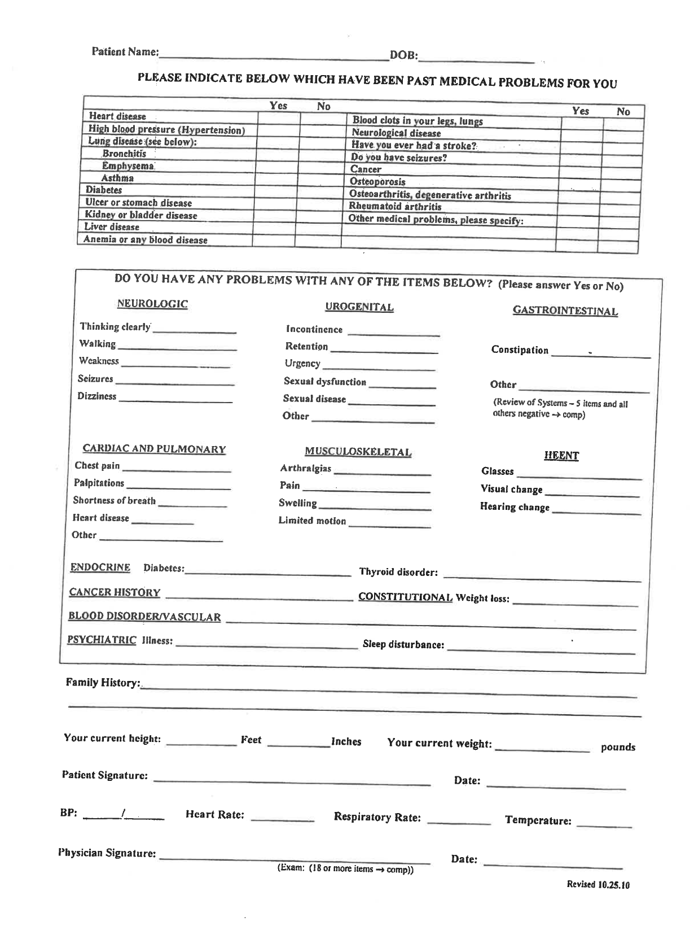


What Patients Used to See

Slide 28
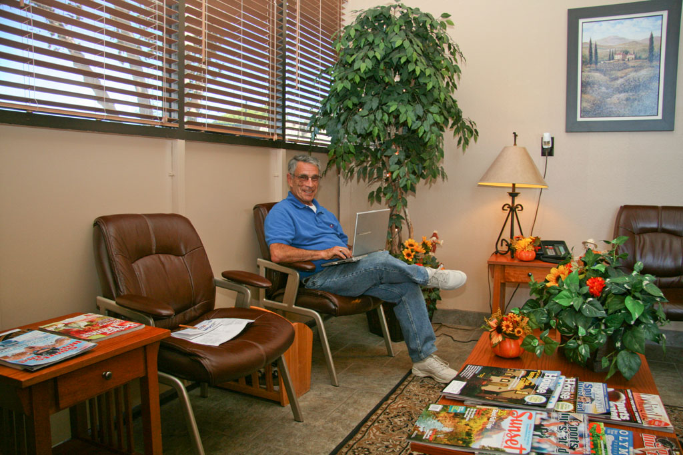
After TIP

Slide 29

How Did TIP Help – Building Blocks for Success
Technology Procurement & Planning Process
Designed Questionnaires
Addressing tickets faster
Improved Physician & Patient Experience
Developing a closer, more collaborative relationship between departments
Notes:
Technology Procurement & Planning Process – During the Assessment, the team identified a % of all of their devices as “End of Life Devices” and recommended devices that needed to be replaced to the Specialty. End of life means past our 5 year Replace and Renew cycle.
Designed Questionnaires – for the patients
Build the algorithms in the system -
Addressing tickets faster
Improved Physician & Patient Experience – Improved the patient experience with
Developing a closer, more collaborative relationship between departments

Slide 30
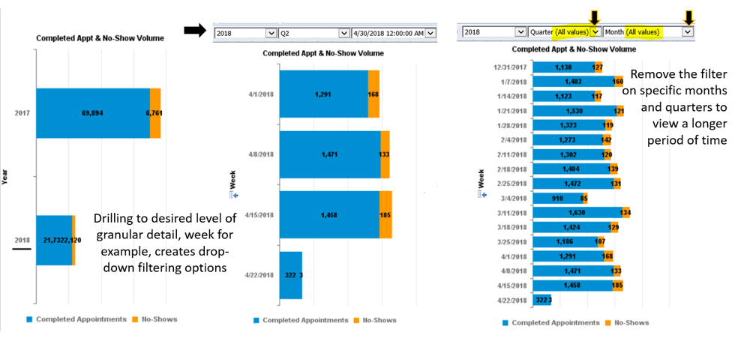
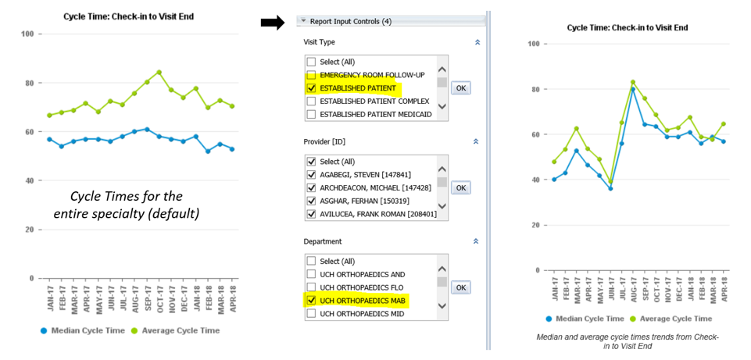
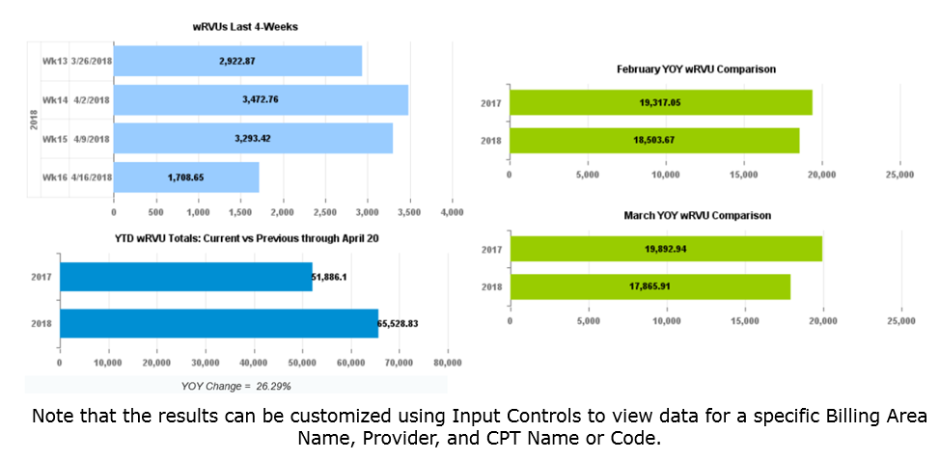
How Did TIP Help – Emphasis on BI
Productized our internally developed Appointments and Schedules Dashboard that showed data such as:
  Completed Appointments & No Show Volume
  Cycle time of patients from check in to visit end.
  Share data with schedulers to make additional phone calls to patients with no show rates
  Provider Productivity Dashboard (wRVU)
Notes:
Relative Value Units
Again, results can be modified using Web Intelligence for each of these different reports within the document
TOP LEFT: 4-week trending wRVU data
BOTTOM LEFT: Year-over-Year wRVU comparison (Year-to-Date)
TOP RIGHT: Monthly YOY comparison (most recently completed month)
BOTTOM RIGHT: Monthly YOY comparison (most recently completed month)

Slide 31
Thank You
“Winning isn’t everything, but wanting to win is.” - Vince Lombardi

