Slide 1

Telehealth
William Manzie
Administrative Director of Telehealth
Memorial Healthcare System
April 24, 2019

Slide 2
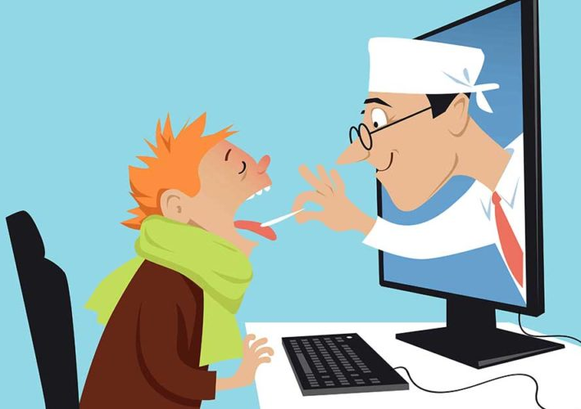
What is Telehealth and Why Should We Care?
Telehealth refers to; clinical services that can be delivered remotely and which utilize electronic communications or software to deliver health care without an in-person visit being required.
Simply put…. it’s delivering health care using technology!
From simple technology
  Smartphones
  Wearables
To more complex technology
  Clinic Kiosks
  Telehealth Carts

Slide 3
What is Telehealth and Why Should We Care?
EXPECTATIONS!!!
A demand which is upon us today by federal and state leaders, and by the consumer is to have accessible more affordable care.
It is estimated that 77% of Americans own smartphones and use their device for daily tasks
Legislators are expecting solutions for reducing healthcare spend and improving patient outcomes
Healthcare executives expect innovative thinking when developing programs which provide a service to the community
Notes:
*Now that about 77% of Americans own smartphones and can use their mobile devices to do a nearly endless number of tasks and activities, people are expecting more from healthcare. In fact, many Telehealth services could potentially help health systems cope better with the growing demands arising from ageing populations, the need for chronic disease management, and ever-increasing consumer expectations. patients expect their experience at a healthcare facility to live up to their experience with brands, restaurants, and retail stores.

Slide 4
The Value of Telehealth
As we have heard time and time again, focusing on the triple aim in healthcare will yield valuable results. As such, selecting telehealth investments based on goals should be priority.

Slide 5

Continuity of Care
Improving quality of care buy enhancing how care is delivered both within and beyond the walls of the hospital
Using telehealth as a means to improve patient management between providers
Creating a “patient never truly gets discharged” model and avoiding the “black hole” of care
There is no I in healthcare
Notes:
Looking at telehealth as a conduit for continuity of care
*as the population grows older with a higher incidence of chronic conditions, we have an imperative to truly improve quality of care both within and beyond the walls of the hospital while reducing costs.
*Continuity of care plays a key role in patient management by ensuring that patients experience a smooth transition from the hospital back to the home, and new models of care that utilize telehealth technologies will be important to support this process and reduce re-hospitalizations.
* the advanced level of care offered by telehealth technology ensures that the healthcare professional can intervene early when a change in health is noted, thereby improving the quality of care, reducing the chance for readmission, and ensuring cost-efficiency for both the hospital and the patient. This advanced level of connectivity is necessary to overcome the traditional “black hole” of care that occurs in the period between initial hospital discharge and a patient’s first follow-up appointment. During this time, physician transitions, medication adjustments, and other changes to the care routine that were made in the hospital often fall by the wayside and are not adequately transitioned when the patient goes back to his or her primary provider.
*Telehealth-enabled care models can help clinicians—whether hospital-based, home-based, or remotely-based—better manage the risk associated with chronic care patients, enabling them to move beyond simple data collection toward more interactive interventions. If we could take advantage of todays technology and the abilities of tomorrows technology to enabling caregivers of patients to communicate, provide notification, share information, track data, provide education, jointly discuss care plans, provide resources to assist with social determinates of care

Slide 6
What Got Us Here Won’t Get Us There
In 2017, the United States spent about $3.5 trillion, or 18 percent of GDP, on health expenditures – more than twice the average among developed countries
During 2016, combined and state spending for Medicaid totaled about $21.8 billion in Florida
Florida ranked #48 for overall health care among 50 states + the District of Columbia. Florida ranked 49th for access, quality and use of health care
Chronic diseases are among the leading causes of morbidity, mortality and disability
Behavioral health disorders increase the risk of many major causes of death in Florida
Notes:
1.
2.
3. Florida ranks No. 48 in a new ranking of state health care systems (and the District of Columbia) published by The Commonwealth Fund, a private foundation that works to achieve better better health care access for low-income Americans
4. See the FL state health assessment
5. See the FL state health assessment

Slide 7
How Do We Begin to Get There?
Improving Healthcare with out of the box thinking while focusing on the Triple Aim…
Improving the patient experience
Reducing the per capita costs of health care
Improving the health of populations overall
“If you are not taking steps to move forward, you end up moving backwards”
“You don’t have to be great to get started, but you have to get started to be great”
Notes:
*Achieving the Triple Aim will be crucial to the success of health care organizations that are moving toward value-based payment systems. The Triple Aim also encourages health care leaders to use the strategies to improve the health of their communities beyond the hospitals and clinics that make up the health care system.﻿
*In order to do this effectively and at the population level, health care systems need to assess the overall health of the communities they serve, identify any existing concerns or areas of risk, and assess overall mortality.
*There are many factors that influence the quality and cost of health care, For one, the U.S. population is aging and developing more chronic health problems. Many are simply consequences of living longer
The cost reduction component of the Triple Aim encourages health care organizations to find ways to reduce the cost of the care they provide, while at the same time increasing quality, as well as identifying at-risk populations and addressing the health concerns of the community
*Understanding what the most likely reasons would be for members of a specific population to engage with the health care system can help organizations preemptively develop strategies to offset costs and provide improved, patient-centered, and coordinated care
*talk about why I put those quotes there

Slide 8
Using Telehealth to Achieve Our Goals
Managing Patients Chronic Conditions Differently
Most health care-related costs in the U.S. are associated with chronic disease conditions
The percentage of children with chronic conditions has risen dramatically
Converting from a reactive system to a proactive system
Look at the highest risk populations and develop targeted programs (population health)
As a result, Memorial Healthcare System offers the following telehealth programs:
Remote patient monitoring | Delivering care in the home
Ability to track results in EMR | TelePrimary Care
TelePharmacy | TeleBehavioral Health
Complex chronic care via Telehealth | HIV care plan compliance
TeleAsthma | TeleOncology
Notes:
*Chronic disease self management can improve quality of life and health care costs.
*Chronic diseases are largely preventable by engaging in healthy behaviors.
*We should no longer be in the business of only treating people when they are sick, we should also be in the business of keeping patients healthy
TALK ABOUT THE PROGRAMS THAT ARE CHANGING PEOPLES BEHAVIORS

Slide 9
Never Truly Being Discharged
Use telehealth to create solutions where our care of the patient continues after discharge.
Utilizing telehealth technology to connect with patients sooner and more frequently
Providing a virtual resource to assist with social determinants of health
Developing a support system for secondary conditions such as wound care
As a result, Memorial Healthcare System offers the following telehealth programs:
Wound care (soon, TeleWound Care) | Post-surgical follow-up
Telehelath on-call | TeleBehavioral Health
Virtual Lactation Consultant | Post-discharge TelePharmacy
TeleNutritionist | Virtual Primary Care Coordination
Notes:
*When a care provider connects with a patient via video after discharge, a noticeable positive change in engagement occurs, if patients are experiencing minor complications they discuss with a care provider before it becomes a major complication
*Addressing social determinants of health is important for improving health and reducing longstanding disparities in health and health care, such as a care manager who understands the need and provides options for resources

Slide 10
On-Demand Assisted Services
Opioid Crisis
From Florida data in 2014, 89.5% reported needing but not receiving treatment for Opioid Abuse. This is from a population aged 12 or older reporting illicit drug dependence or abuse.
Florida saw 5,088 drug related deaths in 2017
Drug related deaths per 100,000 - Florida 24.2, National 21.6
As a result, Memorial Healthcare System offers programs to assist in the opioid crisis. The following telehealth programs are used to augment what is being done today in person.
  Telehealth to expand access (MAT program)
  Virtual pharmacist (prevention and education including distribution of narcan kits)
  Additional opportunities: expanding virtual treatment options for recovery
Notes:
Prevention - for example, educating community members and care providers or implementing harm reduction strategies to reduce the number of fatal opioid related overdoses and the occurrence of opioid use disorder among new and at risk users.
Treatment - for example, implementing or expanding access to evidence-based practices for opioid use disorder treatment, such as medication-assisted treatment.
Recovery - for example, expanding peer recovery and treatment options that help people with opioid use disorder start recovery and avoid relapse
* As documented in the amfAR Opioid & Health Indicators Database in 2014

Slide 11
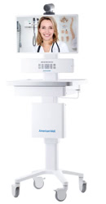
On-Demand Assisted Services
Current Telehealth Workflow assisting with the Opioid Crisis in ER’s
Patient arrival
Overdose/Requesting treatment
Physician order for MAT consult
RN/Secretary contacts Behavioral Health Unit (BHU)
Time is set for virtual consult
Explain video call process to patient
Bring cart to bedside
Provide patient with head phone for privacy
BHU RN to conduct a mental status exam and explain MAT program
Remain at the bedside during telehealth visit for safety
Provide patient with MAT pamphlets
Give take home Narcan-kit
BHU RN will take care of the rest
Notes:
Prevention - for example, educating community members and care providers or implementing harm reduction strategies to reduce the number of fatal opioid related overdoses and the occurrence of opioid use disorder among new and at risk users.
Treatment - for example, implementing or expanding access to evidence-based practices for opioid use disorder treatment, such as medication-assisted treatment.
Recovery - for example, expanding peer recovery and treatment options that help people with opioid use disorder start recovery and avoid relapse
* As documented in the amfAR Opioid & Health Indicators Database in 2014

Slide 12
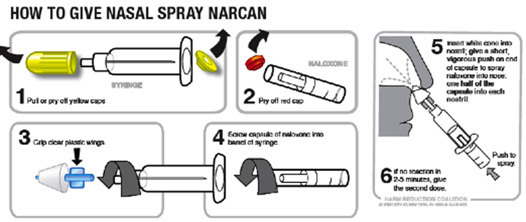
On-Demand Assisted Services
Telehealth MAT Workflow allows Memorial to Utilize Clinical Resources more efficiently and rapidly.
When needed, pharmacists connect via telehealth to provide the necessary clinical information and education to the patient and family.
As a result of the Telehealth MAT program, Memorial has experienced improved engagement by the patient and family to receive care.
During the connection, patients receive:
  Take home kit Given to everyone who presents with CC of OD and/or requesting treatment
  2 doses – Intranasal
  Given as many times as necessary
  Part of the efforts in combating the crisis
  Education by ED pharmacist
Notes:
Prevention - for example, educating community members and care providers or implementing harm reduction strategies to reduce the number of fatal opioid related overdoses and the occurrence of opioid use disorder among new and at risk users.
Treatment - for example, implementing or expanding access to evidence-based practices for opioid use disorder treatment, such as medication-assisted treatment.
Recovery - for example, expanding peer recovery and treatment options that help people with opioid use disorder start recovery and avoid relapse
* As documented in the amfAR Opioid & Health Indicators Database in 2014

Slide 13
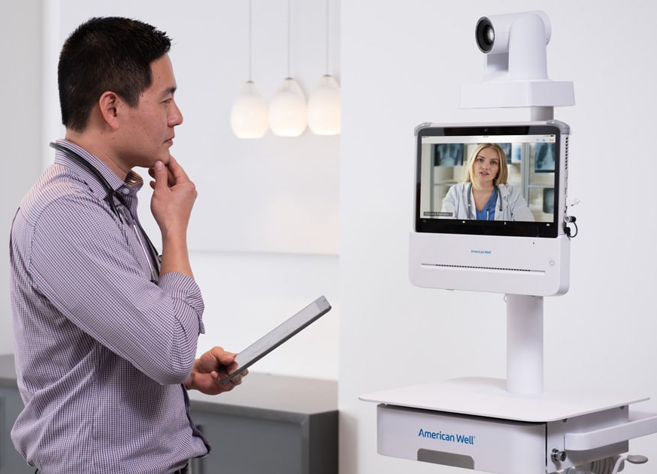
On-Demand Assisted Services
Stroke
Consults are conducted with patients who present to the ER with a possible stroke
Neurologist on-call uses telehealth to virtually connect with the on-site clinical team
The neurologist is able to view, visually examine the patient and zoom into the extremities as well as facial features
The purpose of the program is to improve clinical outcomes by:
  Reducing door to needle times
  Discontinuing unnecessary TPA treatment
  Provide a higher level of physician specialty support
TeleStroke is similarly used for in-patient stroke alerts
  Time to treatment is key
As a result, Memorial Healthcare System implemented a telehealth program which facilitates an expedited on-demand physician connection using a smartphone and a telehealth cart.
Notes:
Look at the PDO for more details

Slide 14
Employers Empower Workforce Health
Telehealth interest grows with desire to curb costs, absenteeism and employee maintenance is how to accomplish this.
Employee absence, demonstrable loss
Embracing telehealth to contain costs
The case for savings
Notes:
*In an effort to reduce the cost of care for non-emergency issues, Memorial developed a care model for our employees offering convenient non-emergency care.
*The 24/7 application is called MemorialDOCNow and is a free download and free service to our employees

Slide 15
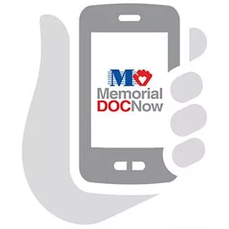
Employee Services
With our commitment to the triple aim and what we are doing to better manage our patient population, Memorial Healthcare System also committed to better managing the care of our employees.
24/7 application based connection to a physician
Available MemorialDOCNow station in our largest hospital available to working employees 24/7
Employees receive this as a free benefit
Advantages
Offer employees a lower cost of care where appropriate
Reduce absenteeism
Initiate treatment of illness sooner
Stats
94% patient satisfaction
97% of patients surveyed said their health care concern was resolved
37% of patients surveyed said they would have gone to the ER
Notes:
*In an effort to reduce the cost of care for non-emergency issues, Memorial developed a care model for our employees offering convenient non-emergency care.
*The 24/7 application is called MemorialDOCNow and is a free download and free service to our employees

Slide 16
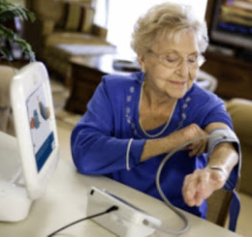
The Proactive Approach
The prospect of healthcare organizations implementing remote patient monitoring (RPM) technology increases the capacity for clinicians to manage more patients. In addition, RPM allows the clinician to monitor patients and proactively identify any negative trends.
Monitoring patients and proactively identifying negative trends reduces the likelihood of an ER visit or readmission
RPM allows the care team to actively manage the patients condition with the physician, pharmacy and other clinicians in a timely manor
Better access to healthcare by communicating with patients in their home
Improved quality of care due to the frequency of connections
Peace of mind and daily assurance by support of self
management
Improved support, education and feedback due to
interoperability

Slide 17
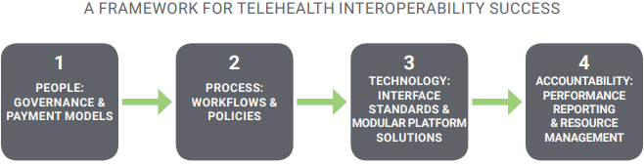
Interoperability
Interoperability is about getting the right information to the right people at the right times so that it can be used to take better care of patients, and then provide accountability and performance metrics for quality standards and reimbursement.
To support these efforts, payers are incenting telehealth interoperability to help reduce total cost of care and unplanned utilization of care
Without the support of enterprise top-down leadership, central governance, standard processes, and workflows, these initiatives can face predictable resistance from clinicians and cannot be effectively scaled
Example of a telehealth interoperability platform as documented by the American Telemedicine Association
Notes:
the business reality is that face-to-face clinical services are a higher source of revenue in a FFS payment environment, and patient/member records are critical in processing claims at that higher revenue. Leadership and governance must address those issues during the transition to alternative payment models that incentivize high-quality outcomes over high volume services.
Configurable clinical processes and workflows follow, with a focus on approaches that can be widely emulated and adapted
The ideal approach is a telehealth technology platform with a flexible, modular design that maintains interoperability even as programs and resources scale and change over time.
Timely, automated reporting depends on centrally aggregated, reliable, and normalized data from an interoperable telehealth platform that is connected to legacy healthcare IT systems

Slide 18
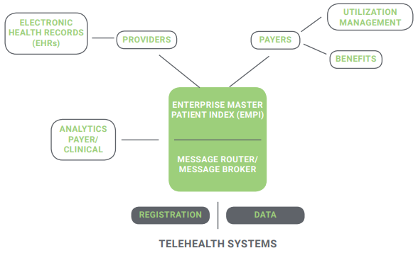
Interoperability
Here is an example of a configurable, connected modular design, which becomes a technology enabler for scalable telehealth initiatives that can reduce complexity and technical risk, even during periods of rapid change and that support long-term programs, even without a clear view of future clinical or business objectives.

Slide 19
Telehealth Program Challenges
Threat to bottom line is a key challenge to providers and health systems.
REACH Health 2018 U.S. Telemedicine Industry Benchmark Survey
Notes:
* All of what I mentioned in the vision is great, however if we don’t fix the challenges within telehealth, Florida will be slow to benefit from the opportunities that telehealth programs can provide.

Slide 20

Telehealth Program Challenges cont.
Inadequate telehealth parity laws and reimbursement
Differentiating telehealth regulations between governing bodies
Integration between solution platforms
Patient education
Segmented systems creating workflow challenges
Perception
REACH Health 2018 U.S. Telemedicine Industry Benchmark Survey

Slide 21
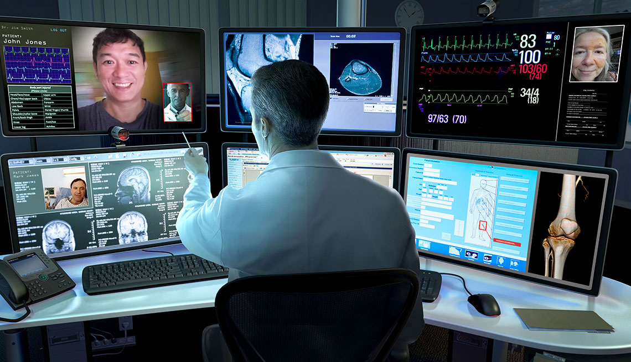
Looking Towards the Future
Artificial Intelligence (AI)
Chat bots
Expanded remote patient monitoring capabilities
Hospital at home
Moving beyond the direct to consumer model
Greater utilization of connected devices
Deeper integration amongst delivery platforms
Asynchronous telehealth communications
5G mobile cellular phone technologies
Expanded broadband as commented by the FCC
Notes:
*artificial intelligence (AI) and how it can not only impact Telehealth and healthcare in general, but how AI companies and investigators will effectively and efficiently integrate AI into the clinical information environment and workflow.
*Chabot's example
*expanded broadband will enable rural and distant locations to receive the best possible communications
*5G delivers gigabit speeds, reduced latency, higher system capacity, and the massive device connectivity needed for optimizing personalized patient care. 5G networks will enable new classes of digital technologies aimed at improving treatment outcomes
*international telehealth - Telehealth will play an important role in addressing global health issues around the world and foster greater partnerships for medical tourism

Slide 22
Conclusion
We as leaders must continue looking for non-traditional methods of delivering care to provide solutions which will improve upon the current state of healthcare.
Utilizing telehealth provides unlimited opportunities that focus on the triple aim:
Improving the patient experience
Reducing the per capita costs of health care
Improving the health of populations overall
“Our only limitation is our imagination!”
Bill Manzie

Slide 23


Thank You
William Manzie
Administrative Director of Telehealth
Memorial Healthcare System
William Manzie
@TelehealthBill

