Slide 1
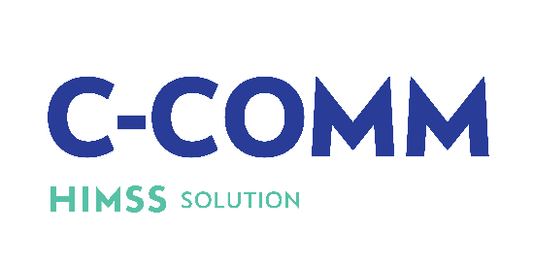
Community
Care
Outcomes
Maturity
Model
This model measures:
Access to Care & Adoption of Digital Technologies
Communication
Care Recipient Engagement
Population Health and Wellness
Healthcare Analytics & Outcomes Measurement to Inform Care Delivery
Interoperability & HIE
Resilience Management
Information Governance & Organizational Strategy
*Not included in O-EMRAM.
Advance digital health transformation for non-acute health organizations serving the community. Focusing on proactive interventions and prevention of risks, in order to strengthen health outcomes for unique population segments.
www.himss.org/ccomm
*C-COMM launched April 1, 2023. This model replaces O-EMRAM.
Notes:
The C-COMM is the evolution of O-EMRAM and was created to advance digital transformation for non-acute health organizations serving the community. Focusing on proactive interventions and prevention of risks, in order to strengthen health outcomes for unique population segments. These are the 8 focus areas that are measured, and the highlighted areas are what are included in C-COMM that were not included in O-EMRAM.
For more information please visit the website or contact Natasha Ramontal, Digital Health Specialist, HIMSS - nramontal@himss.org

