Slide 1
Board Retreat
Chapter Name
Date

Slide 2
Agenda
About HIMSS Chapters
Governance and Policy Review
Board Expectations
Annual Planning

Slide 3
About Chapters

Slide 4
North America Chapter Engagement
Events
350+
55
Chapters
Education hours
750+
HIMSS Chapters across the
U.S., Puerto Rico, and Canada
Volunteer leaders
The Chapters Task Force enhances the relationship between HIMSS and its chapters.
775+
Notes:
55 Chapters as of July 1, 2023

Slide 5
Bold = FY23 top priorities
Asterisk = FY22 top priorities
Top Education Event Topics

Slide 6
Chapter Benefits
Tools & Resources
Dues revenue collected & distributed
Monthly membership and financial reports
D&O insurance
Website and email system
Document Repository
Marketing templates & toolkits
Advocacy guidance
Leadership Training
On demand recordings
Interactive webinars
Chapter Leader Exchange / GHC event
Event Support
Chapters are approved CEU providers for CPHIMS & CAHIMS
Zoom account
Speaker assistance
Financial assistance
Global Health Conference Discounts for Chapter Leaders
HIMSS Affiliation
=
HIMSS Resources
Notes:
Carrie

Slide 7
Dues Revenue
Collection & Sharing
In Person Chapter
Leader Training
Sponsored attendees
Global Health Conference
$100 Discount
Financial Benefits
Event Assistance
Up to $1,000 scholarship
Finance and Tax Planning
Tools, templates, and guidance

Slide 8
Financial – Dues Revenue Sharing
Dues revenue report – Emailed on the 10th of each month to chapter president and treasurer
Individual, Corporate & Chapter-Only Members | Organizational Affiliate Members
$23 Chapters receive $23 per year for each individual, corporate and chapter-only member within their chapter membership. | Up to 4% of contact payment Chapters receive up to 4% of annual contract payment for Organizational Affiliates, based on chapter affiliation. The payment may be shared among multiple chapters.

Slide 9
Website
Drupal
Virtual meetings
Document repository
OneDrive
Zoom
HIMSS-provided chapter tools
Resource center
Reporting
clra.himsschapter.org
Auto emailed to specific positions
Membership email
Individual or group emails
Marketo
@himsschapter.org
Collaboration
Accelerate

Slide 10
Data Sharing
North America Chapters Benchmarking
Auto Reports – Membership, Dues, OA, Analytics
Report | Monthly Date | Access
Membership | 1st Friday | Email: President, president-elect, membership chair, and communications chair
Dues revenue (Rebate) | 10th of month | Email: President and treasurer
OA primary contact | As needed | chapters@himss.org or chapter rep
Google Analytics | 1st of month | Provided president email

Slide 11
Leadership Training
Virtual
Monthly Webinars
Chapter Leadership Academy
Open forums by position (ex: President meet up)
In - Person
Chapter Leadership Workshop – at HIMSS Global Health Conference in Spring
Chapter Leadership Exchange – in Fall
Individualized
Training can be provided on as needed basis

Slide 12
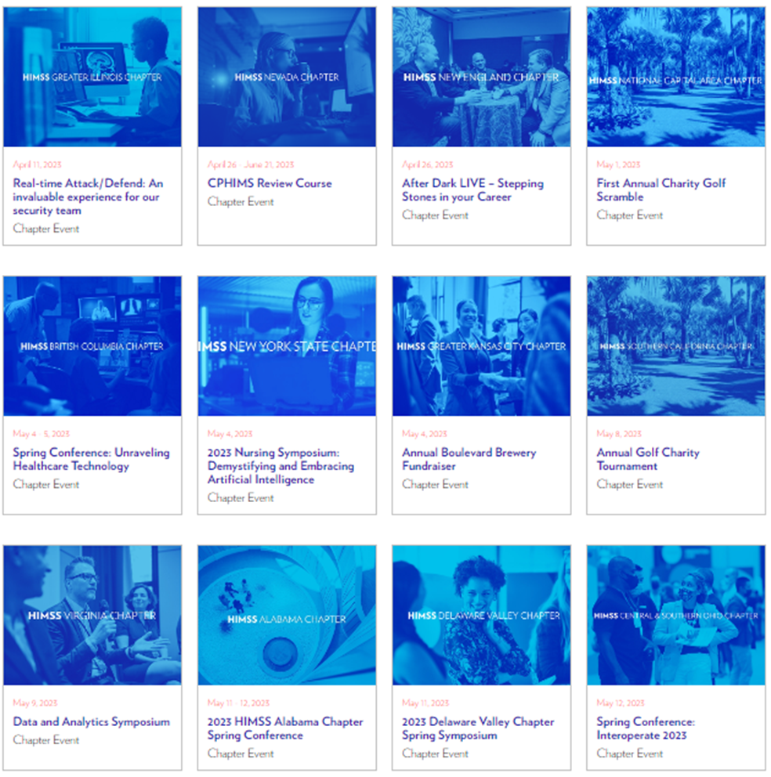
Marketing
Templates & Toolkits
Event toolkits (Global Health Conference, Global Health Equity Week)
Brand guidelines (Logos, PPT presentations, flyers)
Event Promotion
HIMSS.org Calendar
Newsletters

Slide 13
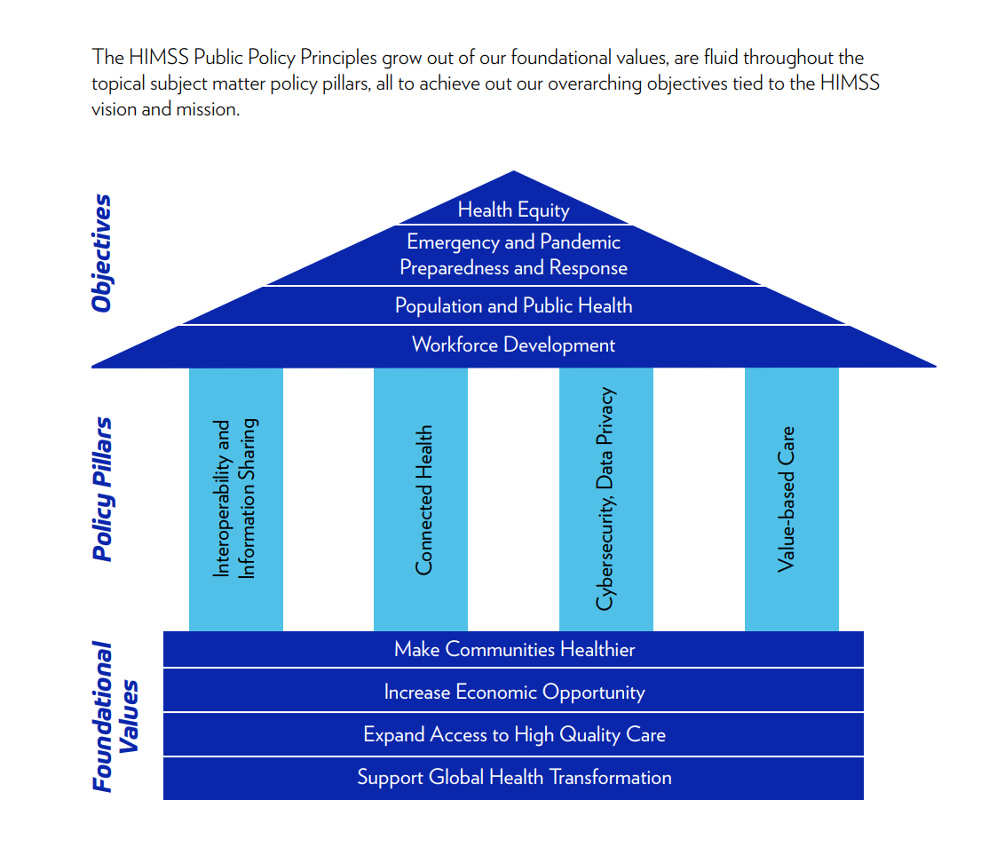
Advocacy
The HIMSS Chapter Advocacy Task Force informs, empowers, and mobilizes chapter leaders to advocate for health information and technology public policy at the state, provincial, and local levels. HIMSS welcomes all chapter leaders, regardless of role, to participate.

Slide 14
Governance

Slide 15
Hierarchy of Governance
The Law
Federal | State | Local
Affiliate Agreement
Establishes the Relationship w/ HIMSS
Chapter
Policy
Articles of Incorporation
Establishes the Association as a Company
HIMSS Declaration
Top Governing Document
Chapter Bylaws
HIMSS Policies
Manages day-to-day operations of the chapter

Slide 16
Incorporation (US Only)
Individually incorporated 501(c)6
US chapters are individually incorporated by HIMSS in the State of Illinois
HIMSS completes the annual report and submits the appropriate fees
Chapters must follow local state (where doing business), Illinois (where registered), and federal association laws
501 c 6 Organizations:
Operate for the benefit of their members
Receive the majority of their funding from dues paying member
Are not eligible to receive tax-deductible gifts
Are not likely to receive grants
Are subject to most taxes paid by businesses
Are governed by a board of directors elected from and by the membership
Notes:
Note that Canadian chapters are still part of the HNA family, but the best practice is to incorporate within the country you are doing business in.
Incorporation:
US chapters are: Individually incorporated by HIMSS in Illinois
HIMSS completes the annual filings and submits the appropriate annual fees
Need signatures from 3 chapter officers
Timely return of signatures = Timely submission = Good standing status of chapter for IL Secretary of State

Slide 17
Affiliate Agreement
Purpose: Formalize relationship between HIMSS and chapters
Defines territories
Moral code and working together
Adopt /abide by bylaws and HIMSS policies
Responsibilities of HIMSS and responsibilities of the chapter
Marketing and branding
Notes:
Affiliate agreement:
Defines territories
Moral code and working together
Adopt /abide by bylaws and HIMSS policies
Responsibilities of HIMSS and responsibilities of the chapter
Marketing and branding
Signed copy on file
The affiliate Agreement is the terms of service between HIMSS and the chapter affiliate, which defines and governs the affiliate relationship. The affiliate agreement specifies what both parties are responsible for, financial terms and legal responsibility. By signing the affiliate agreement, the affiliate acknowledges understanding of HIMSS policies indicated and agrees to the outlined terms. In turn, HIMSS agrees to fulfil their obligations of the terms of support to the chapter affiliates.
In 2012, HIMSS reviewed and re-issued a new standardized Affiliate Agreement in which all chapters and HIMSS President & CEO Steve Lieber signed. The agreement outlines the relationship between HIMSS and the Chapters, protecting both parties. Aspects of the agreement include:
Territory
Relationship of the Parties
HIMSS Responsibilities
Chapter Responsibilities
Reporting & Corporate Status Obligations
License of HIMSS trademarks/branding
Termination

Slide 18
Chapter Bylaws
Purpose: Guide to the structure of the chapter, including its governance, purpose, duties of members, and key operational policies
Flexibility for change for certain section within the Standardized Chapter Bylaws
Process for making changes
Reach out to HIMSS for version on file
Chapter board discuss and approve
Full chapter membership affirmative vote
HIMSS approval

Slide 19
Bylaws vs. Policies – What’s the Difference?
Bylaws
High level
Governance
Concrete
Big picture
Roadmap
Approval process: Chapter Board, full chapter membership, HIMSS
Policies
Detailed
Process orientated
Fluid
Day-to-day
GPS turn-by-turn navigation
Approval process: Chapter Board

Slide 20
Policy Manual
All board members should review the HIMSS Chapter Policy Manual on the CLRA and your Chapter Policy Manual
Chapter policies are important to offer the Chapter Board of Directors a consistent approach, a code of conduct, and a set of guidelines relating to recurring issues or situations.
Policies should also be maintained as pertinent documents – saved or distributed electronically,
A policies document addresses day-to-day chapter management and should be separate from the bylaws

Slide 21
Board Expectations

Slide 22
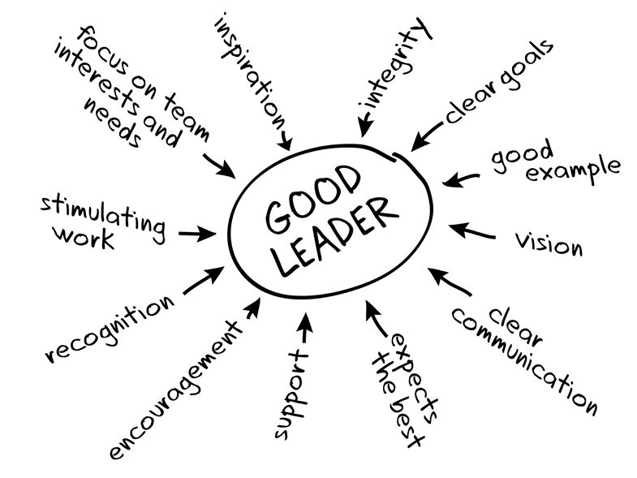
Chapter Leader Roles & Expectations
Knowledge share with outgoing board
Review and abide by important documents and policies
Follow all reporting requirements in a timely manner
Engage in available training opportunities

Slide 23
Expectations of a HIMSS Chapter
North America chapters annual minimum requirements:
Engage members through volunteer opportunities – BOD is elected by the membership
Individuals in a chapter leadership role must be members of HIMSS and the chapter
Host a minimum of 12 educational programming hours (virtual or in-person)
Hold a minimum of 4 board meetings (virtual or in-person / open or closed)
Send a minimum of 4 communications to the chapter membership
Comply with chapter governance documents (bylaws, affiliate agreement, and HIMSS policies and procedures)
Remain in good standing within the local chapter territory
Complete and submit accountability reporting, on time, to HIMSS that confirms the chapter has complied with the requirements above

Slide 24
Accountability Reporting Timeline
http://clra.himsschapter.org/Accountability-Reporting
Due August 1
Report:
Administrative
Recommended submitter: President, & Past President
Due ASAP
Report:
Board List
Recommended submitter: Secretary
Submission Schedule
Due November 1
Report:
Financials
Recommended submitter: Treasurer

Slide 25
Expectations and Delinquencies
Deadlines
Board List, ASAP post-election, no later than July 1
Administrative Report, August 1
Financial Report, November 1
Delinquencies
1-30 days delinquent | Weekly reminders
30+ days delinquent | Probationary status
60+ days delinquent | Charter suspended
90+ days delinquent | Chapter will be in jeopardy of having their charter revoked
Notes:
Early submissions are welcomed/encouraged
If chapters are delinquent after the due dates, the following process will be followed. For more details, please refer to the Chapter Status section of the Chapter Governance and Policy Manual.

Slide 26
Annual Planning

Slide 27
Advantages of a Strategic Plan
Provides greater foresight in long term planning
Leadership becomes more focused
Optimizes financial resources
Enriches chapter membership value
Increases organizational success

Slide 28
Guidelines for a Strategic Plan
Should range between 3-5 years
Provide sufficient details in each goal
Be supportive of HIMSS strategic areas of focus
Allow sufficient timeframe for completion of goals
Determine person(s) responsible for completion and oversight of Strategic Action Plan

Slide 29
Discussion Decorum
Everyone’s opinion is valued and respected
Abide by discussion timeframes
Input should favor chapter’s best interest
Personal agendas are discouraged

Slide 30
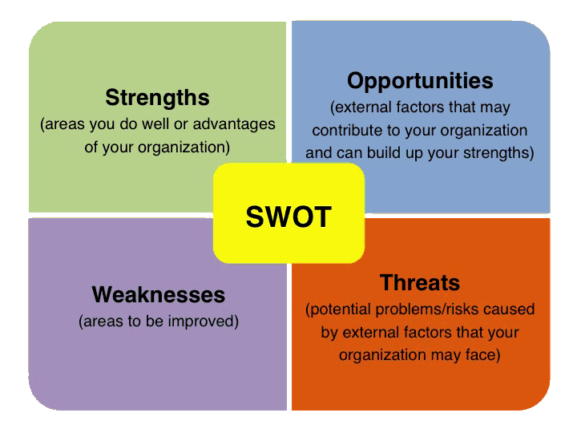
Chapter Discovery
Write down chapter strengths, weaknesses, opportunities, and threats – one item per sticky note

Slide 31
Creating the Chapter Vision
How can we maximize the use of our strengths?
How can we overcome the threats identified?
What do we need to do to overcome the identified weaknesses?
How can we take advantage of our opportunities?

Slide 32
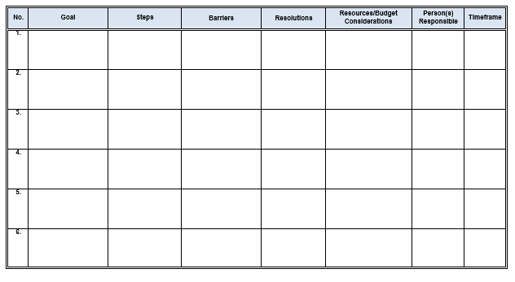
Strategic Planning Worksheet
Goals (Strategic)
Steps (Actions)
Any potential barriers to achieving the goal
Resolution to those barriers
Resources/Budget
Persons responsible
Timeframes

Slide 33
Sample goals and steps
Goal: Develop a chapter policies and procedures guide
Step: Create a task force to oversee development, implementation, and oversight (ideally, include CLE attendees).
Barrier: Time constraint
Resolution: Recruit volunteers and divide up assignments to spread the workload
Resources: Time, organizational skills, oversight
Formalize the committee structure
Step: Designate a point person for all committee oversight to ensure communication, collaboration, and forward movement.
Step: Summer social with tables scattered, each manned by the committee chair – utilize that time to recruit volunteers.
Step: Committee chair creates a formation document that includes the committee’s purpose, frequency of meetings, long term/short term goals, development plan, etc.
Goal from SWOT discussion: XX
Suggestion: XX

Slide 34
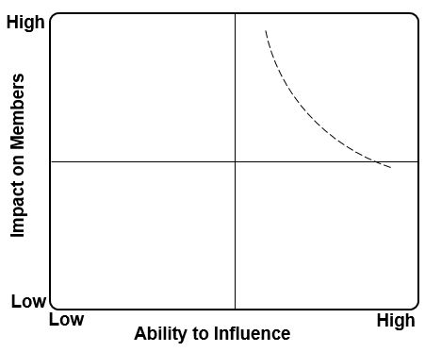
Determining Areas of Focus & Prioritizing 3-Year Snapshot
Topics
1
Insert topics here
2
3
4
1
2
3
4

Slide 35
Open Discussion

Slide 36
Chapter Engagement Team
Angie Claypool | Director, Chapter Engagement
Regions: Canada, Pacific, Southeast, Southwest
Carrie Simon | Manager, Chapter Engagement
Regions: East, Midwest, Rocky Mountain
Maria Pagan | Coordinator, Chapter Engagement
Chapters@himss.org for general questions
https://clra.himsschapter.org/ for resources

