Slide 1
North America Chapters
Notes:
North America Chapters Territorial Jurisdiction as of 2021

Slide 2
California

Slide 3
Florida

Slide 4
Illinois

Slide 5
Indiana

Slide 6
Kansas

Slide 7
Missouri

Slide 8
Ohio

Slide 9
Pennsylvania

Slide 10
Texas

Slide 11
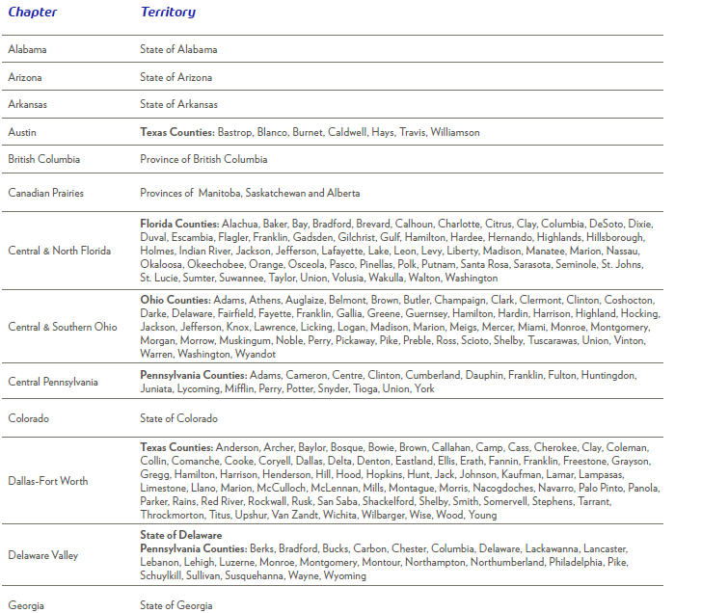
Territorial Jurisdiction

Slide 12
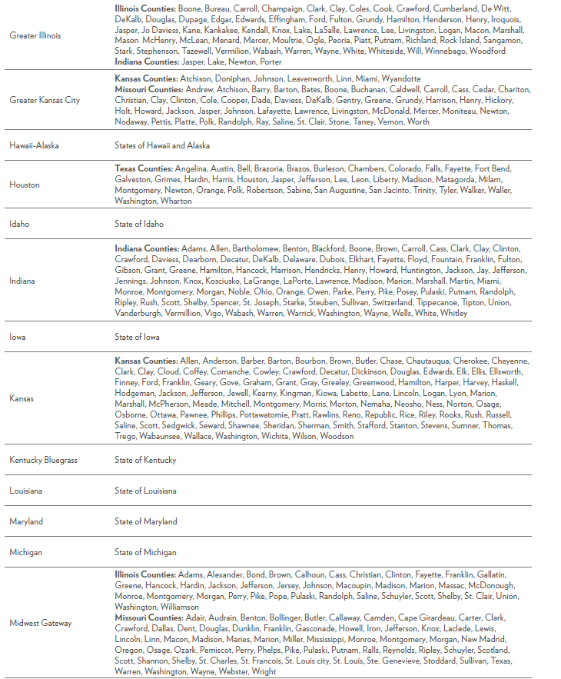
Territorial Jurisdiction

Slide 13
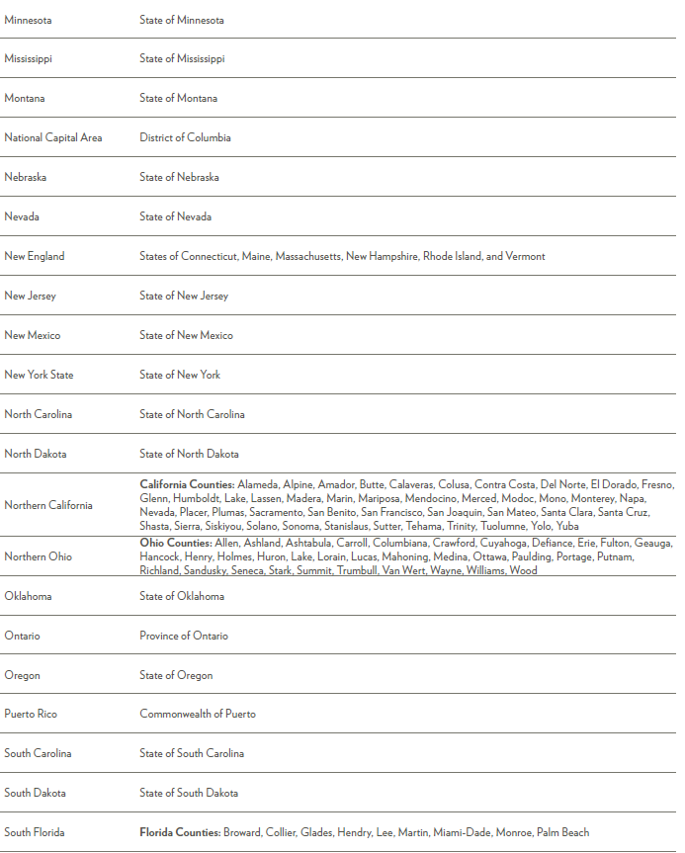
Territorial Jurisdiction

Slide 14
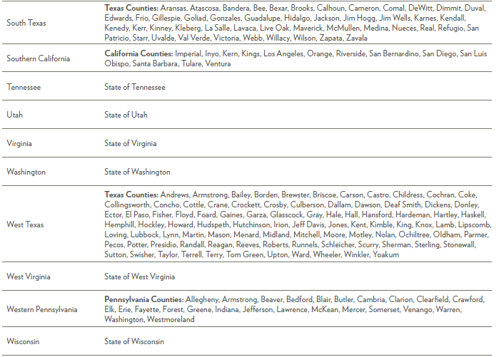
Territorial Jurisdiction

